Slide 1
Aug 9, 2018
Cannon
Chapter 1

Slide 2
Bellwork – 8-6/7
Please continue on the same sheet of paper…
Turn in Key Issue 1, check for your heading…
What’s your favorite place in the world?
Where is it?
Why do you like it?

Slide 3
Agenda:
Homework: Key Issue 2 Questions (Due 8/10)
Notes: Map Basics
Chapter 1 Map (USA) - Due Friday 8/17

Slide 4
Objective:
You will be able to describe the location and distribution of a map in writing.

Slide 5
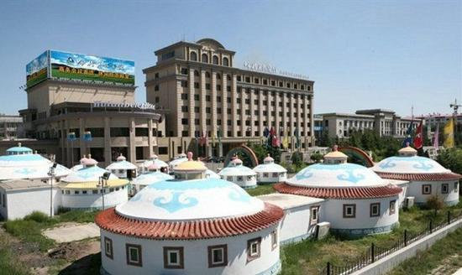
FUN FACT
The largest city in the world – based on surface area, is Hulunbuir, Mongolia which is 263,953 km squared.

Slide 6
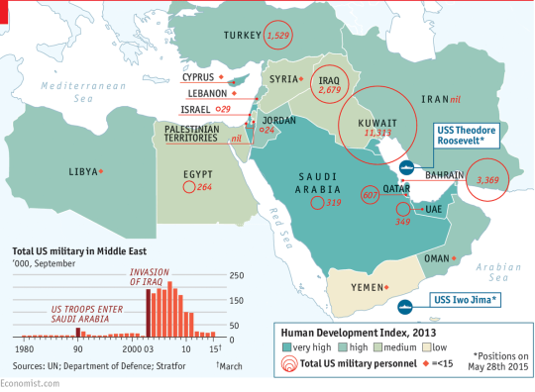
I. Map Basics Notes

Slide 7
Where
Place: a specific point on earth with a characteristic
Toponym: a place name
Location: the position a place is on the Earth’s surface
Notes:
Geographers ask two questions
Where is it located?
Why is it located there?
To help geographers address the where, they use specific vocabulary.

Slide 8
Geographic Connections
Come up with 3 places and their locations!
Write them down
Notes:
Students think of these and write them down
Call on 5 students to share 1 place and location

Slide 9
2. Location
Site: the physical characteristic of the place
Climate, soil, vegetation, etc
Situation: where a place is in relation with other places
This helps us find new places
Relative location

Slide 10
3. Absolute location: where EXACTLY something is, using a reference system
street address or coordinates

Slide 11
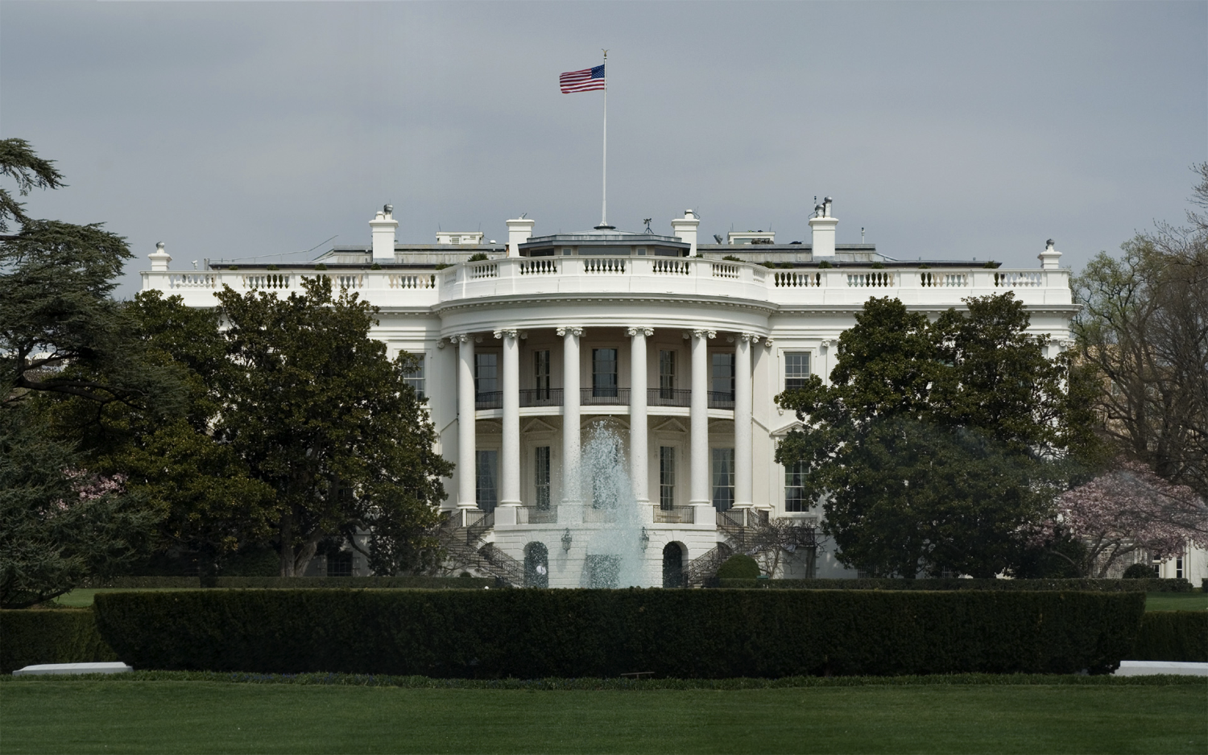
Here is a Place:

Slide 12
Geographic Connection
Analyze it according to the different parts of place!
Toponym
Site
Situation
What is its absolute location?

Slide 13
Period 1 Pick Up Here

Slide 14
Bellwork – 8-6/7
Please continue on the same sheet of paper…
Turn in Key Issue 1, check for your heading…
How do Geographers describe place?
What is the difference between site and situation?

Slide 15
Agenda:
FINISH Notes: Map Basics
“Parent Email” – Due by 8pm TODAY
Chapter 1 Map (USA) - Due Friday 8/17
Homework: Key Issue 2 Questions (Due 8/10)

Slide 16
Objective:
You will be able to describe the location and distribution of a map in writing.

Slide 17
FUN FACT
Turkeys can blush. When turkeys are scared or excited – like when a male sees a female he is interested in – the pale skin on their head and neck turns bright red, blue or white. The slap of skin over their beaks, called a “snood,” also reddens.

Slide 18
B. Scale
Scale: How much detail and area do you show
Cartographic (map) scale: ratio between size of area on the map and actual size on Earth

Slide 19
3. This means
SMALLER SCALE = larger land area and a SMALLER # of details
LARGE SCALE = smaller land area and a LARGER # of details

Slide 20
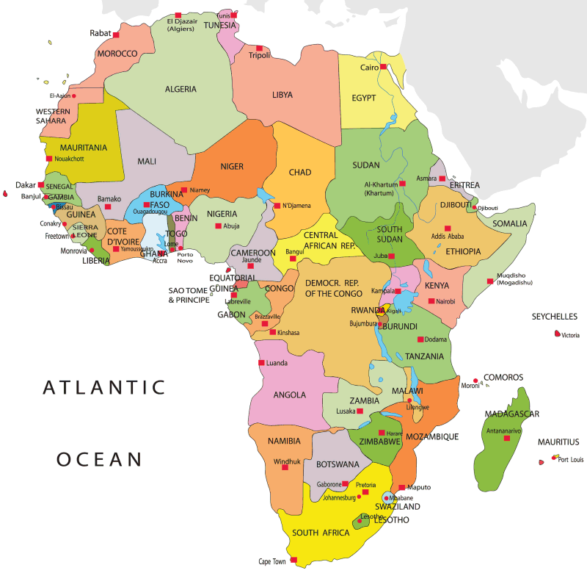
Large or Small scale?

Slide 21
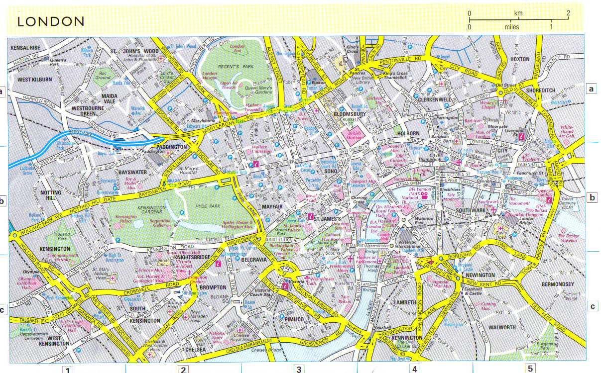
Large or Small scale?

Slide 22
C. Where Stuff Is
Space: physical gap between two objects
Distribution: arrangements of things through space

Slide 23
2. Distribution
Density: The frequency with which something occurs in space

Slide 24
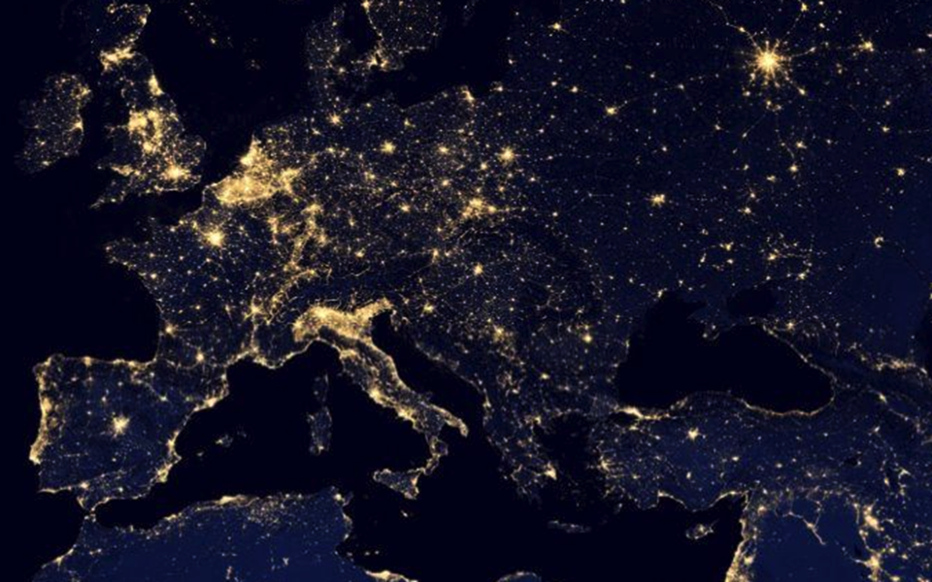

Slide 25
b. Concentration: How features are spread over space
Clustered: Where things are close together
Dispersed: where things are far apart

Slide 26
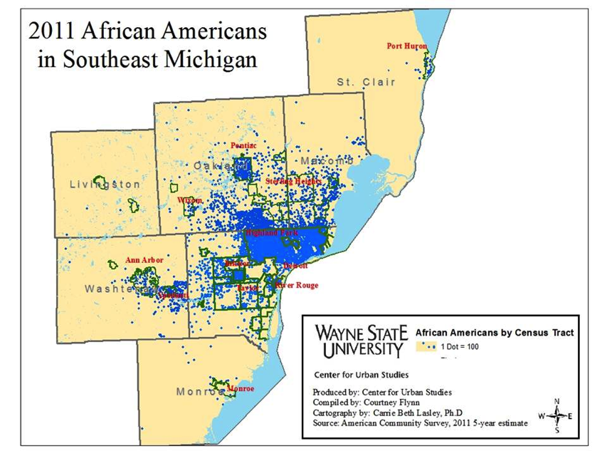

Slide 27
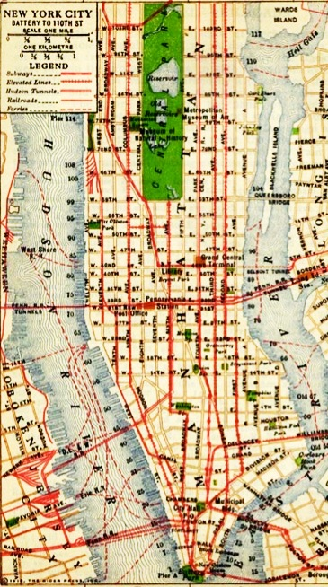
c. Pattern: Geometric arrangement of objects in space
Example: city grid

Slide 28
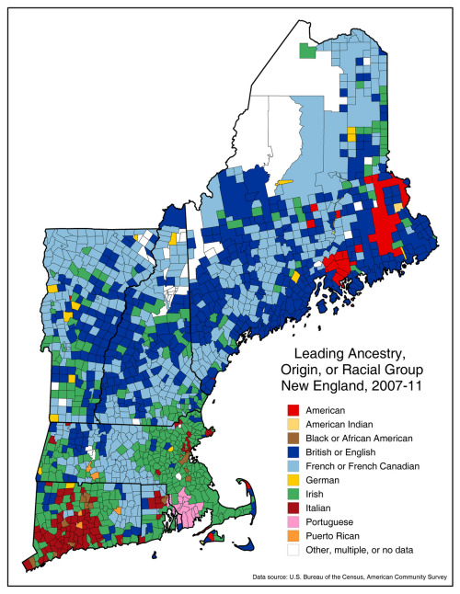

Slide 29
Ticket out the door…
In your tables, create a map of a city using the different types of distribution:
Clustered
Dispersed
Pattern
Explain:
Your map
Areas of high and low density

Slide 30
Ticket out the door
Go to page 46 and look at the map of Population distribution.
1. Describe the map, in writing, focusing on location, scale and distribution.
2. Use vocab words!

Slide 31
Gift of TIme
Please take this “Gift of Time” to work on Key Issue 2 or your USA Map.

Slide 32
World Map: PHYSICAL FEATURES
It will be useful for you to know the major physical features of the world.
Locate, label and color the ones on the list (Pg. 41)
You may work together

Slide 33
