Slide 1
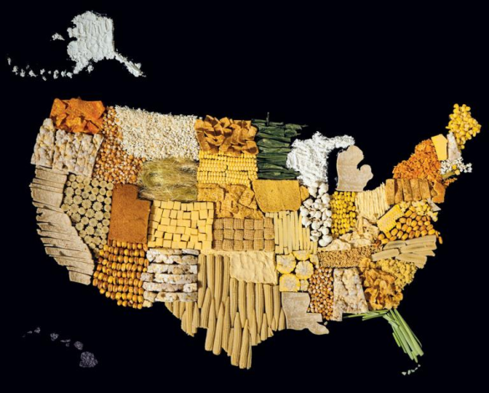
AP Human Geography
Chapter 10: Agriculture
Although this includes powerpoint for each day of the chapter, it references assignments and activities not included in the bundle. For the most effective instruction, purchase the Comprehensive Guide to Teaching Human Geography too.

Slide 2
DAY 1

Slide 3

Notes:
http://henryhargreaves.com/#food-maps-2

Slide 4
Bellwork 2/25/2019:
Think of something you or a family member has grown. Maybe herbs, a garden, in your yard, or for a science project.
What did you grow and describe the process.

Slide 5
Agenda:
Notes: Origin of Agriculture
Suggested Line of Study:
Chapter 10 – Textbook
CH. 10 KBAT
Chapter 5 from Barron’s Review

Slide 6
Objective:
You will be able to summarize the agricultural revolution.

Slide 7

Fun Fact:
Americans today consume 17.3 billion quarts of popped popcorn each year! The average American eats about 68 quarts!

Slide 8
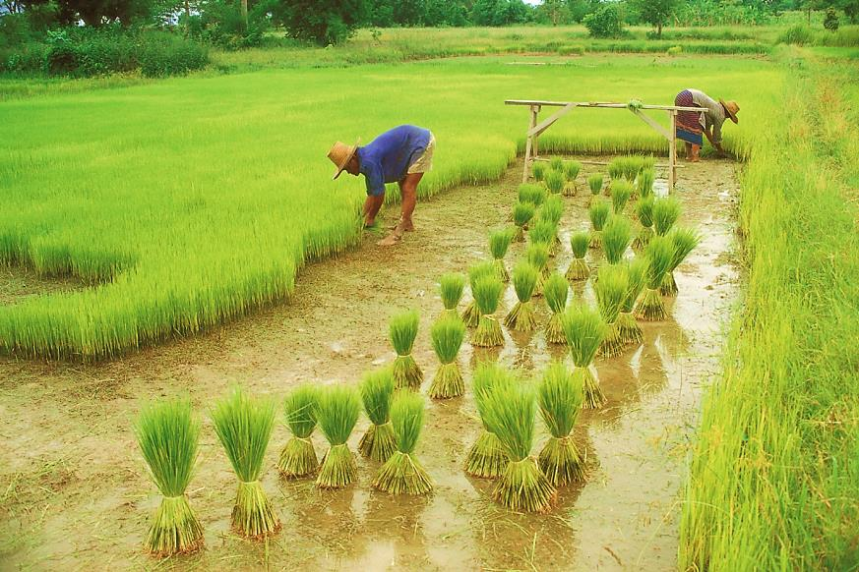
CHAPTER 10 AGRICULTURE

Slide 9
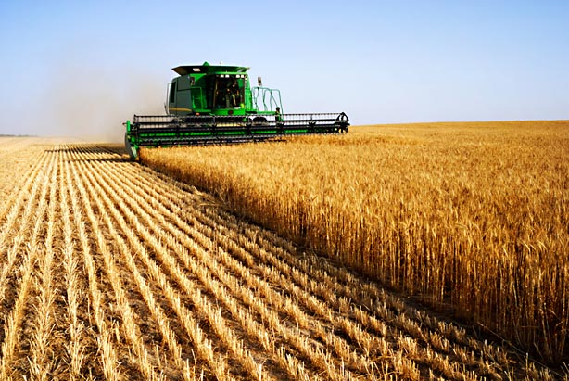
I. Origin of Agriculture

Slide 10
A. The Beginning
Agriculture: deliberate modification of Earth (through plants/animals) for food or money
Crop: any plant cultivated by people

Slide 11
B. Invention
Before agriculture - hunter/gather nomads
Agricultural Revolution: 8000 BC humans settle and domesticate plants/animals
  Fertile Crescent: Egypt, Israel, Lebanon, Syria, Turkey, Iraq, Iran – FIRST AGRICULTURAL HEARTH

Slide 12
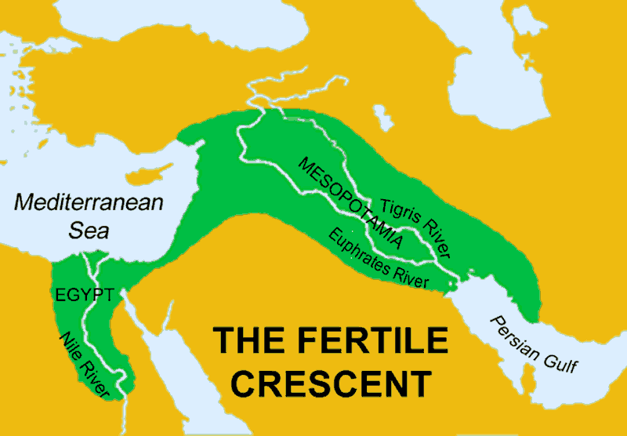

Slide 13
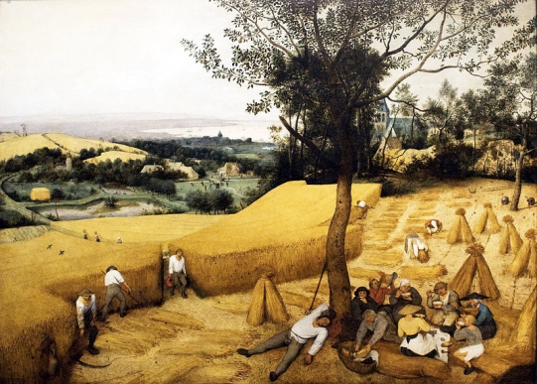
3. Why there?
  Environment: end of ice age!
  Culture: we prefer to live in one place

Slide 14
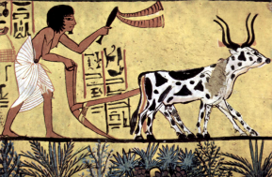
4. Results:
  Increase in reliable food supply
  Increase in population
  Job specialization
  Solidify gender roles
  Extensive Agriculture: dispersed, wide spread ranching and farming

Slide 15
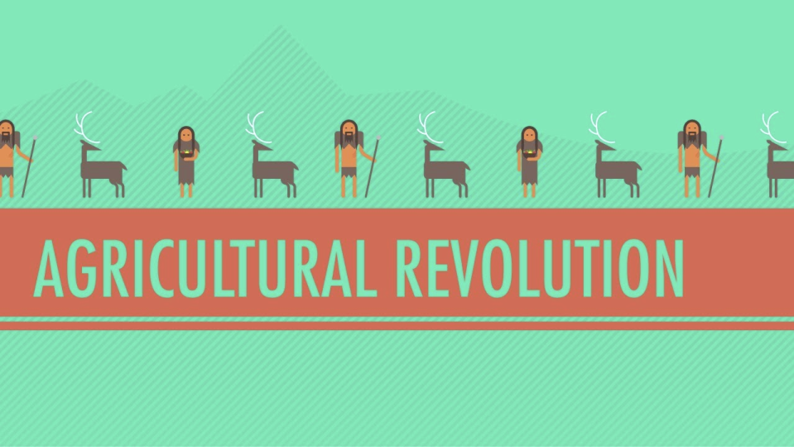
Video: Crash Course Agricultural Revolution
Notes:
https://www.youtube.com/watch?v=Yocja_N5s1I

Slide 16
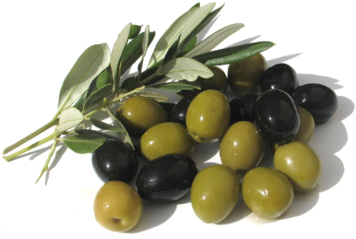
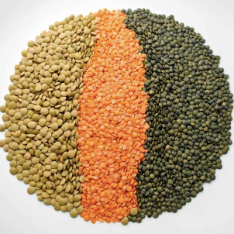
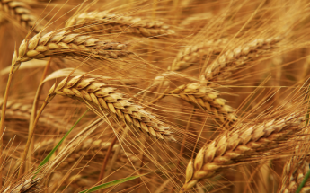
C. Cultivation Hearth
Plants
  SW Asia: lentils, olives, wheat

Slide 17
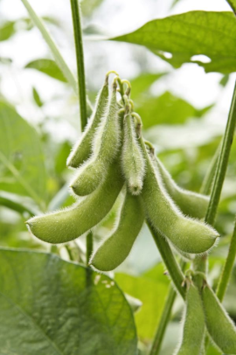
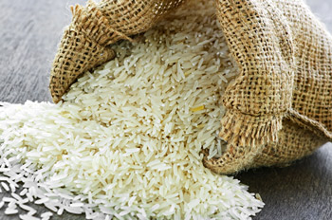
C. Cultivation Hearth
Plants
  SW Asia: lentil, olives, wheat
  E Asia: Rice, soybeans

Slide 18
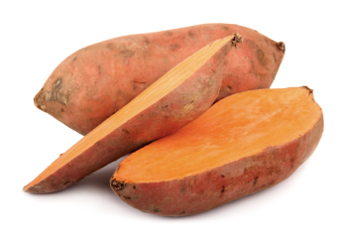
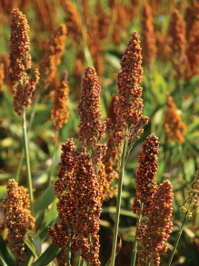
C. Cultivation Hearth
Plants
  SW Asia: lentil, olives, wheat
  E Asia: Rice, soybeans
  Sub-Saharan Africa: sorghum, yams

Slide 19
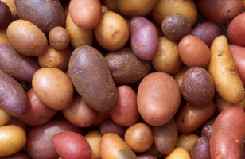
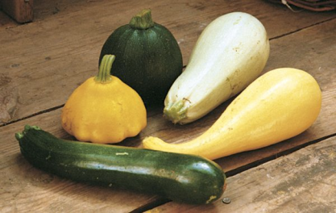
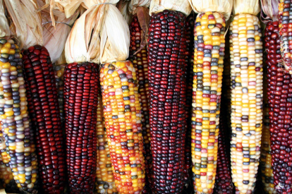
C. Cultivation Hearth
Plants
  SW Asia: lentil, olives, wheat
  E Asia: Rice, soybeans
  Sub-Saharan Africa: sorghum, yams
  Latin America: squash, maize, potato

Slide 20
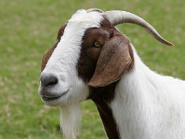
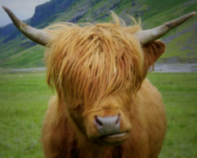
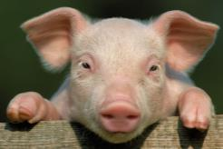
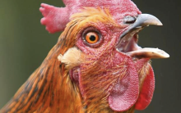

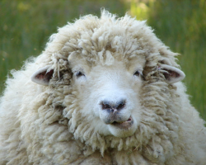
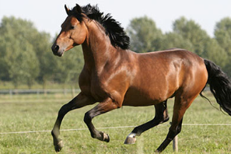
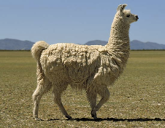
2. Animals
  In chronological order:
    Cattle, goats, pigs, sheep, chicken
    Dog, horse, llama

Slide 21
Discussion
How does agriculture differ between developing and developed countries?

Slide 22
D. Subsistence vs. Commercial
Subsistence Agriculture: food grown so the farmer can eat (developing countries)
Commercial Agriculture: food is grown to sell (developed countries)

Slide 23
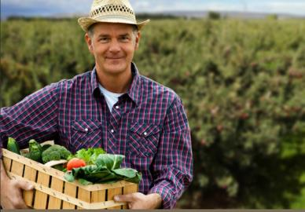
3. Differences
  % Farmers in Labor Force
    Need farmers to feed population
    MDC = 5%, LDC = 44%

Slide 24
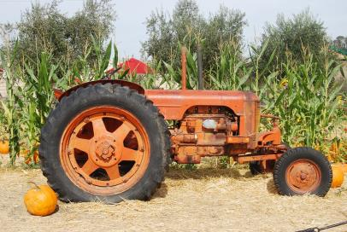
  b. Technology:
    MDC = LOTS OF MACHINES
    LDC = mostly hand tools and animal power
    Transportation
    chemicals (fertilizer, pesticides, hybrid plants)

Slide 25
Discuss
What are the differences between subsistence and commercial farming?
Come up with an example for each.

Slide 26
Summary:
Describe the agricultural revolution and its impact.
Explain the different challenges to agriculture based on a country’s development.

Slide 27
DAY 2

Slide 28
Bellwork:
What did you have for breakfast?
How do you like your eggs cooked?

Slide 29
Agenda:
Notes: Agricultural Distribution: LDC
HW: Map, #7-12, ESPEN

Slide 30
Objective:
You will be able to explain how the geography of a country influences the agriculture.

Slide 31
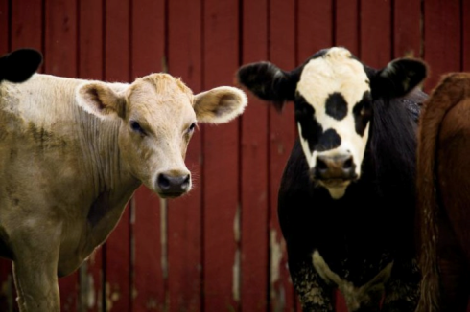
TUBI:
Like snowflakes, no two cows have exactly the same pattern of spots.
Notes:
Like snowflakes, no two cows have exactly the same pattern of spots.

Slide 32
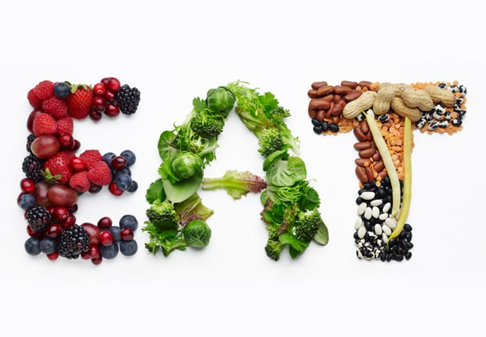
I. Diet

Slide 33

Video: Eggs (BuzzFeed)
Notes:
https://www.youtube.com/watch?v=jWhcXB5hYDE

Slide 34
Discuss
How do you like your eggs?
What do you usually eat for breakfast?
What is your favorite thing to have for breakfast?

Slide 35
A. What do people eat?
Depends on:
  Level of development ( MDC’s eat more food)
  Physical conditions of environment (no bananas in Siberia)
  Cultural preferences

Slide 36
2. Total Consumption
Dietary energy consumption: how much food you eat
Cereal Grains: grass that has grain we eat (Wheat, Rice, Maize)
Protein: MDC = Meat, LDC = cereal

Slide 37
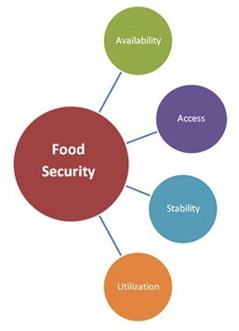
B. Nutrition and Hunger
Food security: physical and economic access to safe and nutritious food at all times

Slide 38
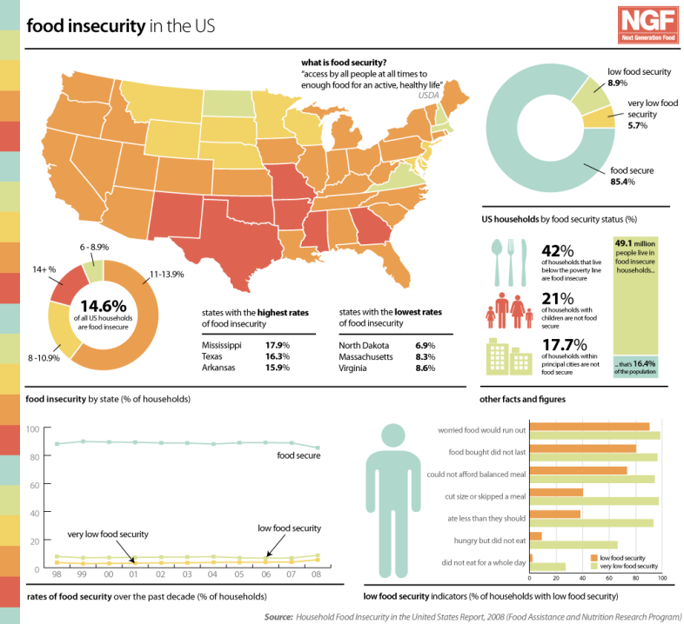

Slide 39
Discuss
As one of the most developed country in the world, why do we still have food insecurity?
What should we do to address this?
WHO should address this?

Slide 40

2. Energy Needs
The UN says we need 1,800 kcal a day
Most people in the world get this!!!! And more!!!
  870 million are
  undernourished

Slide 41
Discuss
In which countries or regions will we find most of our undernourished populations?

Slide 42
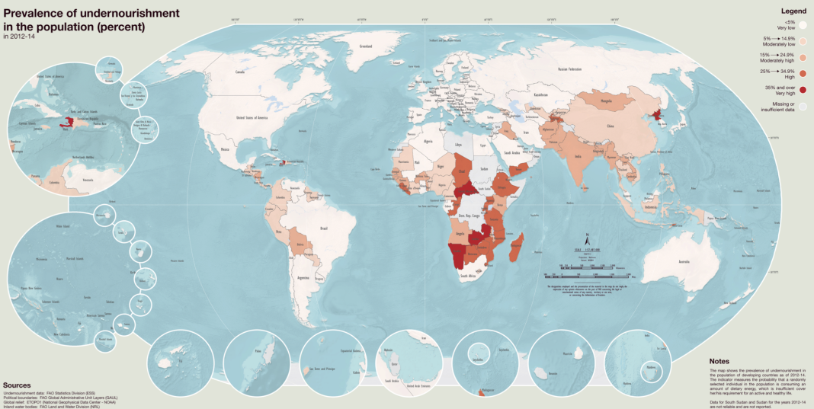

Slide 43
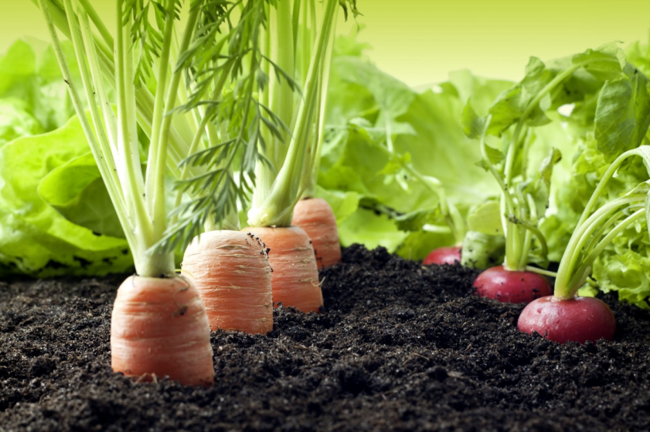
II. Agriculture Distribution - LDC

Slide 44
Geographic Connections
Think about the map you analyzed yesterday.
Name some countries that you think would have pastoral nomadism!

Slide 45
A. Agricultural Regions (Developing)
Pastoral Nomadism: subsistence agricultural based on herding
  dry lands of SW Asia, N. Africa, Central Asia, E. Asia
  Animal Husbandry: raising of domesticated animals, such as cattle, horses, sheep, and goats

Slide 46
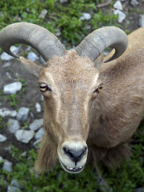
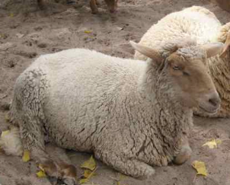
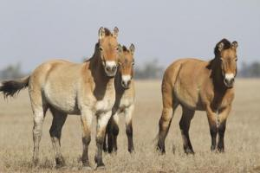
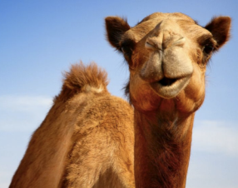
d. Animals
      Type and number depends on local cultural and physical characteristics
      Camel, sheep, goats, horse
      Milk, leather, trading animal products

Slide 47
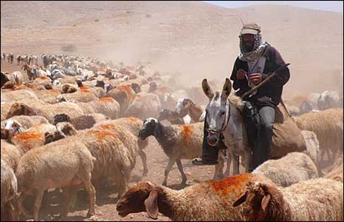
e. Movement
    Strong sense of territory
    Transhumance: seasonal migration of livestock between mountains and pastures

Slide 48
Discuss
What sort of problems do you think pastoral nomads might face?

Slide 49
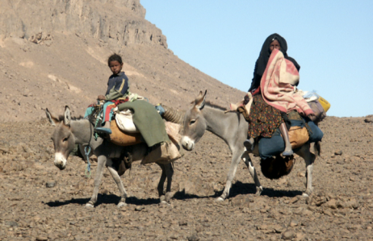
f. The Future
    declining because of modern technology
    Government forcing nomads to settle b/c they want to use the pastures for other stuff
    Loss of folk culture

Slide 50
Geographic Connections
Think about the map you analyzed yesterday.
Name some countries that you think would have shifting cultivation!

Slide 51
2. Shifting Cultivation: farmers clear land, use it, and when soil is depleted, move on
  Tropical Latin America, Sub-Saharan Africa, SE Asia
  Slash and Burn Agriculture: slash vegetation and burn the debris
    Swidden: land cleared by slash and burn

Slide 52
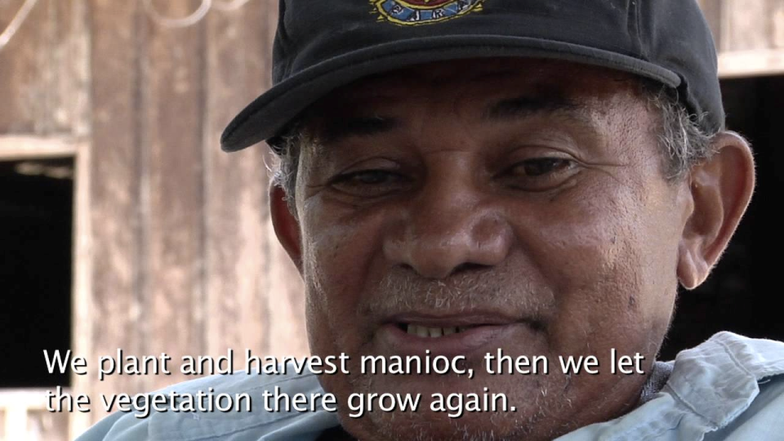
Video: Slash and Burn
Notes:
https://www.youtube.com/watch?v=zDOq7QZXTdI

Slide 53
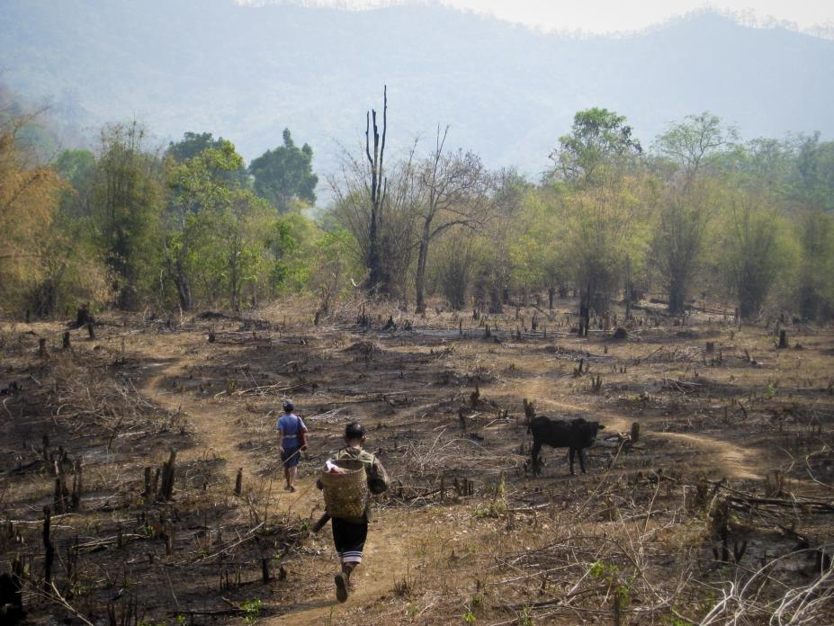

Slide 54
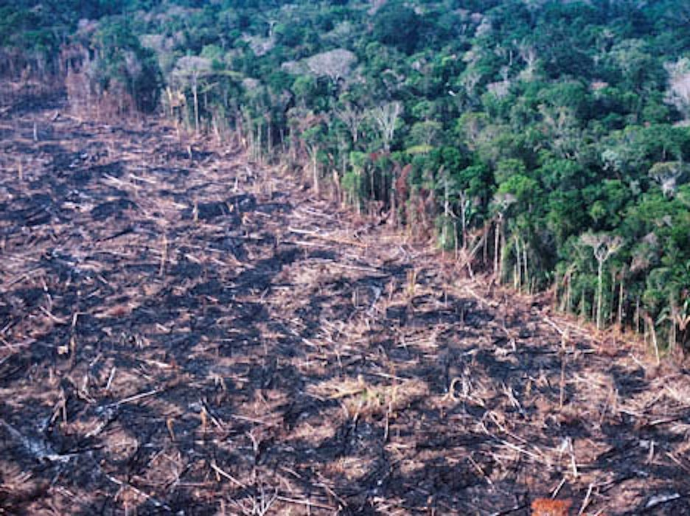

Slide 55
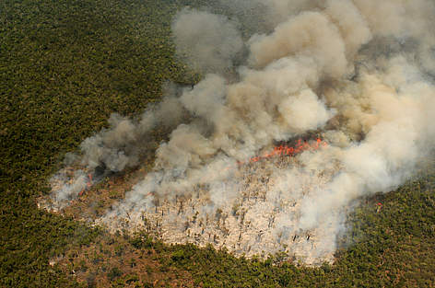

Slide 56
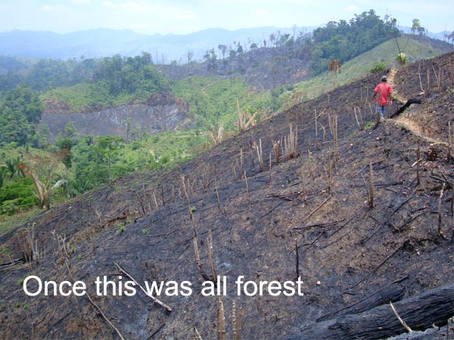

Slide 57
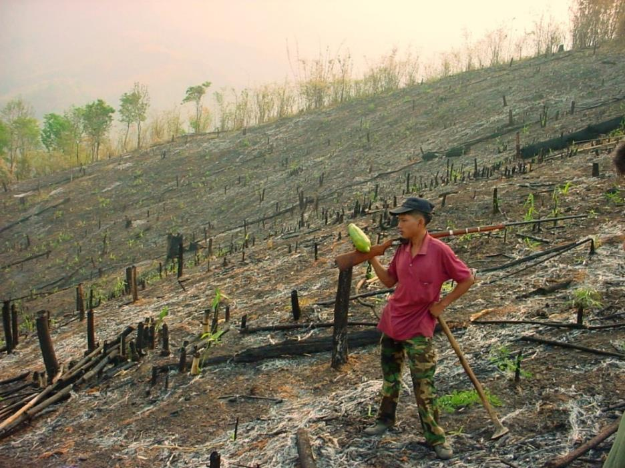

Slide 58
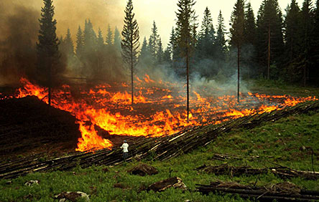

Slide 59
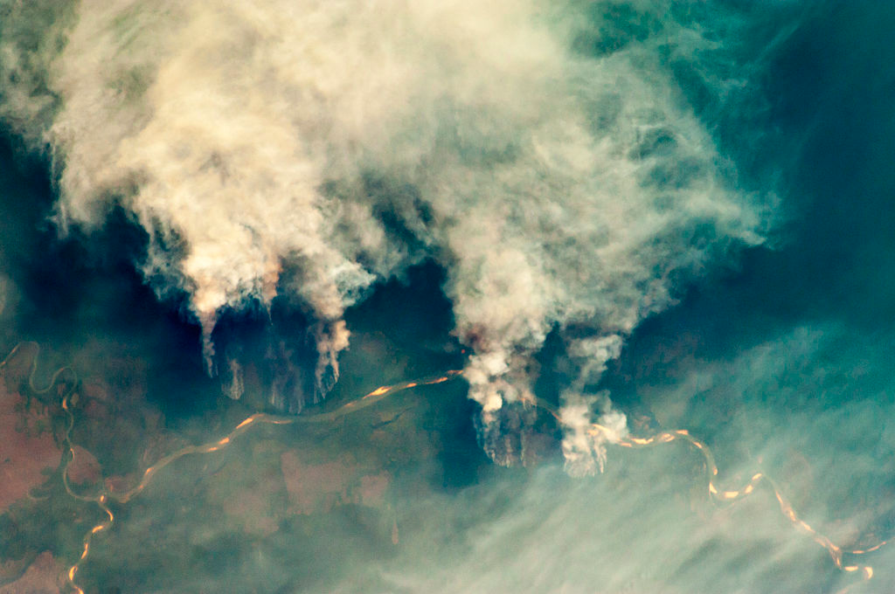

Slide 60
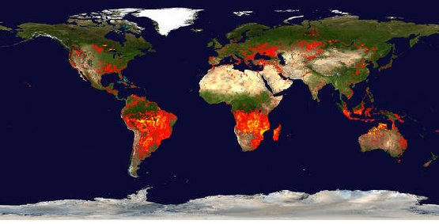

Slide 61
Discuss
What are some ways governments and international NGO’s can work together to reduce slash and burn agriculture?

Slide 62
Geographic Connections
Think about the map you analyzed yesterday.
Name some countries that you think would have intensive subsistence agriculture!

Slide 63
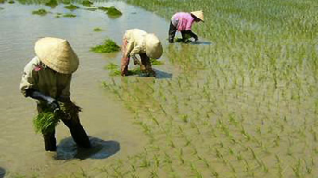
3. Intensive Subsistence Agriculture: farmers have to work part of the land INTENSIVELY to get anything
  large population concentrations in E. Asia and S. Asia
  Wet rice: plant rice on dry land, move to flooded areas as seedling

Slide 64
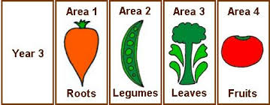
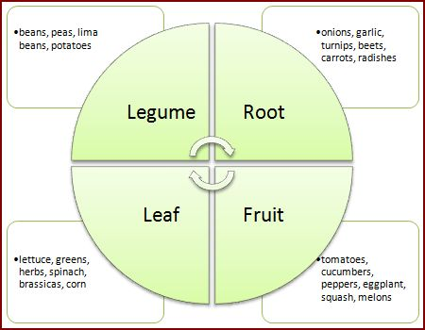

  c. Crop rotation: grow different crops in different fields from year to year to protect the soil

Slide 65
Geographic Connections
Think about the map you analyzed yesterday.
Name some countries that you think would have plantations!

Slide 66
4. Plantation: commercial farm focused on 1 or 2 crops
  tropical and sub-tropical regions of Latin America, sub-Saharan Africa, S. Asia, SE Asia
  Luxury Crops: High-priced, relatively rare crops which are inessential to human survival.
    cotton, sugarcane, coffee, rubber, tobacco, cocoa, tea

Slide 67



Slide 68
Summary:
Choose an LDC and identify a type of agriculture within it.
Explain how the geography of the country influences the agriculture.
Describe how the agriculture influences the ways its citizens live.

Slide 69
What People Eat
http://time.com/8515/what-the-world-eats-hungry-planet/
Notes:
http://time.com/8515/what-the-world-eats-hungry-planet/

Slide 70
DAY 3

Slide 71
Bellwork
What are the four types of agriculture in developing countries?

Slide 72
Agenda:
Turn in Bellwork
Notes: Agricultural Distribution: MDC
HW: ESPEN, Map

Slide 73
Objective:
You will be able to summarize the agriculture of developed countries.

Slide 74

TUBI:
2 Billion pigs in the world

Slide 75

I. Agriculture Distribution (2)

Slide 76

A. Agricultural Regions (Developed)
  Agribusiness: system of commercial farming in developed countries
  Declining revenue/rising costs
  Lots of machines and migrant workers

Slide 77

What is this cartoon saying about agribusiness?

Slide 78

  c. Cash crop: crops grown for money (usually associated with tropical fruit)
  d. Specialty crop: crops which are produced, usually in developing countries, for export.

Slide 79

2. Mixed crop and livestock: US, central Europe
  Integration of animals and crops (Crops grown to feed animals)

Slide 80

3. Commercial gardening: grow plants for people’s gardens
  USA and Australia
  Very efficient, large scale operations
  Fruit and nursery plants

Slide 81

4. Dairying: raising animals for dairy products like milk, butter, and cheese
  near population centers in US, Canada, Europe
  Milkshed: ring surrounding a city from which milk can be supplied without spoiling

Slide 82

Discuss
What are some challenges that dairy farmers might face?

Slide 83

c. Challenges:
    Labor intensive (constant attention)
    Feeding cows during winter is super expensive

Slide 84

  5. Grain: growing of grain to be sold as food for animals and to be manufactured (flour)
  USA, Canada, E. Europe
  World’s leading export crop

Slide 85


Slide 86
6. Mediterranean Agriculture: commercial agriculture, mostly horticulture and luxury crops
  Around the Mediterranean Sea, US , South Africa, Chile
  VERY PRODUCTIVE
  Sea winds brings moisture, mild winters , hot summers

Slide 87

  c. Horticulture: the art or practice of garden cultivation and management.

Slide 88



d. Crops: olives, grapes, figs, citrus
e. Problems: droughts!

Slide 89
7. Ranching: commercial grazing of livestock over an extensive area
  N. America, SE Latin America, Central Asia, Sub-Saharan Africa, S. Pacific
  Over land too dry to cultivate
  First: Open ranges, then: Semi-nomadic, Finally: Ranches

Slide 90




Slide 91

Video: Your Life – Your Agriculture
Notes:
https://www.youtube.com/watch?v=rXmyFcqhd2c

Slide 92
Summary:
Choose an MDC and identify a type of agriculture within it.
Explain how the geography of the country influences the agriculture.
Describe how the agriculture influences the ways its citizens live.

Slide 93

Video: John Oliver - Tobacco
Notes:
https://www.youtube.com/watch?v=6UsHHOCH4q8

Slide 94
DAY 5

Slide 95
Bellwork
What is a crop or type of agriculture we do here in AZ?
What challenges might they face?

Slide 96
Agenda:
Notes: Challenges to Agriculture
HW: #13-18, ESPEN

Slide 97
Objective:
You will be able to summarize the challenges in agriculture today.

Slide 98

TUBI
Cows can walk up a flight of stairs, but once there, they can’t walk back down. Their knees just don’t bend the right way.

Slide 99

I. Challenges to Agriculture

Slide 100
A. Developing Countries
The Challenges:
  Farmers have to feed a growing population
  Farmers pressured to grow crops to export instead of eat

Slide 101
2. Growing Population
Boserup Thesis: Population increases requires more labor and technology , forcing the switch to intensive agriculture
  New farming methods
  Less time to fallow: land that is left unsown for a time to restore its fertility as part of a crop rotation

Slide 102

    Forest Fallow – used 2 yrs, ignored 20
    Bush Fallow – used 8 yrs, ignored 10
    Short Fallow – used 2 yrs, ignored 2
    Annual Cropping – Every year (crop rotation)
    Multi-cropping – fields used multiple times a year

Slide 103
3. International Trade
To increase production, subsistence farmers need to import technology/chemicals
To import that they need money
To get money they grow crops to export

Slide 104
Discuss
When more land is used for growing export crops, then you have less to grow food.
But you can’t grow enough food without the imported tech
What do you do?

Slide 105

4. Drug Crops
Most lucrative export crops are drugs
  Cocaine: Colombia, Peru, Bolivia
  Heroin: Afghanistan, Myanmar, Laos
  Marijuana: Mexico

Slide 106


Slide 107
Discuss
How do we discourage the production of drugs if it is the only source of income in a developing country?

Slide 108
B. Developed Countries
Overproduction of food
  Because commercial farms can supply so much food, demand is low and prices are low

Slide 109
2. Von Thünen Model
AKA: Theory of Rural Land Use
Farmers have to consider:
  cost of land
  cost of transportation
  Farmers closer to markets choose crops that cost more to transport

Slide 110
c. 4 Rings Surround a City
1st ring: Perishable products like dairy and horticulture
2nd ring: Forestry for wood, because of its weight
3rd ring: Various crops (cereal grains)
4th ring: Extensive animal grazing

Slide 112
Discuss
Other than geography, what could change the shape of the rings in the Von Thünen model?

Slide 113

C. Environmental Challenges
Desertification: formally productive land becomes arid, unproductive, and barren

Slide 114


Slide 115
2. Erosion: The loss of the fertile top layer of soil
  Major problem in areas with fragile soils, steep slope, or heavy seasonal rain
  Plants prevent erosion by holding soil with their roots

Slide 116


Slide 117


3. Salinization: Buildup of salts in soil
  occurs when arid soils are irrigated

Slide 118


Slide 119
Summary:
Identify two world regions and explain agricultural challenges they face.
Define the Von Thunen model.
Done? Please read your article. You may use your phone, or ask me to borrow one.(uhshumangeo.weebly.com)

Slide 120
ESPEN
Please read the following article. Answer the questions in complete sentences. Each paragraph should be 8-12 sentences. Highlight, bold, or underline vocab words that are used.
12 bullet points that reflect Economic, Social, Political and Environmental Science
How does this article connect to AP Environmental Science? What are some of the consequences of the actions described in the article? Please use 5 vocab words from APES.
How does this article connect to AP Human Geography? What are some of the consequences of the actions described in the article? Please use 5 vocab words from APHG.

Slide 121

Video: Ted Talk

Slide 122
Day 6

Slide 123
Bellwork
If you live in Vietnam, what kind of agriculture will you be doing?
What challenges will you have?

Slide 124
Agenda:
Notes: Feeding the World
Self Assess: #6 & #7
HW: #19-24, ESPEN

Slide 125
Objective:
You will be able to summarize the different ways to feed the world.

Slide 126


TUBI:
One Puffer Fish contains enough poison to kill 30 people.

Slide 127

I. Feeding the World

Slide 128
A. Export More Food!
Major importers: Russia, Germany, UK, Africa, SW Asia, E. Asia, Central Asia
Major Exporters: USA, Canada, South America, Australia, India, Indonesia

Slide 129

B. More Agricultural Land
Just turn more land into farms
Problems: Urbanization, Desertification, salinization

Slide 130
C. More Fish!!
Capture wild fish
Aquaculture: cultivation of seafood in controlled conditions
We eat a LOT of fish, but we have dangerously overfished the seas

Slide 131



Slide 132

D. Grow More Food
Second Agricultural Revolution: agriculture expands because of the Industrial Revolution
Green Revolution: invention/diffusion of higher yield seeds and use of fertilizers

Slide 133

a. Biotechnology: genetically engineered crops in agriculture & DNA manipulation in livestock in order to increase production.

Slide 134

3. Genetically Modified Organisms (GMO): alter foods to have favorable traits
  Domestication: To adapt or tame so as to be cultivated by and beneficial to human

Slide 135
4. Anti - GMO
Health concerns: eating too many GMO’s reduce the effectiveness of antibiotics
Export problems: MDC’s don’t like them, so there’s no market
Dependence on Corporations: don’t want to have to buy the same seeds from USA forever

Slide 136
Discuss
What do you think of genetically modified foods? A way to feed or doom the future generations?

Slide 137
Summary
Explain the main source of food for two major world regions.
Describe challenges to those feeding those regions.

Slide 138

Categorilla: Pesticide Use
Use the Most |  | Use the Least
Costa Rica |  | Haiti
Colombia |  | Sudan
Netherlands |  | Niger
Ecuador |  | Laos
Portugal |  | Ghana
France |  | Bhutan
Greece |  | Cameroon
Uruguay |  | Ethiopia
Suriname |  | Iraq
Honduras |  | Estonia
Germany |  | Rwanda
Austria |  | Bangladesh
Dominican Republic |  | Lithuania
Ireland |  | Malawi
Slovakia |  | Norway
Paraguay |  | Finland
Denmark |  | Poland
Jordan |  | Yemen
Czech Republic |  | Romania
Pakistan |  | Thailand
Why would those countries use the most pesticides? Why would those countries use the least? Consider geography, culture and the environment! Academic paragraph!

Slide 139
Day 7

Slide 140
Bellwork
TURN IN ESPEN
Name 4 islands and their capitals.
Name 3 coastal countries and their capitals.

Slide 141
Agenda:
Tuesday Schedule
Quiz
Practice FRQ
HW: #25-30

Slide 142
Agenda:
You will be able to identify and explain the decline in dairy farms.

Slide 143

TUBI
Someone bet Dr. Suess he couldn’t write a book with only 50 words. So he wrote Green Eggs and Ham.

Slide 144
Quiz
Write clearly!
Done? No Tech, no Naps
  Do Something!

Slide 145
Practice FRQ
Write MORE!
You can’t get the points if you don’t put words on paper.
Use MULTIPLE examples
More of your time should be spent writing than planning
You should use every minute available

Slide 146
Practice FRQ
45 minutes
Plan and Write
You can work with those around you and use your notes
Done? Staple prompt to back and turn in

Slide 147
Score
Return to owner
Owner, score your own
Write 2 suggestions of what you can do better

Slide 148
Day 8

Slide 149
Bellwork
What are things you can do that will help the environment?

Slide 150
Agenda:
Notes: Sustainable Agriculture and Agribusiness
HW: #31-37; Bring Book

Slide 151
Objective:
You will be able to address the paradox of agribusiness and sustainability in writing.

Slide 152

TUBI
When Woodrow Wilson was President, the First Lady had sheep graze on the White House lawn to keep it neat and well trimmed.

Slide 153

I. Sustainable Agriculture and Agribusiness

Slide 154

Sustainable Agriculture: practices that preserve and enhance the environment

Slide 155

1. Sensitive Land Management
Ridge Tillage: plant crops on ridge tops.
  Lowers the cost of production
  less soil erosion

Slide 156

b. Less irrigation: the watering of land to make it ready for agriculture.
c. Less double cropping: harvesting twice a year from the same field.

Slide 157

2. Limited Chemicals
Best way to prevent weeds and insects: a little chemicals, mechanical weeding, ridge tillage
Organic Agriculture: relies on local ecological processes, no pesticides

Slide 158

Pesticides: a substance used for destroying insects or other organisms harmful to crops

Slide 159


3. Integrated Crop and Livestock
Grow food to feed your animals!!
Let your animals wander around the farm!

Slide 160
Discuss
Obviously, sustainable agriculture is the best option.
What are some ways governments can encourage/ pressure transnational corporations to use it?

Slide 161

B. Agribusiness
1. CAFO
  CAFO = Concentrated Animal Feeding Operation
  Feedlots: area where livestock is fed and fattened up

Slide 162
2. Vertical Integration: when several steps in production and distribution of a product is controlled by a single company to set up a monopoly

Slide 163
Vertical Integration in Grain-based Beef Production
Industrial inputs: seeds, sprays, fertilizer
Grain farming
Trucking
Markets
Financing Banks Loans
Trucking
Feedlots
Processing and Manufacturing
Restaurants
Calf production

Slide 164
Discuss
Which parts are what we typically think of as “farming”?

Slide 165
3. Why?
More efficient production of food
Rising population/wealth created need
Rural -> urban migration
Corporations make more money

Slide 166
4. So what?
Disappearance of family farms
Money invested in research (GMO)
Corporate control of agriculture: Monsanto
  Protected under law and get subsidies
    Subsidy: money from the gov to a company or industry
  No oversight
  Have HUGE monopoly

Slide 167


Slide 173

c. BACKLASH
Cooperatives
Farmers Markets! (more popular)
Local foods movement
“Fair Trade” movement

Slide 174





Videos: The Meatrix, Hog Production, Secrets to Food Marketing, Back to the Start, Food Inc.
Notes:
https://www.youtube.com/watch?v=rEkc70ztOrc
https://ed.ted.com/on/Go6KLJ4c
https://www.youtube.com/watch?v=zhHREL8n9NE
https://www.youtube.com/watch?v=S1zXGWK_knQ
https://www.youtube.com/watch?v=IJDGUxqEdYY

Slide 175
Discuss
What are your reactions to those videos?
How did the manipulate you?
Which ones were most effective? Why?
What do you think about agribusiness now?

Slide 176
Discuss
Like any industry agribusiness isn’t perfect. However, the use of CAFO’s and GMO’s feed millions of people every day.
As we look towards the future, what should we do?

Slide 177
Summary:
Define sustainable agriculture and explain two of its practices.
Describe challenges to sustainable agriculture. Use specific geographic and agricultural examples.

Slide 178
DAY 9

Slide 179
Bellwork
If you lived in Nigeria, what kind of agriculture would you be doing?
What would be some challenges

Slide 180
Agenda:
4 Level Map pg. 356
Review
  Tiny.cc/aphgch19
HW: Study, upload questions to google doc

Slide 181
Objective:
You will be able to write multiple choice questions with a partner about agriculture.

Slide 182

TUBI
President John Quincy Adams had a pet alligator.

Slide 183
4 Level Map Analysis
Do you understand the map?
  Type of map, information depicted, etc
Where do you see things? - 5
  Patterns, distribution, unique things
Why there? - 5
  Reasons for you Level 2 Observations
So what? - 5
  Connect this to at least 3 other chapters. What models apply?
BULLET POINTS
COMPLETE SENTENCES

Slide 184
Practice Multiple Choice
Find a partner
Write 4 MULTIPLE CHOICE QUESTIONS
(needs 5 choices, A B C D E)
  All the following is true about _____________ EXCEPT
  ______________ is an example of
  An example of ___________________ is
  From what we know about _____________ we can assume

Slide 185
Lots of Ted Talks on Agriculture
https://www.ted.com/topics/agriculture

