Slide 1
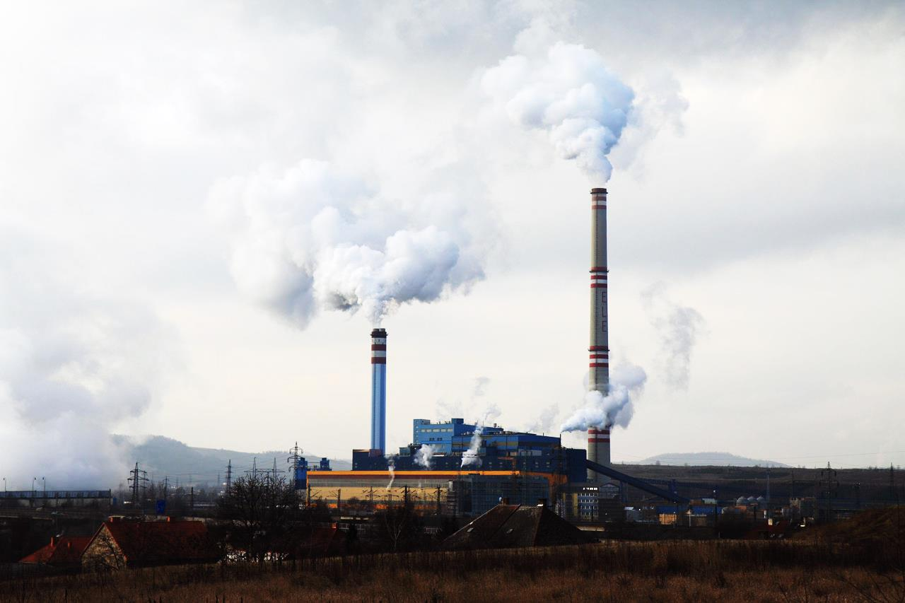
AP Human Geography
Chapters 11 & 12: Industry and Services
Although this includes powerpoint for each day of the chapter, it references assignments and activities not included in the bundle. For the most effective instruction, purchase the Comprehensive Guide to Teaching Human Geography too.

Slide 2
Day 1

Slide 3
Bellwork-Wednesday 3/13/2019
What do you want to be when you grow up?
Or something you MIGHT want to be

Slide 4
Agenda
Notes: Distribution of Industries
Suggested Line of Study:
Chapter 11 – Textbook
Chapter 6 – Barron’s
Key Issue Questions

Slide 5
Objective
You will be able to summarize the distribution and differences in industries around the world.

Slide 6
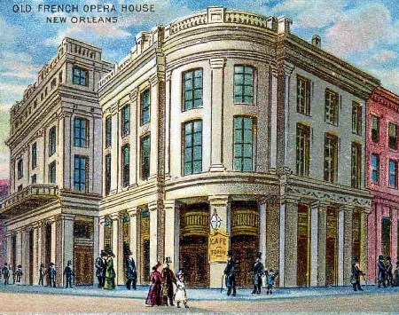
TUBI
New Orleans was the first city in the US to get an opera house and the last to get a sewer system.

Slide 7
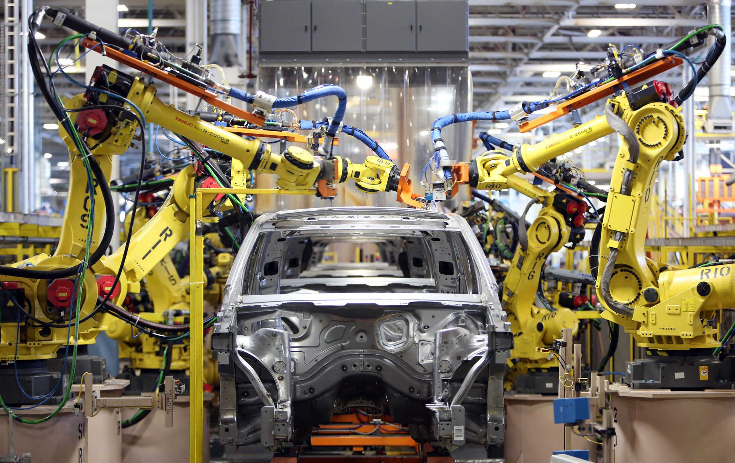
Chapter 11/12: Industry and Services

Slide 8
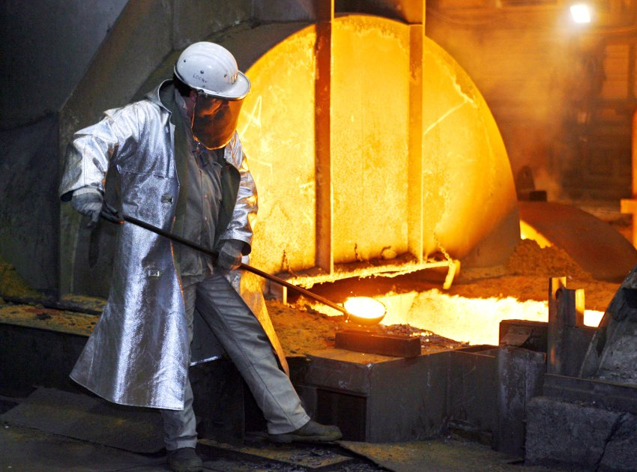
I. Distribution of Industry

Slide 9
A. Industrial Regions
Industrial Revolution: a bunch of technological improvements that changed the process of manufacturing
Started in the 1800’s in the UK
Spread through Europe first

Slide 10
Video: Crash Course
Notes:
https://www.youtube.com/watch?v=zhL5DCizj5c

Slide 11
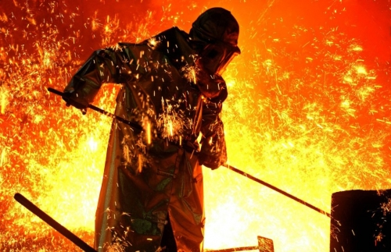
B. Industrial Regions Today
Europe
UK: steel, textiles, hi-tech
Western Europe: Synthetic fibers, pharmaceuticals, coal, iron
Eastern Europe: ship building, minerals, petroleum, coal

Slide 12
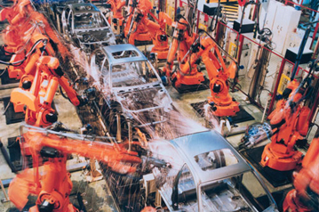
2. North America
New England: Cotton, coal
Great Lakes: steel
West Coast: textiles, food, furniture

Slide 13
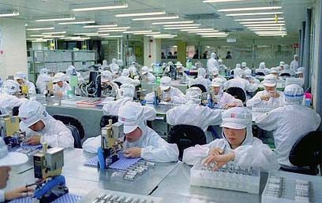
3. Asia
Japan: exports
East Coast China: cheap labor, exports
Southern Coast South Korea: ship building

Slide 14
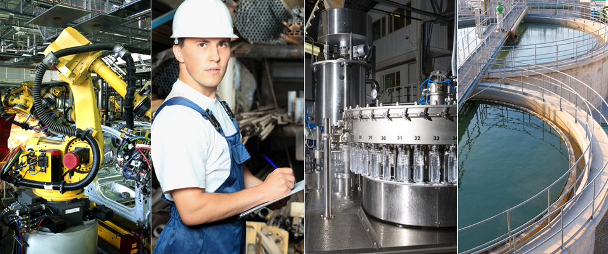
Discuss
What is it about these regions that encourage industry?
Why there?

Slide 15
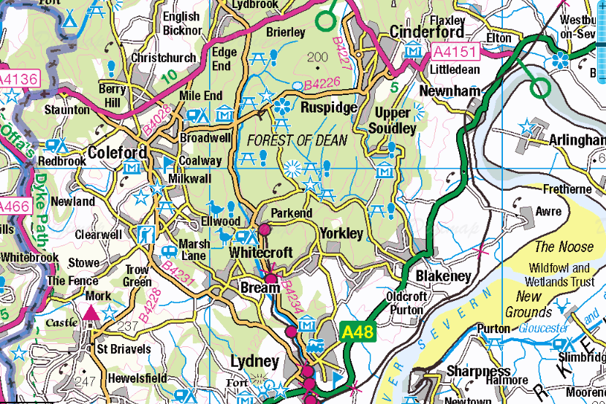
Geographic Connection
Think/Look back to Chapter 1.
Define Situation
Select one of the regions and apply the concept of Situation.

Slide 16
C. Situation Characteristics
Proximity to Input:
Cost of transporting raw materials expensive? Put plant closer to materials than markets
Bulk-reducing industry: inputs weigh more than the final product

Slide 17
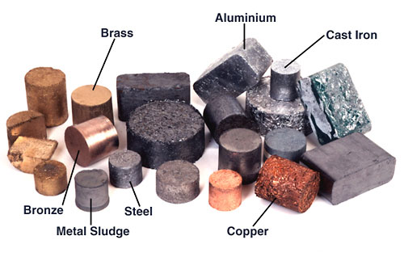
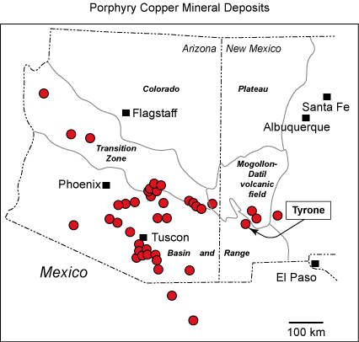
Minerals
Metallic:
Ferrous = Alloy with Iron
NICKEL, TIN, TITANIUM
Nonferrous = no iron
ALUMINIUM, COPPER, LEAD, LITHIUM

Slide 18
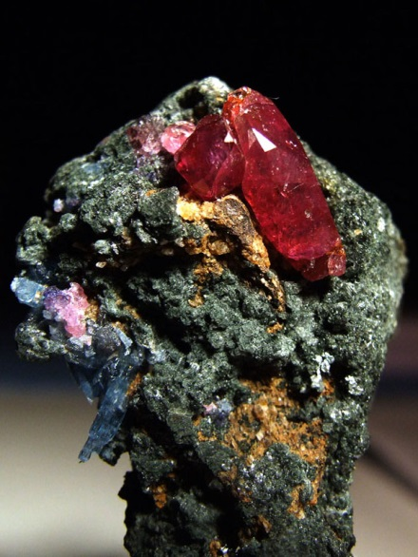
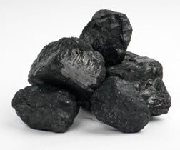
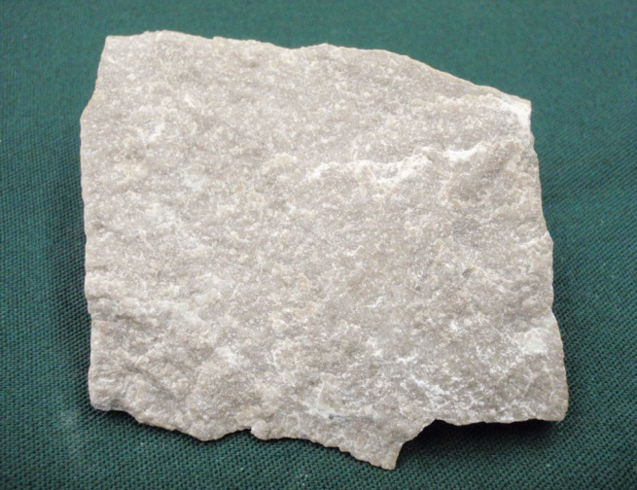
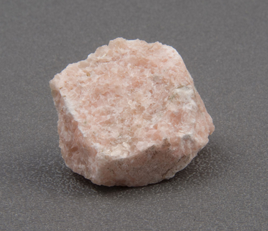
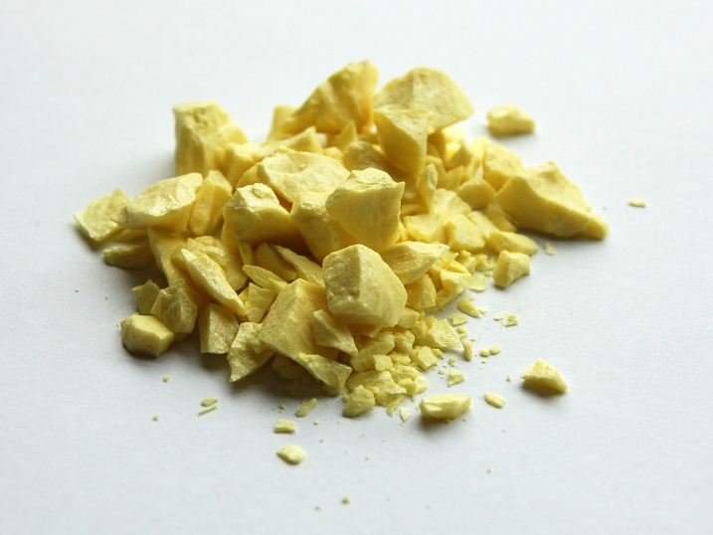
Nonmetallic:
building stones, gemstones, nitrogen, calcium, sulfur

Slide 19
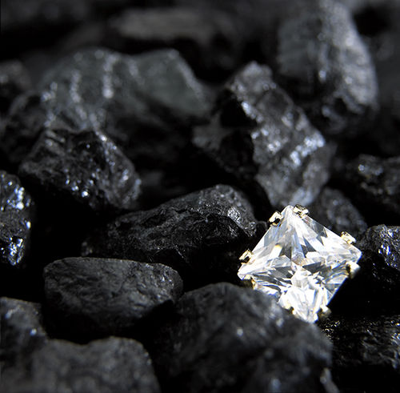
Discuss
All minerals are just rearrangements of carbon
Why do we value some minerals above others?

Slide 20
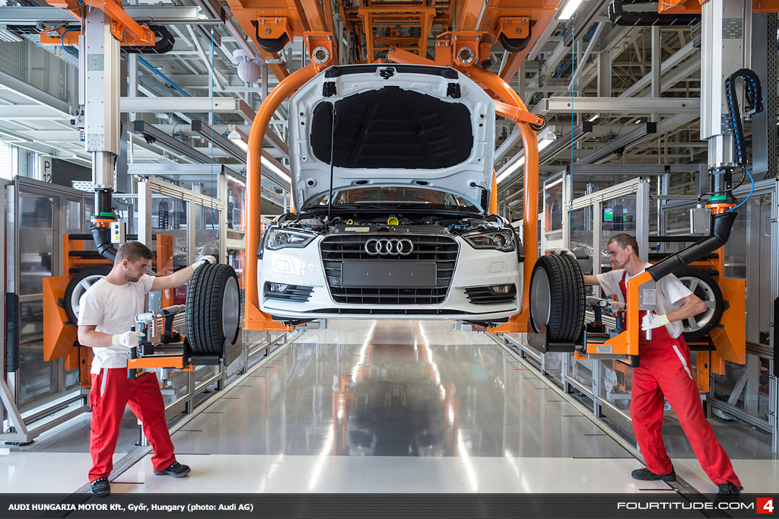
2. Proximity to Markets
If it costs more to transport the finished product, put the plant closer to the market
Bulk-gaining industry: makes something that gains volume or weight

Slide 21
3. Transportation
Companies want the
cheapest transportation
Trucks: quick and cheap (for short distances)
Trains: take longer, but no stops
Ships: cheap! But slow
Air: Most expensive, but fastest

Slide 22
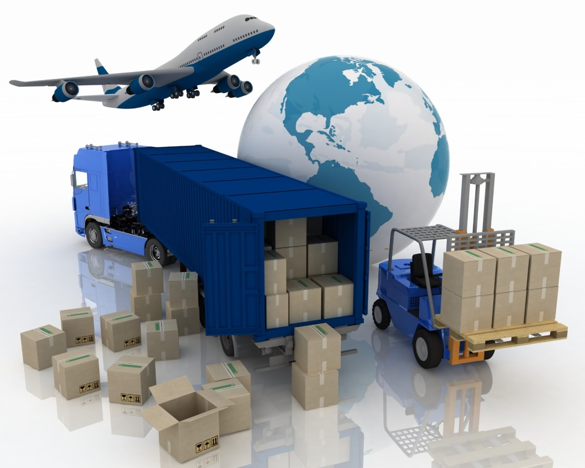
Decide
If you were transporting ______ which would be the best for you?
Laptops
Bananas
Shoes
Books

Slide 23
Geographic Connection
Think back to Chapter 1.
Define Site
Write a definition for each in your notes.

Slide 24
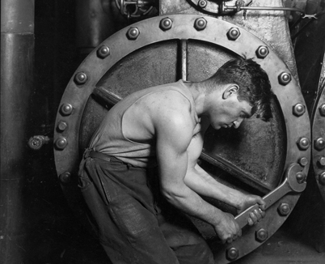
D. Site Characteristics
Distinctive features of a place
Labor
Labor-Intensive Industry: wages make up a high percentage of expenses
mining

Slide 25
3. Capital
Capital: money available to use
Need to be able to borrow money to start or expand manufacturing

Slide 26
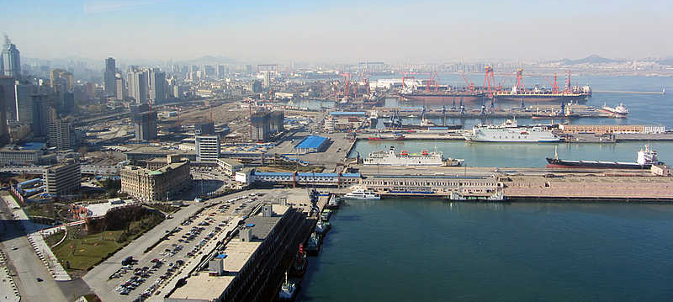
4. Land
Where do you put your factory?
Near cities!
Labor, transportation, markets

Slide 27
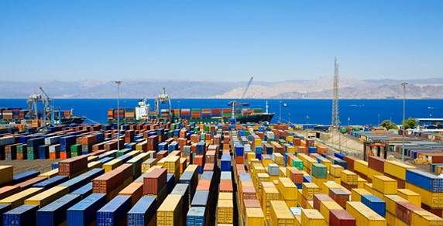
Summary:
Describe the distribution of industry around the world.
Explain situation can influence an industry, use a specific example.

Slide 28
Day 2

Slide 29
Bellwork
How does location affect where you place an industry?

Slide 30
Agenda:
Notes: Industrial Factors
HW: #1-8

Slide 31
Get out KBAT
Cross off: Annexation, Edge City, Gentrification

Slide 32
Objective:
You will be able to use Weberian Analysis to describe the sugar industry in writing.

Slide 33
TUBI:
It takes the average American 8 hours to do their taxes.

Slide 34
I. Factors to Industry

Slide 35
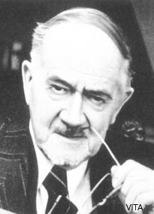
A. Least Cost Theory
Alfred Weber (1868-1958)
Best place for manufacturing reduces:
Transport costs (most important)
Labor costs
Agglomeration costs
Agglomeration: clustering of productive activities and people for mutual advantage

Slide 36
3. Weber’s 5 Assumptions
Area is uniform (the same)
Making one thing to send to one known market
Multiple sources of raw materials
Labor available but immobile
Transport uses shortest distance, so costs reflect the weight/distance

Slide 37
4. Weber’s Location Triangle
Shows the break-of-bulk: the place where goods are transferred
Footloose Industry: Industries that are not market or resource oriented

Slide 38
4. Weber Location Triangle
SUPPLY 1
FACTORY
The location of this depends on the weight of raw materials vs finished product
MARKET
SUPPLY 2

Slide 39
Practice!
Draw a Weber Triangle for:
Lumber
Coca Cola Bottling
Automobile Assembly
Copper Production
Baked Goods
Is it bulk gaining or bulk reducing?

Slide 40
Video: How It’s Made
Notes:
https://www.youtube.com/watch?v=6TIXDbxtzMY

Slide 41
B. Industrializing Countries
We have our major industrial zones: Anglo- America, Europe, East Asia
Gross Domestic Product (GDP): total value of goods and services produced within a country during a specific time

Slide 42
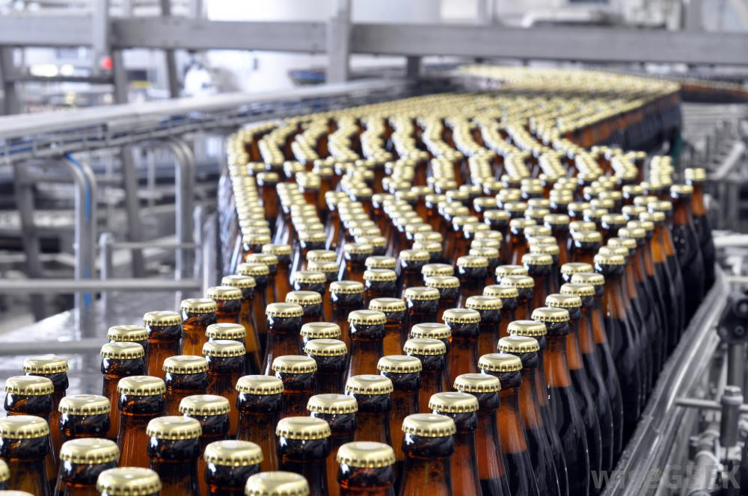
b. Mass Production: production of large amounts of standardized products, often on assembly lines.

Slide 43
Summary:
Explain the location of an industry contrasting raw material oriented with market oriented industries.
Define Weber’s Least Cost Theory.

Slide 44
Day 3

Slide 45
Bellwork
What are some sources of pollution?
How can we reduce pollution?

Slide 46
Agenda:
Notes: Industrial Pollution
Pick up notes after tomorrow
HW: #9-16

Slide 47
Objective:
You will be able to explain the way pollution and development relate in writing.

Slide 48
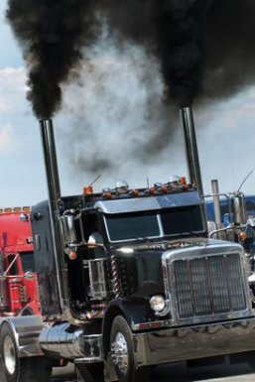
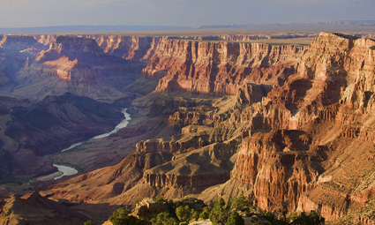
TUBI:
Fine particles can remain suspended in the air and travel long distances. For example, a puff of exhaust from a diesel truck in Los Angeles can end up over the Grand Canyon.

Slide 49
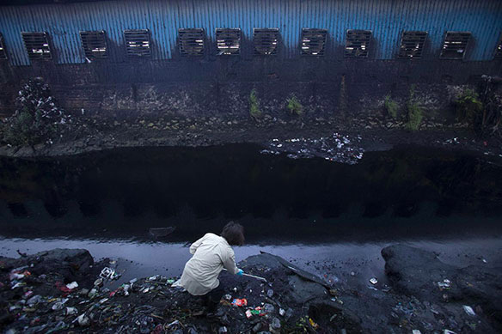
I. Industrial Pollution

Slide 50
Discuss
What do you know about pollution from Environmental Science?

Slide 51
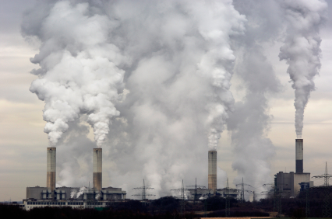
A. Air Pollution
The concentration of trace substances at a greater level than occurs in average air

Slide 52
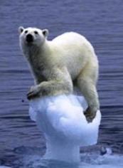
2. Global Scale
Global Warming
Industry and humans produce carbon dioxide
CO2 traps radiation from the earth, causing the temperature to rise

Slide 53
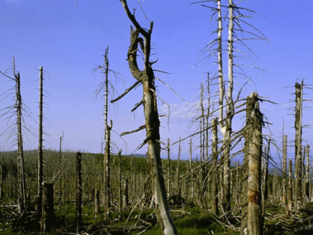
3. Regional-Scale
Can damage a region’s vegetation and water supply
Sulfur and nitrogen oxides combine with oxygen and water = ACID RAIN

Slide 54
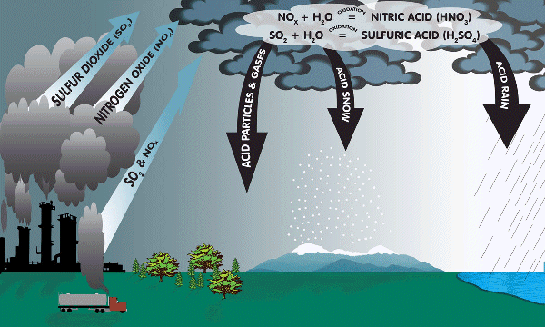

Slide 55
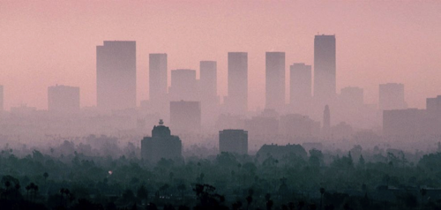
4. Local Scale
Worse in urban areas
Comes from industry and motor vehicles

Slide 56
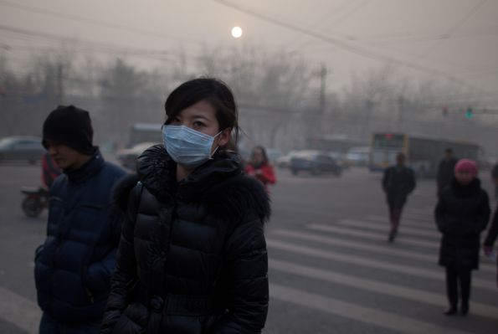

Slide 57
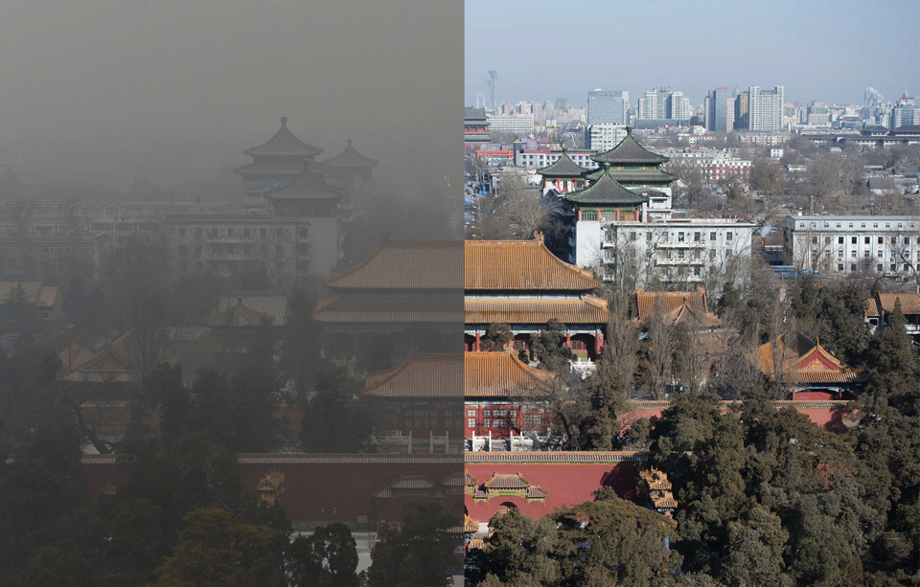

Slide 58
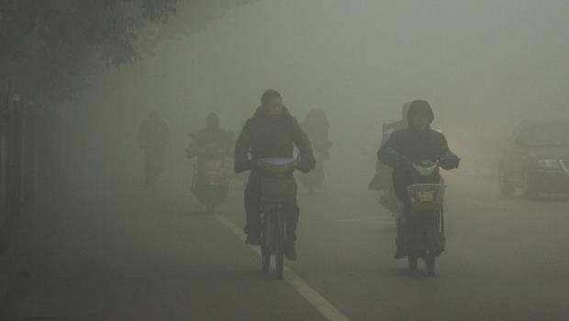

Slide 59
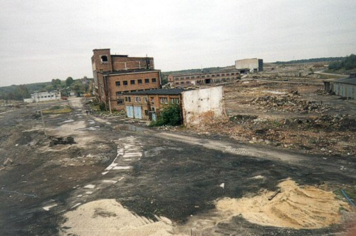
5. Brownfield: a former industrial region which has the presence or potential to have hazardous waste or pollutants

Slide 60
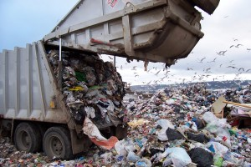
B. Solid Waste
Sanitary Landfill: garbage trucked to a landfill and covered with soil
No space? Burn it.
Hazardous Waste:
Heavy metals, mechanical oil, poisons, acids, chemicals

Slide 61
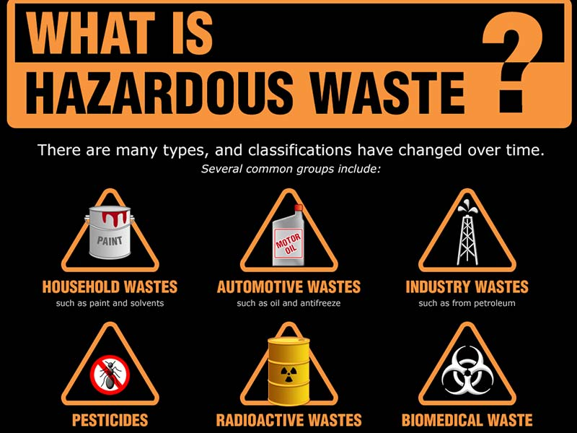

Slide 62
Discuss
What could be possible consequences of the improper disposal of hazardous materials?

Slide 63
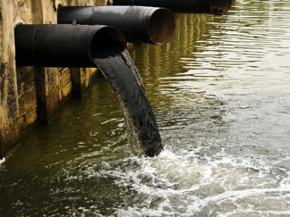
C. Water Pollution
Industry needs water; BUT humans need water too
Pollution comes from Manufacturing and sewage

Slide 64
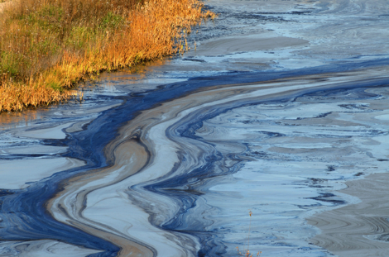
3. Nonpoint Sources: produce more pollution and are harder to stop
AGRICULTURE! (fertilizers and pesticides are washed into the rivers)

Slide 65
Discuss
What are some contemporary problems with water pollution? Who should address them?

Slide 66
D. Changes in International Industry
1. Newly Industrializing Countries: a country whose level of economic development is between the LDC and MDC.
India, Indonesia, Malaysia, Thailand, China
Mexico, Chile, Brazil

Slide 67
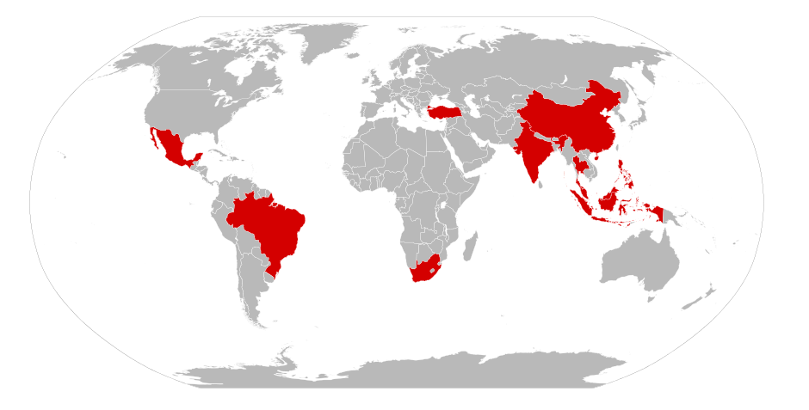
Newly Industrialized Countries (NIC’s)

Slide 68
3. Asian Tigers: Countries that focused on creating consumer goods for export; South Korea, Taiwan, Hong Kong, Singapore
4. BRIC Countries: Brazil, Russia, India, and China – similar stage in economic development

Slide 69
Discuss
What are some non-industrial factors that lead to the development of a NIC?

Slide 70
E. Changes in Domestic Industry
USA
Industries is moving to the South East
Especially foreign auto companies
Europe
Encouraging industry and manufacturing to move to Eastern and Southern Europe

Slide 71
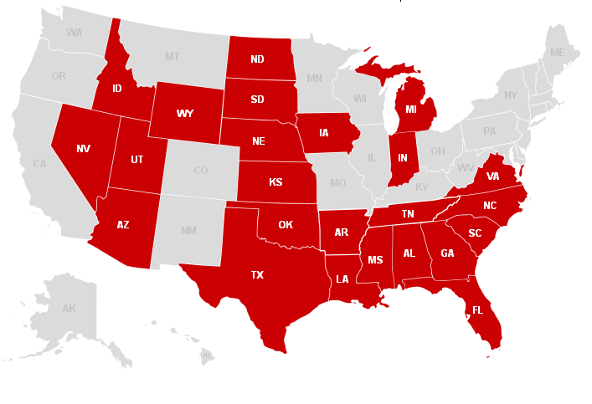

Slide 72
3. Outsourcing
New International Division of labor: Transfer of jobs from core to periphery; especially low-paid, less-skilled workers

Slide 73
b. Outsourcing: corporations use independent suppliers abroad
c. Commodity Chain: the process of gathering resources, manufacturing and distribution

Slide 74
4. Mexico
Maquiladoras: factories built by US companies in Mexico, just across the border
Export Processing Zone: industrial regions with easy access to transportation, few environmental regulations and tax exemptions for foreign companies

Slide 75
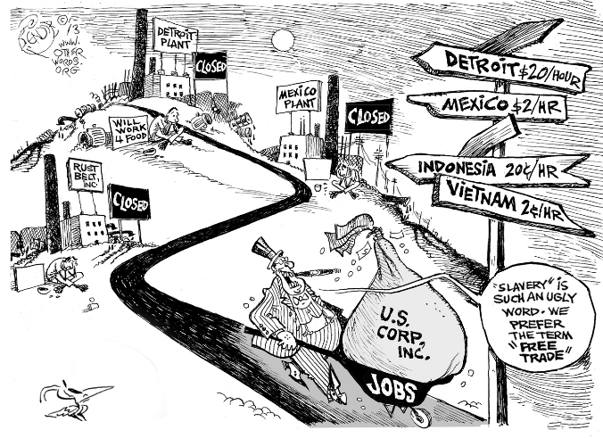
Notes:
Discuss the message of this political cartoon?

Slide 76
5. Every Settlement has
Basic industries: Essential economic processes for a community, if this industry left the city would die
Non-basic Industries: non-essential consumer services INSIDE the settlement
Economic base: a settlement’s combination of basic and non basic industries to create the economic foundation

Slide 77
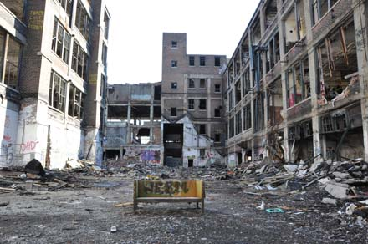
d. Deindustrialization: when industry leaves an area, taking the economic base with them

Slide 78
Summary
Explain how pollution and development influence each other.
Describe the economic structure of a NIC country, be specific.
Explain the basic and non-basic industries of Tucson.

Slide 79
Day 4

Slide 80
Bellwork
Other than industrial and agricultural work, what kind of jobs do people do?
List at least 3.

Slide 81
Agenda:
Test Correction Sign Up
Notes: Introduction to Services
HW: #9-24

Slide 82
Objective:
You will be able to describe the different kinds of services, the Central Place Theory and the Rank-Size Rule.

Slide 83
TUBI
McDonald’s serves about 9 million pounds of fries globally—per day!

Slide 84
I. Distribution of Services

Slide 85
A. The Basics
Services: any activity that meets a human want/need in exchange for money

Slide 86
B. Types of Services
Consumer Services: provide for individuals who want something and can pay for it
Retail
Education
Health and Social
Leisure (restaurants, hotels, entertainment)

Slide 87
2. Business Services: help other businesses do business
Professional (law, technical, engineering)
Financial (accounting, investments, insurance, real estate)
Transportation and Information (trucking, storage, publishing)

Slide 88
3. Public Service: services for the community paid by taxes
Law enforcement
Federal employees

Slide 89
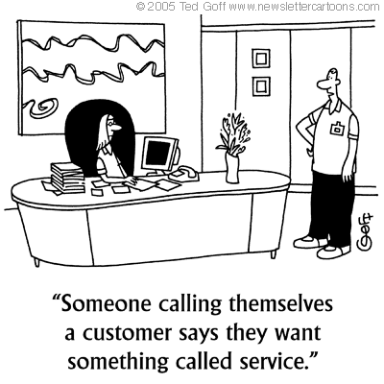
C. Service Employment
Most economic growth worldwide has been in services
Health care and professional are the fastest growing services

Slide 90
Discuss
What are ways that changes in the economy can influence the service industries?

Slide 91
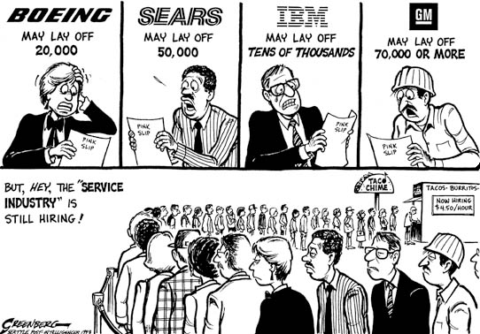

Slide 92
C. Distribution of Consumer Services
Central Place Theory: explains how to find the most profitable location for a consumer service
Walter Christaller
Market Area / hinterland: the area surrounding a service from which the consumers come
Notes:
Geographic connection: market area = NODAL REGION

Slide 93
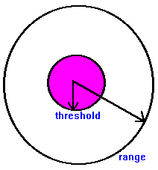
b. Range & Threshold of Service
Range: the maximum distance people are willing to travel for a service
Threshold: minimum market for the service to survive

Slide 94
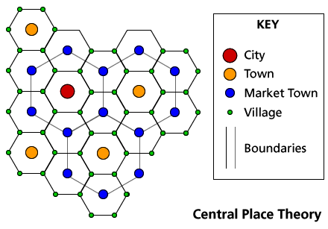
c. Market vary in size (town vs. city) so they fit into each other and overlap

Slide 95
Discuss
Come up with 3 different consumer services you would put near your neighborhood.
Consider range and threshold

Slide 96
d. Rank-Size Rule: a country’s nth-largest settlement is 1/n of the largest settlement’s population
So the 2nd largest city in the country has ½ the population of the largest

Slide 97
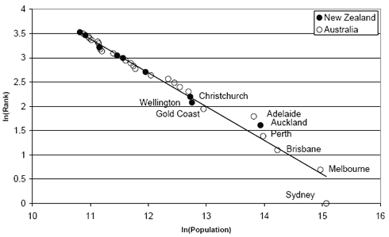

Slide 99
Practice
Make a graph in your notes.
Using a highlighter, graph the actual population of Arizona’s biggest cities
Does Arizona follow the rank size rule?
Do the math and use a different high lighter to graph your predictions
Glendale: 237,517
Scottsdale: 230,517
Tempe: 172,816
Peoria: 169,934
Surprise: 126,275
Phoenix: 1,537,058
Tucson: 527, 972
Mesa: 462,704
Chandler: 254,276
Gilbert: 239,278

Slide 100
Summary
Describe the different kinds of services.
Explain how development effects the Central Place Theory and the Rank-Size Rule.

Slide 101
Day 5

Slide 102
Bellwork:
List as many consumer services you can think of.

Slide 103
Agenda:
Notes: Consumer Services
HW: #25-32, Quiz on Wednesday

Slide 104
Objective:
Using a state capital, you will be able to describe the consumer and public services that can be found there.

Slide 105
TUBI
In Mohave County, Arizona, if anyone is caught stealing soap, he must wash himself with it until the soap is gone

Slide 106
I. Services for People

Slide 107
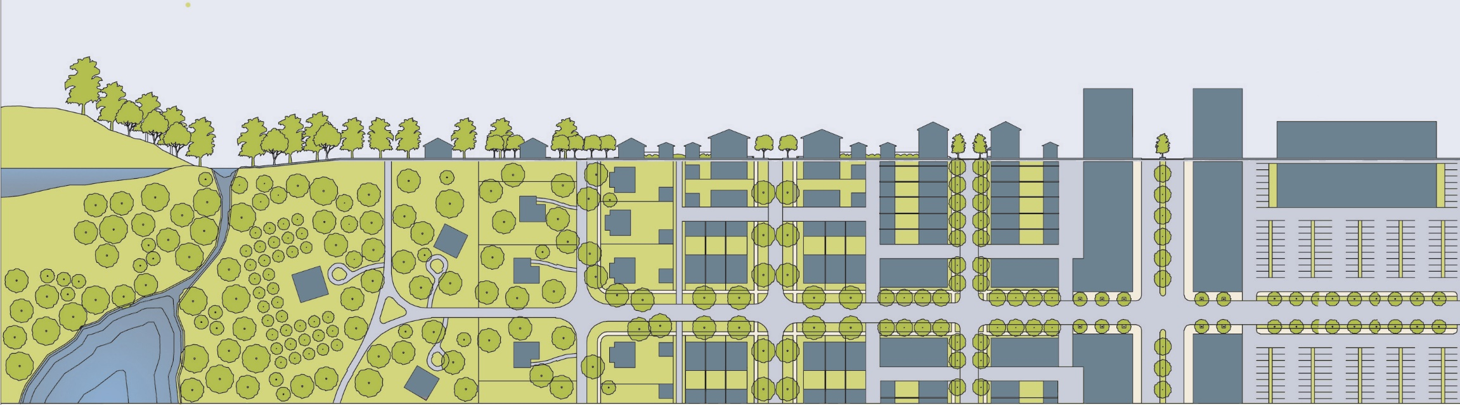
A. Services in Cities
50% of global population lives in rural settlements, 50% in urban settlements
Urban populations are growing

Slide 108
Geographic Connection
What concepts from our chapter on migration contribute to this?

Slide 109
2. Services in Early Settlements
Places of worship
Protection (walls)
Periodic markets: vendors offer goods and services in a location on specified days

Slide 110
3. Services in Urban Settlements
First urban center in Mesopotamia
Urban settlements arose in the 1800’s
Developed countries – most people live in urban centers
Developing countries – have the largest urban centers

Slide 111
e. Primate City Rule: largest settlement has more than twice the population of the second largest
Paris, London
Mexico City, Jakarta

Slide 115
Discuss
If a country does or does not have the rank-size distribution of cities, what can that tell us about the country??

Slide 116
4. Other Services in Global Cities
Consumer:
HUGE retail market area
Lots of leisure activity
Wealthy people live in global cities
Public:
National government agencies
International organizations

Slide 117
5. Tourism
Relies on a population with enough money to vacation
Serves as a basic industry, brings in money from the outside
Designed to cater to our desires

Slide 118
Discuss
In what ways is tourism geographically oriented?
What are the biggest tourist destinations in America?
What about the world?

Slide 119
6. Specialized Settlements - Public Services
State capitals
Legislatures, executive offices, courts
Large universities
Military Bases

Slide 120
Summary:
Using a state capital, describe the consumer and public services that can be found there.
Use a model to explain why we see that service there!

Slide 121
4 Level Map Analysis - pg. 405
Do you understand the map?
Type of map, information depicted, etc
Where do you see things? - 6
Patterns, distribution, unique things
Why there? - 6
Reasons for you Level 2 Observations
So what? - 6
Connect this to at least 3 other chapters. What models apply?
BULLET POINTS
COMPLETE SENTENCES

Slide 122
Day 6

Slide 123
Bellwork
SPOT CHECK 28
List 1 Hindu, 1 Jewish, 3 Buddhist, 3 Christian, 3 Muslim Countries

Slide 124
Agenda:
Quiz
Stress Check in
HW: #33-41

Slide 125
TUBI
President Bush once barfed on the Prime Minister of Japan then passed out.

Slide 126
Quiz
Write Clearly
Complete sentences for application part
Countries, no capitals

Slide 127
Stress De-Brief
Get out a piece of paper and answer the following questions. Your name is optional.
What is one thing you are proud of this school year?
On a scale of 1-10 (10 being high) what is your overall stress level normally this year?
On a scale of 1-10 how much pressure do you feel from your parents?
What are some things that you are worried/anxious/stressed about?
Do you feel more or less stressed than previous years?
Are you more stressed about grades, the AP or college?
What class causes you the most stress?
Short of not giving you homework, what are some ways I can help you?

Slide 128
Day 7

Slide 129
Bellwork
What is something you’re going to do over break?

Slide 130
Agenda:
Turn in Bellwork
2 Practice FRQ
HW: SLEEP

Slide 131
TUBI
Denmark Law: If a horse drawn carriage is trying to pass a car and the horse becomes uneasy, the owner of the car is required to pull over and if necessary, cover the car.

Slide 132
Practice FRQ
Take 15 minutes to plan for both
30 minutes to write both
PEN
Staple prompt to back and turn in when done

Slide 133
Score FRQ
Score according to the Rubric
Self Score, write one thing you can do to improve at the bottom

Slide 134
Day 8

Slide 135
Bellwork
Describe three different industries and three different services.

Slide 136
Agenda:
Notes: Distribution Business Service
4 Level Map pg. 455
HW: #41-47, Review On Wednesday, TEST/ FRQ THURSDAY

Slide 137
Objective:
You will be able to describe the impact of business services on more developed countries and less developed countries.

Slide 138
TUBI
It is illegal for a donkey to sleep in a bathtub in Arizona.

Slide 139
I. Distribution of Business Services

Slide 140
A. Global Cities
Important urban
settlements for
international
business
HQ of large corporations
Stock exchanges
Professional/Financial Services! (lawyers, accountants, insurance)

Slide 141
2. Global cities are either: Alpha, Beta, or Gamma
Divisions based on:
Economic – # of corporate HQ/financial institution/law firms
Political – hosting international events
Cultural – famous icons/sports/education
Infrastructure – international airport, communications, health care

Slide 142
B. Business Services in LDC’s
Offshore financial services:
Taxes
Companies operate out of these countries to hide their money to avoid being taxed
Privacy:
Corporations can hide where their money comes from

Slide 143
Video: Tax Havens 101
Notes:
https://www.youtube.com/watch?v=UCaT6VOZJZM

Slide 144
Video: Panama Papers
Notes:
https://www.youtube.com/watch?v=k2APYPjTWZ8

Slide 145
2. Outsourcing:
QUICK LOOK BACK IN YOUR NOTES AND DEFINE OUTSOURCING YOURSELF

Slide 146
2. Outsourcing:
Business-Process Outsourcing: transferring work like customer service abroad
Why outsource to LDC?
CHEAPER! You can pay workers less
Can speak English (Asia!!)

Slide 147
Discuss
What could be some positive or negative effects of business-process outsourcing for the workers in LDC’s?

Slide 148
Video: Why Outsourcing Is Bad For Business
Notes:
https://www.youtube.com/watch?v=V7fsEIp2r_8

Slide 149
C. Specialized Settlements
General business
Computer and Data Processing
Military Activity Support
Management-Consulting
Entertainment and Recreation
Medical

Slide 150
Geographic Connections
Come up with example cities for each of the specialized settlements.

Slide 151
D. Distribution of Talent
Some places have a high density of specific people
College educated
Scientists
Cultural diversity
Business Professionals

Slide 152
Geographic Connections
How many vocab words from previous chapters can you connect to these ideas?

Slide 153
Summary
Describe the impact of business services on more developed countries and less developed countries.

Slide 154
4 Level Map Analysis - pg. 443
Do you understand the map?
Type of map, information depicted
Where do you see things? - 6
Patterns, distribution, unique things
Why there? - 6
Reasons for you Level 2 Observations
So what? - 6
Connect this to at least 3 other chapters. 3 Vocab words. What models apply?
BULLET POINTS
COMPLETE SENTENCES

Slide 155
Day 9

Slide 156
Bellwork
What’s the Least Cost Theory?
What’s the Central Place Theory?

Slide 157
Agenda:
Test Review
HW: Study! Test/FRQ Tomorrow

Slide 158
TUBI
A flock of flamingos is called a Flamboyance.

