Slide 1
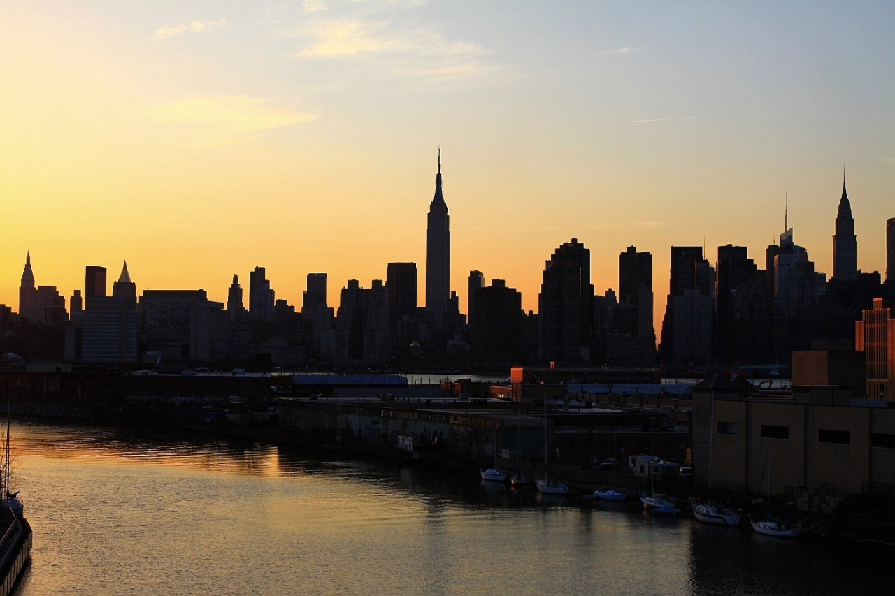
AP Human Geography
Chapters 13: Urban Development
Although this includes powerpoint for each day of the chapter, it references assignments and activities not included in the bundle. For the most effective instruction, purchase the Comprehensive Guide to Teaching Human Geography too.

Slide 2
Day 1

Slide 3
Bellwork
Describe the downtown of a city. What do we expect to find there?

Slide 4
Agenda:
Notes: The Big City
4 Level Map – City map
HW: #1-8

Slide 5
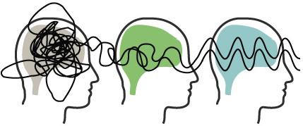
Mindfulness Moment

Slide 6
Objective:
You will be able to explain how the decline of the CBD affect the rest of the city.

Slide 7
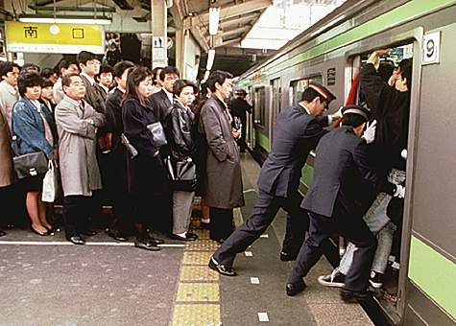
TUBI:
Oshiya, or “pushers,” are employed in some of Tokyo’s railway stations. They literally push people onto crowded trains during rush hour.

Slide 8
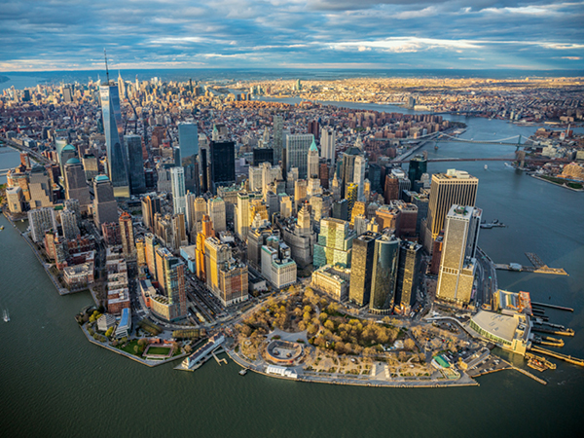
Ch. 13 Urban Development

Slide 9
Discuss
What makes a good city?

Slide 10
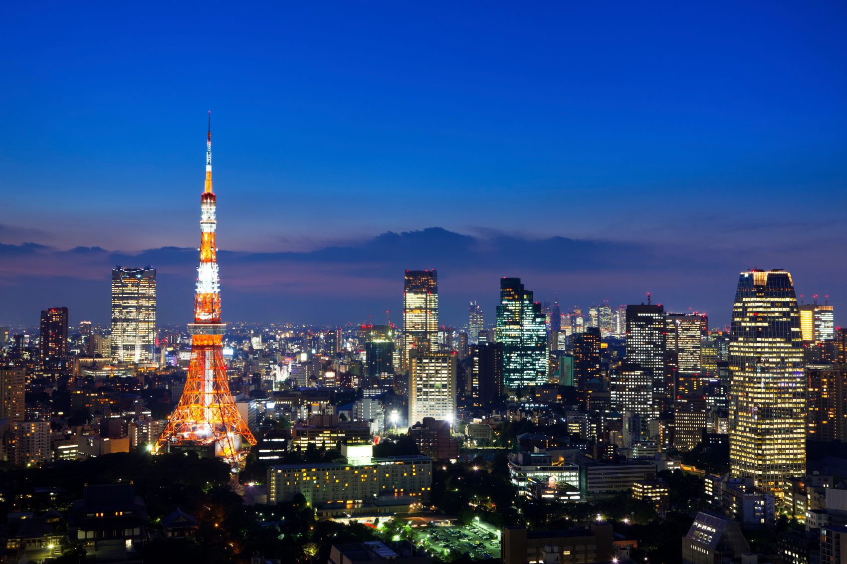
I. The Big City

Slide 11
A. Urbanization
The increase in the number of people living in a city (LDC)
An increase in a country’s percentage of people living in cities (MDC)

Slide 12
3. Differences between Urban and Rural Settlements:
Higher concentration/density of people, less social relationships more isolated
HIGH density specialized services
MORE cultural differences/diversity, less homogeneity

Slide 13
B. Urban Categories
Town: Has a CBD, but is less complex and small
City: Has a CBD, with a complex economic base and large population
Suburb: Residential and homogenous communities
Metropolitan Area: Urban area including suburbs and small towns
Notes:
Why are cites pull factors?

Slide 14
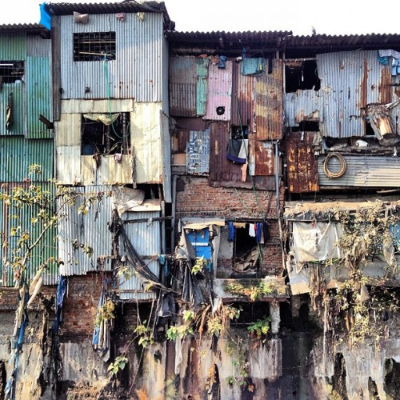
5. Megacity: cities with more than 10 million
Unable to control expansion
Overpopulated apartments
Rise in slums without basic necessities
Notes:
Where do we find these megacity slums?

Slide 15
6. Megalopolis: Several metropolitan areas that have merged
7. World City: international urban center that control global systems of commerce and finance
AKA: Global City

Slide 16
Geographic Connections
Come up with your own examples of each type of city!

Slide 17
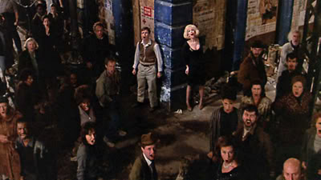
Video: Little Shop of Horrors “Skid Row”
Notes:
https://www.youtube.com/watch?v=z0kSBiu1IGk

Slide 18
Discuss
Look at the lyrics and think about what you saw in the video.
What is this musical saying about life downtown?

Slide 19
C. Downtown
Central Business District (CBD): compact area with a high percentage of services
Often the oldest part of the city
Hub for public transportation

Slide 20
Discuss
Why sort of services would we find in the Central Business District?

Slide 21
2. NOT in the CBD
Industry
Manufacturing needs space and access to transportation
Residents
People live in suburbs
Millennials moving back to cities

Slide 22
D. Competition for Land
Everyone wants to be in the CBD, so land is SUPER expensive
Underground:
Transportation, public services even consumer services
Skyscrapers:
Retail at bottom, offices in middle, apartments at top

Slide 23
Summary
Describe the Central Business District.
Identify some problems CBD’s could face.
Explain how the decline of the CBD affect the rest of the city.

Slide 24
Discuss
Based off your knowledge from Environmental Science, what role do cities play in your environment? What are challenges or benefits?

Slide 25
Make a list of services, industries and infrastructure for each!
My Perfect City
Requirements for a City

Slide 26
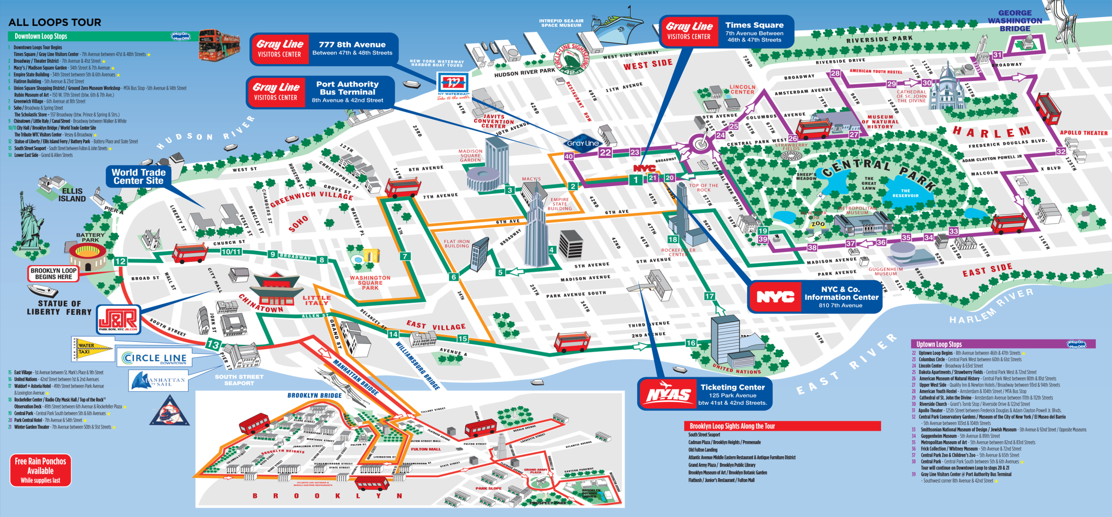
New York City

Slide 27
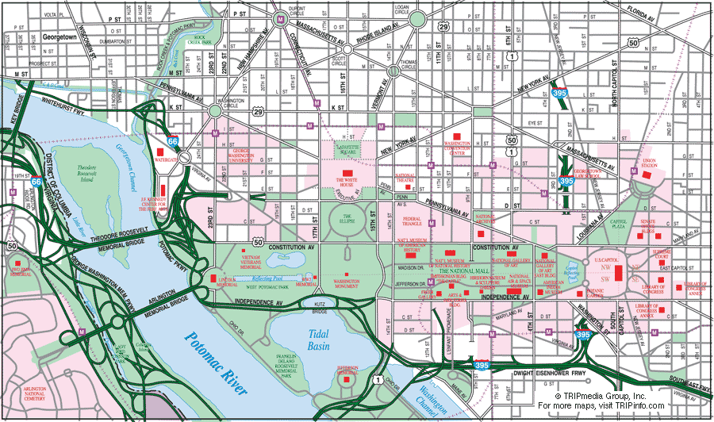
Washington DC

Slide 28
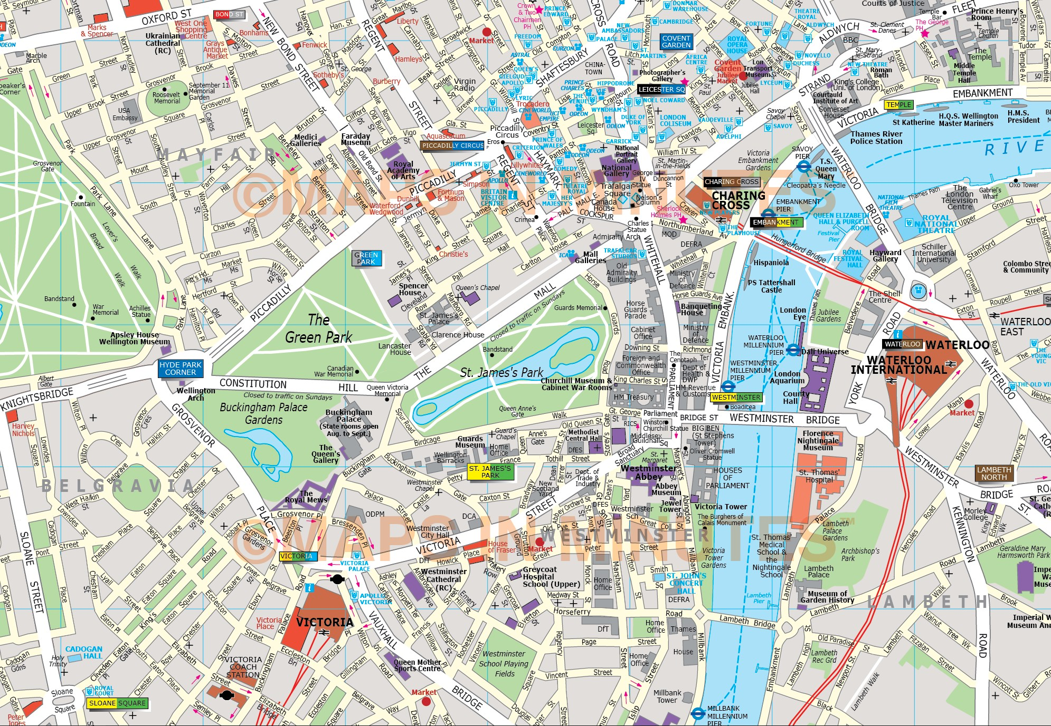
London

Slide 29
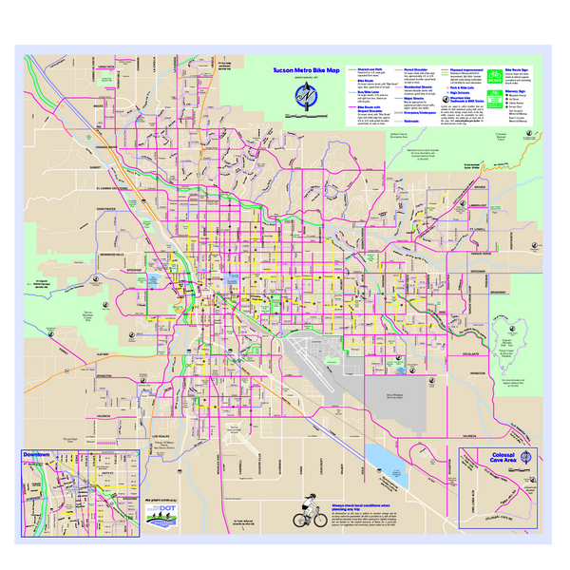
Tucson

Slide 30
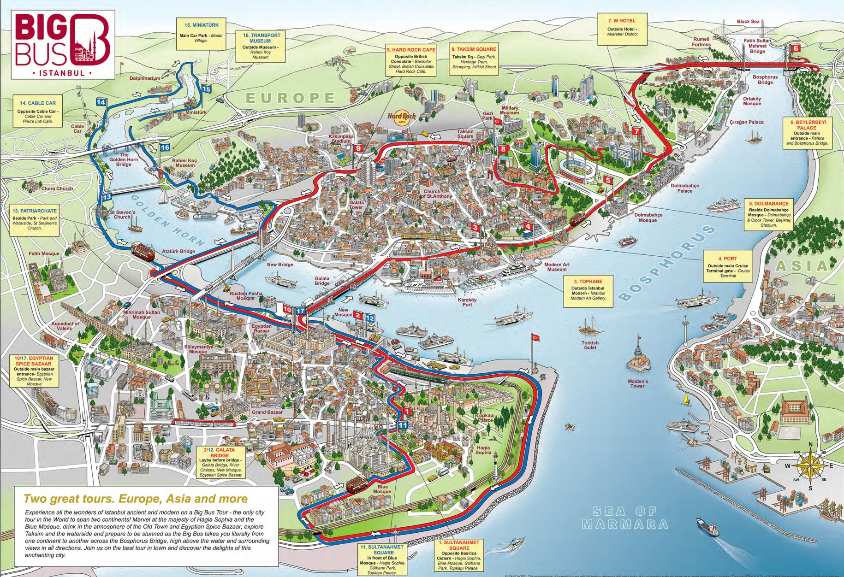
Istanbul

Slide 31
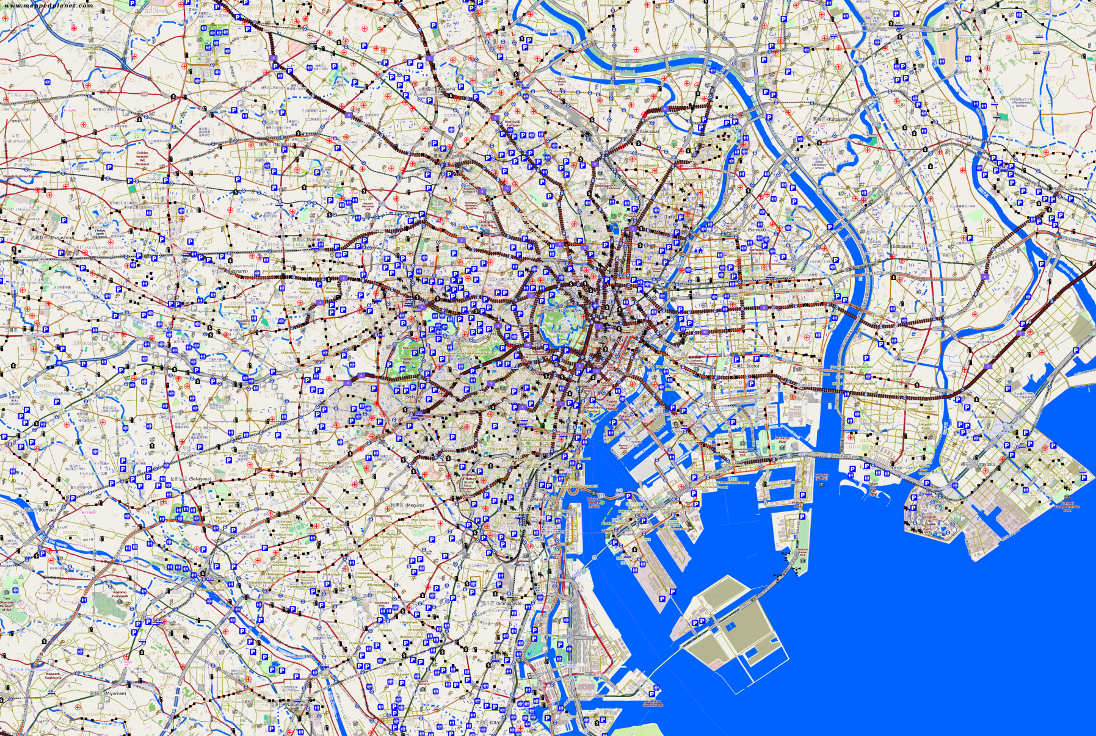
Tokyo

Slide 32
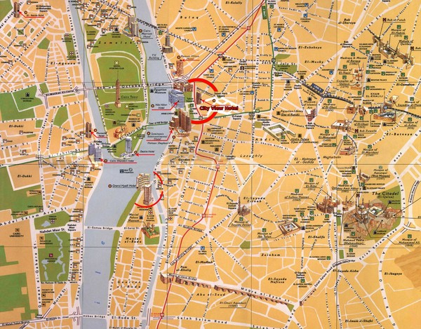
Cairo

Slide 33
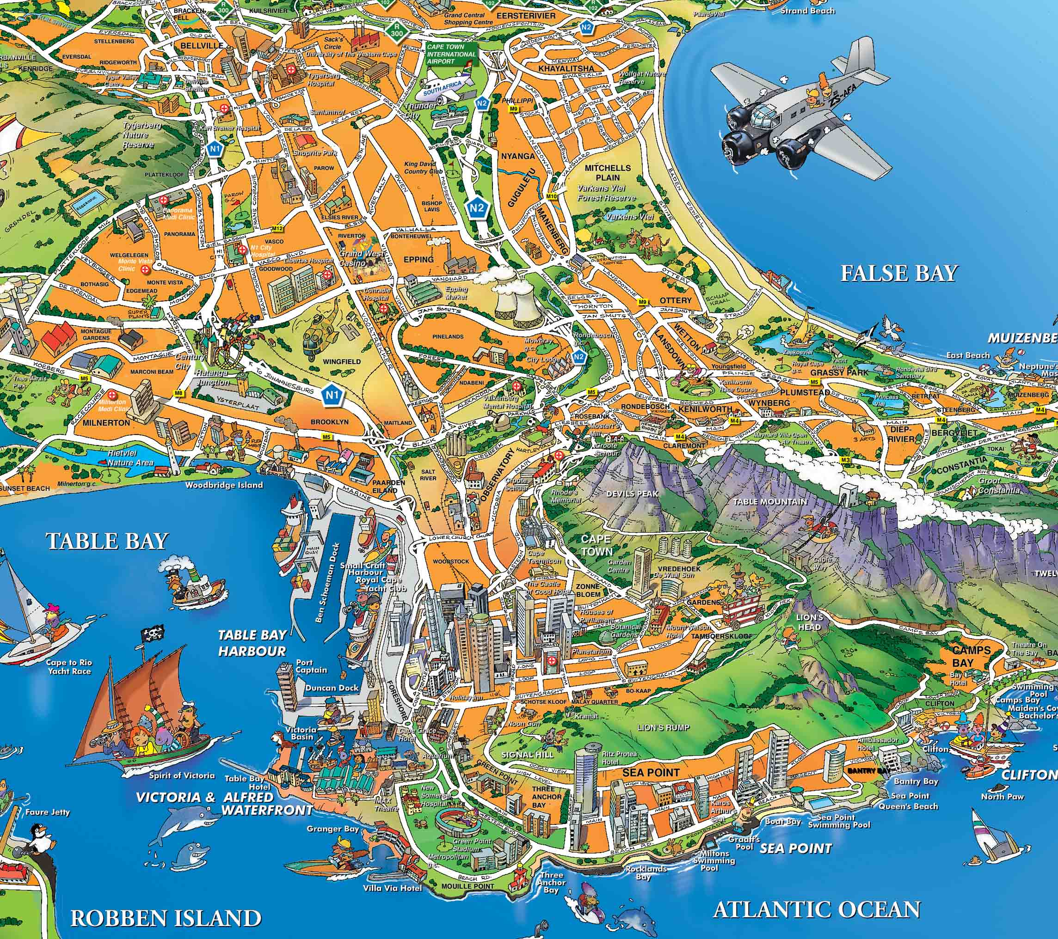
Capetown

Slide 34
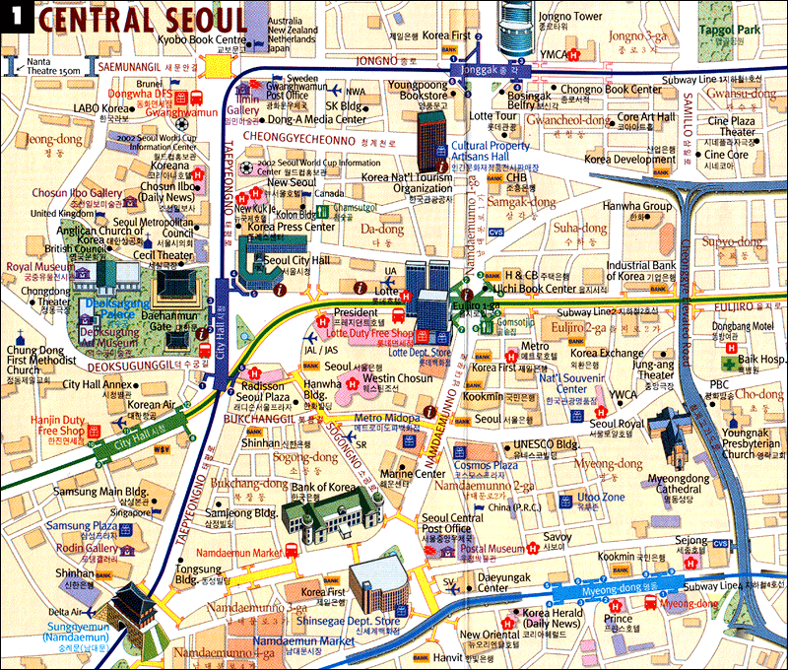
Seoul

Slide 35
4 Level Map Analysis
Do you understand the map?
Type of map, information depicted
Where do you see things? - 6
Patterns, distribution, unique things
Why there? - 6
Reasons for you Level 2 Observations
So what? - 6
Connect this to at least 3 other chapters. 3 Vocab words. What models apply?
BULLET POINTS
COMPLETE SENTENCES
Notes:
Use physical city maps of US cities – I recommend going to AAA

Slide 36
Day 2

Slide 37
Bellwork 4/12/2019
Turn to page 2 of your Urban Planning Project. List three basic and three non-basic industries that you would like to add to your ideal city.

Slide 38
Day of Silence
If you are truly participating in the Day of Silence, just proceed as usual. Thank you for caring.
Love,
Ms. Cannon

Slide 39
Do you need a ride?
Your APHG Exam on Tuesday, May 14 is in the middle of the day.
1. Right now, text your folks and ask them if they are able to take you.
2. If NOT, see me so I can get your name on a list for a bus.

Slide 40
Agenda:
Urban Planning Project – Complete Part 4 and Part 1 by the end of the period.

Slide 41
Objective:
You will be able to describe the geography of your imaginary city.

Slide 42
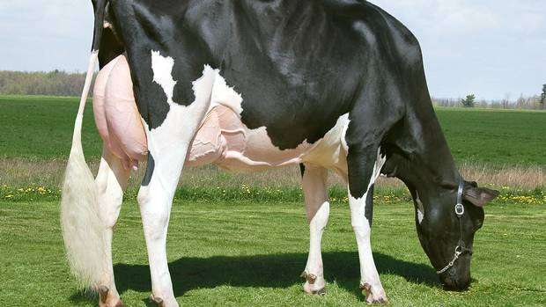
TUBI:
The most money ever paid for a cow in an auction was $1.3 million. (Her name was Missy)

Slide 43
Discuss
What are some challenges cities face as they grow?

Slide 44
Turn to page 2 of the packet
Add three Basic and three Non-Basic Industries.

Slide 45
You Have Options…
You may type your responses or print with Blue/Black Pen for your final draft.

Slide 46
Discuss
How can an urban planner make sure their city is environmentally responsible?

Slide 47
New York City

Slide 48
Washington DC

Slide 49
London

Slide 50
Tucson

Slide 51
Istanbul

Slide 52
Tokyo

Slide 53
Cairo

Slide 54
Capetown

Slide 55
Seoul

Slide 56
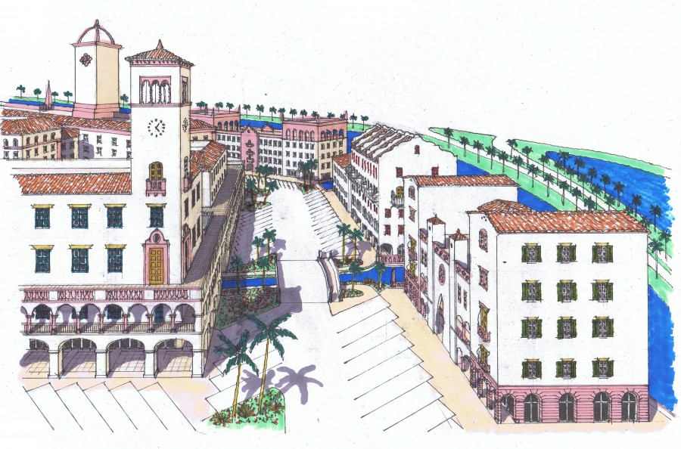
Urban Planning Project

Slide 57
Day 3

Slide 58
Bellwork 4/15/2018:
Describe 3 stereotypes associated with the suburbs.

Slide 59
Agenda
Notes: The Suburbs
Urban Planning Project
Chapter 10/11/12 Retakes need to wait until next week. If you were absent, you have this week, ONLY, to take the test!

Slide 60
Objective:
You will be able to summarize the types of urban expansion and its effects.

Slide 61
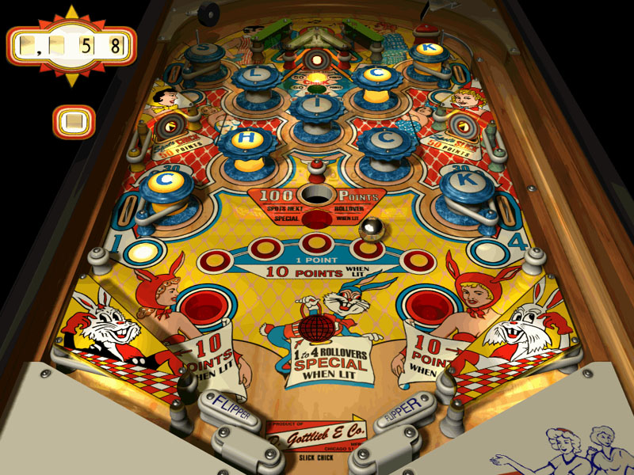
TUBI
Pinball was banned in the city until 1978. The NYPD even held “Prohibition-style” busts.

Slide 62
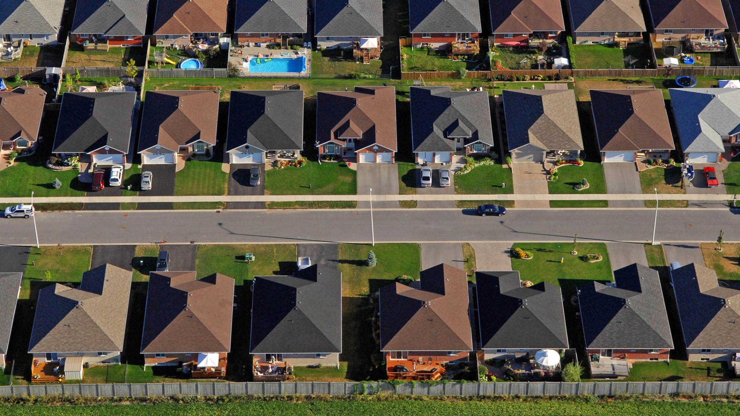
I. The Suburbs

Slide 63
What are the pictures showing? What do they have in common? What message are the following pictures trying to project? How?

Slide 64
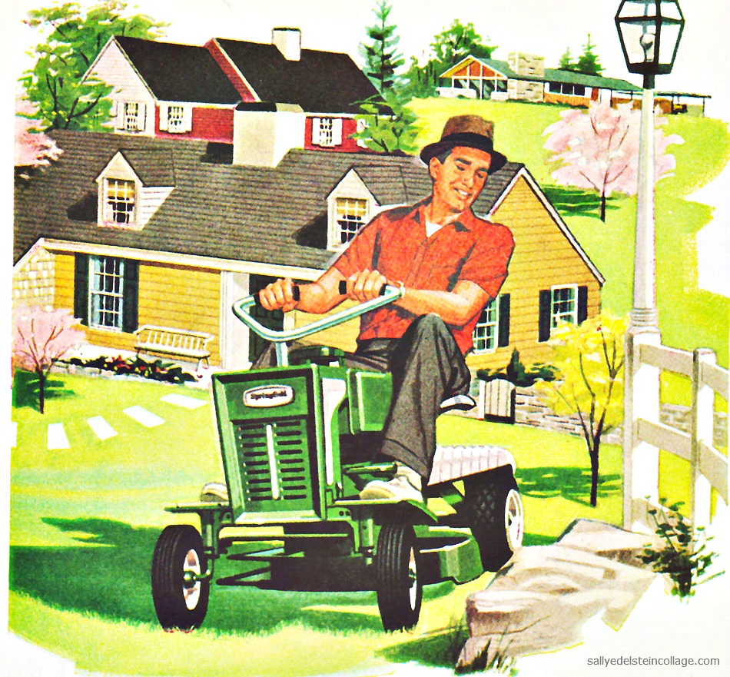

Slide 65
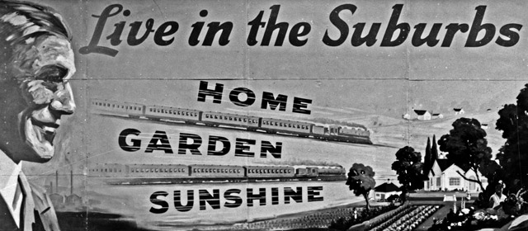

Slide 66
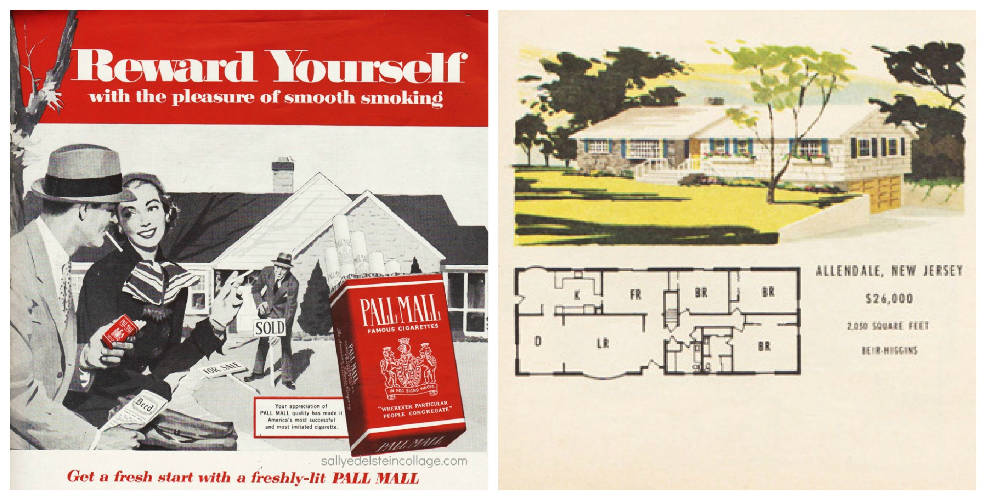

Slide 67
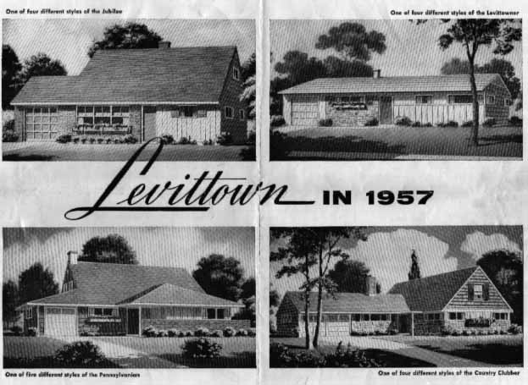

Slide 68
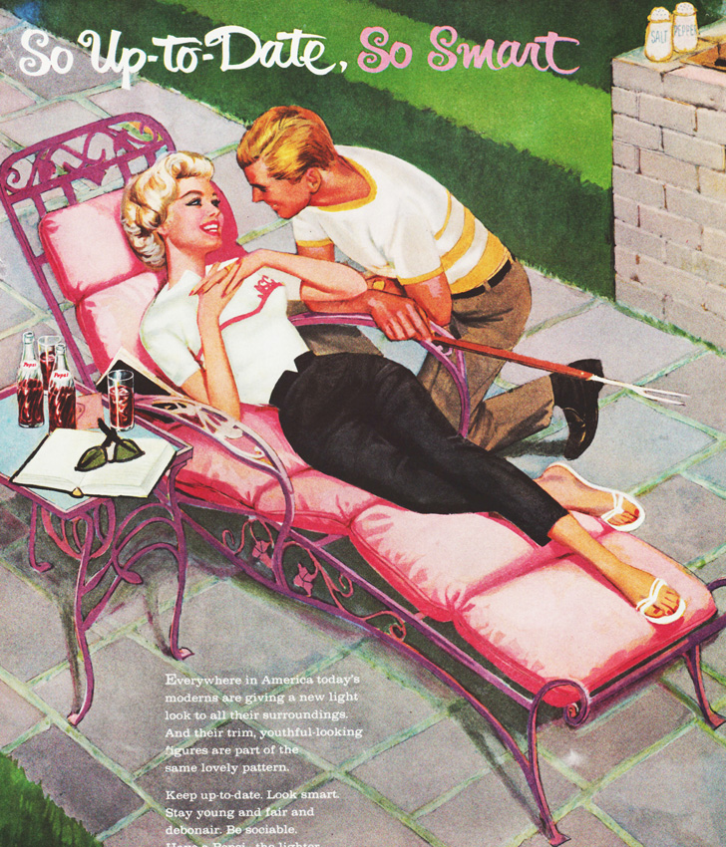

Slide 69
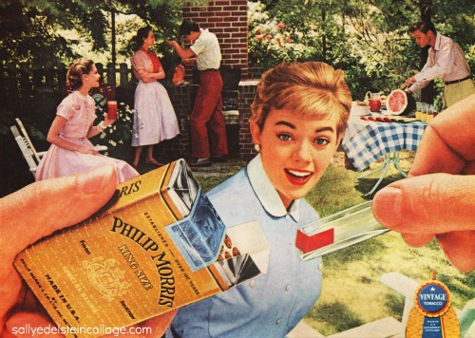

Slide 70
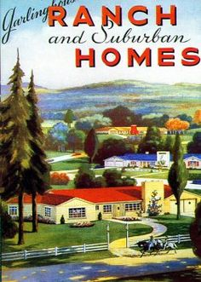

Slide 71
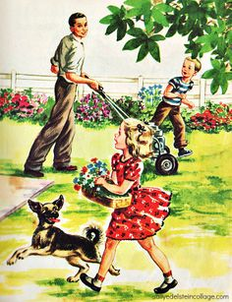

Slide 72
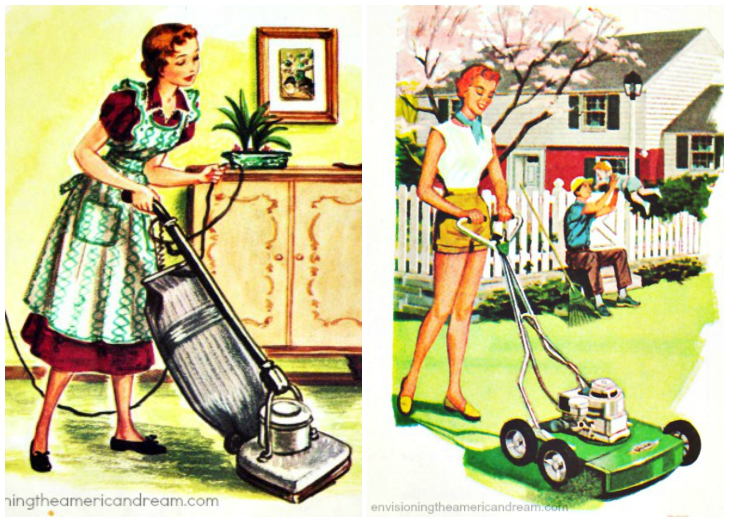

Slide 73
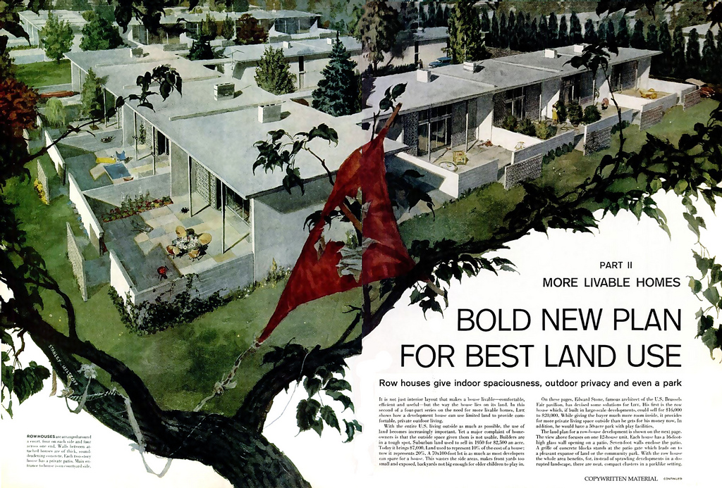

Slide 74
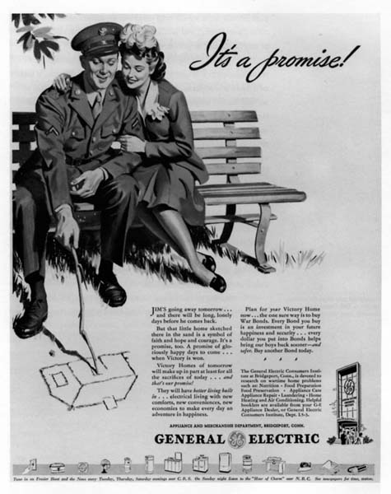

Slide 75
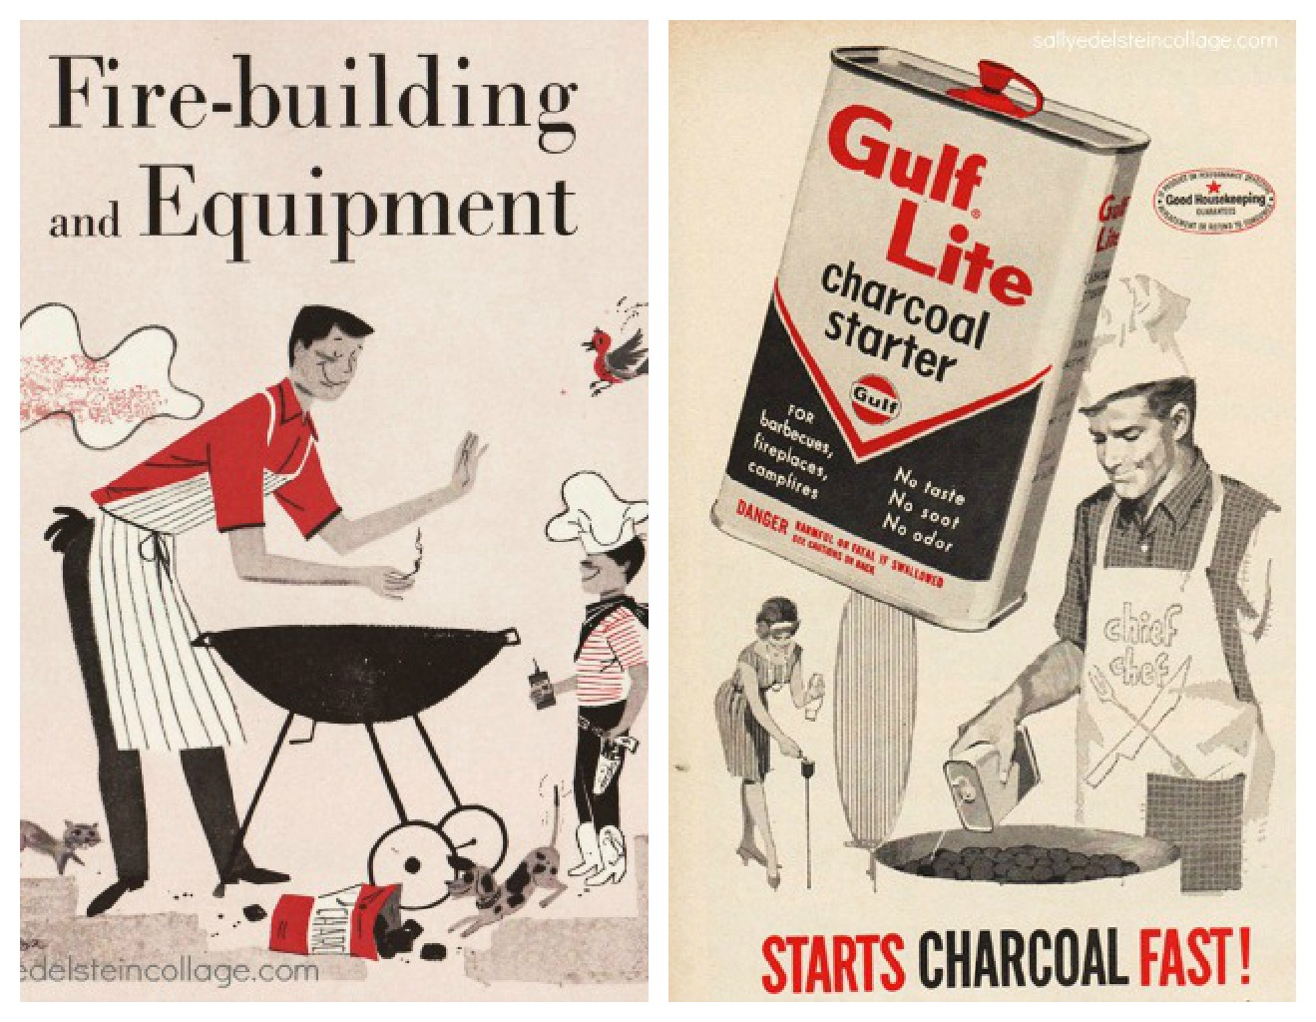

Slide 76
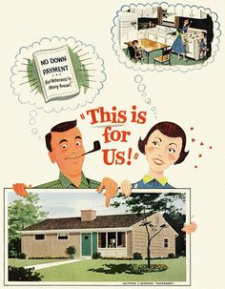

Slide 77
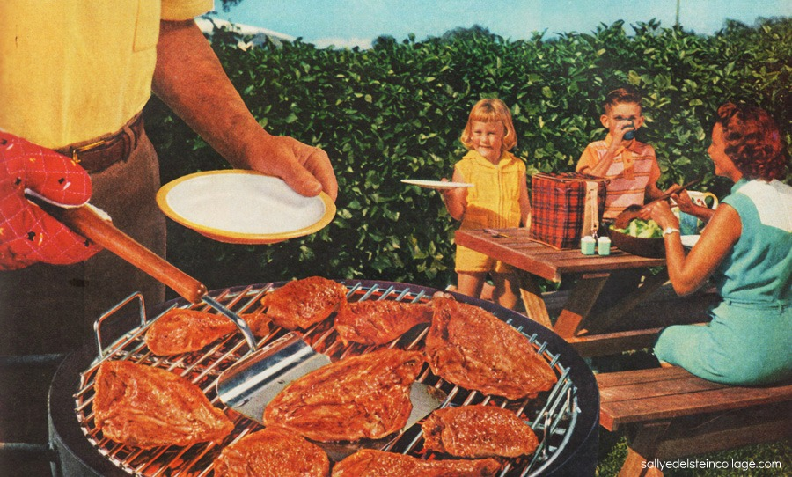

Slide 78
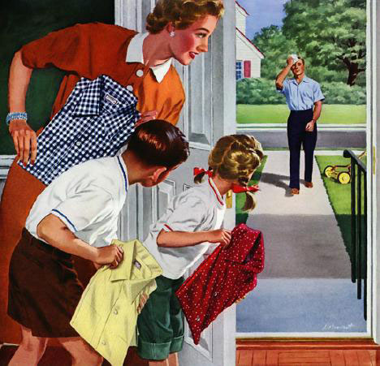

Slide 79
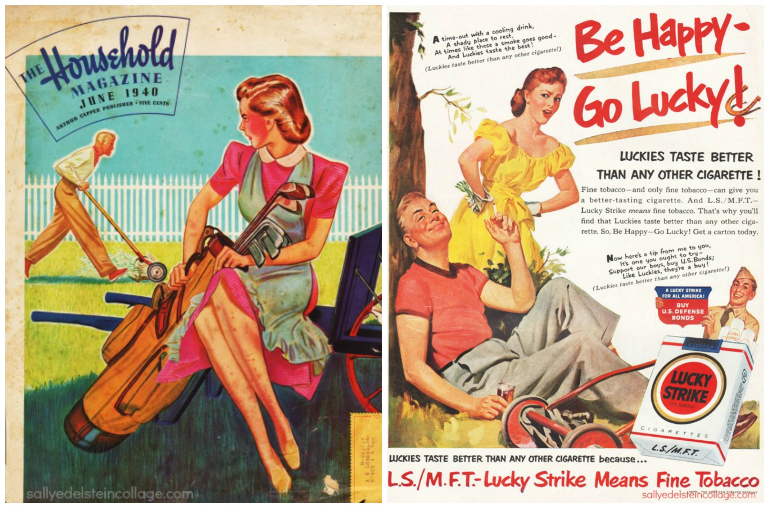

Slide 80
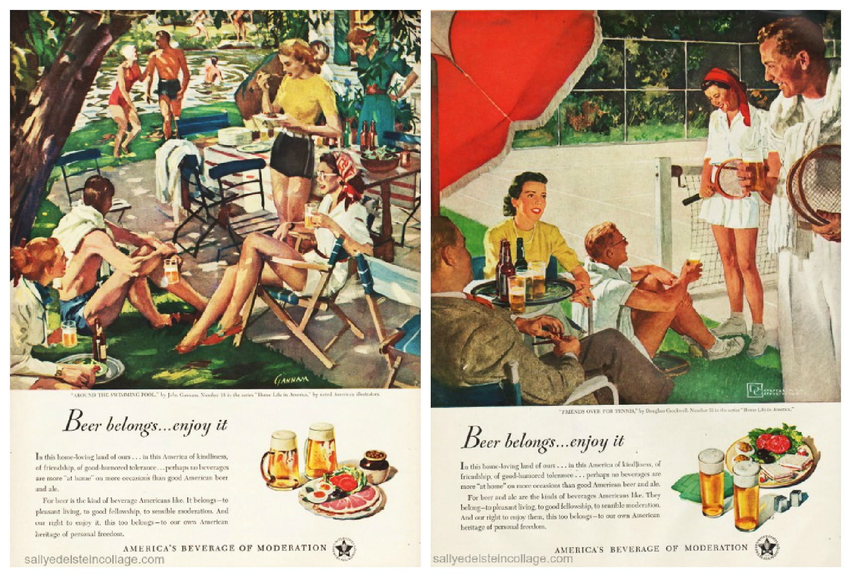

Slide 81
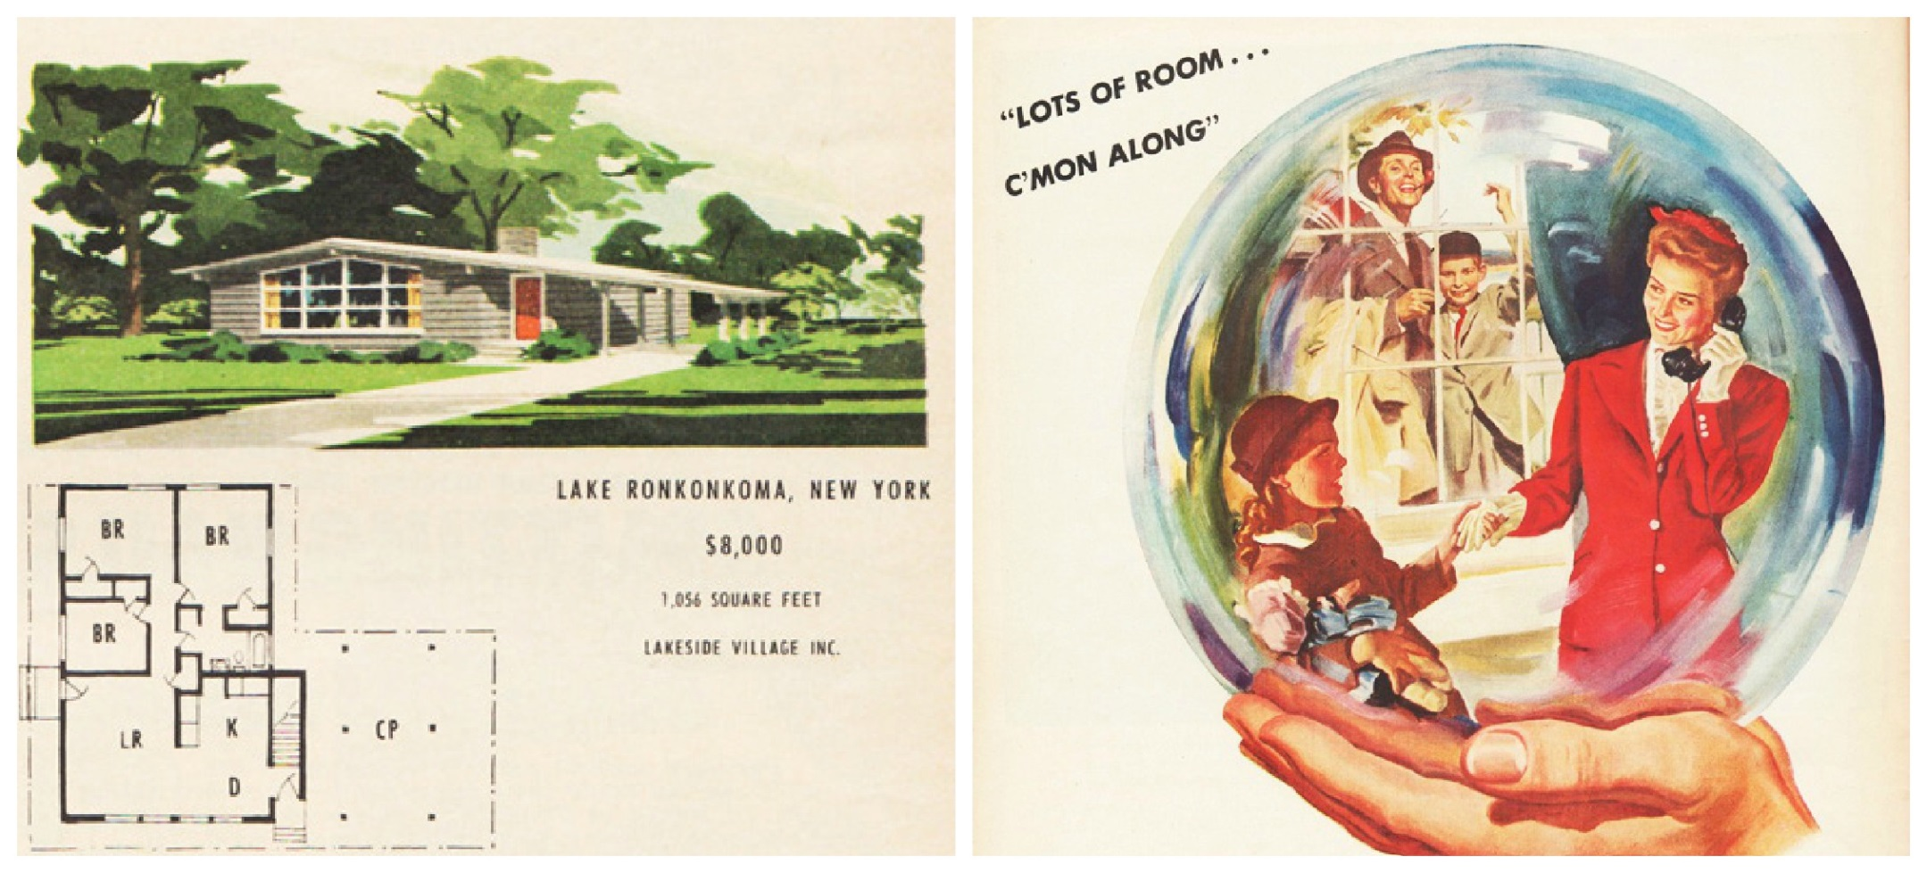

Slide 82
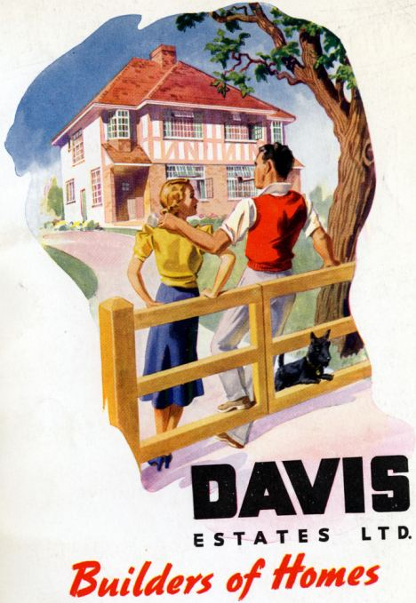

Slide 83
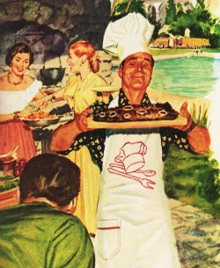

Slide 84
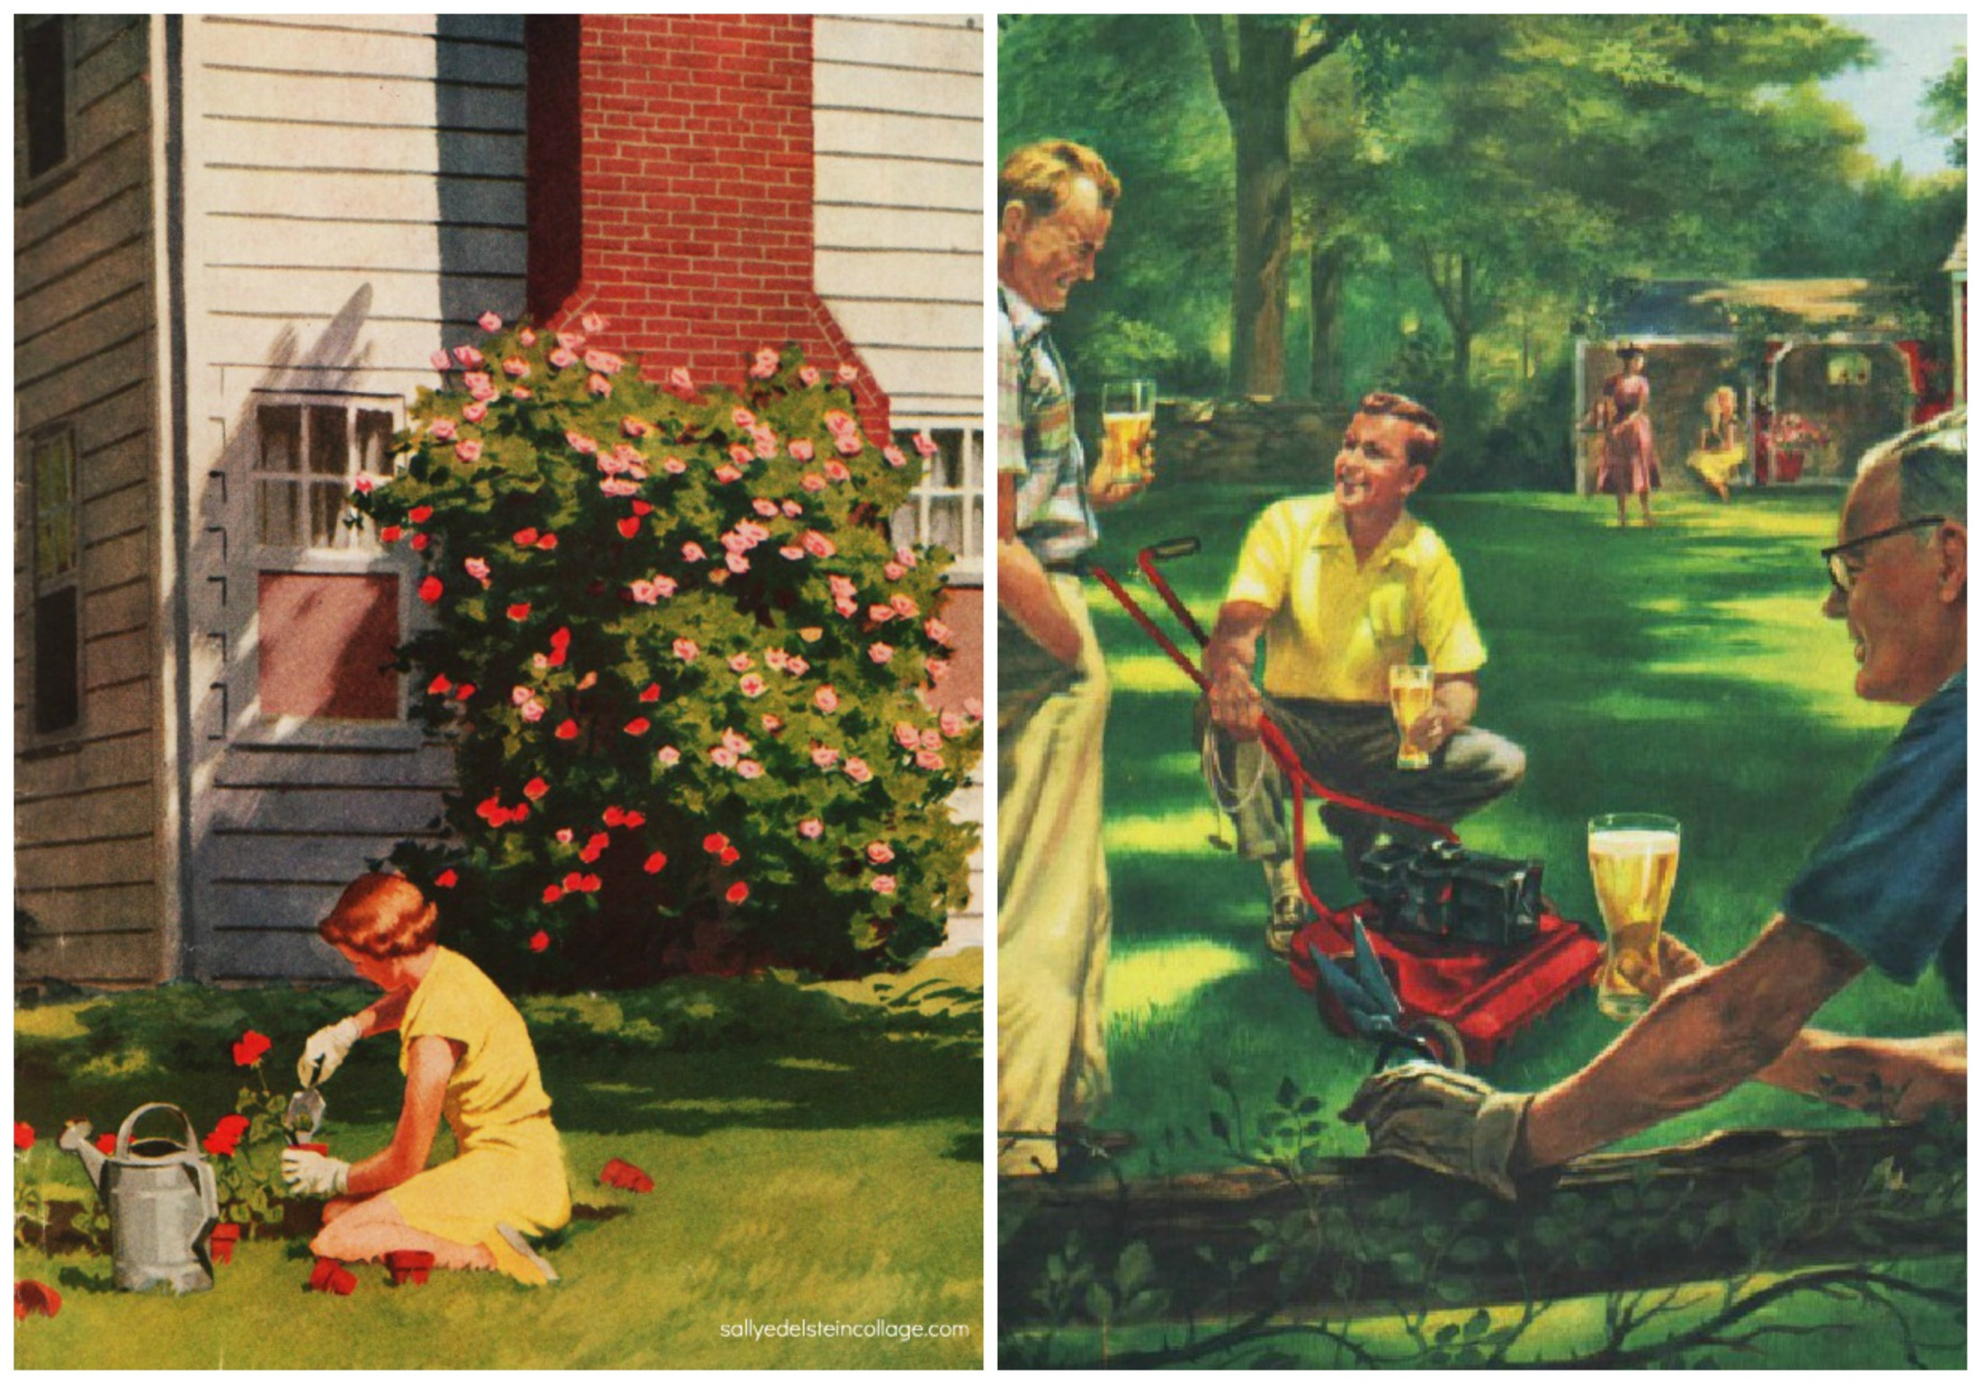

Slide 85
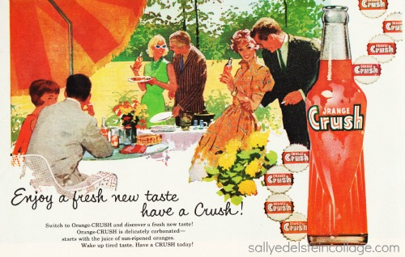

Slide 86
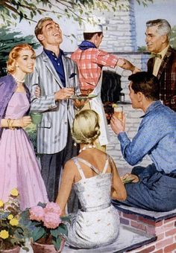

Slide 87
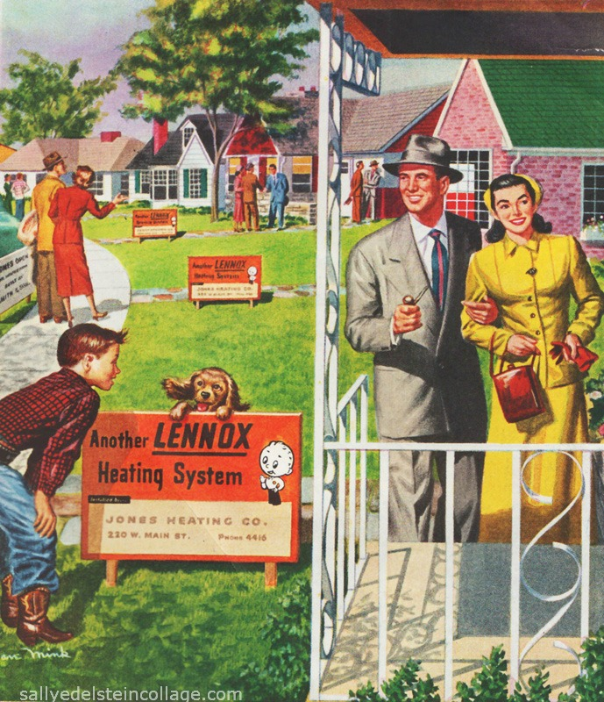

Slide 88
What are the pictures showing? What do they have in common? What message are the following pictures trying to project? How?

Slide 89
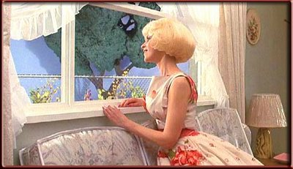
Video: Somewhere That’s Green
Notes:
https://www.youtube.com/watch?v=ouLiQ7KhmYU

Slide 90
Discuss
Why does Audrey want to live in the Suburbs?
How are the suburbs portrayed?
Do you want to live in a suburb?

Slide 91
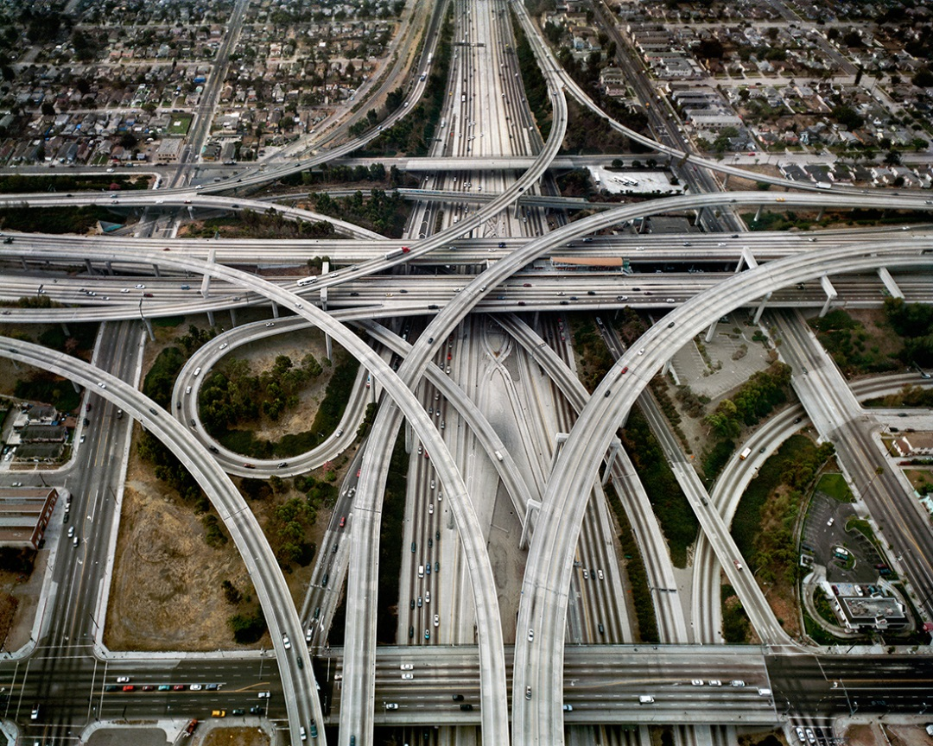
A. Urban Expansion
Conurbation: when cities grow until they meet
This forms a megalopolis

Slide 92
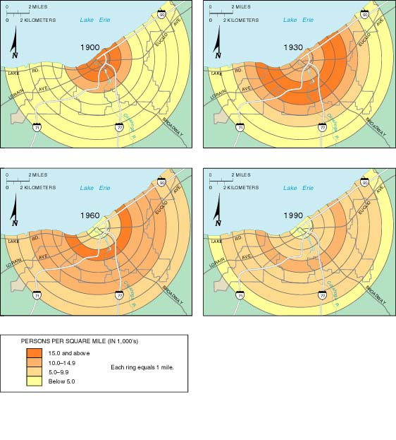
b. Density Gradient: population density changes in a city
Historically more people live in center

Slide 93
2. Suburb
Edge City: independent settlements near big cities
Annexation: legal process of adding land area to a city
Sprawl: progressive spread of development over land

Slide 94
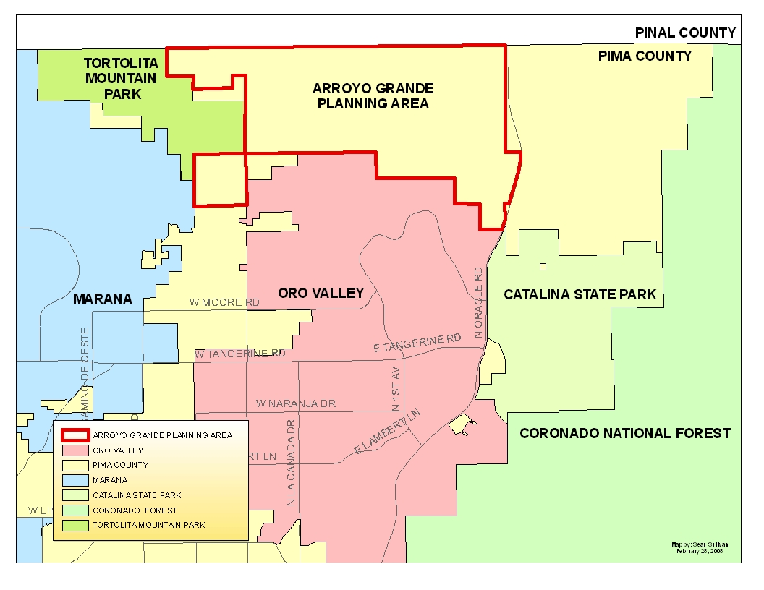

Slide 95
Discuss
What could be some possible problems arising from annexation and suburban sprawl?

Slide 96
3. Loss of open space and farm land
Greenbelts: in the UK there are rings of open space around cities, before the suburbs
Smart Growth: regulation dealing with suburban sprawl and preserving land

Slide 97
B. Problems with Suburbs
Wealthy families move out of old homes and into new ones; poorer family move into the old ones
Socio-Economic Status: someone’s economic and social position in relation to others, based on income, education, and occupation

Slide 98
2. Economics:
Consumer services move because of customers
Business services move because its cheaper
ABANDONING THE CBD

Slide 99
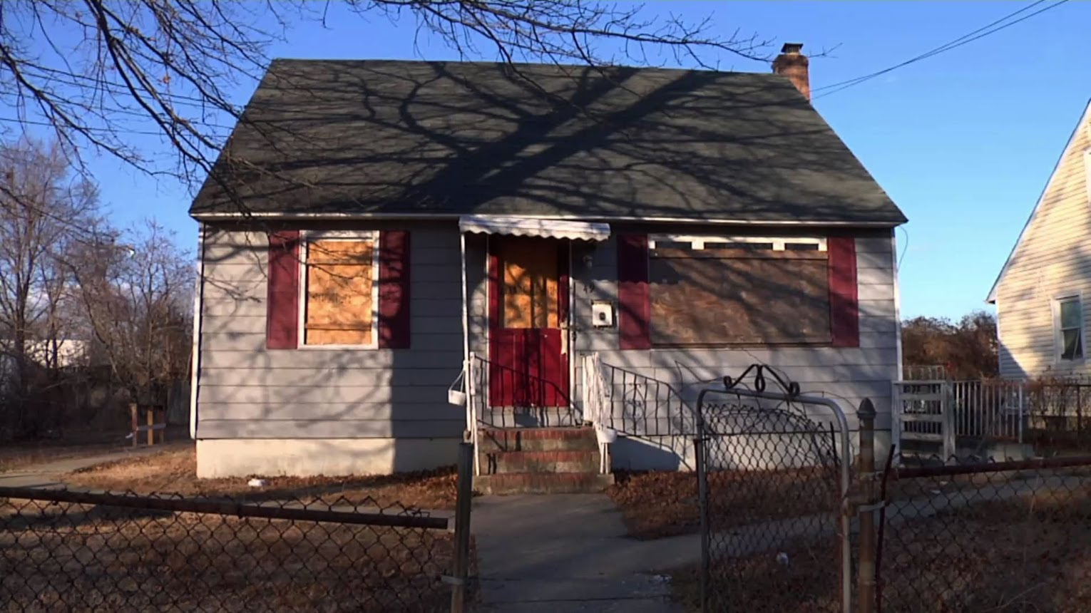
Video: Poverty in the Suburbs
Notes:
https://www.youtube.com/watch?v=qjsrdcbbPBU

Slide 100
Summary:
Explain the ways are urban centers expanding.
Describe the positives and negatives of this expansion.

Slide 101
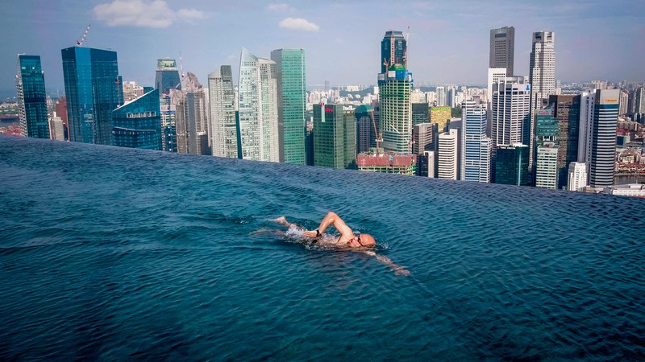
Video: How to Re-Invent the Apartment
Notes:
https://www.ted.com/talks/moshe_safdie_how_to_reinvent_the_apartment_building

Slide 102
Urban Planning Project

Slide 103
Day 4

Slide 104
Bellwork
Draw a map of Tucson.

Slide 105
Agenda:
Notes: Urban Models
Urban Planning Activity
HW: #17-24

Slide 106
Objective:
You will be able to summarize the different urban models.

Slide 107
TUBI
Vladimir Putin has porridge for breakfast.

Slide 108
I. Urban Models

Slide 109
Bid Rent Curve
the price and demand for real estate change as the distance from the CBD increases
retail wish to maximize profit, so they will pay more for land close to the CBD
The more accessible an area the more profitable.
the greater the concentration of customers

Slide 110
Bid Rent Curve
RENT
Distance from CBD

Slide 111
B. Urban Models in the US
Concentric Zone Model
Burgess (1920’s); Chicago
CBD
Zone In Transition: Industry and poor housing
Zone of working class housing
Zone of middle class housing
Commuter zone

Slide 112
DRAW THIS!!
CBD
Zone In Transition
Working Class housing
Middle Class Housing
The Suburbs

Slide 113
2. Sector Model:
Hoyt (1940’s); Calgary, Canada
Cities don’t develop in neat rings!
Social groups form sectors (wedges) coming out of the CBD

Slide 114
DRAW THIS

Slide 115
3. Multiple Nuclei Model:
Harris and Ullman (1945); LA
Cities don’t have just one center of activity! They have multiple nodes!
Activities are attracted and repulsed by particular nodes

Slide 116
DRAW THIS

Slide 117
4. Peripheral Model
Harris (1960-1990); Detroit
A highway around the city links it to the suburbs (peripheral zone)
Most life happens in the periphery! But CBD still necessary

Slide 118
DRAW THIS

Slide 119
5. Urban Realms Model
Vance (1960’s); Phoenix
Cities are made up of independent region/realm
Each one has its own CBD

Slide 120
DRAW THIS

Slide 121
Which model do you think Tucson fits?

Slide 122
C. Urban Models Everywhere Else
Europe
OLD cities; narrow streets
Center might be a church or public space
Wealthy people still live in the center of cities
Suburbs have high rises and crime

Slide 123
MEDIEVAL CITY
WEALTHY HOUSING
TOURISM
CBD
SUBURBS
SLUMS

Slide 124
Paris

Slide 126
2. Developing Countries
Latin American Cities
Church and Plaza at center
Wealthy live in the center, poor in the periphery
Combines concentric and sector models
CBD/industrial spine

Slide 127
DRAW THIS
INDUSTRY
CBD
HOUSING

Slide 128
Mexico City

Slide 130
b. Southeast Asia
No clear CBD
Usually the center is an old colonial port
Uneven growth

Slide 131
Draw this
INDUSTRY
POOR
MIDDLE
RICH
CBD

Slide 132
Ho Chi Minh

Slide 134
c. Sub Saharan Africa City Model
3 CBD (Colonial, Traditional, and Market)
Least urbanized region
The biggest cities in Africa were set up by Europeans

Slide 135
Draw this
CBD
INDUSTRY

Slide 136
Dar Es Salaam

Slide 138
Discuss
The world is becoming more and more urbanized.
Which urban model will allow for the growth of cities most effectively? Why?

Slide 139
Summary
Describe the population distribution differ for the various urban models.
Explain how the models in developing countries different from those in Europe or North America.

Slide 140
Urban Planning Activity

Slide 141
Day 5

Slide 142
Bellwork
What are some challenges the city of Tucson faces?
What are some ways it can respond to those problems?

Slide 143
Agenda
Notes: Challenges for Cities (LAST DAY OF NOTES!!!)
HW: #25-32

Slide 144
Objective
You will be able to explain the way demographic changes and migration influences challenges for cities.

Slide 145
TUBI
Rio de Janeiro has a population density of 12,382 persons per square mile.

Slide 146
I. Challenges for Cities

Slide 147
A. Borchert’s Epochs
American urbanization has changed over time because of transportation changes

Slide 148
2. The Evolution of Transport
Sail-Wagon Epoch (1790–1830), cities grow near ports and major waterways
Iron Horse Epoch (1830–70), steam engine technology, steamboats and regional railroad networks

Slide 149
c. Steel Rail Epoch (1870–1920), development of a national railroad network;
d. Auto-Air-Amenity Epoch (1920–70), gasoline combustion engine; cars
e. Satellite-Electronic-Jet Propulsion (1970–?), AKA High-Technology Epoch

Slide 151
In your notes define white flight and ethnic neighborhood.

Slide 152
B. Deterioration
Redlining: banks draw lines on a map to show where they won’t lend money
TECHNICALLY ILLEGAL

Slide 153
2. Public Housing: housing for low income households subsidized by government
Unsafe! (ignored and crime flourishes)
3. Ethnic Neighborhoods
Chinatown, Ghetto, Barrio

Slide 156
Video: In the Heights
Notes:
https://www.youtube.com/watch?v=86zg3y1NMDQ

Slide 157
4. Squatter Settlements:
Informal communities without a legal tie to the land without services
Favela – Brazil
Megacities have HUGE squatter settlements
Rio de Janeiro, Sao Paulo, Mexico City, Bangkok, Cairo, Lagos, Mumbai

Slide 162
Discuss
What can and should cities do about massive squatter settlements?

Slide 163
4. Zoning: a city designates land different purposes such as residence and business and manufacturing etc

Slide 165
C. Gentrification
Gentrification: process where middle class people move in to inner city neighborhoods and renovate
Urban Renewal: clearing and redevelopment of urban slums

Slide 166
Discuss
What could be some pro’s and cons of gentrification?
What do you think the people who already live there think?

Slide 171
4. Underclass: inner city residents trapped in a cycle of economic and social problems
Poor public services (health, education, police)
No education? No good jobs
No good jobs = no money
No money, makes crime appealing

Slide 172
6. Economic Consequences
Eroding tax base
Low income areas = fewer dollars from taxes
Reduce services
Raise tax revenue by attracting businesses with subsidies (invite gentrification, maybe force the poor to leave)

Slide 173
Discuss
To help break the cycle of poverty, you need to increase the number and quality of services in the inner city.
But that costs money (tax payer money, often.)
What do you think we should do?

Slide 174
D. New Urbanism
A planning and development approach based on the principles of how cities and towns had been built for the last several centuries: walkable blocks and streets, housing and shopping in close proximity, and accessible public spaces.

Slide 175
2. Goals
Walkability
Connectivity
Mixed Use Buildings
Diversity of people – age, income, culture
Quality Architecture
Traditional Neighborhood Structure
Increased Density
Green Transportation
Sustainability

Slide 176
Summary
Describe the challenges faces by cities. Identify problems that face cities in LDC’s or MDC’s.
Explain the way demographic changes and migration influences challenges for cities.

Slide 177
Video: Future of Cities
Notes:
https://www.ted.com/talks/alex_steffen

Slide 178
Day 6

Slide 179
Bellwork
Identify and define all the different types of regions.

Slide 180
Agenda
Vote – Urban Planning Project
Quiz
HW: Study for AP

Slide 181
Urban Planning Project Voting
Get out a piece of paper
Select your top 5 favorite cities. For your top 3, write a three sentences explaining what you liked about each one.
TOP 5 CITIES:
Explanation:
City 1:
City 2:
City 3:

Slide 182
Quiz
Write Clearly

Slide 183
Day 7

Slide 184
Bellwork
How does transportation affect urbanization?

Slide 185
Agenda
2 Practice FRQ
Urban Planning Project (DUE THURSDAY)
HW: Study, Urban Planning Project

Slide 186
Objective
You will be able to explain the ways railroad and highway systems influenced patterns of urban growth in the United States.

Slide 187
TUBI
The name “hamburger” actually came from Hamburg, the second largest city in Germany. In the late 1700s, sailors who traveled between Hamburg and New York City often ate hard slabs of salted minced beef, which they called “Hamburg steak.”

Slide 188
FRQ
Plan for 10 minutes
Write for 35 minutes
Done? Turn in

Slide 189
Score FRQ

Slide 190
Urban Planning Project

Slide 191
TED TALKS: https://www.ted.com/topics/cities

