Slide 1
AP Human Geography
Chapter 3: Migration

Slide 2
Day 1

Slide 3
Bellwork
Take out your phone and go to
https://bit.ly/OLLGEOG
If your phone can't connect to internet, use a friend's when they're done

Slide 4
Agenda:
Ch. 3 KBAT
Notes: Introduction to Migration
Top 10 Migrations
HW: Map, #1-5

Slide 5
Objective:
You will be able to describe the way geography influenced the movement of early humans.

Slide 6
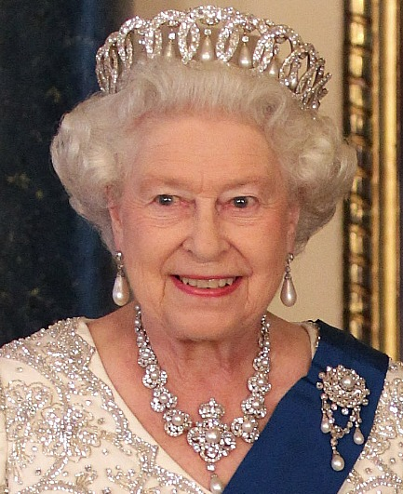
TUBI
Queen Elizabeth II of England is now the longest serving monarch

Slide 7
Chapter 3: Migration

Slide 8
I. Introduction to Migration

Slide 9
Vocab
Migration: permanent move to somewhere new
Emigration: migration from a
Location
3. Immigration: migration to a
newplace

Slide 10
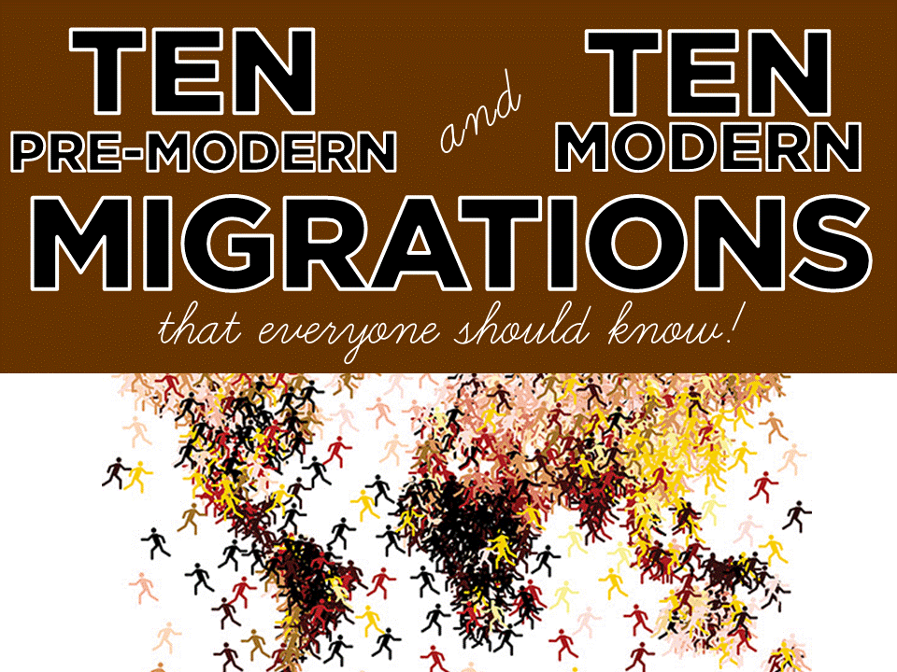

Slide 11
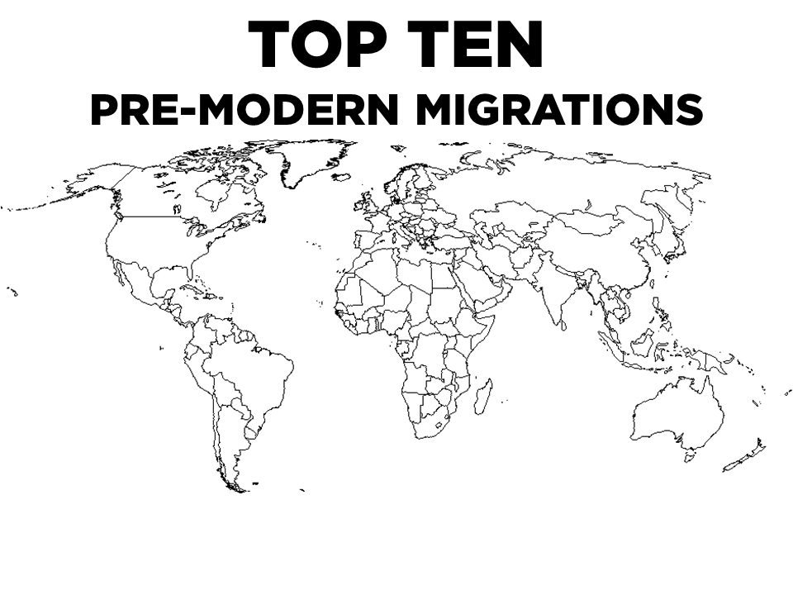

Slide 12
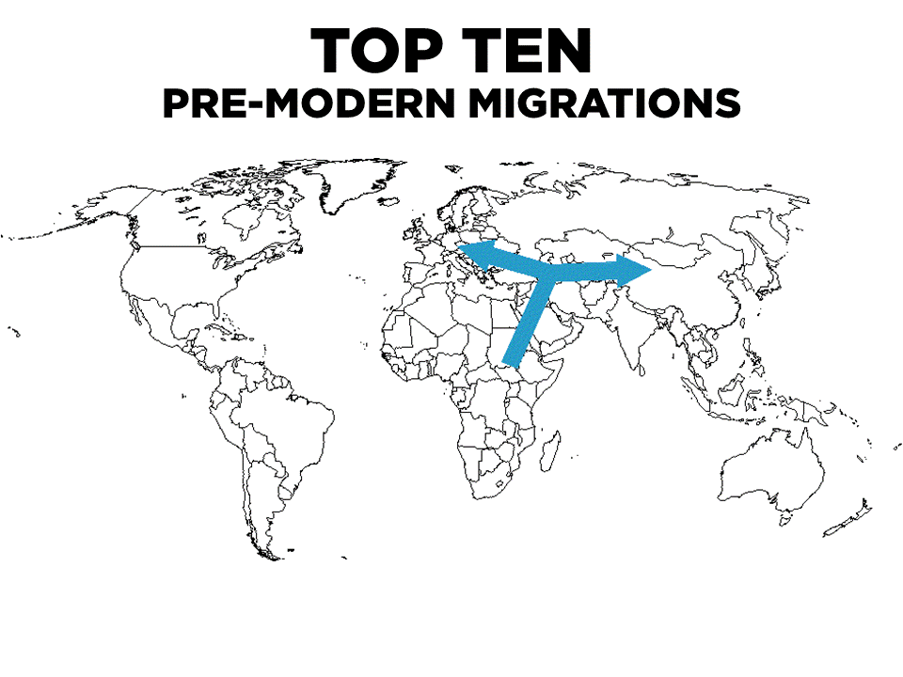
Notes:
Out of Africa to Eurasia

Slide 13
Notes:
Asia to Australia

Slide 14
Notes:
Eurasia across the Bering Strait to the Americas

Slide 15
Notes:
From North America to South America

Slide 16
Notes:
From Southeast Asia to Pacific Islands

Slide 17
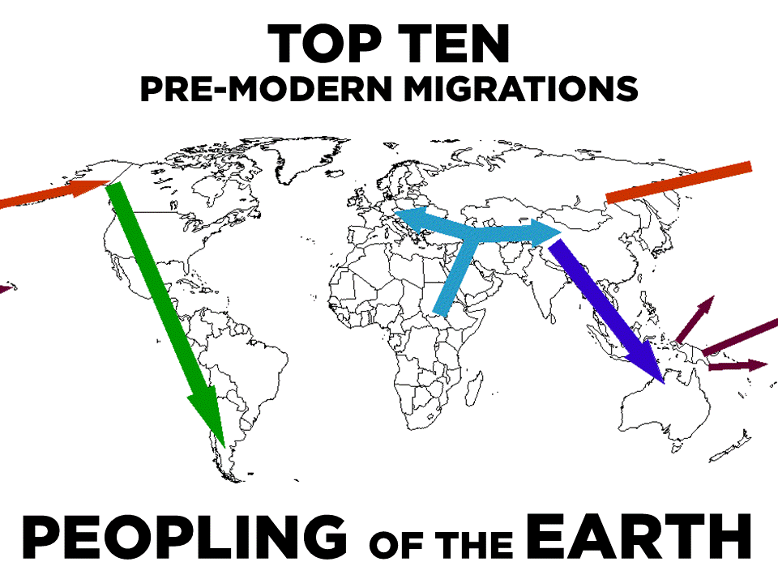

Slide 18
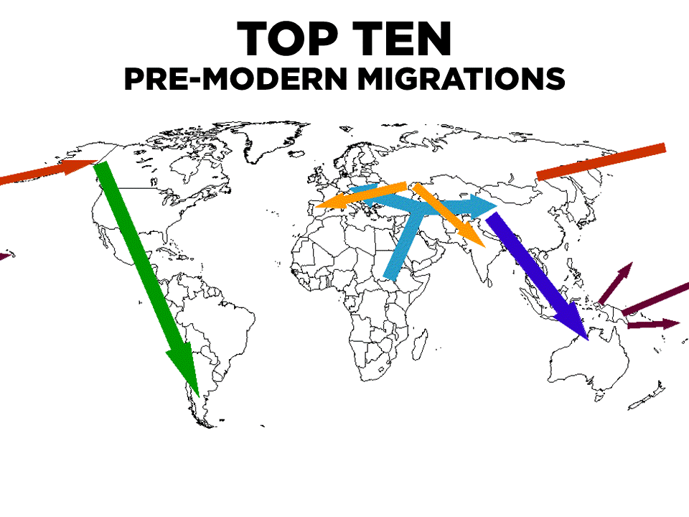
Notes:
Aryans from Central Asia to Western Europe and India

Slide 19
Notes:
Bantu Migration – Nigeria to Sub-Saharan Africa

Slide 20
Notes:
Celtic – Eastern Europe to Western Europe

Slide 21
Notes:
Muslim Empire – Mecca across North Africa

Slide 22
Notes:
Romani – India to Europe

Slide 23
Video: Pre-Modern Migration

Slide 24
Discuss
How did geography influence the movement of early people?
How do you think it will affect how they develop?

Slide 25
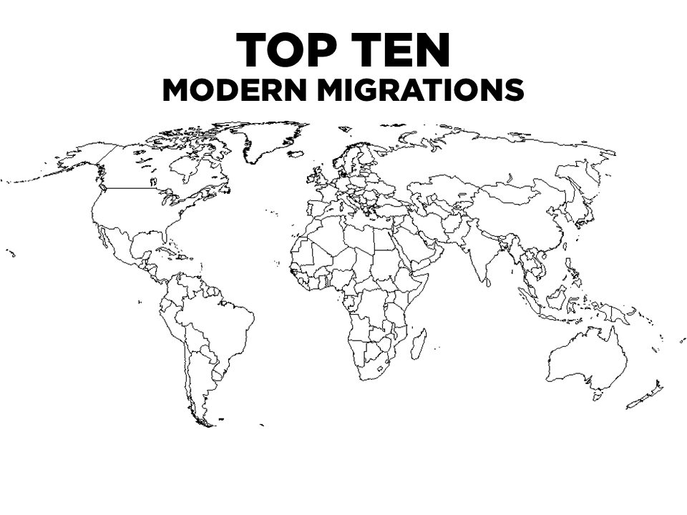

Slide 26
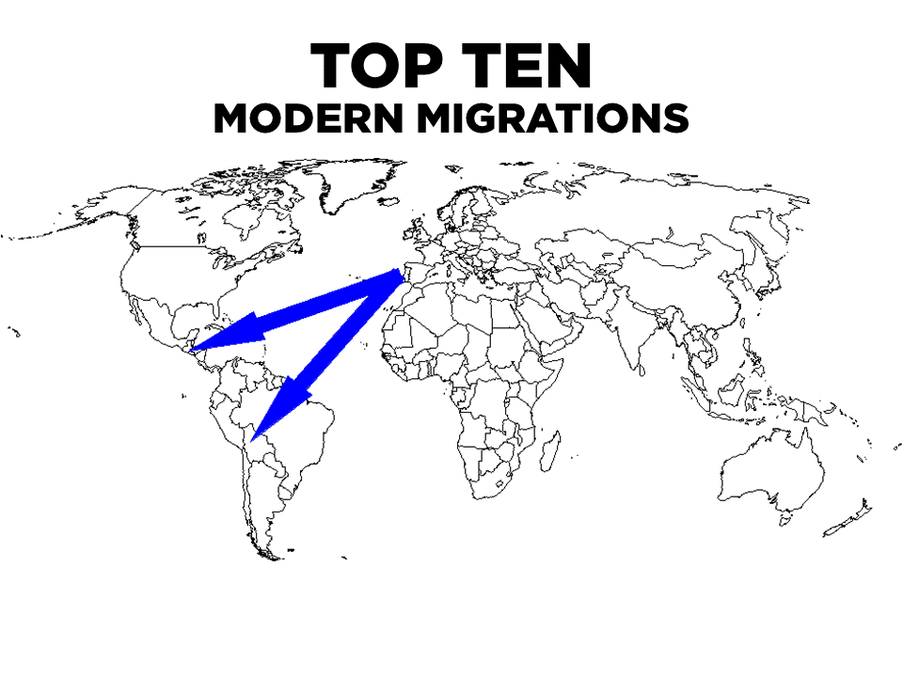
Notes:
Columbus – Iberian Peninsula to Central and South America

Slide 27
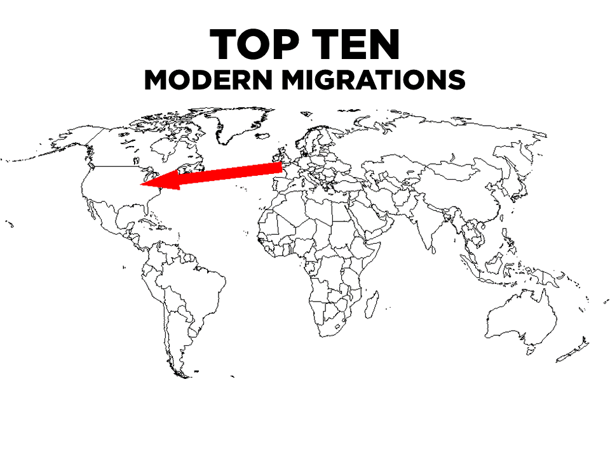
Notes:
UK to North America

Slide 28
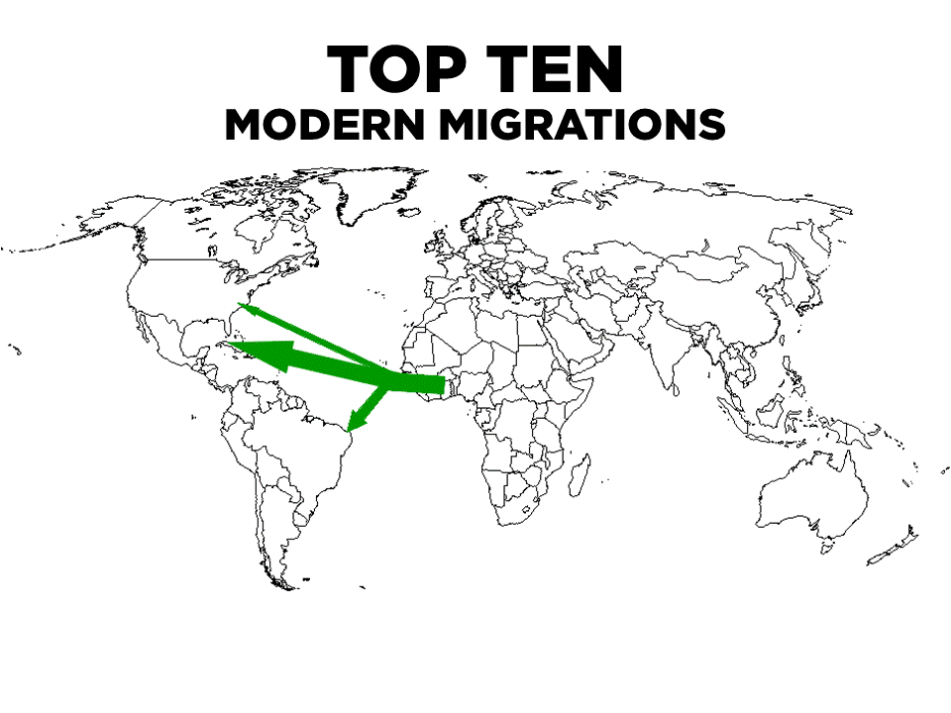
Notes:
Slave Trade – Africa to Americas

Slide 29
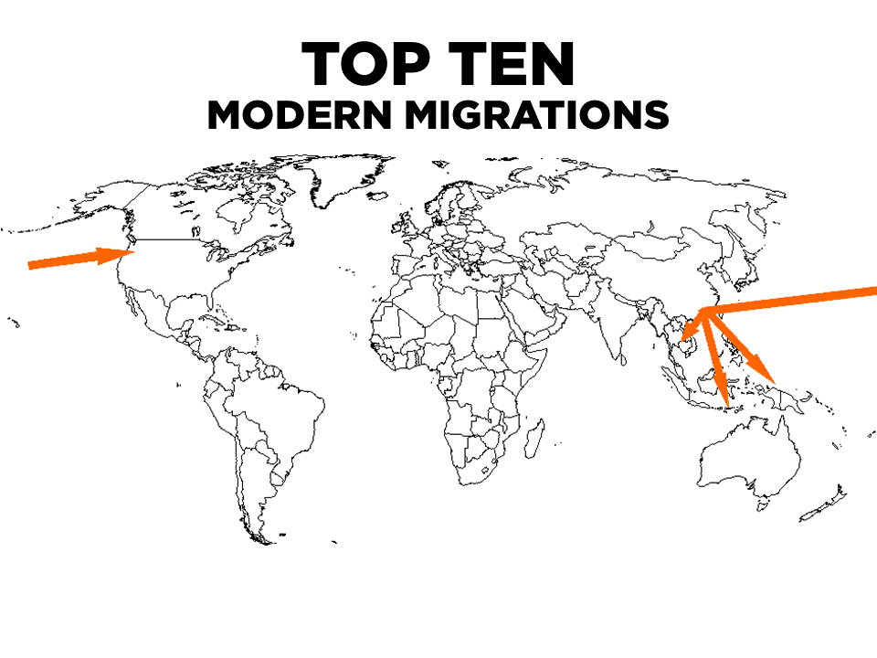
Notes:
Chinese 1800’s – China to Southeast Asia and Americas

Slide 30
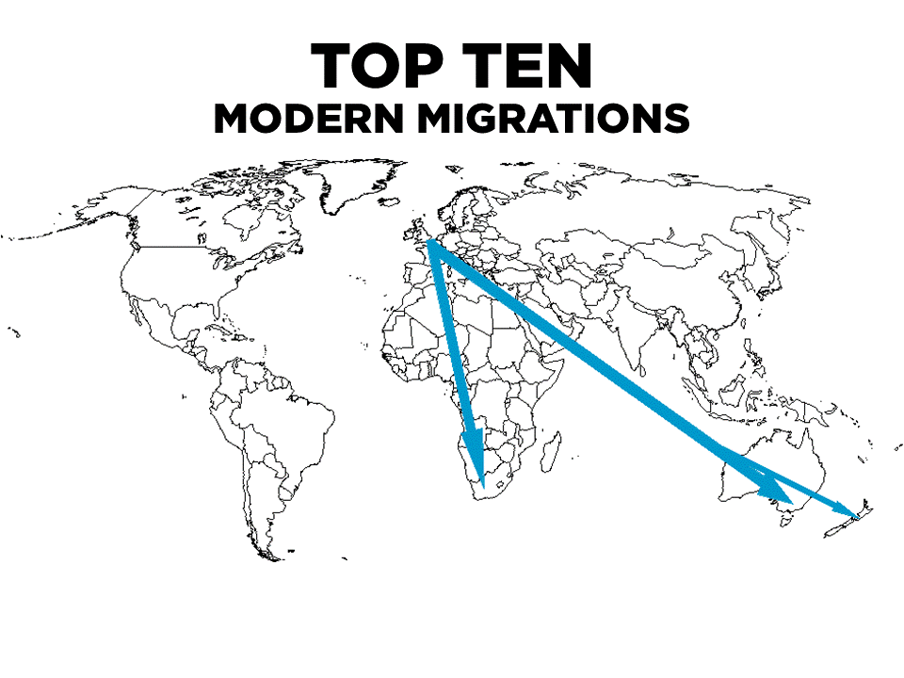
Notes:
Brits to South Africa, Australia and New zealand

Slide 31
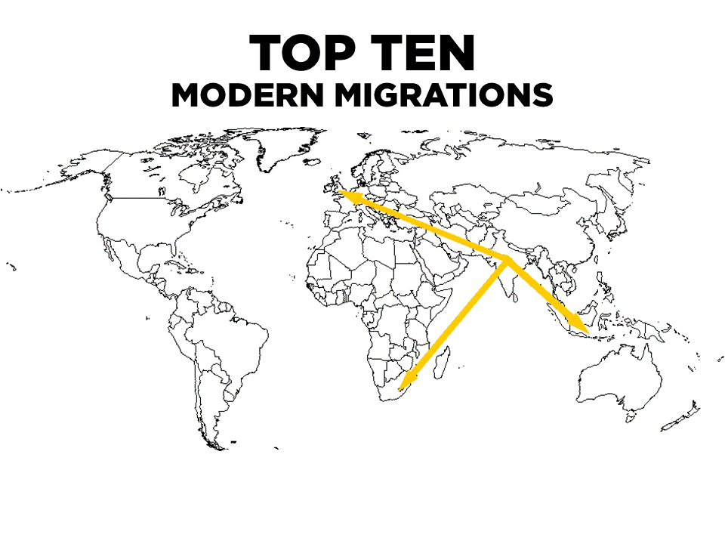
Notes:
India to UK, South Africa and Australia

Slide 32
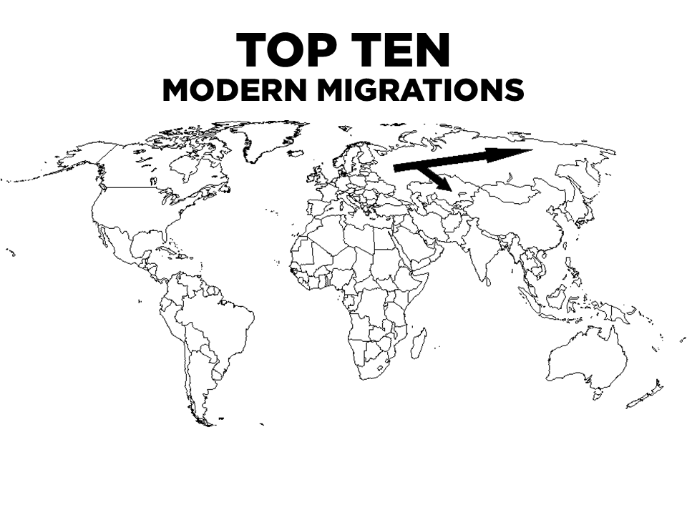
Notes:
USSR – Russia goes east

Slide 33
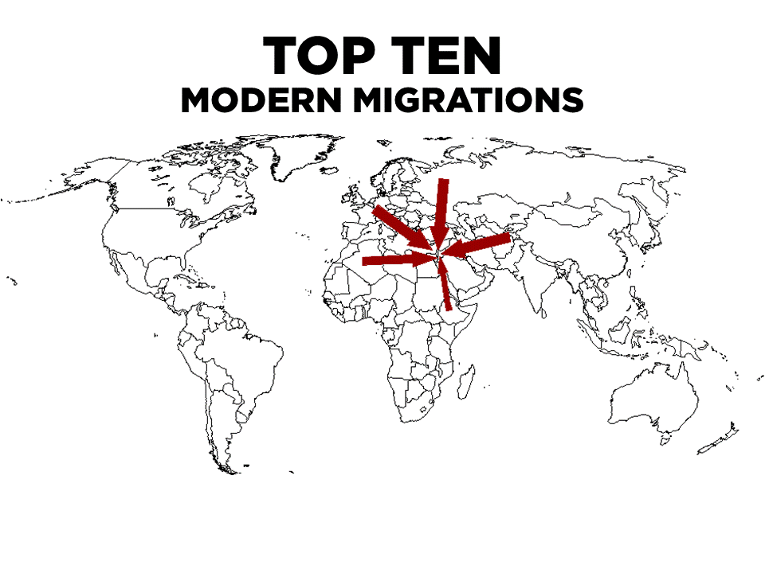
Notes:
Jews from Europe/North Africa/Middle East to Israel

Slide 34
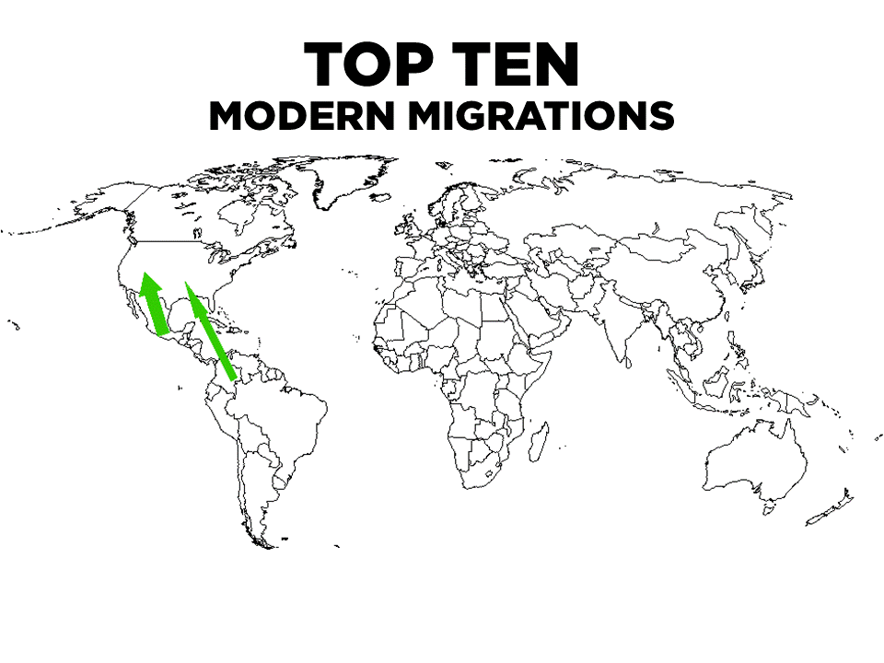
Notes:
20th century Latin America to USA

Slide 35
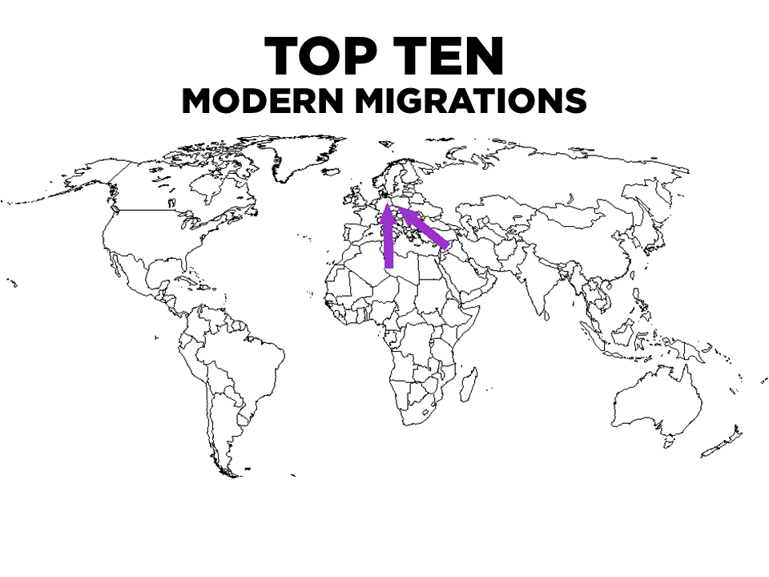
Notes:
Refugees – North Africa and Middle East to Europe

Slide 36
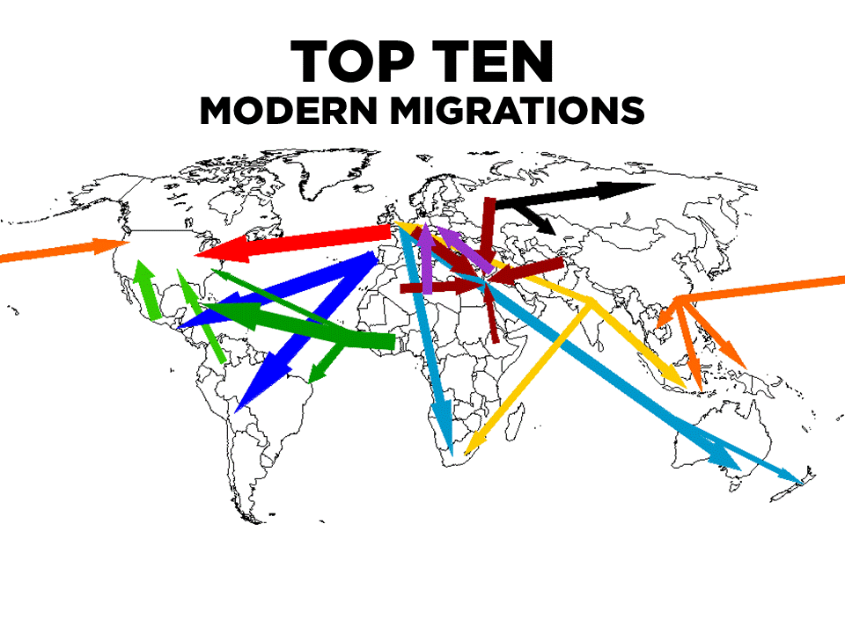

Slide 37
Video: Modern Migration

Slide 38
Discuss
In general, what are the reasons that people migrate to a new place?
Do you see any patterns?

Slide 39
Summary:
Describe the way geography influenced the movement of early humans.
Identify a reason that people move to a new place.

Slide 40
Day 2

Slide 41
Bellwork
Has your family, or someone you know, ever moved?
From where to where? Why move?

Slide 42
Agenda:
Notes: Migration Distribution
HW: Map, RQs #6-10

Slide 43
Objective:
You will be able to describe the motivations for people to migrate on a international and domestic scale in writing.

Slide 44
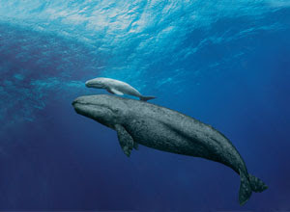
Fun Fact of the Day
Baby Blue Whales are born weighing 3 tons (6,000lbs) and gain an extra 200lbs per day during their first year of life

Slide 45
I. Migration Distribution

Slide 46
Lee’s Migration Model
Push/Pull factors: things that cause people to move
Intervening obstacle: an environmental or political thing that stops migration

Slide 47
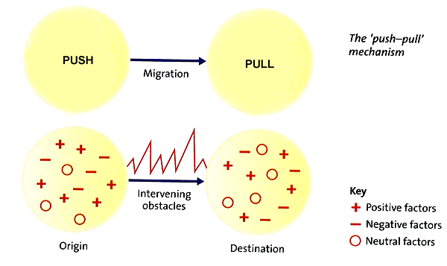
A. Lee’s Model (cont)

Slide 48
Discuss
Come up with an example of a:
push factor
pull factor
Intervening obstacle

Slide 49
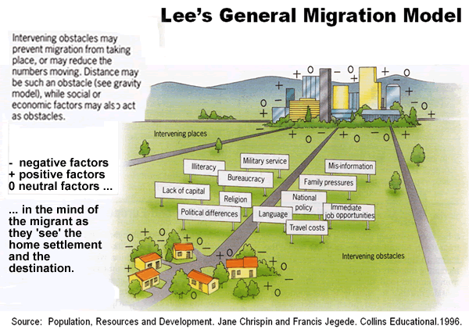
Examples:

Slide 50
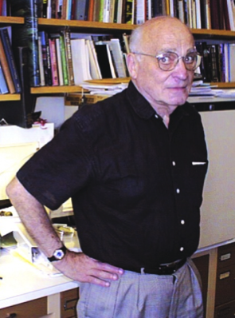
B. Migration Transition Model
Identified by Wilbur Zelinsky
The way migration patterns change as a country gets more developed

Slide 51
3. Transitions
High daily/season migration (search for food)
High international emigration
High internal migration: rural to urban
High international immigration
High internal migration: cities to suburbs

Slide 52
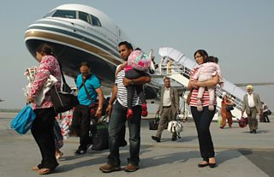
C. How Far do they go?
International Migration: Permanent move from one country to another

Slide 53
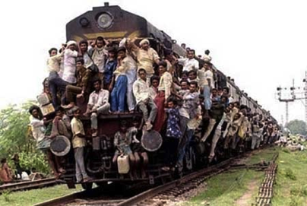
a. Voluntary migration: you choose to move (probably for better economics)
b. Forced migration: you HAVE to move (probably political or environmental)

Slide 54
c. Major Migration Patterns
Asia to Europe
Asia to North America
Latin America to North America

Slide 55
Discuss
What are some historical or modern reasons for forced migrations?
Be specific!

Slide 56
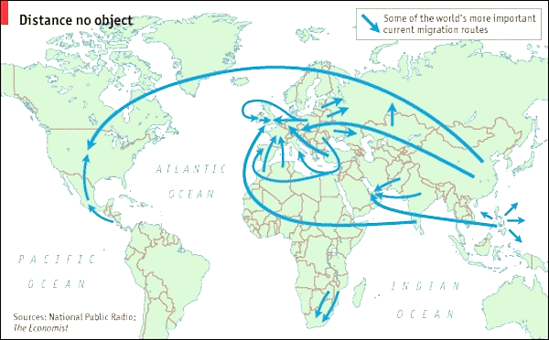

Slide 57
Video: International Migration
Notes:
6th period ended here

Slide 58
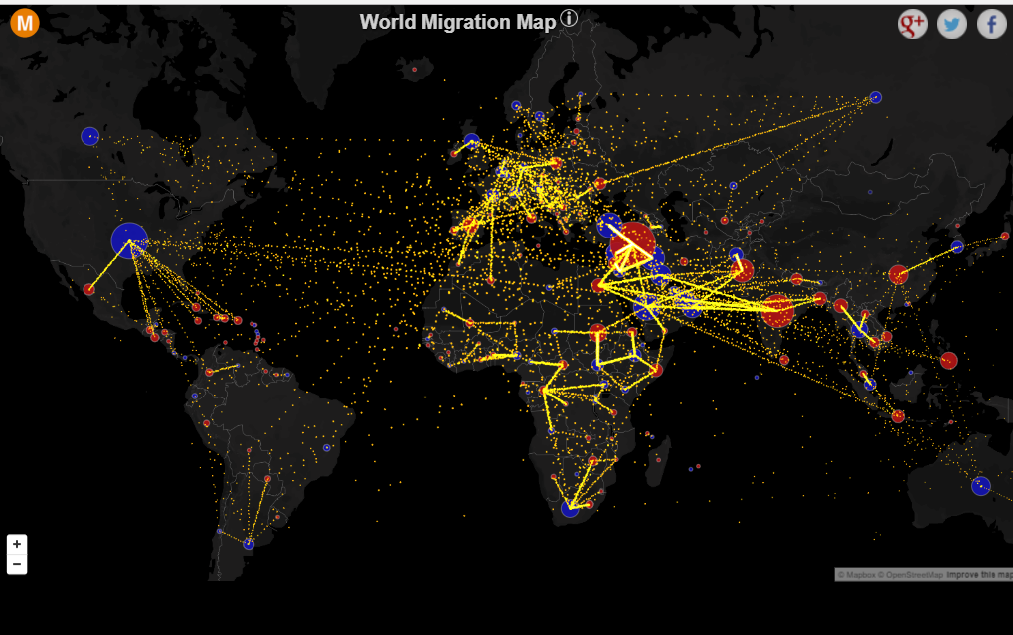
http://metrocosm.com/global-migration-map.html
Notes:
1st Period ended here

Slide 59
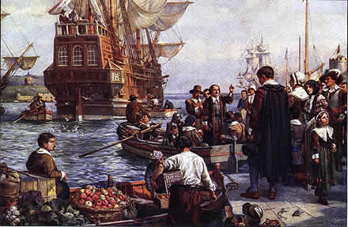
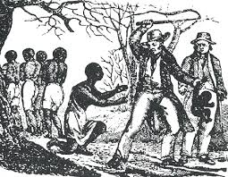
2. U.S. Immigration Patterns
17th and 18th century:
Europeans to American colonies
From Great Britain mostly
Slaves to America
From Sub-Saharan Africa

Slide 60
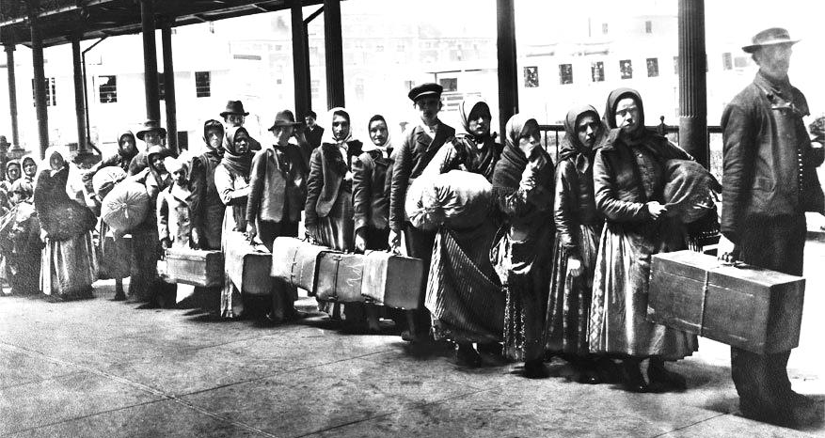
b. Mid 19th and early 20th century
1840-70’s: Ireland and Germany
1880’s: Sweden, Norway
1900: Italy, Russia, Austria-Hungary (Eastern Europe)

Slide 61
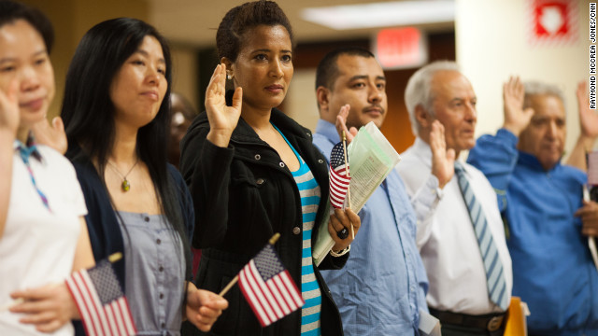
c. Late 20th and early 21st century
China, Philippines, India, Vietnam
Latin America (especially Mexico and Puerto Rico)
Notes:
2nd and 4th period ended here

Slide 62
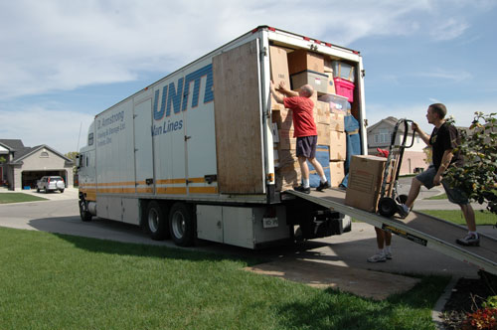
3. Internal Migration
Permanent move inside a country

Slide 63
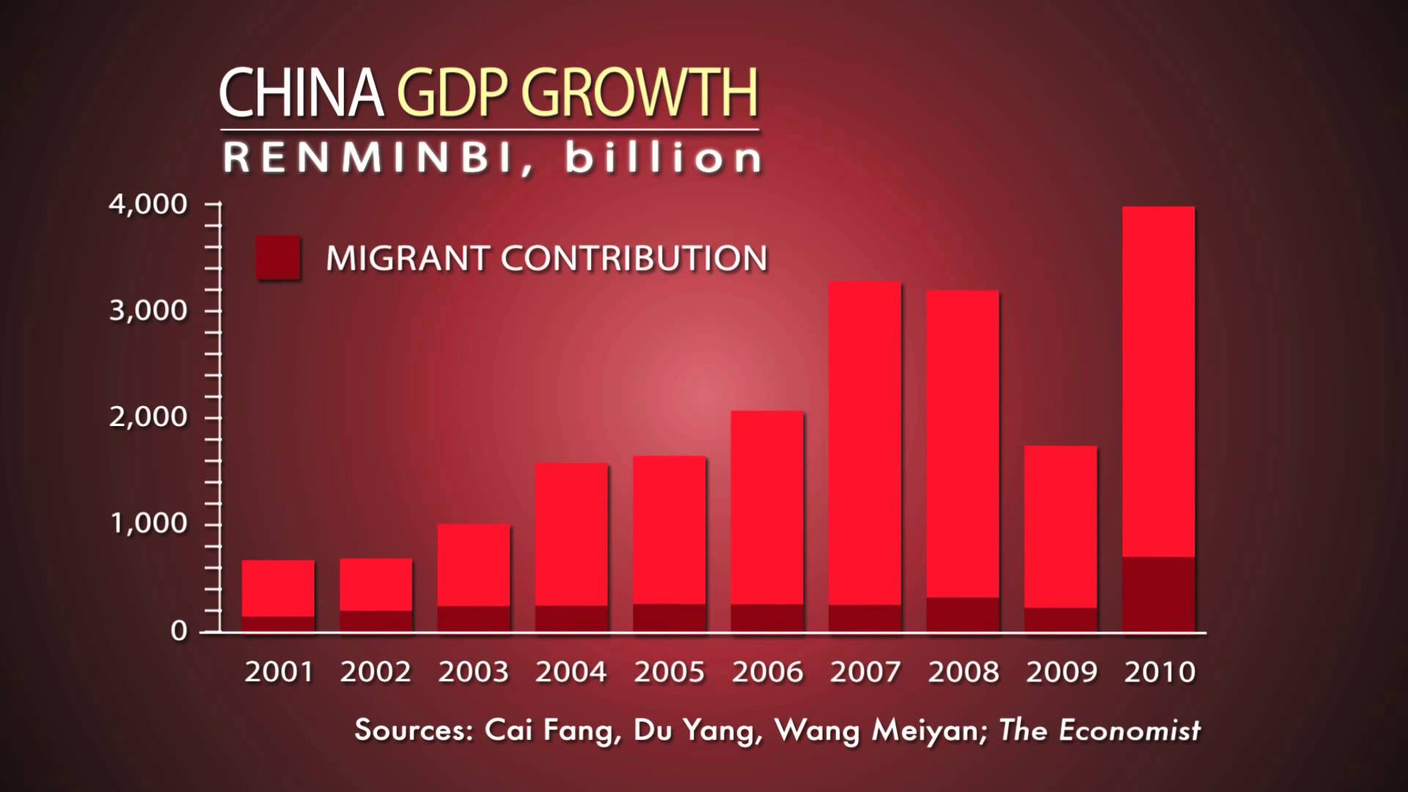
Video: Internal Migration China
Notes:
https://www.youtube.com/watch?v=KNXg-kYk-LU

Slide 64
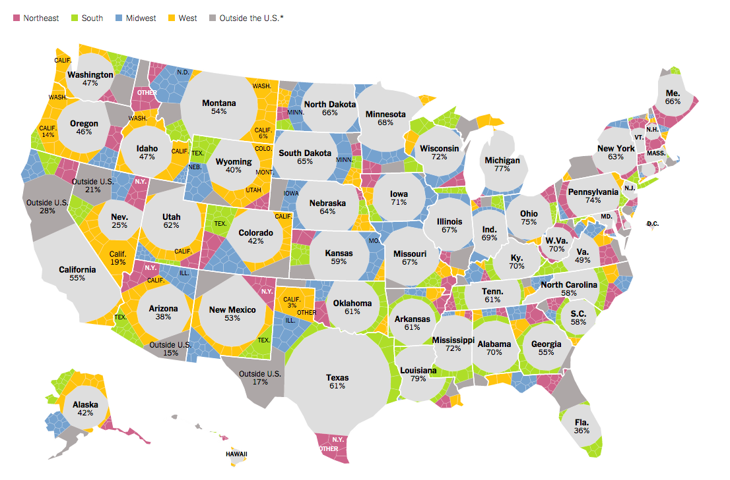
Each shape represents where the people living in a state were born.

Slide 65
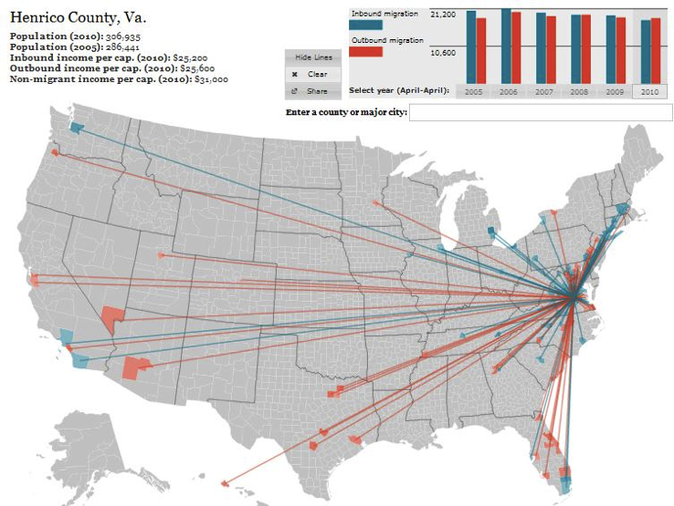
http://www.forbes.com/special-report/2011/migration.html

Slide 66
Discuss
Why do people move across the country?
Do you plan on moving out of Tucson? Why? Where?

Slide 67
Video: US Immigration
Notes:
https://www.youtube.com/watch?v=Fe79i1mu-mc

Slide 68
Summary
Describe the motivations and obstacles for people to migrate on a international and domestic scale.

Slide 69
Day 3

Slide 70
Internal Migration/Migrant Workers Bellwork 9/17 + 9/18:
Get out RQs; spot check #7.
Draw a representation of the Migration Transition model.

Slide 71
Agenda:
Notes: Regional Migration + Migrant Workers
HW: #11-15; QUIZ Thursday

Slide 72
Objective:
You will be able to define Lee’s Migration Model using one of the international intraregional migrations.

Slide 73
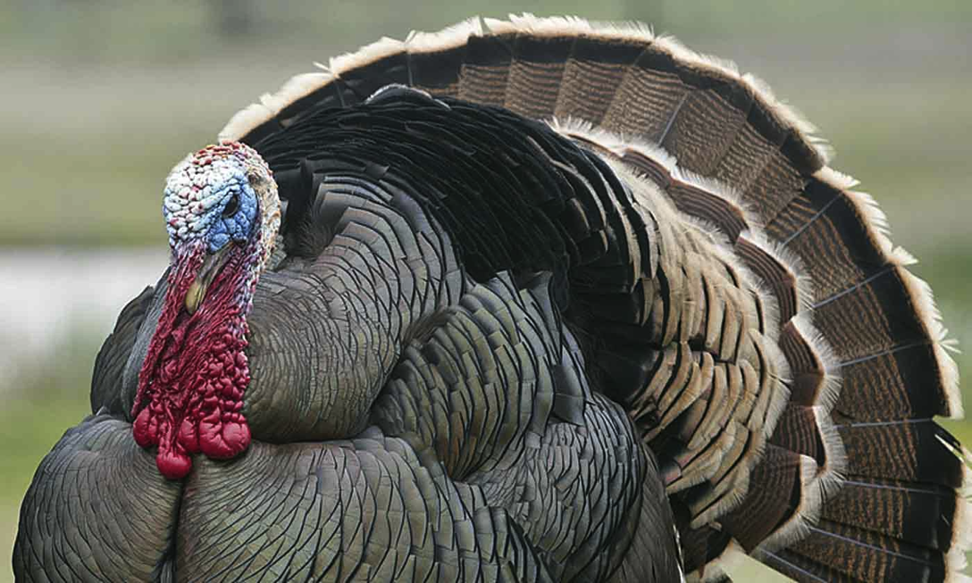
FFotD
Benjamin Franklin wanted to make the wild turkey the national bird of the United States.

Slide 74
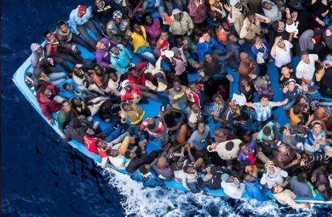
I. Regional Migration

Slide 75
Interregional migration: from one region to another
Intraregional migration: movement within a region

Slide 76
A. International Intraregional Migration
Intraregional Migration: movement within a region
EX.1: Myanmar – Ethnic conflict between Buddhists and Muslims forced Muslims into Bangladesh

Slide 77
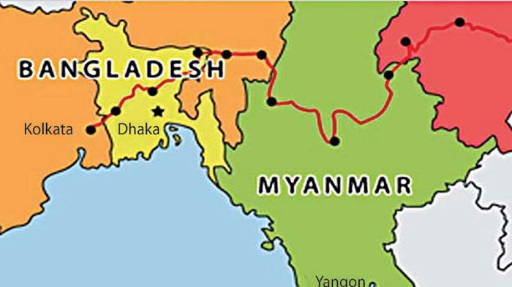

Slide 78
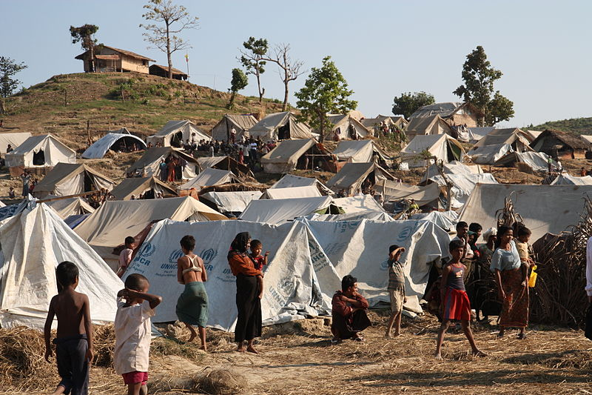
Bangladesh

Slide 79
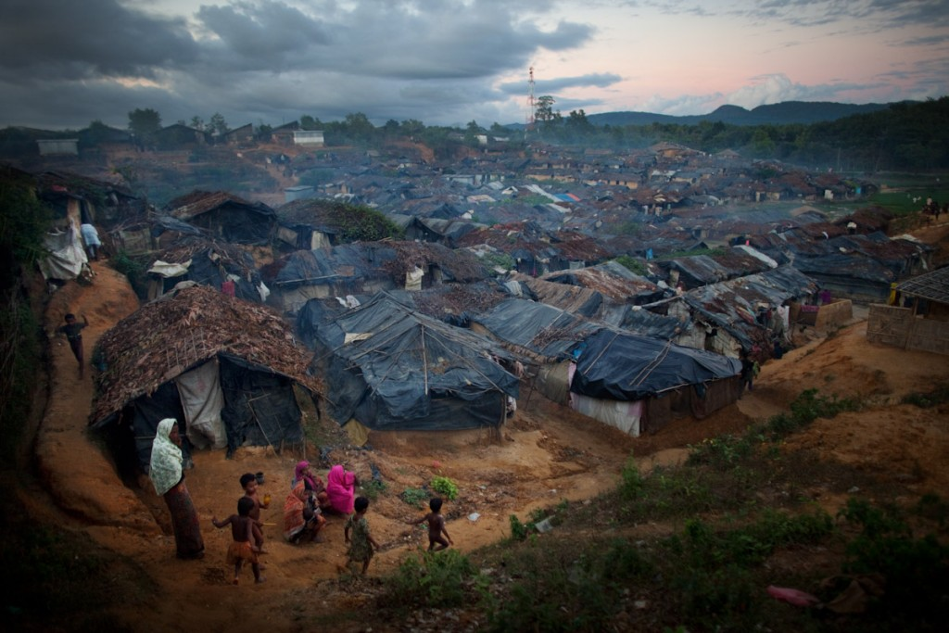
Myanmar

Slide 80
EX 2 - The Balkans collapse in the 1990’s, ethnicities break up into different countries

Slide 81
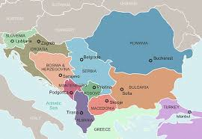

Slide 82
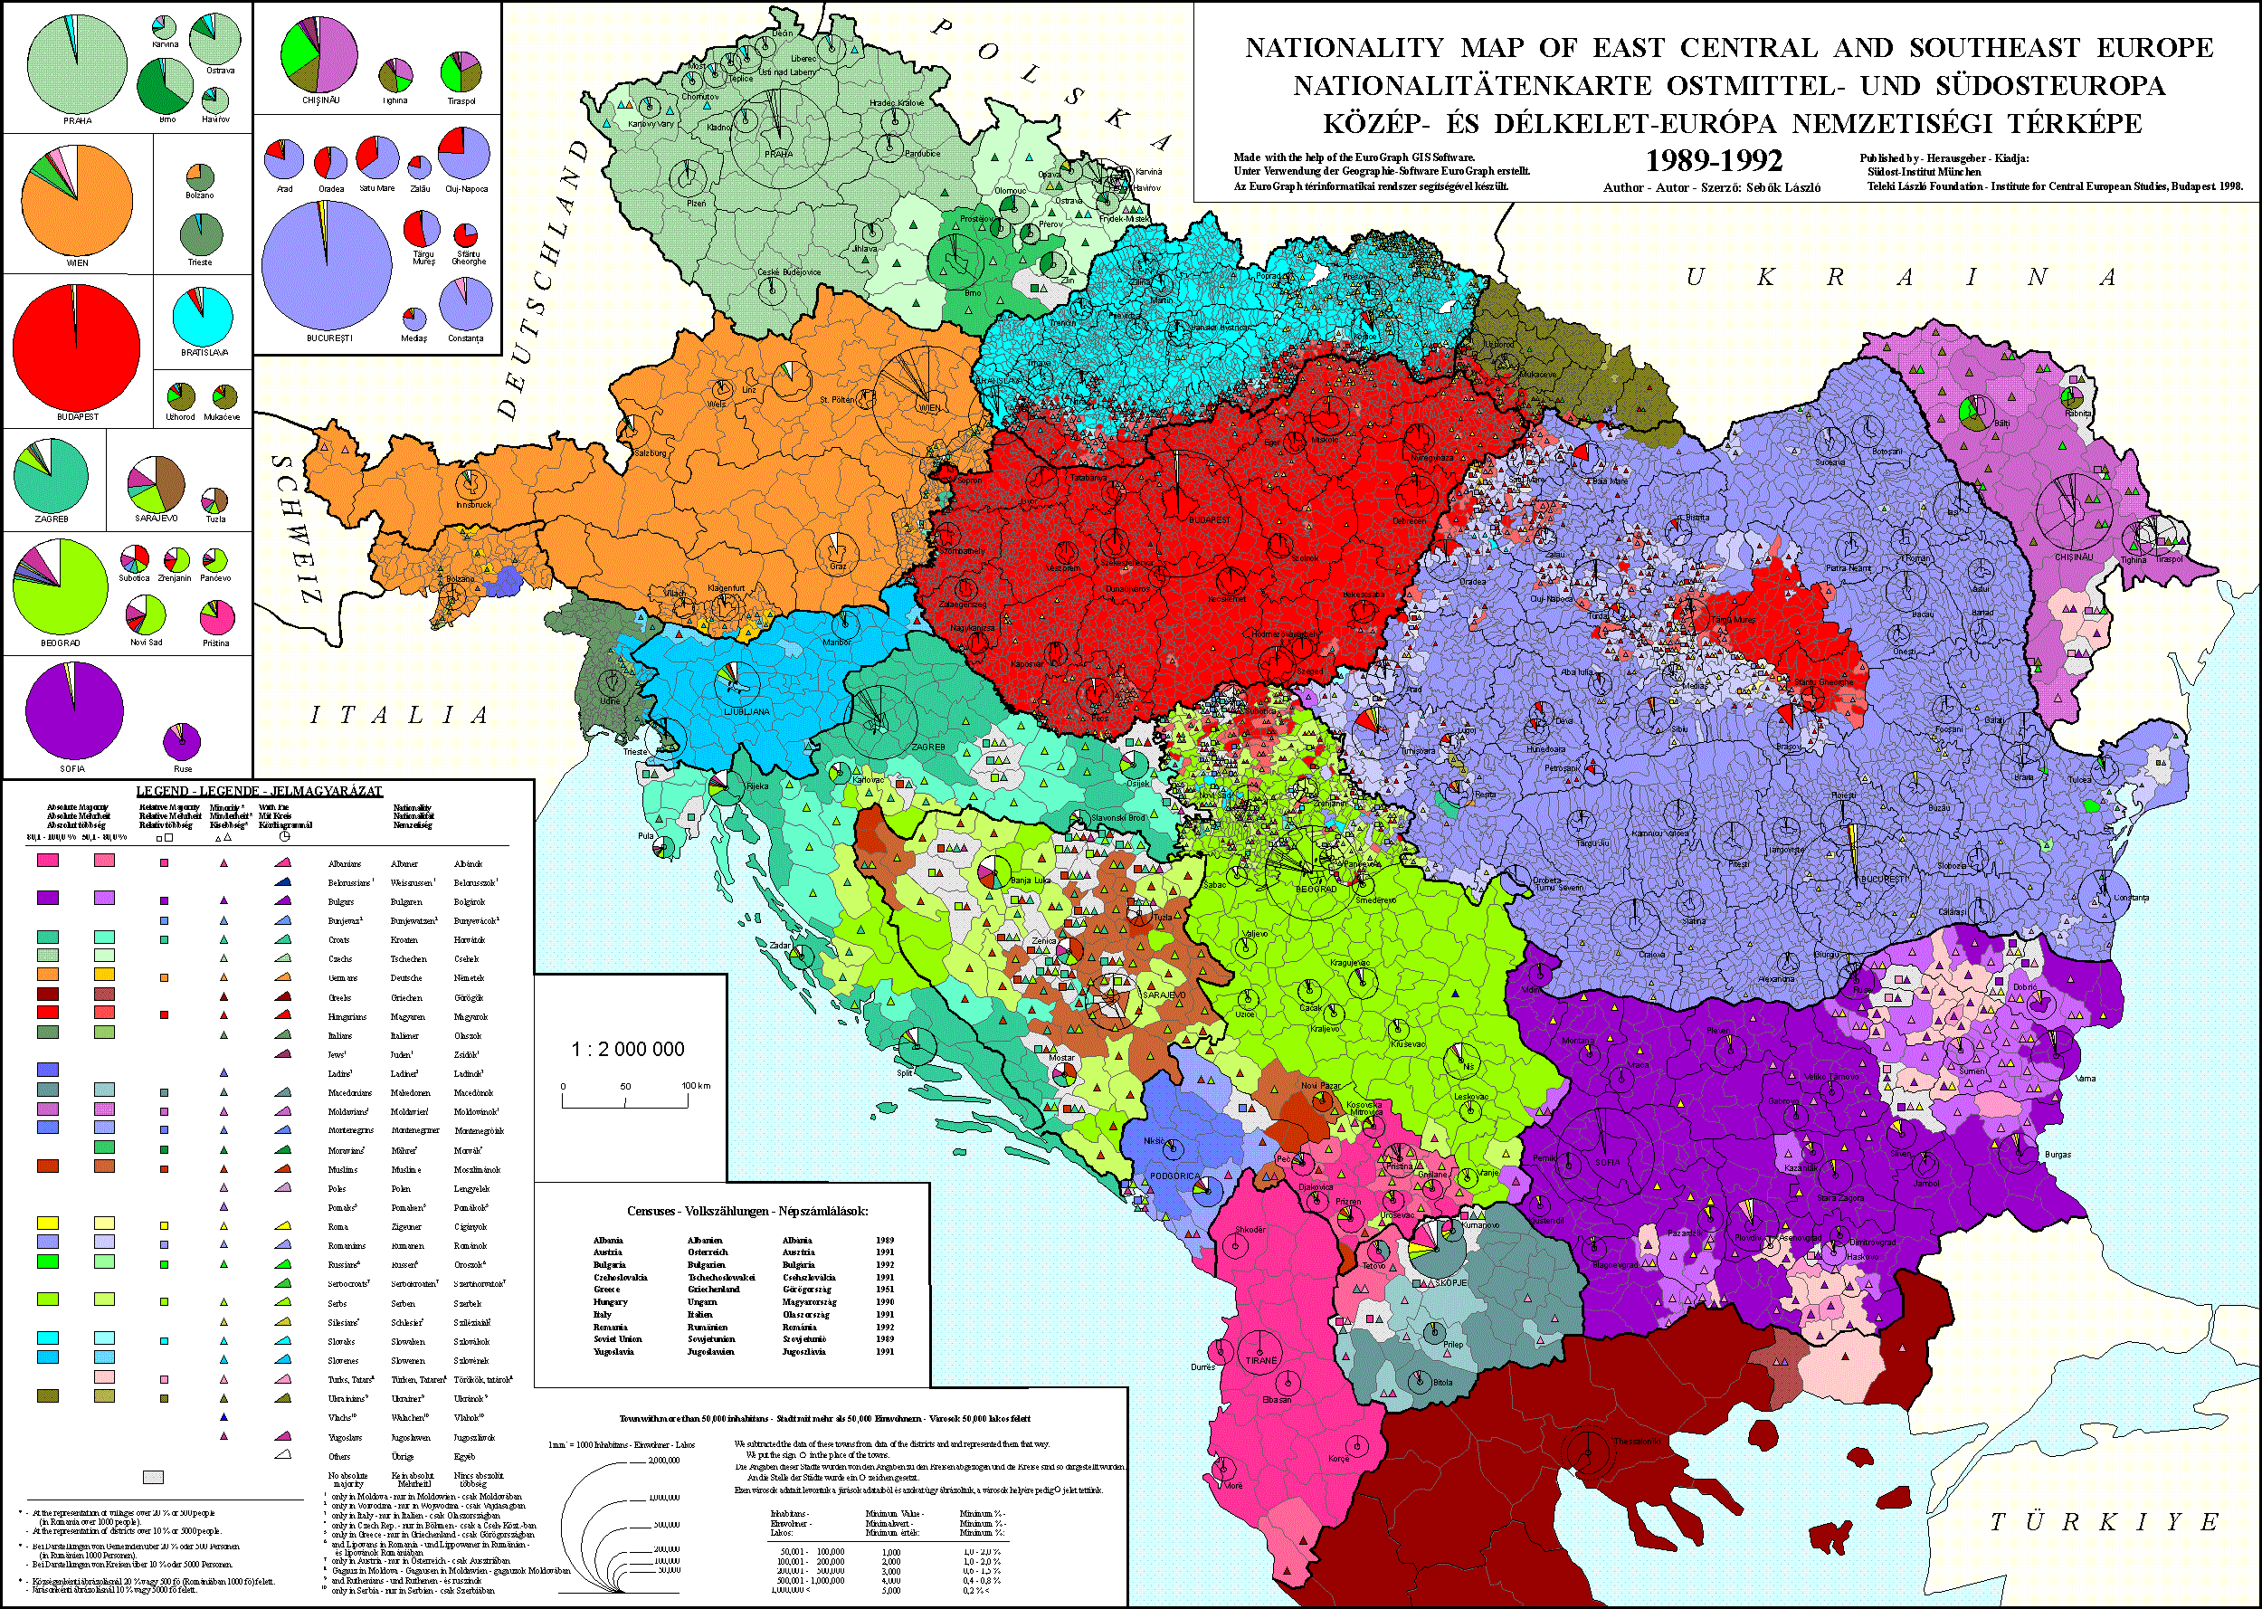

Slide 83
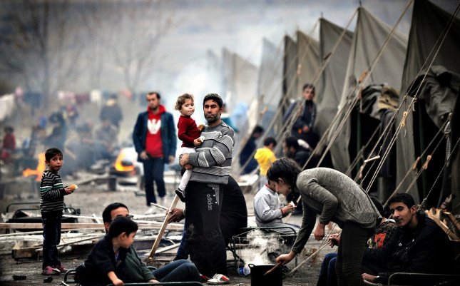
The Balkans

Slide 84
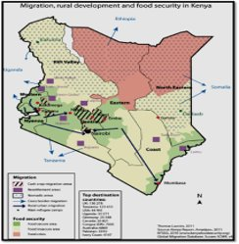
EX 3 - Sub-Saharan Africa: corrupt governments, human rights abuses lead to citizens leaving for neighboring countries

Slide 85
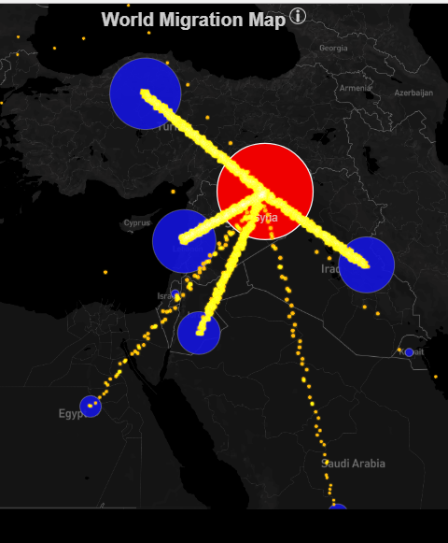
EX 4 - Southwest Asia: Syrian Civil War (2011) – refugees into Turkey and Lebanon

Slide 86
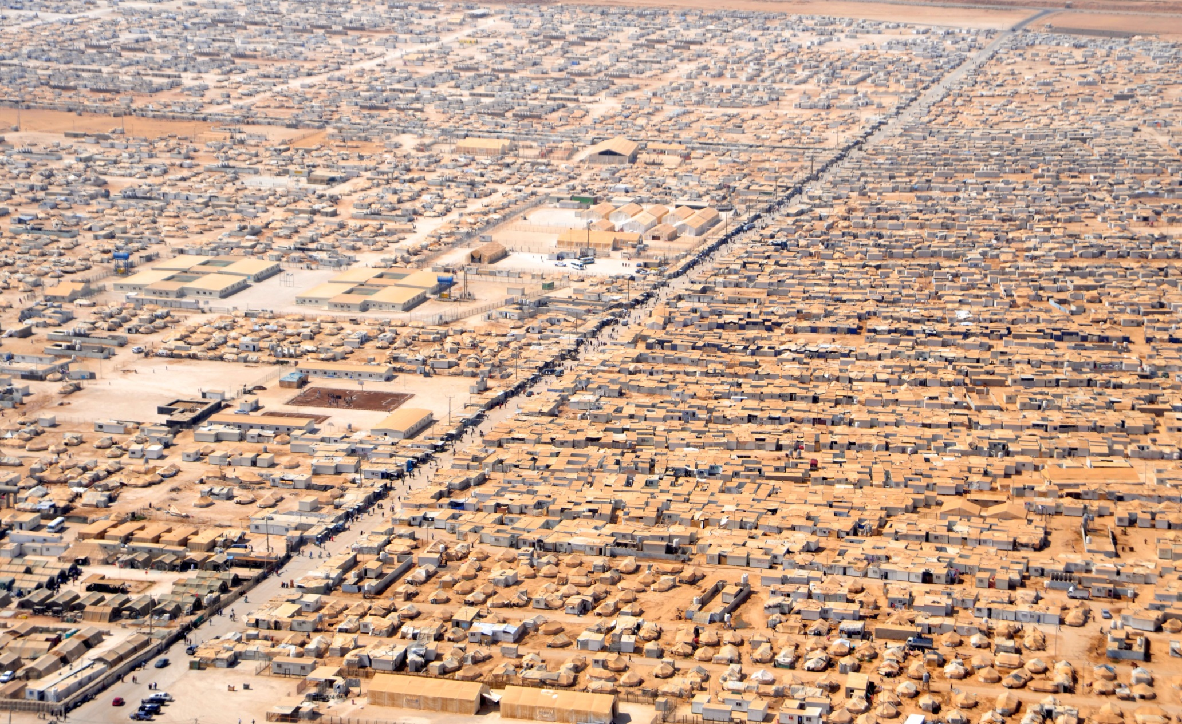
Syria

Slide 87
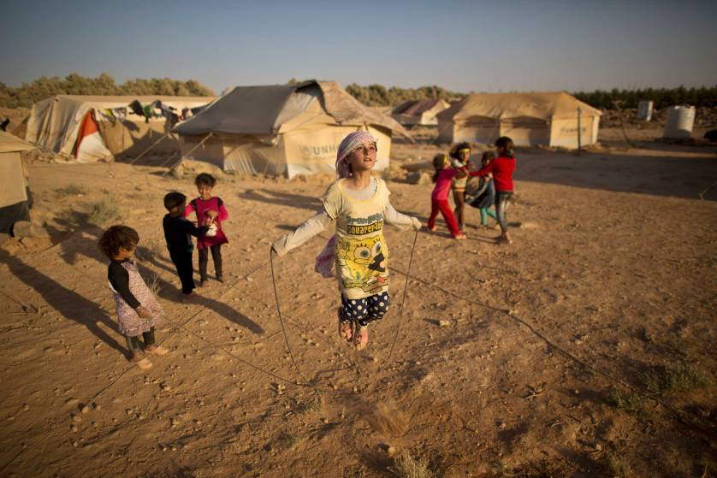
Syria

Slide 88
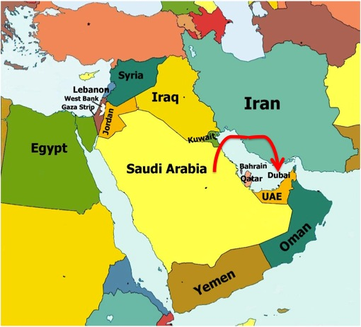
EX5: Arabian Peninsula has become extremely rich, and people move to gain opportunities

Slide 89
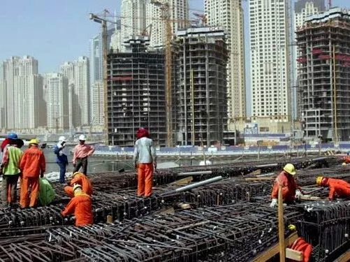

Slide 90
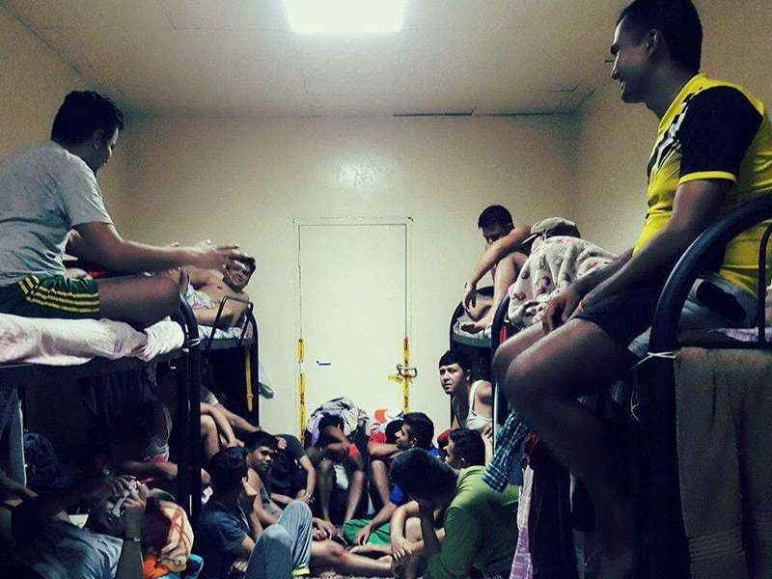

Slide 91
Discuss:
Describe the motivations for people to migrate on a international scale.
Using one of the international intraregional migrations, define Lee’s Migration Model.

Slide 92
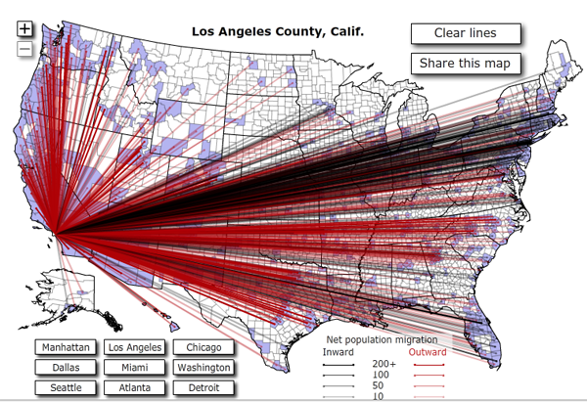
II. Domestic Regional Migration

Slide 93
A. Migration in the USA
People are moving out of the Rust Belt (Former industrial states in Northeast and Midwest) into the Sun Belt (Southern states)

Slide 97
Discuss
Why do people move across the country?
Do you plan on moving out of Tucson? Why? Where?

Slide 98
2. Rural to Urban - Early 1900’s
Urbanization: moving into a city
3. Urban to Suburban - 1950 +
Suburbanization: moving into a predominately residential communities
4. Urban to Rural – 1990+
Counterurbanization: Urban to rural

Slide 99
Discuss
What are some demographic consequences for internal migration?

Slide 100
B. Ravenstein’s Laws of Migration
Most move a short distance
Long-distance migrants go to economic centers
Most migrate for economic reason
Notes:
RAVEN-STEEN

Slide 101
4. But also political and environmental
5. Most long distance migrants are male
6. Most long distance migrants are single adults

Slide 102
C. Internal Movement
Periodic Movement: nonpermanent travel over long distances, that occurs occasionally
College, military service
Circulation: repetitive movement of a person
Home to school to gym
Mobility: your ability to move

Slide 103
Discuss
What is your general circulation pattern?

Slide 104
D. Migrant Workers
Guest worker: laborers allowed in a country for a specific job and a specified period of time
Time-contract worker
Remittance: payments made by migrants to their families back home

Slide 105
2. Brain Drain: the emigration of highly trained or intelligent people from a developing country
Brain Gain

Slide 107
Notes:
6th period here

Slide 108
3. Step-Migration: migration to a place, working there for a while before moving again

Slide 109
4. Chain Migration: people migrate to a location because of family, friendship, or common cultural background
Diaspora: the dispersion of any people from their original homeland.

Slide 110
Discuss
Where do we see chain migration in American History?
Why would people follow chain migration?

Slide 111
E. Abuse of Guest Workers
Migrant labor in the US
Latino migrants work our farms for less than minimum wage, no benefits, and no education for their kids
Cesar Chavez advocated for the rights of farm workers

Slide 112
Latino Migrant Workers
Notes:
http://youtu.be/KNXg-kYk-LU

Slide 114
Video: Stephen Colbert Testifies
Notes:
https://www.youtube.com/watch?v=ewPburLEZyY

Slide 115
2. Qatar’s abuse of guest workers
Richest country in the world
Only 12% of people in Qatar were born there
Workers from South and Southeast Asia
Work 12-15 hours a day in the heat for almost no money
Notes:
2nd, 4th period here

Slide 117
Qatar

Slide 121
Summary
Using the Migration Transition Model we have discussed in class, describe the movement of migrants for work.
Use a historical example of migration to discuss Ravenstein’s laws.

Slide 122
Day 5

Slide 123
Refugees cont'd Bellwork 9/24 + 9/25
Why might people abandon their home and culture to flee to another country?

Slide 124
Agenda:
Notes: Refugees
RQs #26-30; Test Tomorrow

Slide 125
Objective:
You will be able to discuss what we should do about refugees.

Slide 126
FFotD
DOLPHINS and other sea-dwelling mammals can obtain water from their food and by producing it internally from the metabolic breakdown of food.

Slide 127
I. Refugees

Slide 128
A. Victims of Forced Migration
Refugee: a person who has been forced to leave their country in order to escape war, persecution, or natural disaster.
ASYLUM SEEKER

Slide 129
2. Internally displaced person: someone who is forced to flee his or her home but who remains within his or her country's borders.

Slide 130
3. United Nations High Commissioner on Refugees (UNHCR)
Help more than 65 million refugees today
provide housing, food, medical care, and protection

Slide 131
Video: UNHCR Global Trends 2017
Notes:
https://www.youtube.com/watch?v=4lRcdIr05w8

Slide 132
B. Internally Displaced Persons
Violence:
Syria – 7.6 million
Columbia – 6 million
Iraq – 4 million
South Sudan – 1.7 million
D.R.C. – 2.8 million

Slide 133
REGIONS WITH MOST NEW DISPLACEMENT IN 2015

Slide 134
COUNTRIES WITH MOST NEW DISPLACEMENT IN 2015

Slide 137
Video: TED What Does it Mean to be a Refugee
Notes:
https://www.youtube.com/watch?v=25bwiSikRsI

Slide 138
c. Human Trafficking
Modern day slavery is the acquisition of people using force, deception, or coercion with the intent to exploit
Notes:
1st period

Slide 139
2. $150 BILLION market for sex and labor (factories, mines, stores)
Labor trafficking and debt bondage

Slide 140
Gold Mines in Ghana

Slide 144
Brick Making in Pakistan

Slide 151
b. Sex Trafficking
$99 billion in profits
Prostitution, strip clubs, pornography, massage parlors
and a lot of time it involves kids

Slide 154
3. Why does it exist today?
Because there is demand.
Demand for cheap products
Which means you need cheap labor
Demand for commercial sex industry

Slide 155
Discuss
What now? What do we do? What should the world do?
Where should these people live? Who should pay for their food, housing, health care and education?

Slide 156
II. Obstacles to Migration

Slide 157
A. Laws
Most countries have strict laws about immigration
Quotas: maximum limits on the number of people who can immigrate in one year
USA: 700,000 people

Slide 158
2. Immigration preferences:
Family reunification
Spouses, children, parents
Skilled workers
Diversity: from countries with low rates of immigration to the US
Refugees: 70,000 a year
https://youtu.be/2x97sDLMjvg

Slide 159
Discuss
Do you think Tucson is an immigrant friendly city?
Why or why not?

Slide 160
B. Europe
Refugees from the Middle East and North Africa want to go to a safe place
Europe is closest!
THOUSANDS migrate
But Europe doesn’t agree how to handle these migrants

Slide 165
Summary
Identify and explain a refugee migrant stream today.
Describe obstacles facing migrants.

Slide 166
Want to help?
Refugees:
Donate money or time!
UNHCR
International Rescue Committee
Save the Children
Red Cross International
World Vision
Doctors Without Borders
Human Trafficking:
Not For Sale
Good Guide
Buy fair trade!!
Stay informed.
Make your voice heard.
Let your money speak for you.

Slide 167
4 Level Map Analysis
What do you identify?
Do you comprehend the map?
Where do you see things?
patterns, something unique, distributions
Why there?
Draw logical conclusions
So what?
Synthesize this information together. Connect it to what we already know.
BULLET POINTS
COMPLETE SENTENCES

