Slide 1
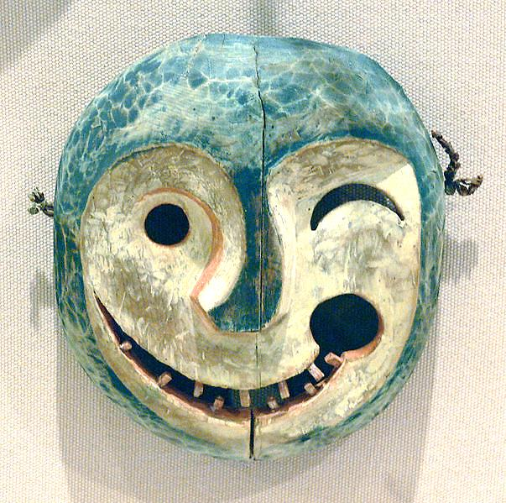
AP Human Geography
Chapter 4: Folk and Popular Culture

Slide 2
Day 1

Slide 3
Intro to Culture Bellwork 10/1 + 10/2:
What’s the most recent song you’ve listened to?

Slide 4
Agenda:
Notes: Introduction to Culture
HW: RQs #1-5, Map

Slide 5
Objective:
You will be able to describe the differences between folk culture and popular culture.

Slide 6
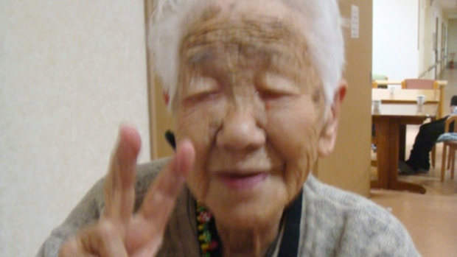
TUBI:
Guinness World Records says the oldest living person is Kane Tanaka of Japan, aged 115 years, 272 days.. The oldest verified age was 122 years and 164 days: Jeanne Calment of France, who died in 1997.

Slide 7
Ch. 4: FOLK AND POPULAR CULTURE

Slide 8
I. Introduction to Culture

Slide 9
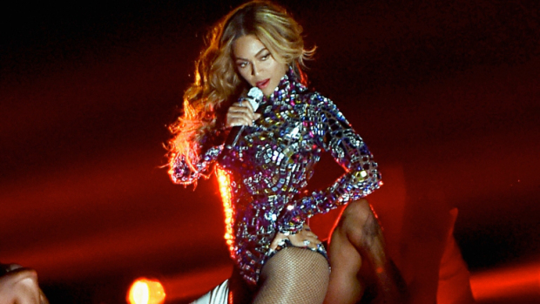
FOLK OR POPULAR?

Slide 10
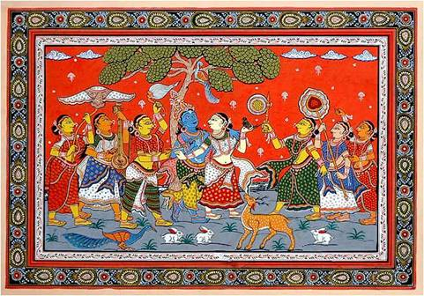
FOLK OR POPULAR?

Slide 11
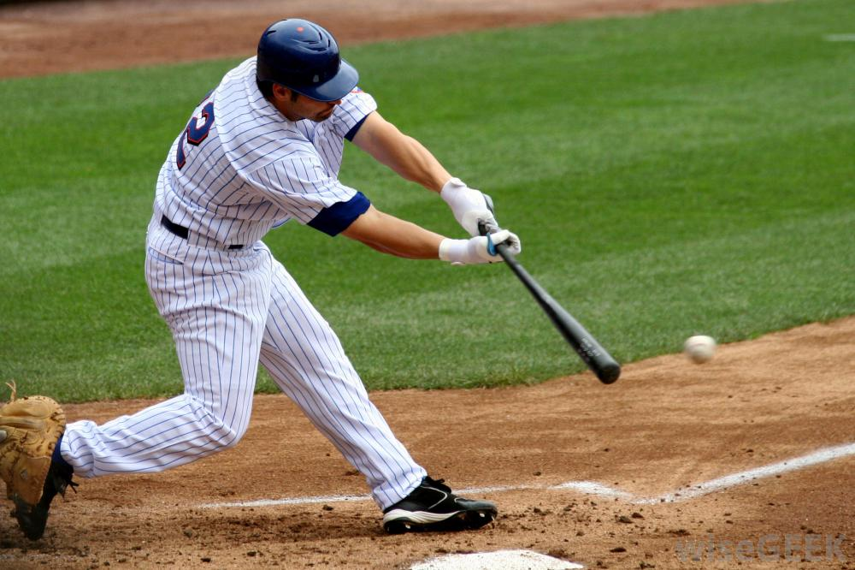
FOLK OR POPULAR?

Slide 12
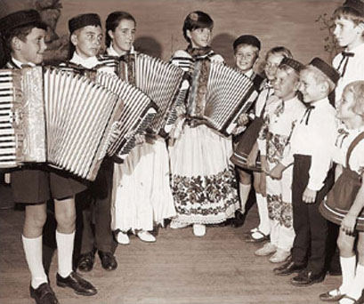
FOLK OR POPULAR?

Slide 13
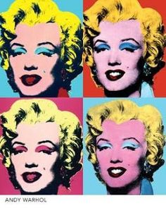
FOLK OR POPULAR?

Slide 14
Folk Culture: practiced by small homogenous groups in isolated, rural areas
Popular Culture: practiced by large heterogeneous societies that share certain habits despite being different

Slide 15
Discuss
Come up with a local example of folk and popular culture

Slide 16
C. Characteristics
Habit (repetitive act of a person) VS. Custom (repetitive act of a group)
ORIGIN:
ALL Culture comes from a hearth
Popular Culture comes from developed nation

Slide 17
Intro to Culture cont'd: Bellwork 10/3
Take out your phone, open web browser
Go to bit.ly/Ch3Ref
Take the Ch. 3 Reflection
If you don't have an internet-capable phone, ask a neighbor to use theirs after they're done!

Slide 18
DIFFUSION OF CULTURE:
Folk culture = relocation diffusion
Pop. Culture = hierarchical diffusion
DISTRIBUTION
FC= limited by physical features and access to materials
PC= Everywhere!!

Slide 19
5. Culture is made up of
Trait: a common unique feature of culture (like chopsticks)
Complex: a BUNCH of culture traits for behavior or activity

Slide 20
Discuss
What would be some of the characteristics of American culture?

Slide 21
D. Development
Autonomy: cultures develop independently of their environment
Convergence: Cultures become the same b/c of being connected via tech and travel
Divergence: cultures become different over time

Slide 22
4. Multilinear evolution: theory that similar places developed similar cultures without being connected

Slide 23
E. Culture and Geography
Region: a thematic or functional region based on common cultural traits/complexes
Like: government, language, religion, food, ethnicity
Realm: collection of cultural regions

Slide 24
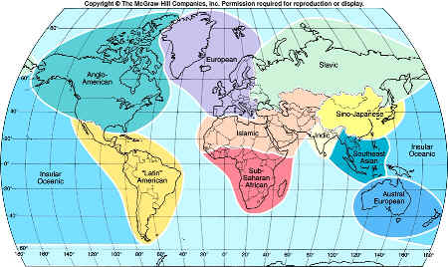
Anglo-American
European
Slavic
Sino-
Japanese
Insular
Oceanic
Austral-
European
Latin America
Sub-Saharan
Africa
Indic
Southeast Asia
Islamic

Slide 25
Discuss
Folk culture has become popular culture millions of times.
Do you think it is possible for popular culture (or a piece of it) to become folk culture?
Why/Why not?

Slide 26
Summary
Describe the differences between folk culture and popular culture.
Origins
Diffusion
Regions
Distribution

Slide 27
Day 2

Slide 28
Material Culture Bellwork 10/4:
What are some traditions in your family?
Think about holidays and celebrations, food, games, etc!

Slide 29
Agenda
Notes: Material Culture
HW: Reading Questions #6-10; Map

Slide 30
Objective
You will be able to identify and explain two examples of folk culture and popular culture each.

Slide 31
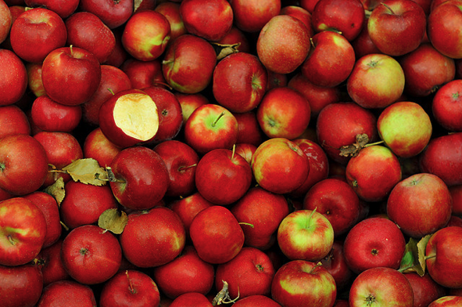
TUBI
There are 7,500 varieties of apples grown throughout the world, and if you tried a new variety each day, it would take you 20 years to try them all.

Slide 32
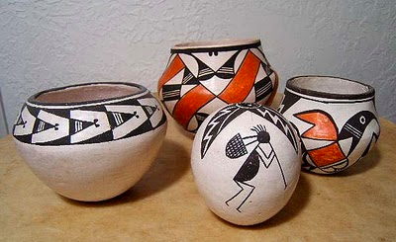
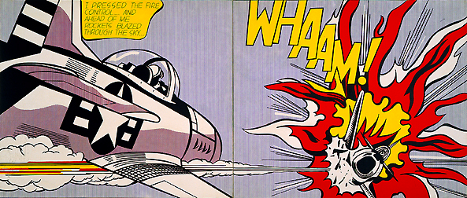
I. Material Culture

Slide 33
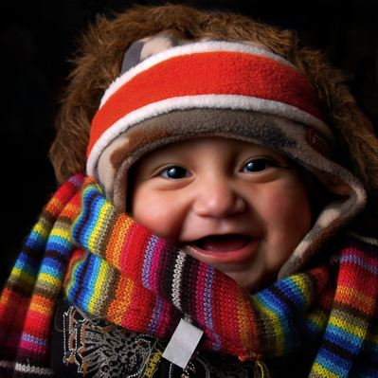
A. Material Characteristics
Material culture depends on time, space, and access

Slide 34
2. Artifact: the THINGS of material culture (houses, clothes, music, etc)
3. Mentifact: the ELEMENTS of culture (language, beliefs, folklore)
4. Sociofact: a rule, ritual, custom that links people in CULTURE (family structure, religion, education, politics)

Slide 35
B. Clothing
Folk Clothing
Influenced by environment and culture (like religion)
Travel/media turns folk clothing to popular
Can be controversial

Slide 36
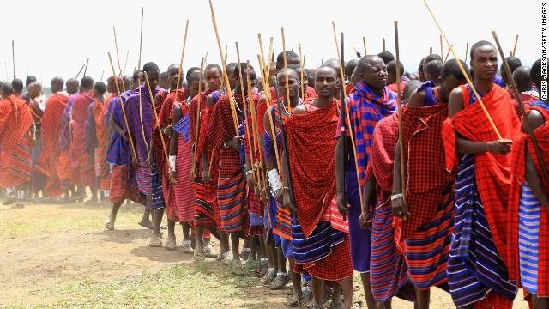

Slide 37
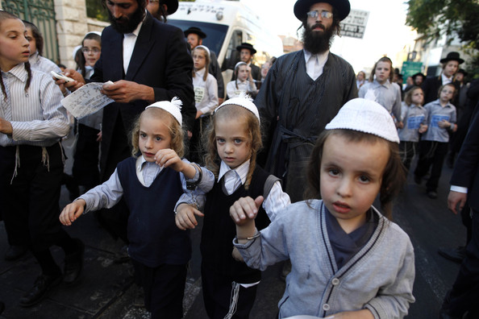

Slide 38
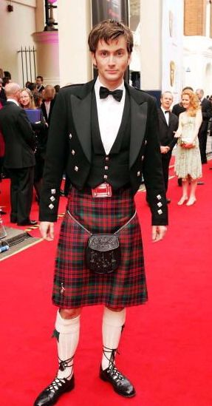

Slide 39
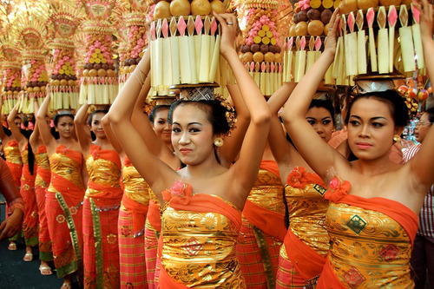

Slide 40
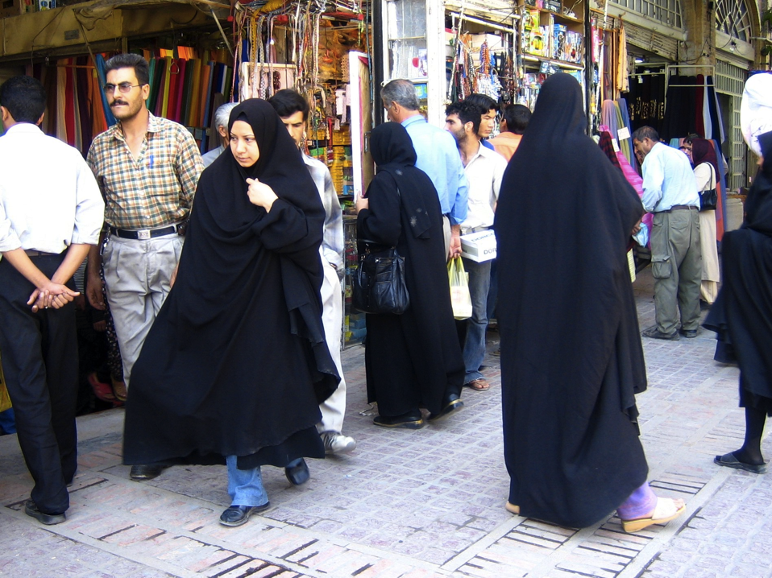

Slide 41
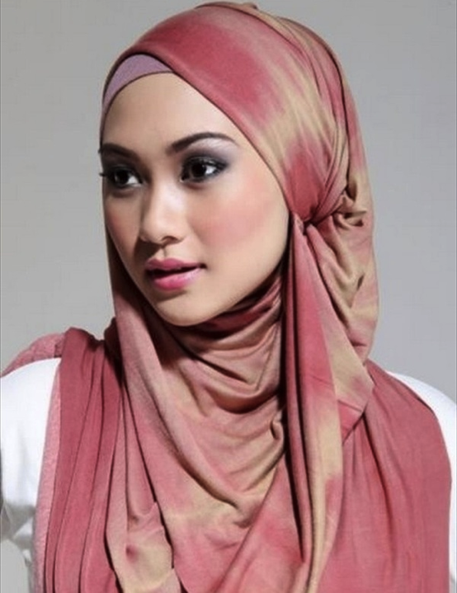

Slide 42
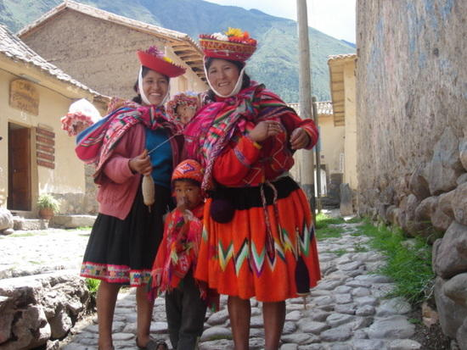

Slide 43
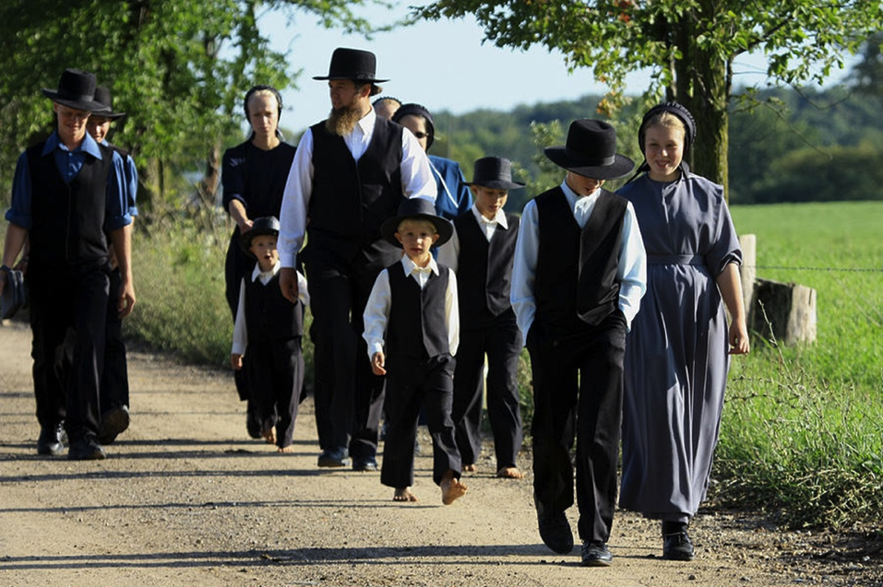

Slide 44
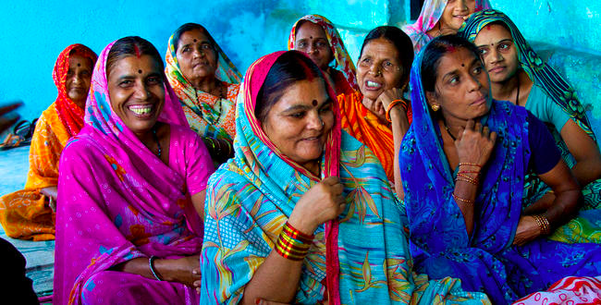

Slide 45
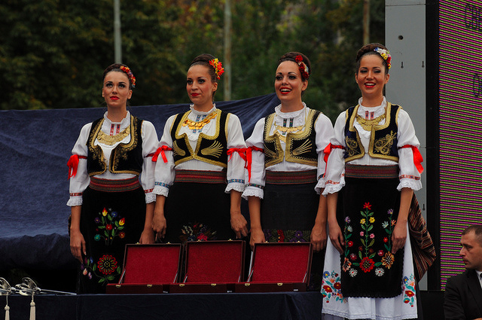

Slide 46
2. Popular Clothing
Reflects wealth and job
Women’s clothing styles change more than men
Reproduced on mass and cheaply
Spreads quickly
Notes:
6th period here

Slide 47
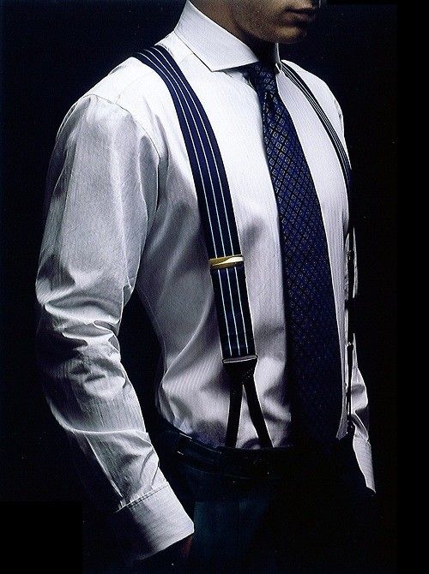

Slide 48
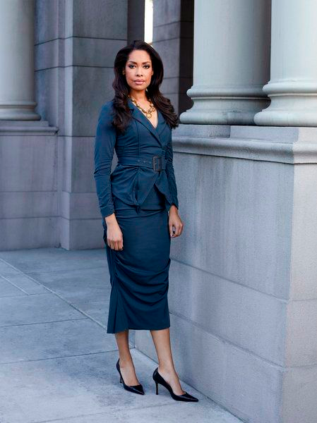

Slide 50
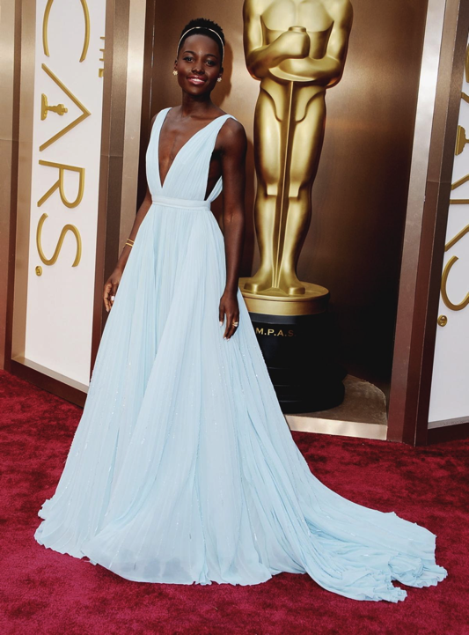

Slide 51
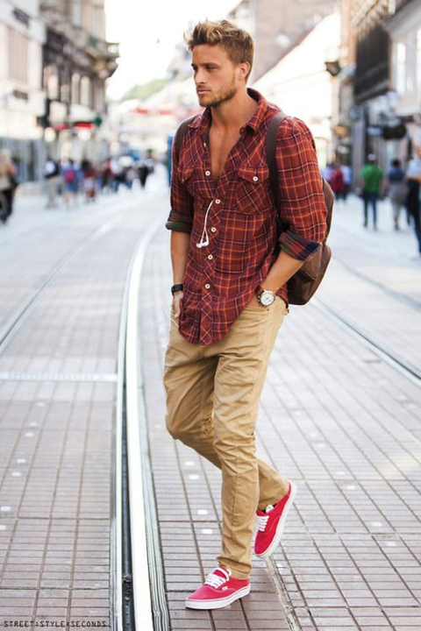

Slide 52
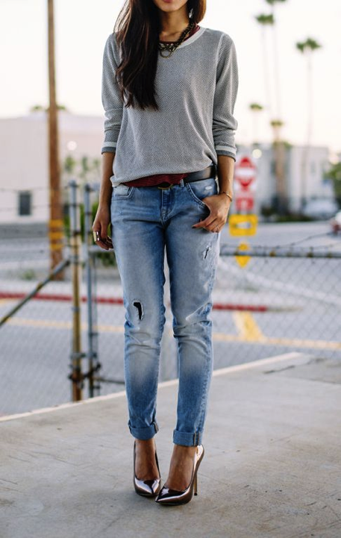

Slide 53
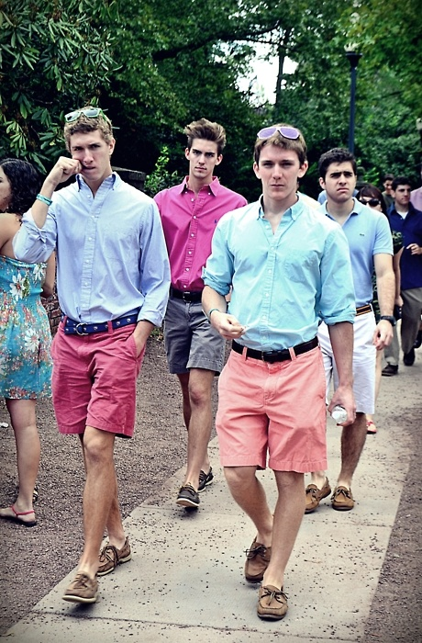

Slide 54
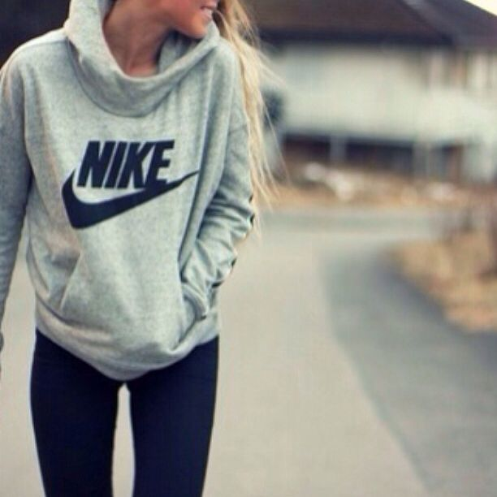

Slide 55
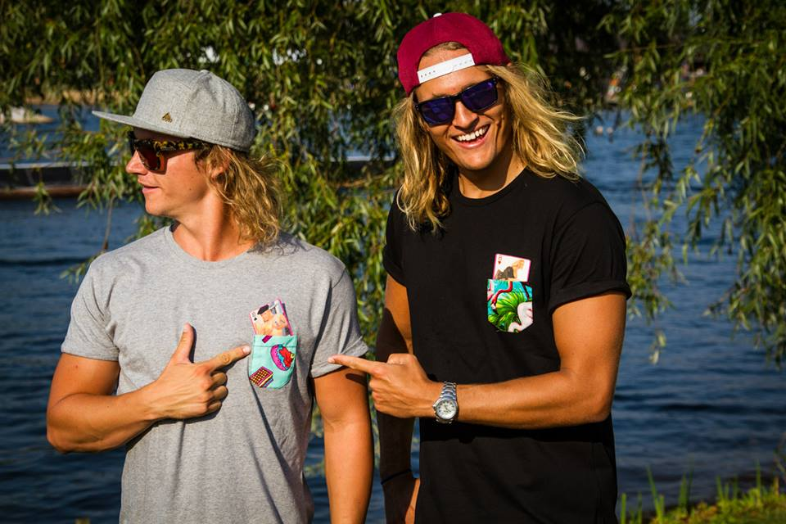

Slide 56
Discuss
What popular clothing trends have you seen in your life?

Slide 57
Material Culture cont'd Bellwork 10/15 + 10/16
List the elements of Folk Culture and Popular Culture for each of the songs played:
Video 1

Slide 58
C. Food
Food tends to STAY folk and local
Folk
Strongly influenced by environment (plants, animals, region)
Terroir: the way a place’s physical features influences how food tastes
Notes:
2nd period here

Slide 59
Food preferences influenced by environment

Slide 60
e. Taboo: restriction of behavior imposed by social custom
Social taboos: endangered, organic, etc.
Religious taboos:
Jews: keep kosher (and avoid pork)
Muslims: avoid pork and alcohol
Hindus: avoid beef
Notes:
1st per here

Slide 61
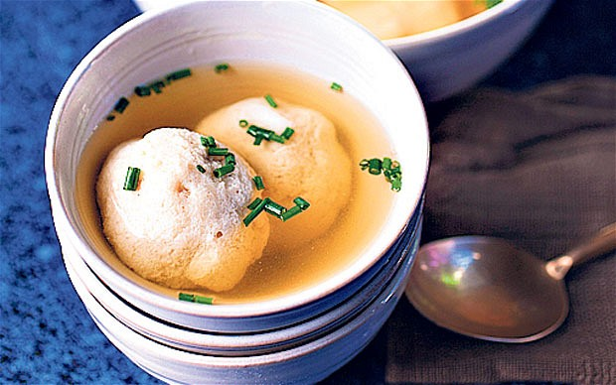

Slide 62
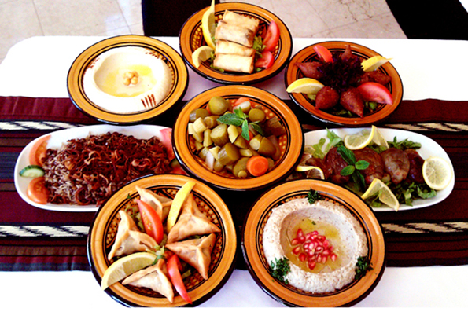

Slide 63
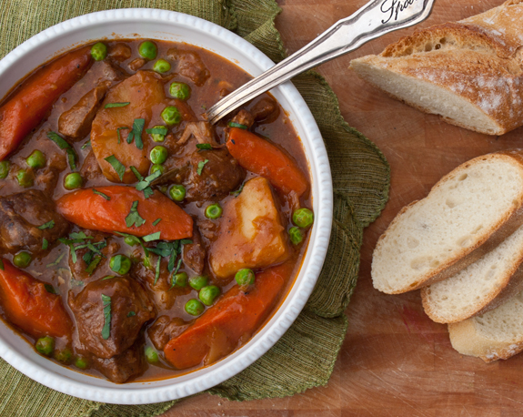

Slide 64
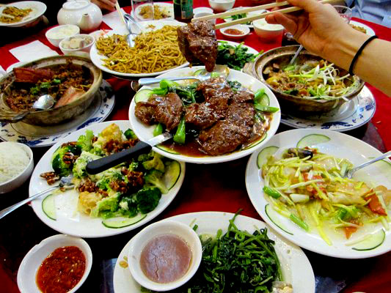

Slide 65
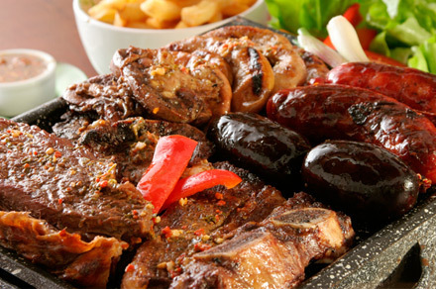

Slide 66
Popular Food
More reliant on culture
Preferences depend on marketing
There are still regional differences!

Slide 67
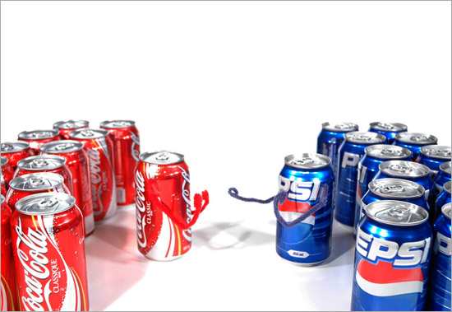

Slide 68
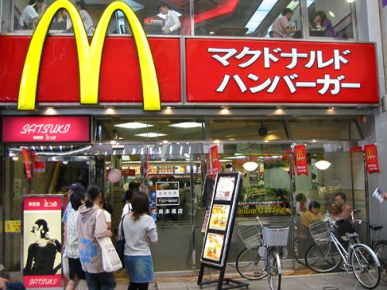

Slide 69
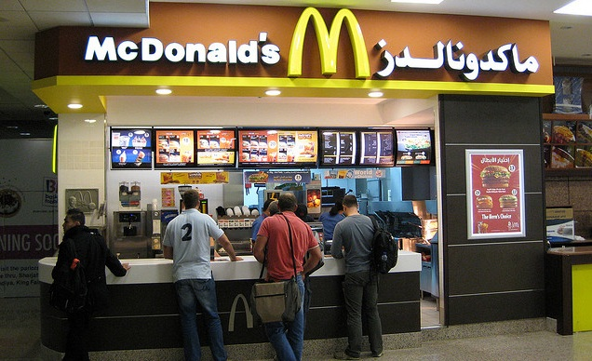

Slide 70
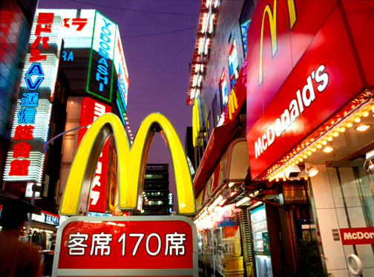

Slide 71
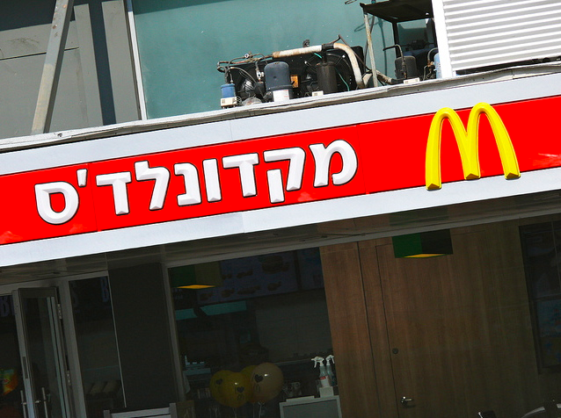

Slide 72
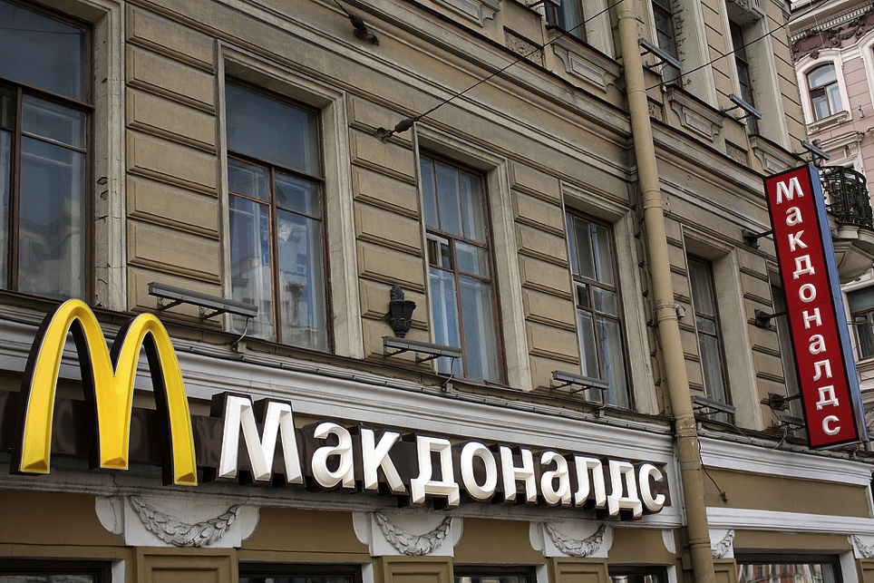

Slide 73
Discuss
What kinds of foods do you like?
Do you like more folk or popular foods?

Slide 74
Video: Tucson
Link
Notes:
https://www.youtube.com/watch?v=ymuIMtJhKAc

Slide 75
D. Architecture
Homes crucial to human geography
Folk culture:
Influenced by environment
Weather, Materials
Unique

Slide 76
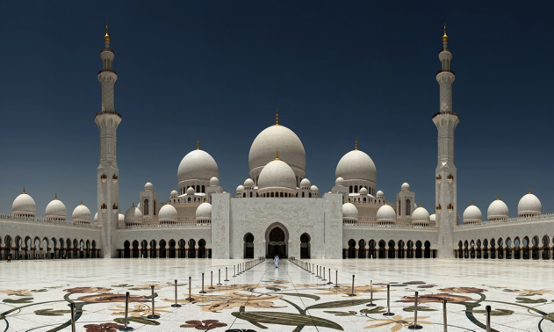
Includes sacred Space
Space for religion
Religious architecture is folk culture

Slide 77
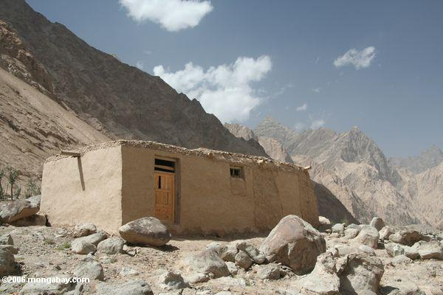

Slide 78
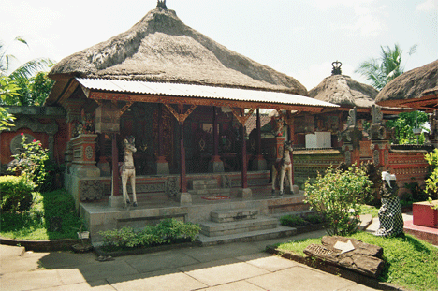

Slide 79
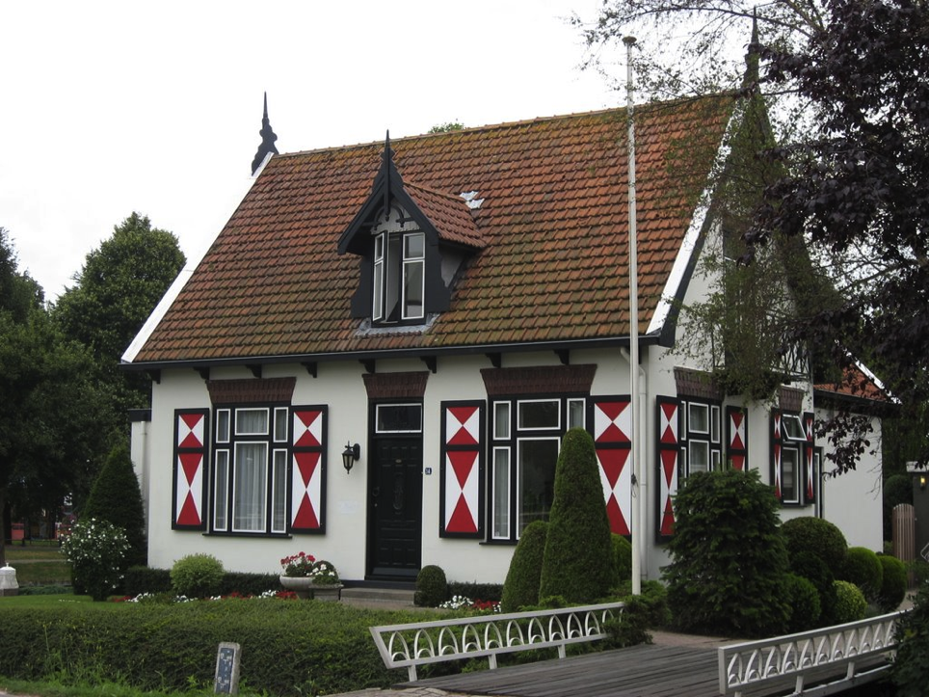

Slide 80
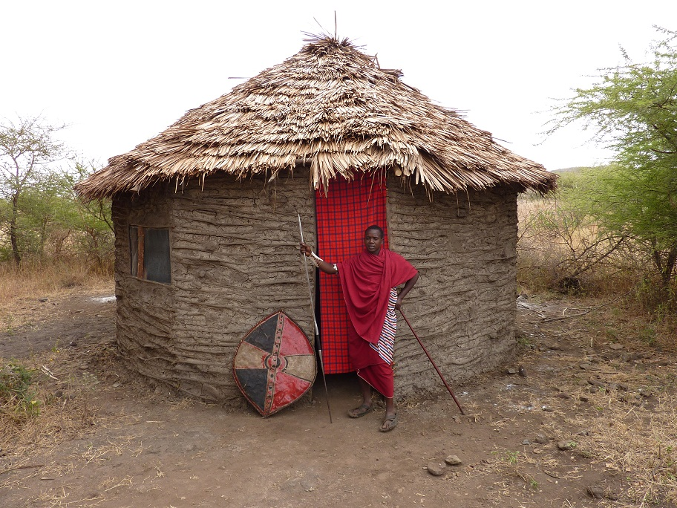

Slide 81
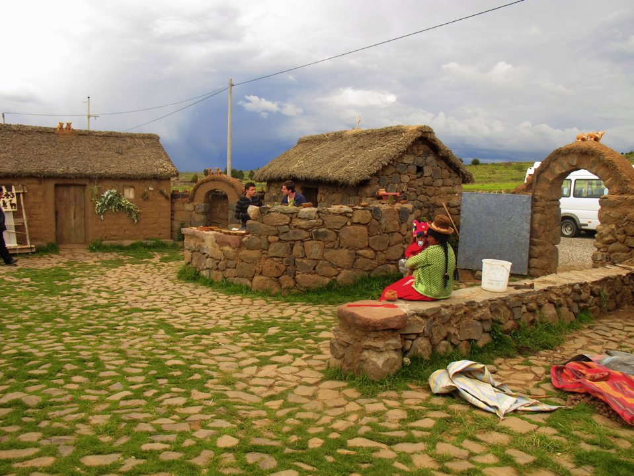

Slide 82
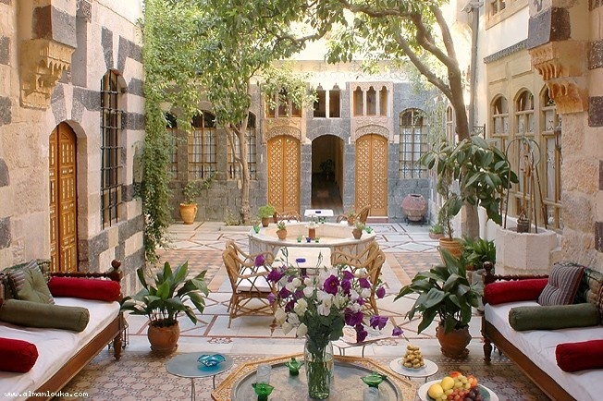

Slide 83
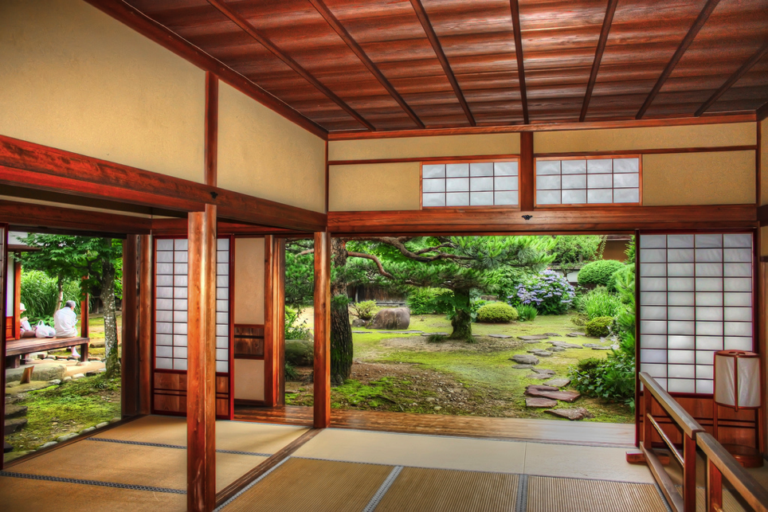

Slide 84
2. US Housing
Folk:
Colonial inspiration
Unique features, styles
Popular:
Mass produced, cookie cutter houses, cheap materials

Slide 85
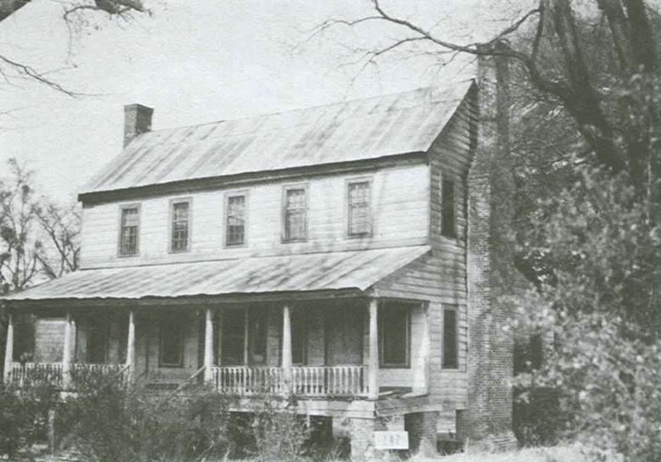
Middle Atlantic

Slide 86
Lower Chesapeake

Slide 87
New England

Slide 93
Popular: Phoenix Subdivisions

Slide 94
Discuss
Describe your dream home!

Slide 95
E. Music
Folk Music:
Anonymous Author, spreads via relocation diffusion, about every day life, tells a story!
Popular Music:
Specific Author, spreads via hierarchical diffusion, technical skill, mix of cultures

Slide 96
Summary
Identify one example of folk culture and popular culture for each:
Clothing, Food, Architecture, Music
USE YOUR OWN EXAMPLES

Slide 97
Day 3

Slide 98
Diffusion of Culture Bellwork:
Describe your dream house!

Slide 99
Agenda:
Finish Material culture!!
Notes: Diffusion of Culture
HW:

Slide 100
Objective:
You will be able to discuss how culture diffuses using historical examples.

Slide 101
TUBI:
Sea lions are the only non-human mammals that have demonstrated the ability to keep a beat.

Slide 102
I. Diffusion of Cultures

Slide 103
Electronic Diffusion
Globalization: the increasing connectedness of cultural, political, social and economic processes on an international level
Glocalization: adaptation of globalized products to local tastes and contexts

Slide 104
3. TV!!!!!!*
Spreads popular culture
Most people watch TV to relax
Most people have TV’s

Slide 105
4. Access to Cultures Changes the understanding of them
Cultural perception: attitudes/beliefs about a culture
Environmental perception: attitudes/beliefs about a place
Syncretism: fusion of old and new cultural values

Slide 106
5. Geographers And Diffusion
Carl Sauer and Torsten Hagerstrand
Identified the types of diffusion culture fits with

Slide 107
Discuss
What kind of diffusion does TV represent? Be ready to explain!

Slide 108
B. The Internet*
Since 1995, it’s everywhere
Popular media spreads worldwide INSTANTLY
Social Media
Connects people and their experiences

Slide 109
Discuss
How do you use the internet to interact with culture?

Slide 110
C. Access to Media
Limiting Access:
Cultural Imperialism: most entertainment comes from USA, are we forcing our culture on others
News: governments or a few corporations are in control

Slide 111
Government censorship*
Political views
Social content (sex, drugs, gambling)
Security content
Tools (email, searching, hosting)

Slide 112
Top 5 Internet Censors
North Korea
Saudi Arabia
Iran
China
Syria

Slide 113
2. Beating the Man
Social Media > government control
Arab Spring 2011
#Blacklivesmatter
China anti-censorship

Slide 114
Summary
Discuss how culture diffuses using historical examples for:
Relocation diffusion
Expansion diffusion

Slide 115
Day 4

Slide 116
Cultural Sustainability Bellwork 10/22+23:
Turn in Cultural Tourism Poster
Do you think that internet censorship is a problem? Are there instances where censorship is okay?

Slide 117
Agenda:
Turn in Cultural Tourism Poster
Turn in Housing Survey
Notes: Sustainable Culture
SCHEDULE - PSAT on Wednesday!!
HW: Study! Test Thurs/Fri

Slide 118
Objective:
You will be able to describe the relationship between cultural traits and environment in writing.

Slide 119
FFotD:
Folk Culture- The Amish
Women never cut their hair
Men grow a beard after marriage
Live in midwest/northeast USA

Slide 120
I. Sustainable Culture

Slide 121
Challenges:
Popular culture is overwhelming/destroying folk culture
Assimilation: when a minority population loses its folk culture by joining the dominant culture
Acculturation: when one culture adopts/borrows traits of the dominant culture

Slide 122
Discuss
What are some examples of folk culture disappearing?

Slide 123
2. Environment
Cultural landscape: the combination of human culture and physical effects (built environment)
Cultural Ecology
Environmental Determinism
Possibilism
Cultural Autonomy

Slide 124
Uniform Landscape: popular culture results in places looking the same
EX: fast food, super market, gas stations
North America has uniform landscape and it’s spreading worldwide

Slide 125
How does this political cartoon illustrate the concept of popular culture? How does imply some of the concerns?

Slide 126
3. Consequences
Both popular and folk culture produce a lot of pollution
solid, liquid, & gas waste

Slide 127
b. Resource depletion
Popular culture has a lot of material = uses a lot of natural resources
Animal products: fur, ivory, meat
Recycling is helping with this problem
paper, plastic, aluminum, food

Slide 128
B. Core-Domain-Sphere Model
Core: area of greatest concentration of culture traits
Domain: area outside of the core in which the culture is still dominant but less intense
Sphere: the edge of influence for a culture region.

Slide 129
DRAW THIS
Core
Domain
Sphere
Figure 2.3 (p. 39)
Notes:
DISCUSSION
* Why does the reality of a culture region rarely follow the simplified model presented here?
* Does the Mormon culture region here pre-empt or overlap with the U.S. "Mountain West" culture region?

Slide 130
Discuss
What are other examples of the Core-Domain-Sphere Model?
Be ready to explain your reasoning!

Slide 131
Summary
Describe the different ways in which cultural traits are affected by and affect:
The natural environment
The cultural landscape
The economies of a region

