Slide 1

AP Human Geography
Chapter 5: Language

Slide 2
Day 1

Slide 3
Intro to Languages
Bellwork 10/29+10/30
Don't get too comfortable – seat change coming!
If you could be instantly fluent in two other languages, which would you pick?
Why?

Slide 4
Agenda:
Notes: Intro to Languages
4 Level Map Analysis
HW: Reading questions #1-6

Slide 5
Objective:
You will be able to analyze a map of the distribution of languages.

Slide 6
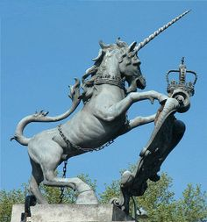
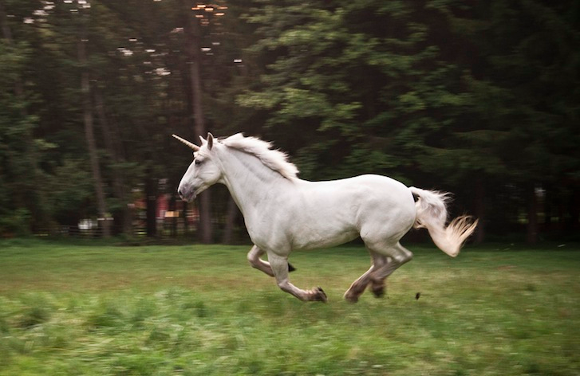

FFotD
The unicorn is the national animal of Scotland.

Slide 7

CHAPTER 5: LANGUAGE

Slide 8
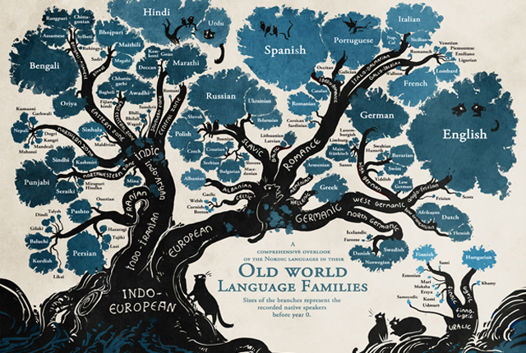
I. LANGUAGE IS EVERYTHING

Slide 9
The Basics
  Language: a system of communication through symbols, gestures, and a collection of sounds that a group of people understand to have the same meaning

Slide 10

1. Language
Cultural values are communicated through language
Language connects us!

Slide 11
c. Statistics!
66 % of people speak a Indo-European or Sino-Tibetan language
2-6% speak a language that is in the 7 other language families
Everyone else speaks something from a smaller language family

Slide 12
Top 10 Most Spoken Languages in the World:
Bengali
Portuguese
Russian/ Belorussian
Japanese
German
Mandarin
Spanish
English
Hindi/Urdu
Arabic

Slide 13
Discuss
Consider what we have already learned about, do you see a correlation between earlier chapters and major languages?
Be ready to explain!

Slide 14
Literary tradition: system of written communication, BUT not all languages do
  Ideogram: symbols that represent words/ideas
  Logograms: symbols that combine to spell out words themselves

Slide 15
Written Tradition:
  Roman alphabet (ABC)
  Arabic (صباح الخير)
  Devanagari (शुभ प्रभात)
  Cyrillic alphabet (доброе утро)

Slide 16


Slide 17
Official language: country picks a language for governing (hierarchical diffusion)
Lingua franca: language used by speakers whose native languages are different

Slide 18
Discuss
Does the existence of multiple languages matter? Is it important?
Why or why not?

Slide 19
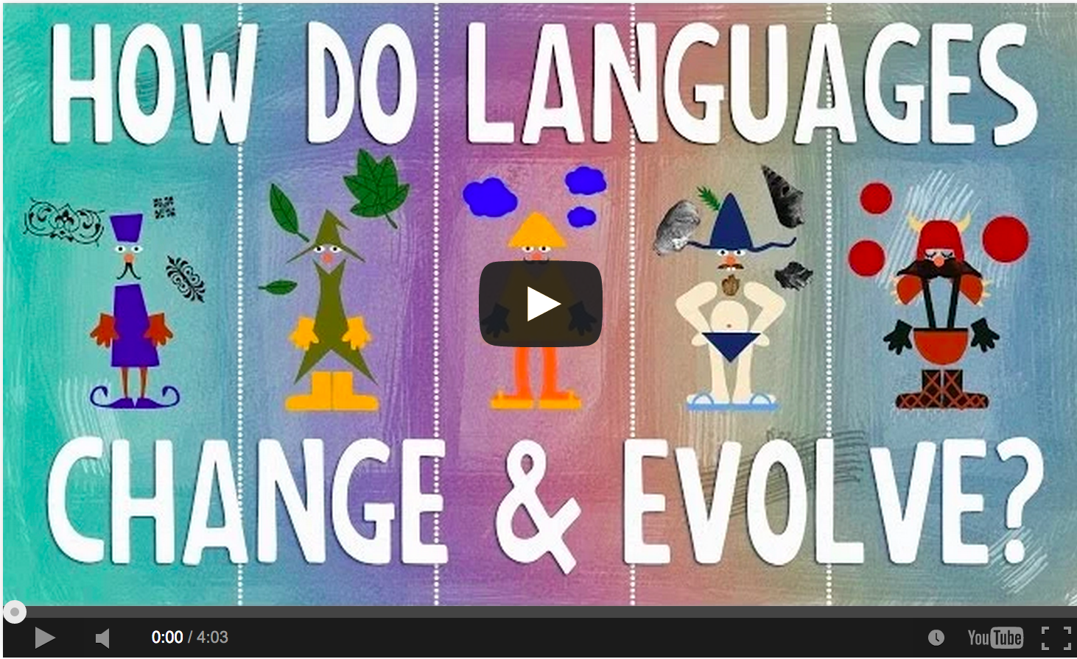
Video: How Languages Evolve
Notes:
https://www.youtube.com/watch?v=iWDKsHm6gTA

Slide 20
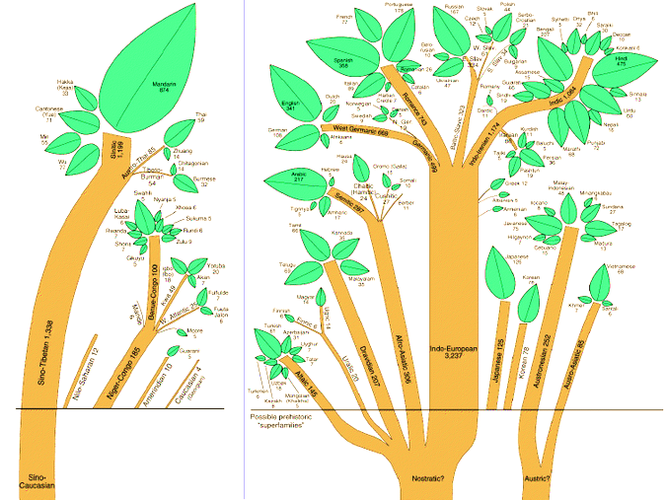
II. Language Families

Slide 21
A. Classification
Protolanguage: reconstructed/ early form of a language
Language family: connected by pre-history ancestral language

Slide 22
3. Language branch: collection of similar languages in a family
4. Language group: collection of languages in a branch connected recently w/ similar grammar

Slide 23
Summary
Define language in your own words.
Describe the evolution of language.
Explain how languages might diffuse using vocab from earlier chapters.

Slide 24
Family Trees cont'd
Bellwork 10/31:
What countries do you think have similar languages, or languages that are in the same language family?

Slide 25
II. Language Families

Slide 26
A. Classification
Protolanguage: reconstructed/ early form of a language
Language family: connected by pre-history ancestral language

Slide 27
3. Language branch: collection of similar languages in a family
4. Language group: collection of languages in a branch connected recently w/ similar grammar

Slide 28
B. Language Families
Sino-Tibetan
    China, Myanmar, Tibet
    Second most widely spoken language family
    Chinese – official UN language
    Languages to Know: Mandarin, Cantonese

Slide 29
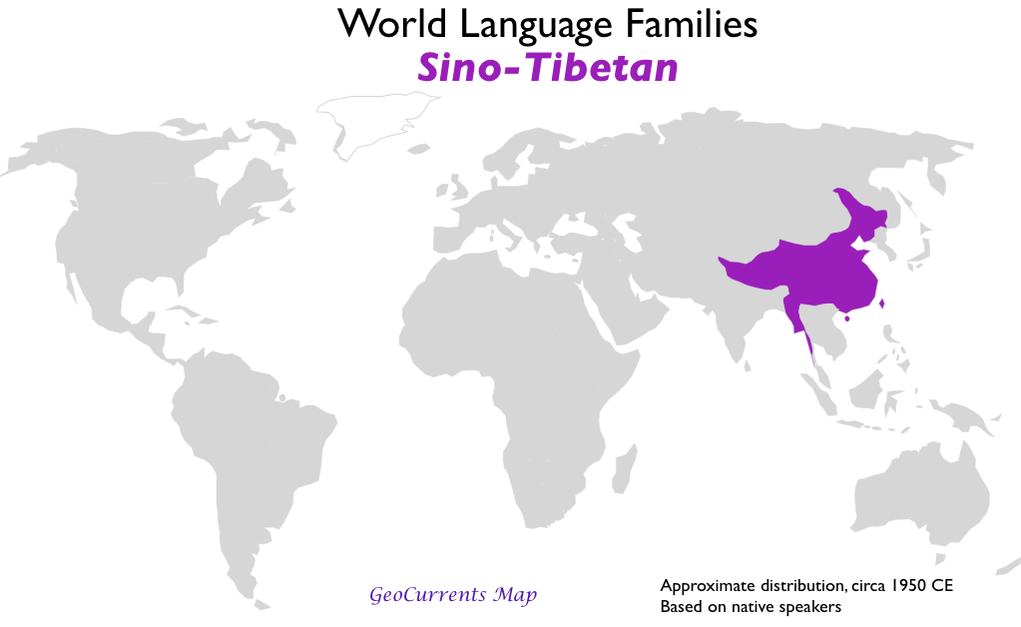

Slide 30
2. Austro-Asiatic
  Vietnam, Cambodia
  Vietnamese alphabet created by Catholic missionaries
3. Tai-Kadai
  Thailand, Laos
  Tonal language

Slide 32
4. Afro-Asiatic
  Arabic & Hebrew
  Official language in 24 countries of Middle East and North Africa
  One of the six official languages in U.N.

Slide 33
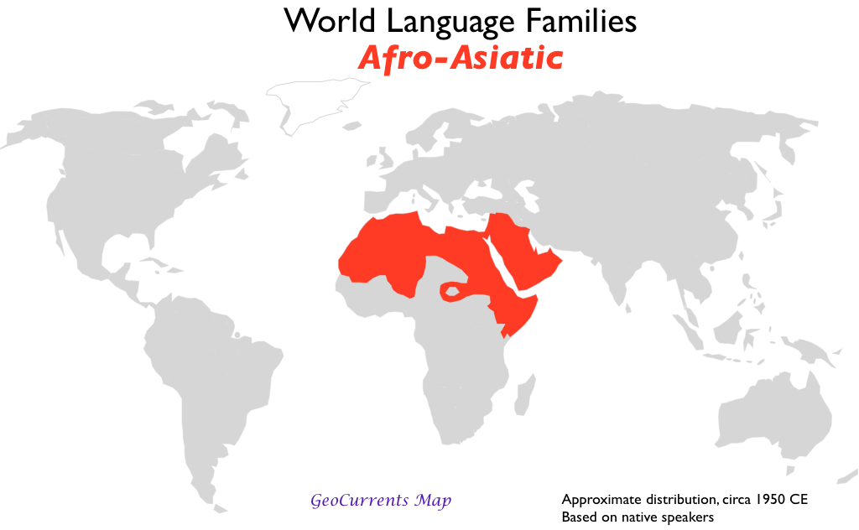

Slide 34
5. Altaic
  Altaic language with most speakers is Turkish
  Official language of post U.S.S.R. countries
    Azerbaijan, Kazakhstan, and Turkmenistan

Slide 36
6. Niger-Congo
Swahili (From the Bantu Migration)
  Spoken by 30 million Africans
    LINGUA FRANCA OF S-S AFRICA
1,000+ distinct languages in African Language Family
  Several thousand dialects recognized
  Most have no written tradition

Slide 37
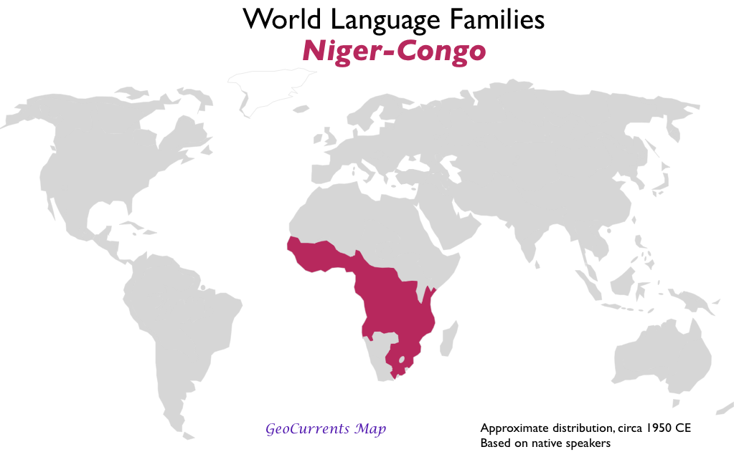

Slide 38
Quick review
Without looking at your notes, identify three language families and where they are spoken.

Slide 39
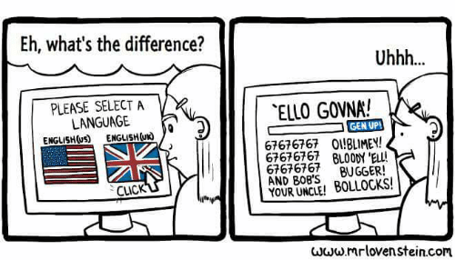
Indo-European Languages
Bellwork 11/2
Look at the cartoon below. How does this reflect the difference between "language" vs. "language group"?

Slide 40

FFotD

Slide 41

FFotD:
There are about 750 types of trees in North America and about 100,000 in the world. Many of those are endangered. Those numbers count both conifer (cone bearing) trees and deciduous trees.

Slide 42

1. Indo-European
Most widely spoken language family
UN Official: English, French, Spanish, Russian

Slide 43
Language Family: | Indo-European
Language Branch: | Germanic | Romance | Balto-Slavic | Indo-Iranian | Greek
Individual Language in each branch | German English Dutch Swedish Danish | Spanish French Portuguese Italian Romanian | Russian Ukrainian Czech Polish | Hindi Farsi Urdu Pashto Bengali Panjabi

Slide 44
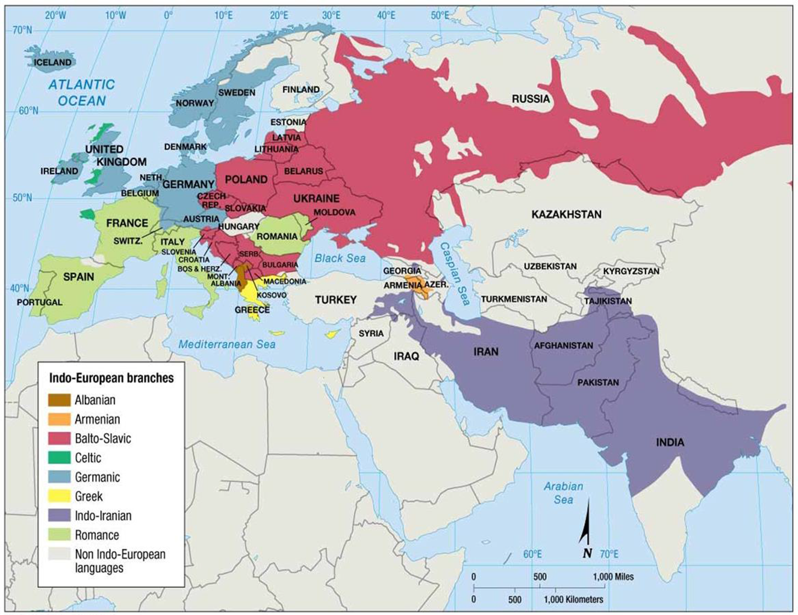
2. Germanic Branch
Spoken in northwestern Europe and North America
  English is a Germanic language!

Slide 46

b. Around the World
English goes with British colonies over 400 years
English official language in most former British colonies

Slide 47
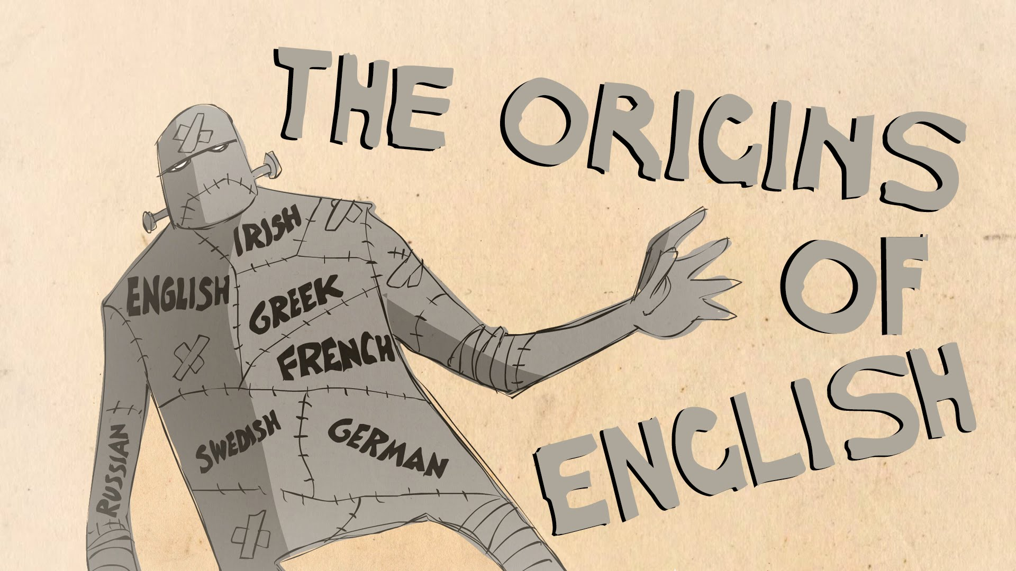
Video: Where did English Come From?
Notes:
https://www.youtube.com/watch?v=YEaSxhcns7Y

Slide 48
3. Indo-Iranian branch
Spoken in Southwest Asia
Divided
into eastern
group (Indic) and
western group
(Iranian)

Slide 49
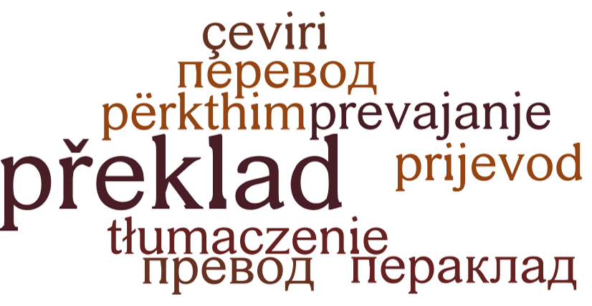
4. Balto-Slavic Branch
Spoken in Eastern Europe
Dominated by Russian
    Shaped by political control of 20th century

Slide 50
Indo-European: Balto-Slavic Branch

Slide 51
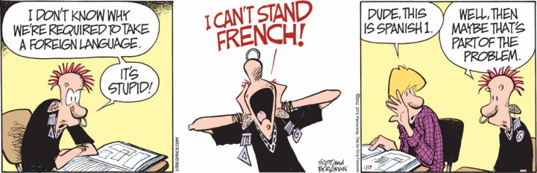
5. Romance Branch
Spoken in southwestern Europe and Latin America
Based off Latin
Spanish, French,

Slide 52
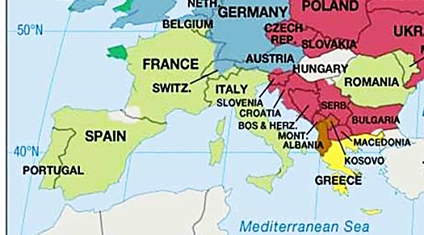
Indo-European: Romance Branch

Slide 53
DISCUSS
What countries outside of Europe speak romance languages??
List at least 3 countries and the language they speak!!

Slide 54
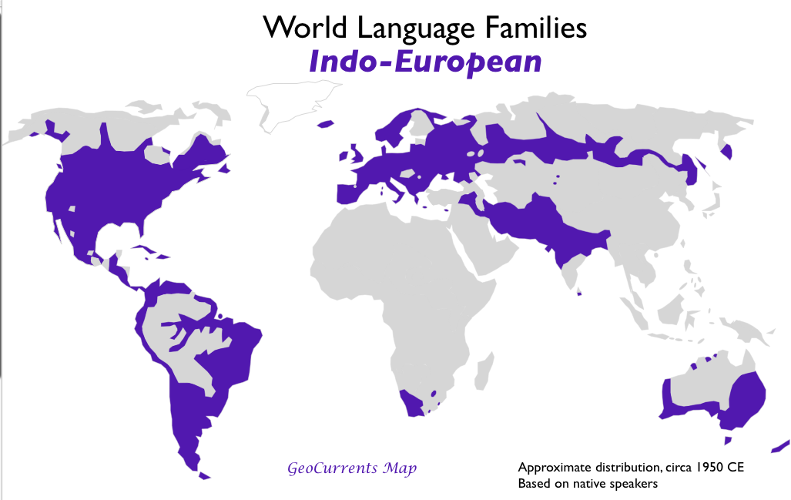

Slide 55
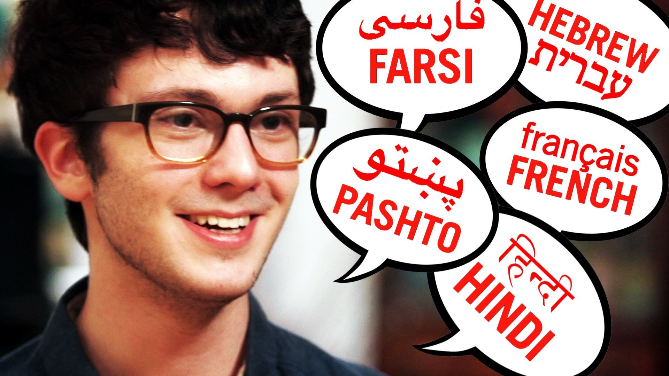
Video: Polyglot
Notes:
https://www.youtube.com/watch?v=Km9-DiFaxpU

Slide 56

II. Diffusion of Language

Slide 57
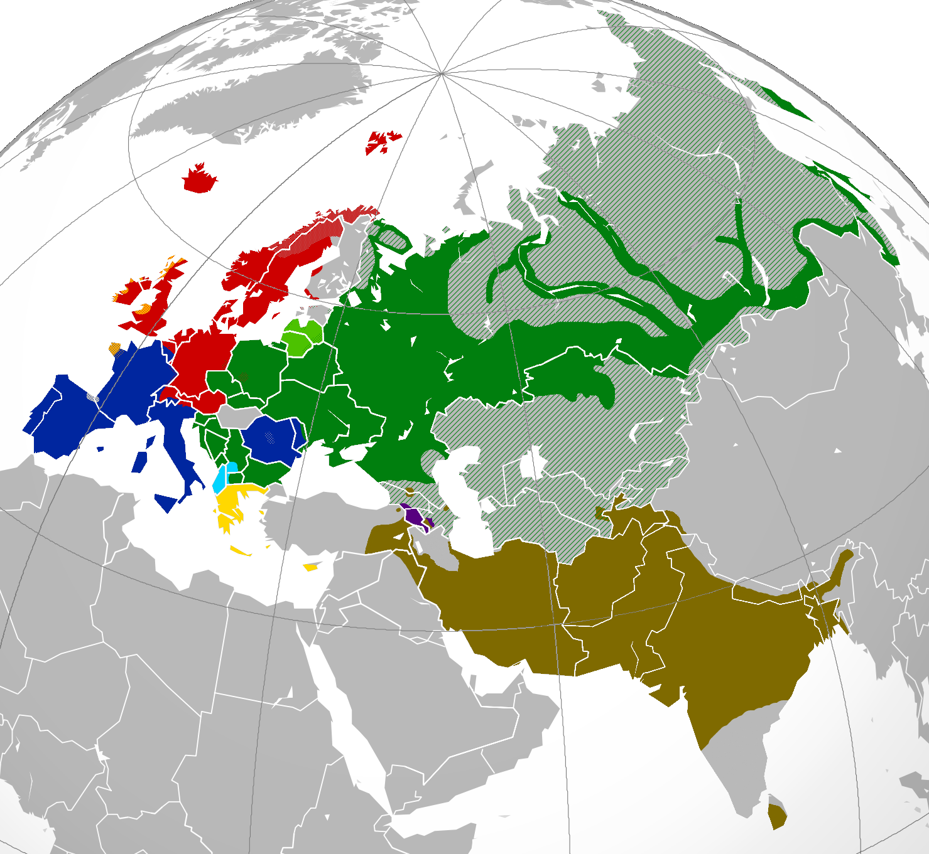
A. Origin of Indo-European
Theorized that they stem from common ancestral language

Slide 58
2. Nomadic Warrior Hypothesis
Kurgan Hypothesis
Kurgan People (4000 BCE) in Kazakstan
Nomadic herders
2500 BCE: they travel/conquer Europe and Asia
Language spread via MILITARY

Slide 59
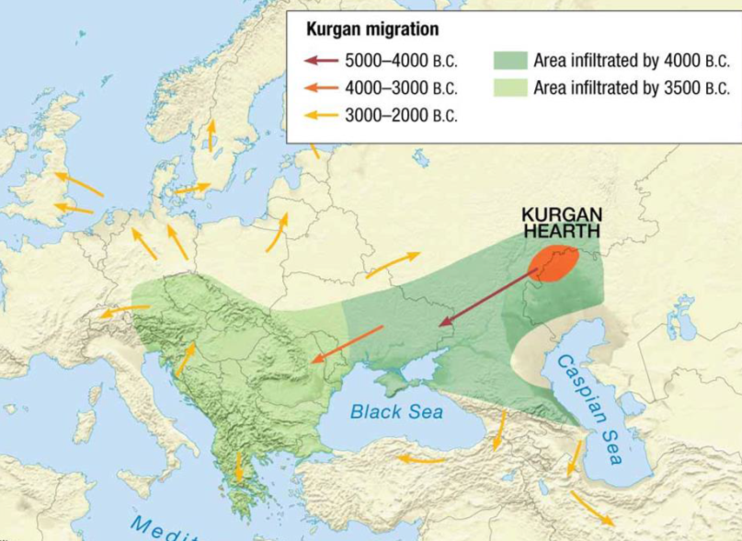

Slide 60
3. Sedentary Farmer Hypothesis
Anatolian Hypothesis
Farmers in Turkey 6,000 BCE
Language spread with agricultural innovations west into Europe and east into Asia

Slide 62
DISCUSS
What theory do you think is most accurate?
WHY?
Notes:
1st Period Here

Slide 63
Language Diffusion
Bellwork 11/8
Have you ever gotten a slang term/phrase or inside joke to catch on with your friends? If not, have you ever adopted one of theirs?
What was it, and how does that show diffusion?
*School appropriate please

Slide 64
A. Other Examples of Language Diffusion
Slavic Expansion across Siberia destroys Paleo-Asiatic language
  Ancient agriculture allowed for population growth
  Later military growth spreads dominance

Slide 65
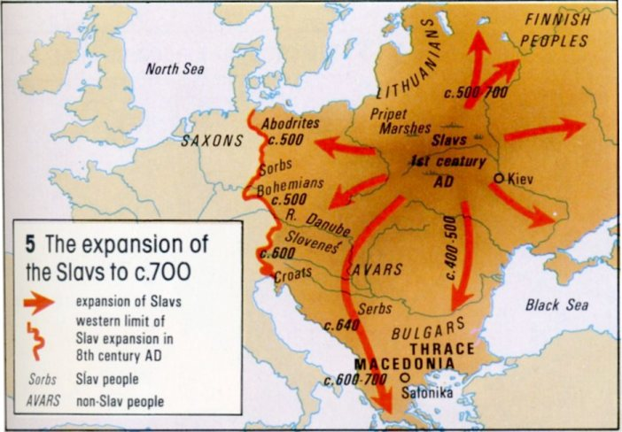

Slide 66
2. Sino-Tibetan spreads North and East
  Originated ~4000 BC (?)
  Originally near rivers and Himalayan Plateau
  Diffused along rivers

Slide 67
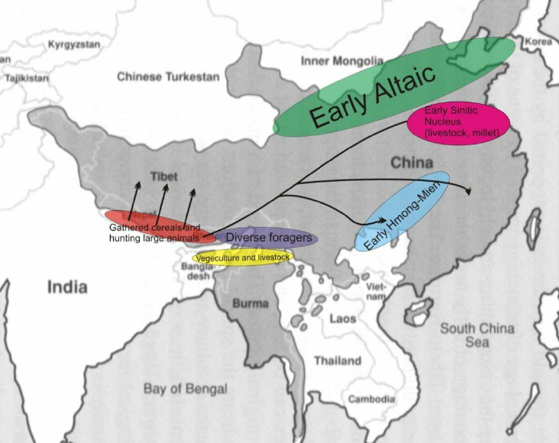

Slide 68
Discuss
What’s the relationship between geography and language?

Slide 69
3. Islam spreads Arabic
  From Arabian Peninsula
  Holy language of Islam and official language of Islamic empires
  632 onward

Slide 70
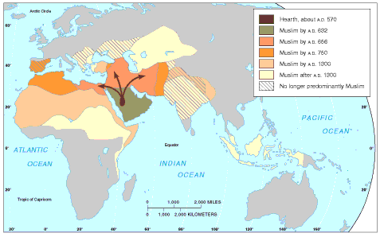
Spread of Islam

Slide 71
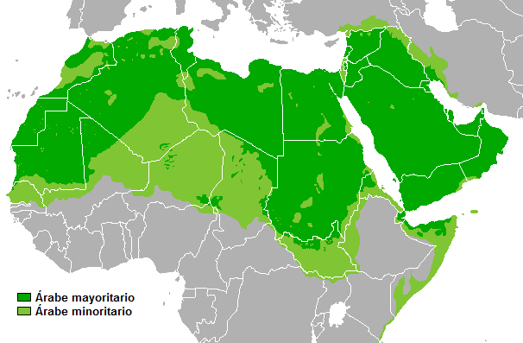

Slide 72
Discuss
What’s the relationship between language and religion?

Slide 73
4. Bantu migration spreads Swahili
  500CE – migrate East for food
    Trade language: a neutral language used by those with different native languages; lingua franca

Slide 74
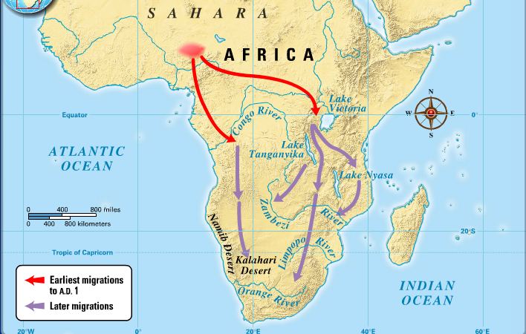
Bantu Migration

Slide 75
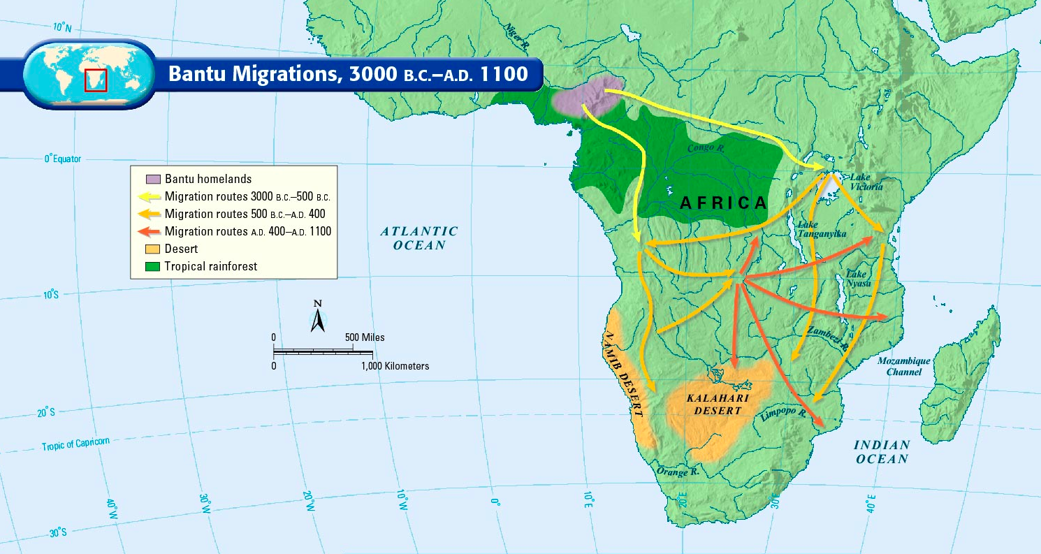

Slide 76
Discuss
What’s the relationship between language and trade?

Slide 77
5. Latin spread by Roman empire and Christianity
  Latin was the official language of Rome; established laws throughout empire
  Catholic church taught in Latin & still used it after Rome fell

Slide 78
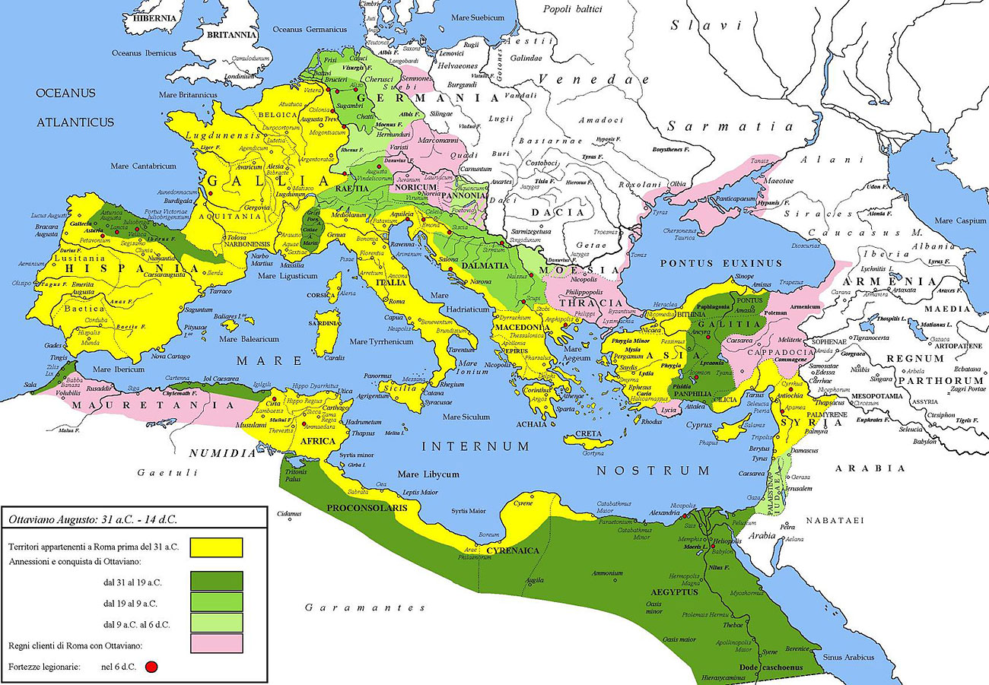
Roman Empire

Slide 79
Discuss
What’s the relationship between language and government?

Slide 80
B. Barriers to Diffusion
Refusing to adopt an official language as an act of rebellion
  Breton, Catalan, Basque
Geographic barriers
  Mountains, oceans, deserts

Slide 81
Summary
Describe the ways languages can diffuse.
Identify two things that can halt the diffusion of a language.
Explain the evolution of Indo-European languages.

Slide 82
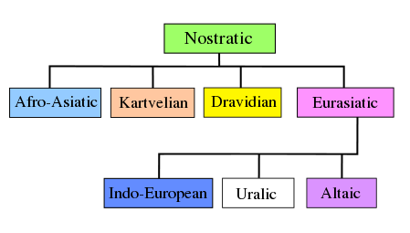
4. Nostratic Hypothesis
15,000-12,000 BCE
Origin language for all language families for Eurasia and Africa

Slide 83
Day 5

Slide 84
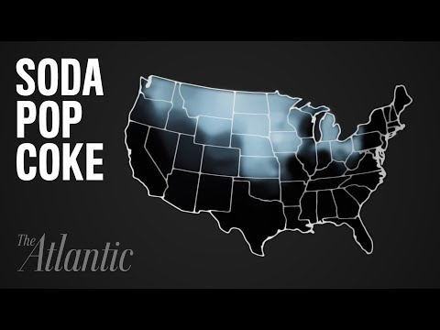
Bellwork: Are there any words/phrases you say that aren't shown in Arizona?
Notes:
https://www.youtube.com/watch?v=4HLYe31MBrg

Slide 85
Agenda:
Notes: Dialects
HW: Enjoy the 3-day weekend!

Slide 86
Objective:
You will be able to explain how dialects develop.

Slide 87
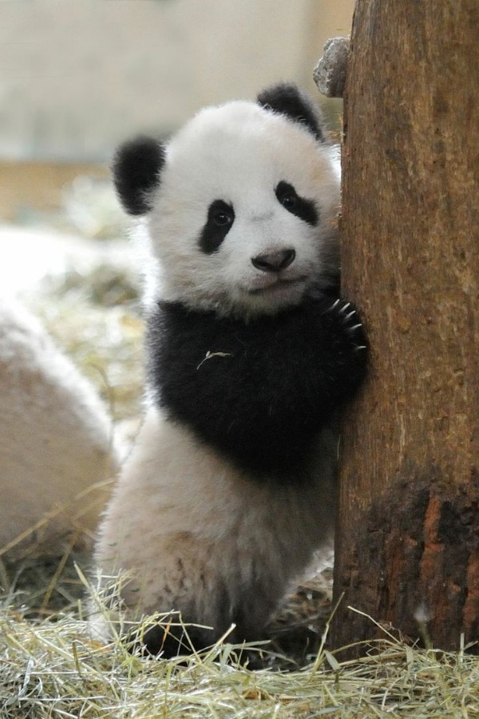
TUBI:
All the pandas in the world are on loan from China

Slide 88
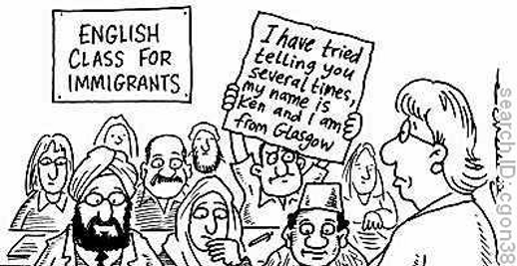
I. Dialects

Slide 89
A. Definitions:
  Dialect: Regional variation of language with distinctive vocabulary, spelling, and grammar
  Accent: the way people speak and pronounce words in different parts of the world
Every individual has an accent, but we focus more on large groups

Slide 90
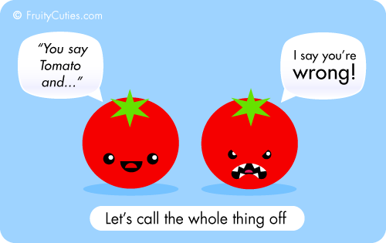
3. Vernacular: the common language/dialect spoken by people

Slide 91

4. Syntax: the arrangement of words and phrases
5. Isogloss: geographical boundary within which a particular linguistic feature occurs

Slide 92
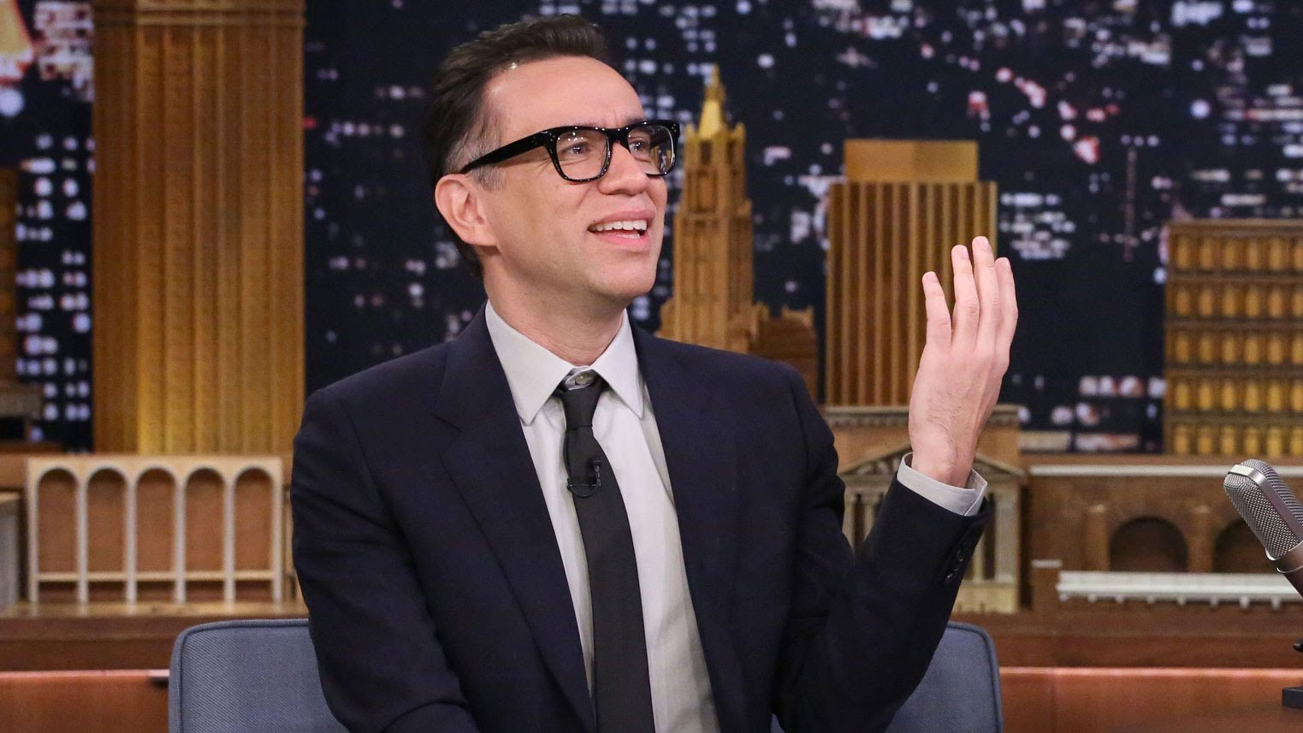
VIDEO: BRITISH to SOUTHERN / FRED ARMISEN
Notes:
https://www.youtube.com/watch?v=LakigMiP63k

Slide 93
DISCUSS
What is your favorite American accents?
This is your chance: SPEAK IN DIFFERENT ACCENTS

Slide 94
B. Dialects in the United Kingdom
  Languages with multiple dialects often have a standard language
    Standard language: most acceptable for government, business, education, etc
    Orthography: conventional spelling of a language

Slide 95
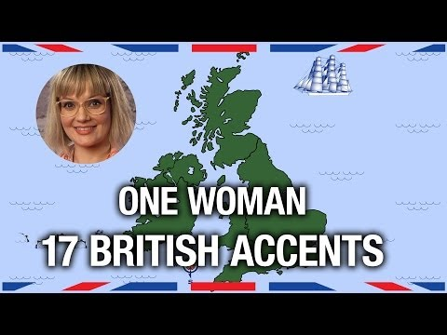

Slide 96
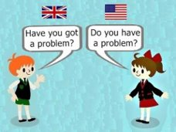
  C. American vs. British English
Vocabulary
  Different climate and geography
Spelling
  Noah Webster made English in America distinct

Slide 97
3. Pronunciation
  Because of limited interaction after colonialism
  Phoneme: the sounds used distinguish one word from another,
    Example: p, b, d, and t in the English
    words pad, pat, bad, and bat.

Slide 98
D. English Changes
Hierarchical Diffusion
  First from British Colonization
  Then, from urban centers
  REVERSE – people retain linguistic uniqueness as identity

Slide 99

2. Pidgin: the simplified form of a language
Notes:
https://www.youtube.com/watch?v=OaolMcl8v0I

Slide 100
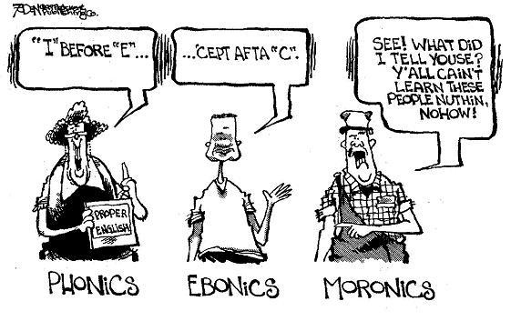
Ebonics: African American dialect
  African American Vernacular English

Slide 101

Video: 3 ways to Speak English
Notes:
https://www.ted.com/talks/jamila_lyiscott_3_ways_to_speak_english

Slide 102
Discuss
Do you have multiple ways of speaking English?
What are they?

Slide 103

E. Creolized Language
  Creole Language: when a pidgin language develops into its own language
    Haiti, Seychelles

Slide 104
F. Spanish and Portuguese
90% Spanish and Portuguese speakers don’t live in Europe
Spain and Portugal create official versions of their languages in the 1990’s

Slide 105
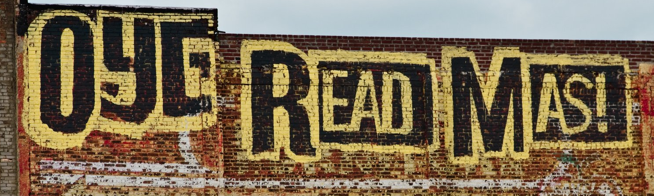
4. Spanglish: combination of English and Spanish spoken by Hispanic Americans
a. Speech Community: group of people sharing a common language/dialect

Slide 106

Video: How to Speak Spanglish
Notes:
https://www.youtube.com/watch?v=RVnJ4odvlHc

Slide 107
5. There is no “Correct” English, just a Standard Language
  Paupa New Guinea Pidgin, Singlish (Singapore), Taglish (Philippines), Franglais

Slide 108
Summary
Define dialect.
Describe how different dialects develop and use 2 examples.

Slide 109
Day 7

Slide 110
Isolated and Revived Languages
Bellwork 11/13:
Why would languages change over time? What needs/factors would prompt new words or languages?

Slide 111
Agenda:
Notes: Isolated and Revived Languages
HW: RQs #26-30

Slide 112
Objective:
You will be able to discuss the use of formal English.

Slide 113
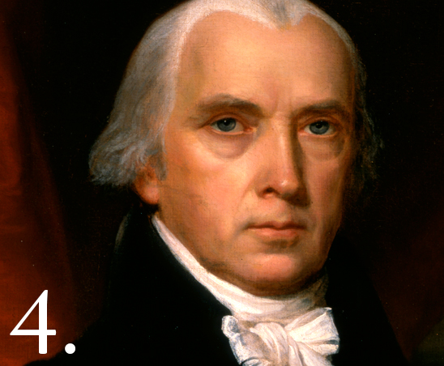
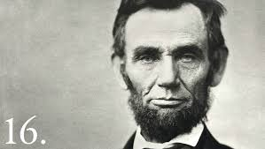
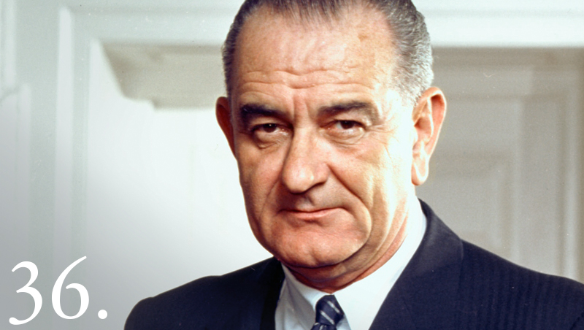
TUBI
The tallest U.S. Presidents were Abraham Lincoln and Lyndon B. Johnson at 6’4”, while the shortest was James Madison at 5’4”.

Slide 114
I. Isolated Languages
Isolated language: unrelated to any other language family
  Arises from lack of interaction with speakers of other languages

Slide 115
b. Basque in Europe
  First language of 666,000 people in the Pyrenees Mountains
  Only pre- Indo-European spoken language left
  Wants to be independent

Slide 116
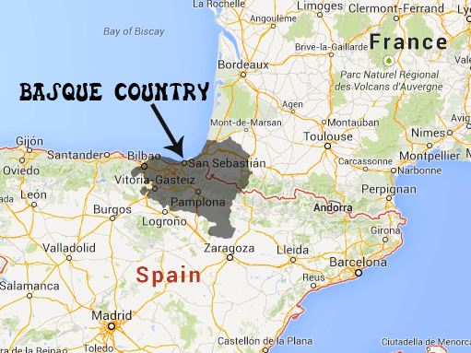

Slide 117
c. Korean and Japanese
- Not part of Sino-Tibetan family
- Developed in relative isolation
-Use similar logograms due to centuries of political and military exchange
-Not in any risk of decline, though

Slide 118
II. Extinct Languages
Hundreds of languages will become extinct during the 21st century
  Only ~300 languages are safe
  Extinct language: no longer spoken or read in daily activities by anyone

Slide 119
c. Now: 473 languages nearly extinct
  46 in Africa
  84 in Asia
  9 in Europe
  152 in Pacific
  182 in Americas
d. Ex. Native Americans
  74 Native American languages extinct in the USA

Slide 120
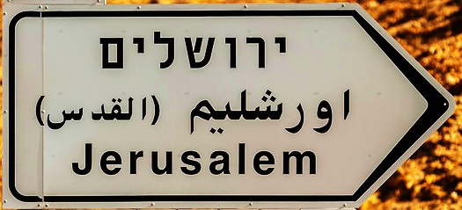
III. Revived Languages
Hebrew: Official language of Israel; Dead language before WWII
  Updated words for telephones, cars, technology, and electricity

Slide 121
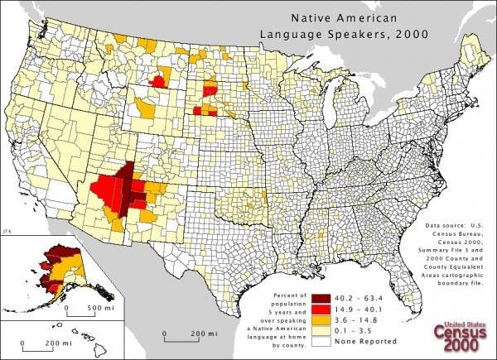
2. Native American Languages
a. Large push to restore spoken language after centuries of US repression
b. Especially significant here in AZ!

Slide 123
Discuss:
Why revive a language?

Slide 124
C. Reasons and support for reviving languages
Maintain folk culture
  Teaching Navajo
Separatists
  Basque region
3. Unity in a multicultural state!
  Belgium, Canada

Slide 125
4. Nationalism
  Israel and Hebrew
5. Modern technology
  Minority groups use it to preserve language
6. Tourism
  Welsh

Slide 126
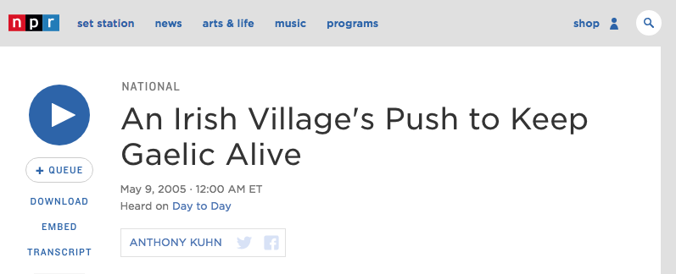
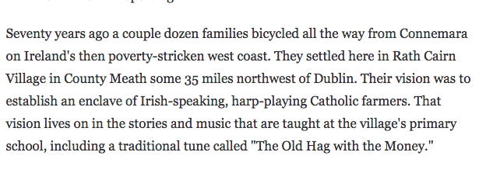
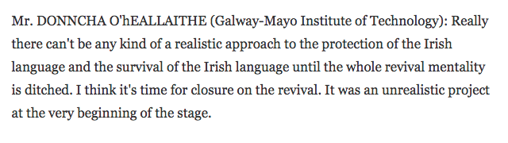

Slide 127
Summary
Describe the relationship between isolated and extinct languages.
Explain why languages are threatened and preserved.
Thanksgiving Leaves!

Slide 128
Day 8

Slide 129
Things and Stuff
Bellwork
Is there a correct way to speak English? Why or why not?

Slide 130
Agenda:
Notes: English Dominance
HW:

Slide 131
Objective:
You will be able to connect English as a lingua franca to earlier chapters.

Slide 132
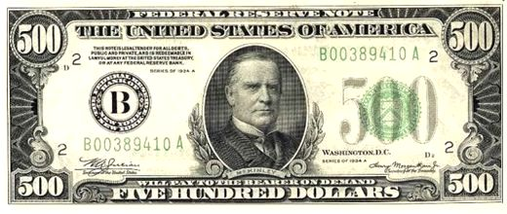
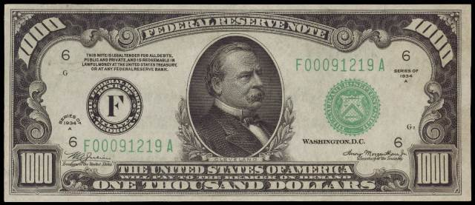
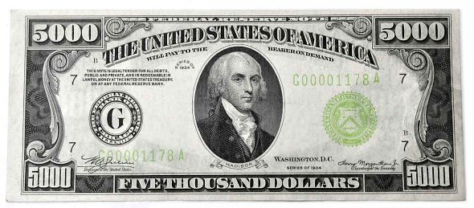
TUBI:
William McKinley ($500), Grover Cleveland ($1,000), James Madison ($5,000

Slide 133
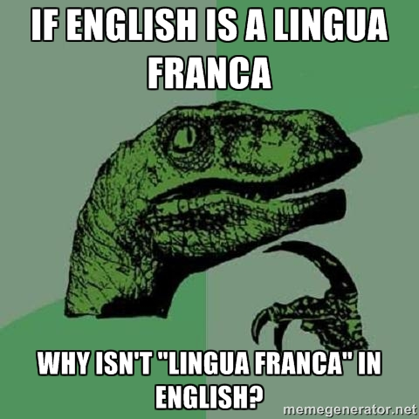

Slide 134
Language of international community
  Spoken fluently by up to 1.5 billion
  Official language of 57 countries
  People learn English to be part of global economy/culture
    Historically, language of development and education

Slide 135
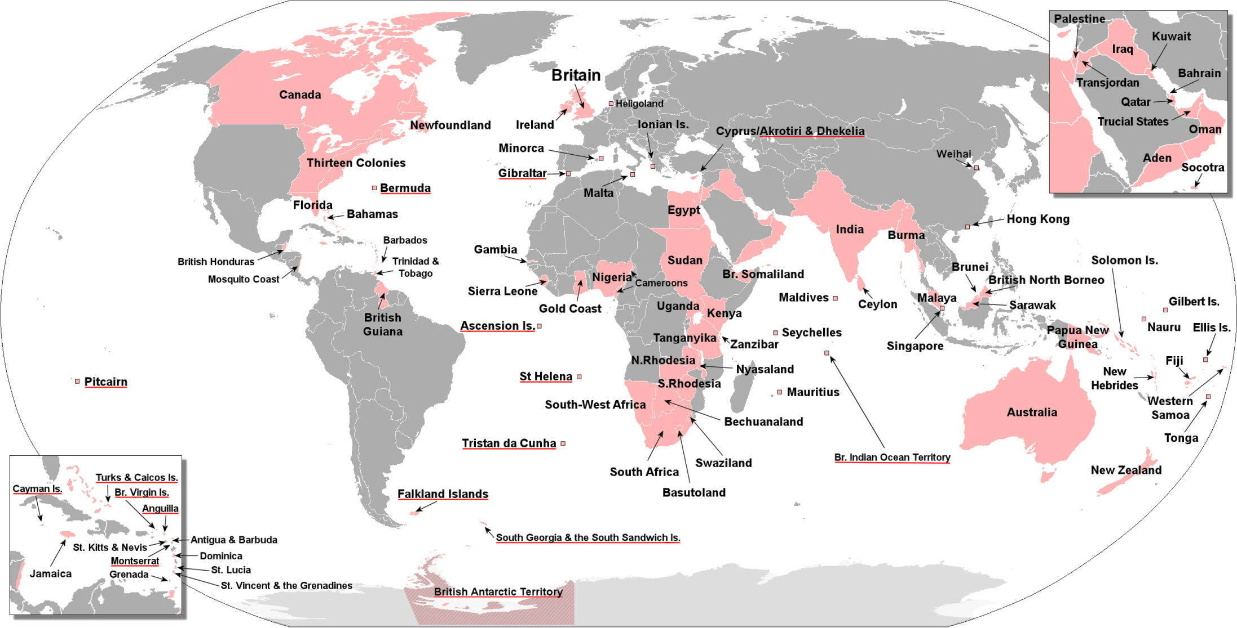
British Empire

Slide 136
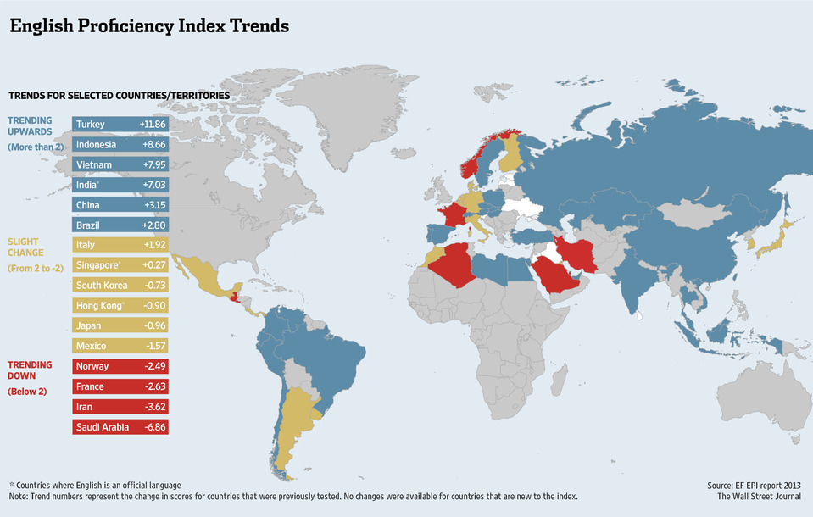

Slide 137
B. English & the Internet
80% internet content is in English
BUT English on the internet is declining
Mandarin becoming a MAJOR internet language

Slide 138

LANGUAGES OF
ONLINE SPEAKERS

Slide 139
Discuss
Try and come up with as many slang words for English as possible.

Slide 140


C. Dissecting English
Slang: informal words or phrases in a language

Slide 141
D. English Changes
Hierarchical Diffusion
  First from British Colonization
  Then, from urban centers
  Now from US pop culture

Slide 142
2. Pidgin: the simplified form of a language
-Creole Language: indigenous and colonial languages fuse into a new language
    Haiti, Seychelles

Slide 143
Video: How to Speak Pidgin
Notes:
https://www.youtube.com/watch?v=OaolMcl8v0I

Slide 144
Ebonics: African American dialect
  African American Vernacular English

Slide 145
Video: 3 ways to Speak English
Notes:
https://www.ted.com/talks/jamila_lyiscott_3_ways_to_speak_english

Slide 146
Discuss
Do you have multiple ways of speaking English?
What are they?

Slide 147
4. Spanglish: combination of English and Spanish spoken by Hispanic Americans
a. Speech Community: group of people sharing a common language/dialect

Slide 148
Video: How to Speak Spanglish

Slide 149
5. There is no “Correct” English, just a Standard Language
  Paupa New Guinea Pidgin, Singlish (Singapore), Taglish (Philippines), Franglais

