Slide 1
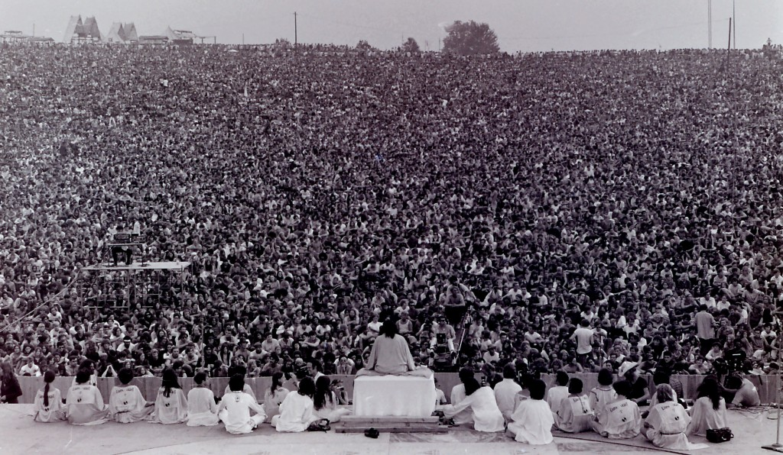
AP Human Geography
Chapter 2: Population

Slide 2
Day 1

Slide 3
Population Bellwork 8/23
Grab a KBAT.
In what kind of environments do people want to live?
Come up with 3 examples!

Slide 4
Agenda:
KBAT
Notes: Population Distribution
4 Level Map Analysis
HW: RQs #1-5, Map + capitals

Slide 5
Objective:
You will be able to analyze a map of population density in writing.

Slide 6
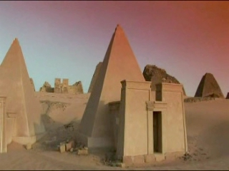
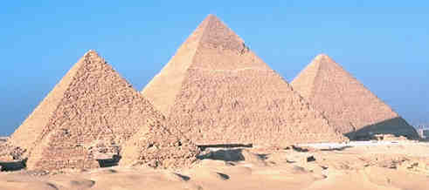
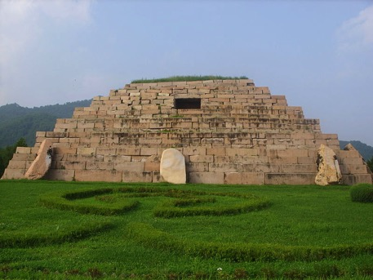
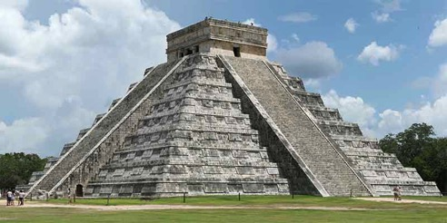
TUBI
Pyramids!
Notes:
Totally Useless Bit of Information

Slide 7
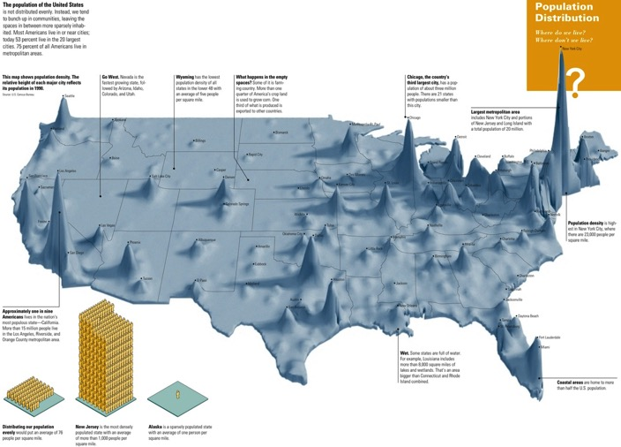
I. Population Distribution

Slide 8
A. Population Concentrations
Demography: the study of population
Ecumene: the portion of the Earth’s surface where people can live
Population clusters

Slide 9
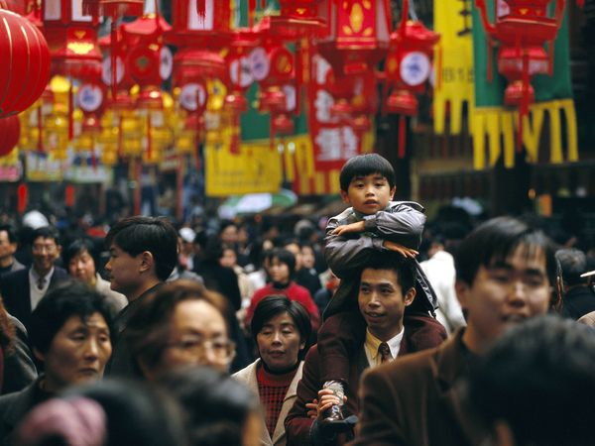
a. East Asia

Slide 10
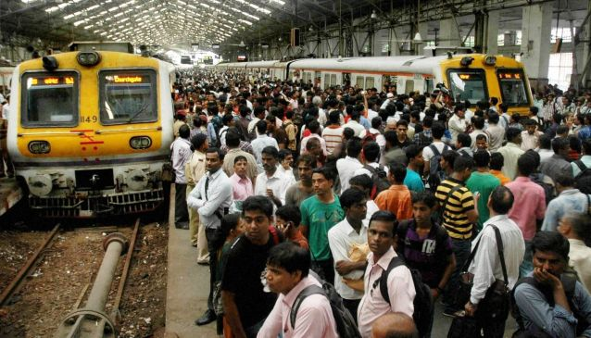
b. South Asia

Slide 11
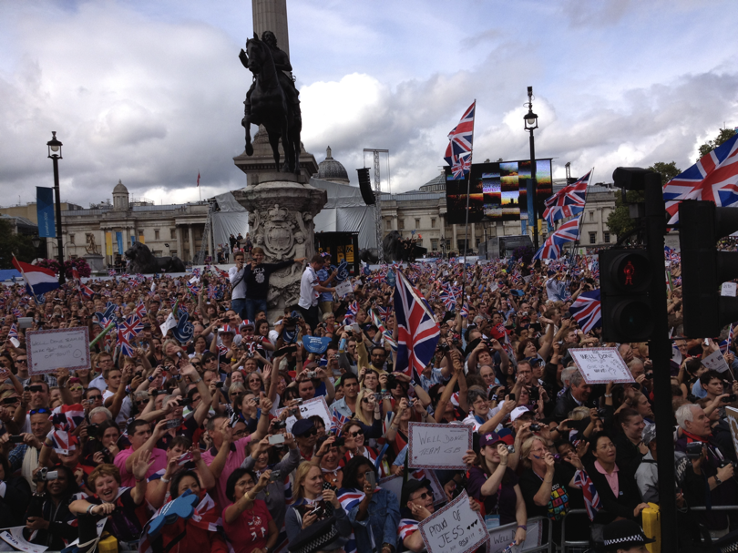
c. Europe

Slide 12
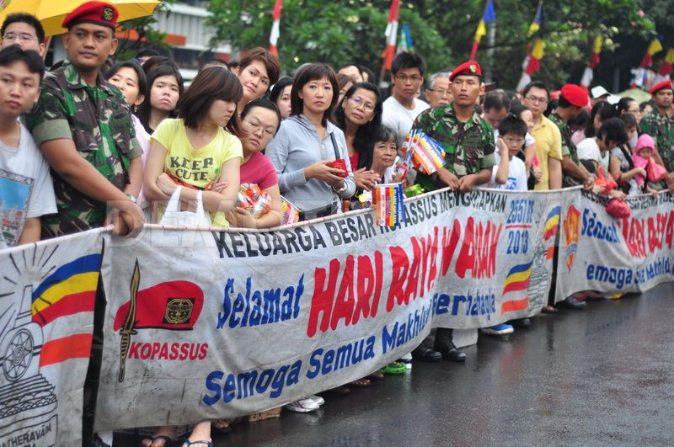
d. Southeast Asia

Slide 13
B. Sparsely Populated
Aka where people don’t live
Nonecumene: the uninhabited parts of the planet, where people can’t easily survive

Slide 14
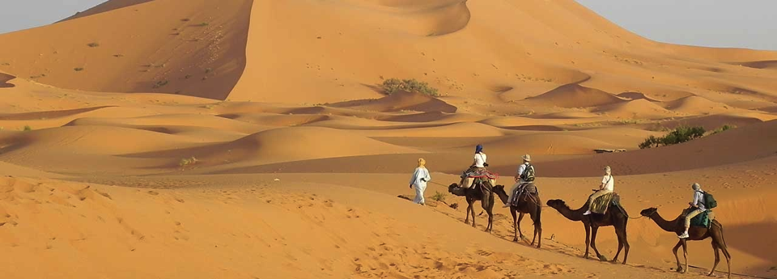
a. Deserts/Tundra

Slide 15
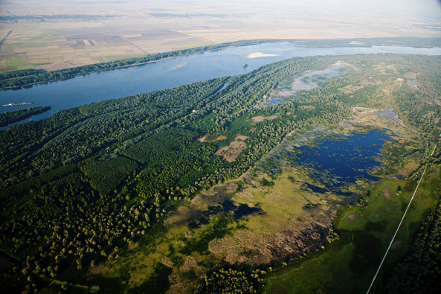
b. Swamps, River deltas, everglades

Slide 16
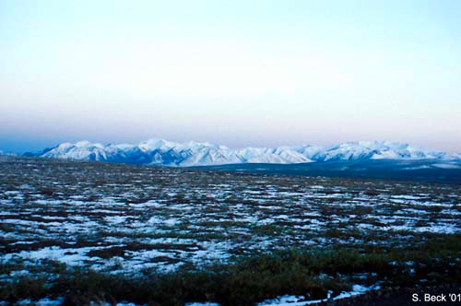
c. Arctic and Antartica

Slide 17
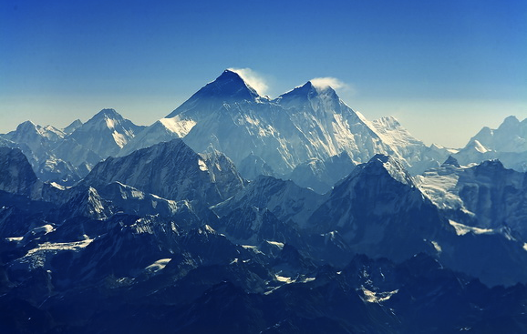
d. Tops of mountains, high plateaus

Slide 18
Geographic Connections
Name a major geographic feature for each type of non-ecumene.

Slide 19
3. Natural Hazards
These show up in both Nonecumene AND ecumene
Hurricanes, Typhoons, Flooding
Desertification, Earthquakes, Volcanoes
Avalanches, Mudslides

Slide 20
Discuss
What are some ways that humans change the environment so that we can turn nonecumene into ecumene?

Slide 21
Summary
Define ecumene and nonecumene.
Describe relationship between ecumene and population.

Slide 22
4 Level Map Analysis –
What do you see?
Do you comprehend the map?
Where do you see things?
(patterns, unique things)
Why there?
So what?
Connect this to what we know about geography. Summarize what the map is saying. Why is this map important?
BULLET POINTS
COMPLETE SENTENCES

Slide 23
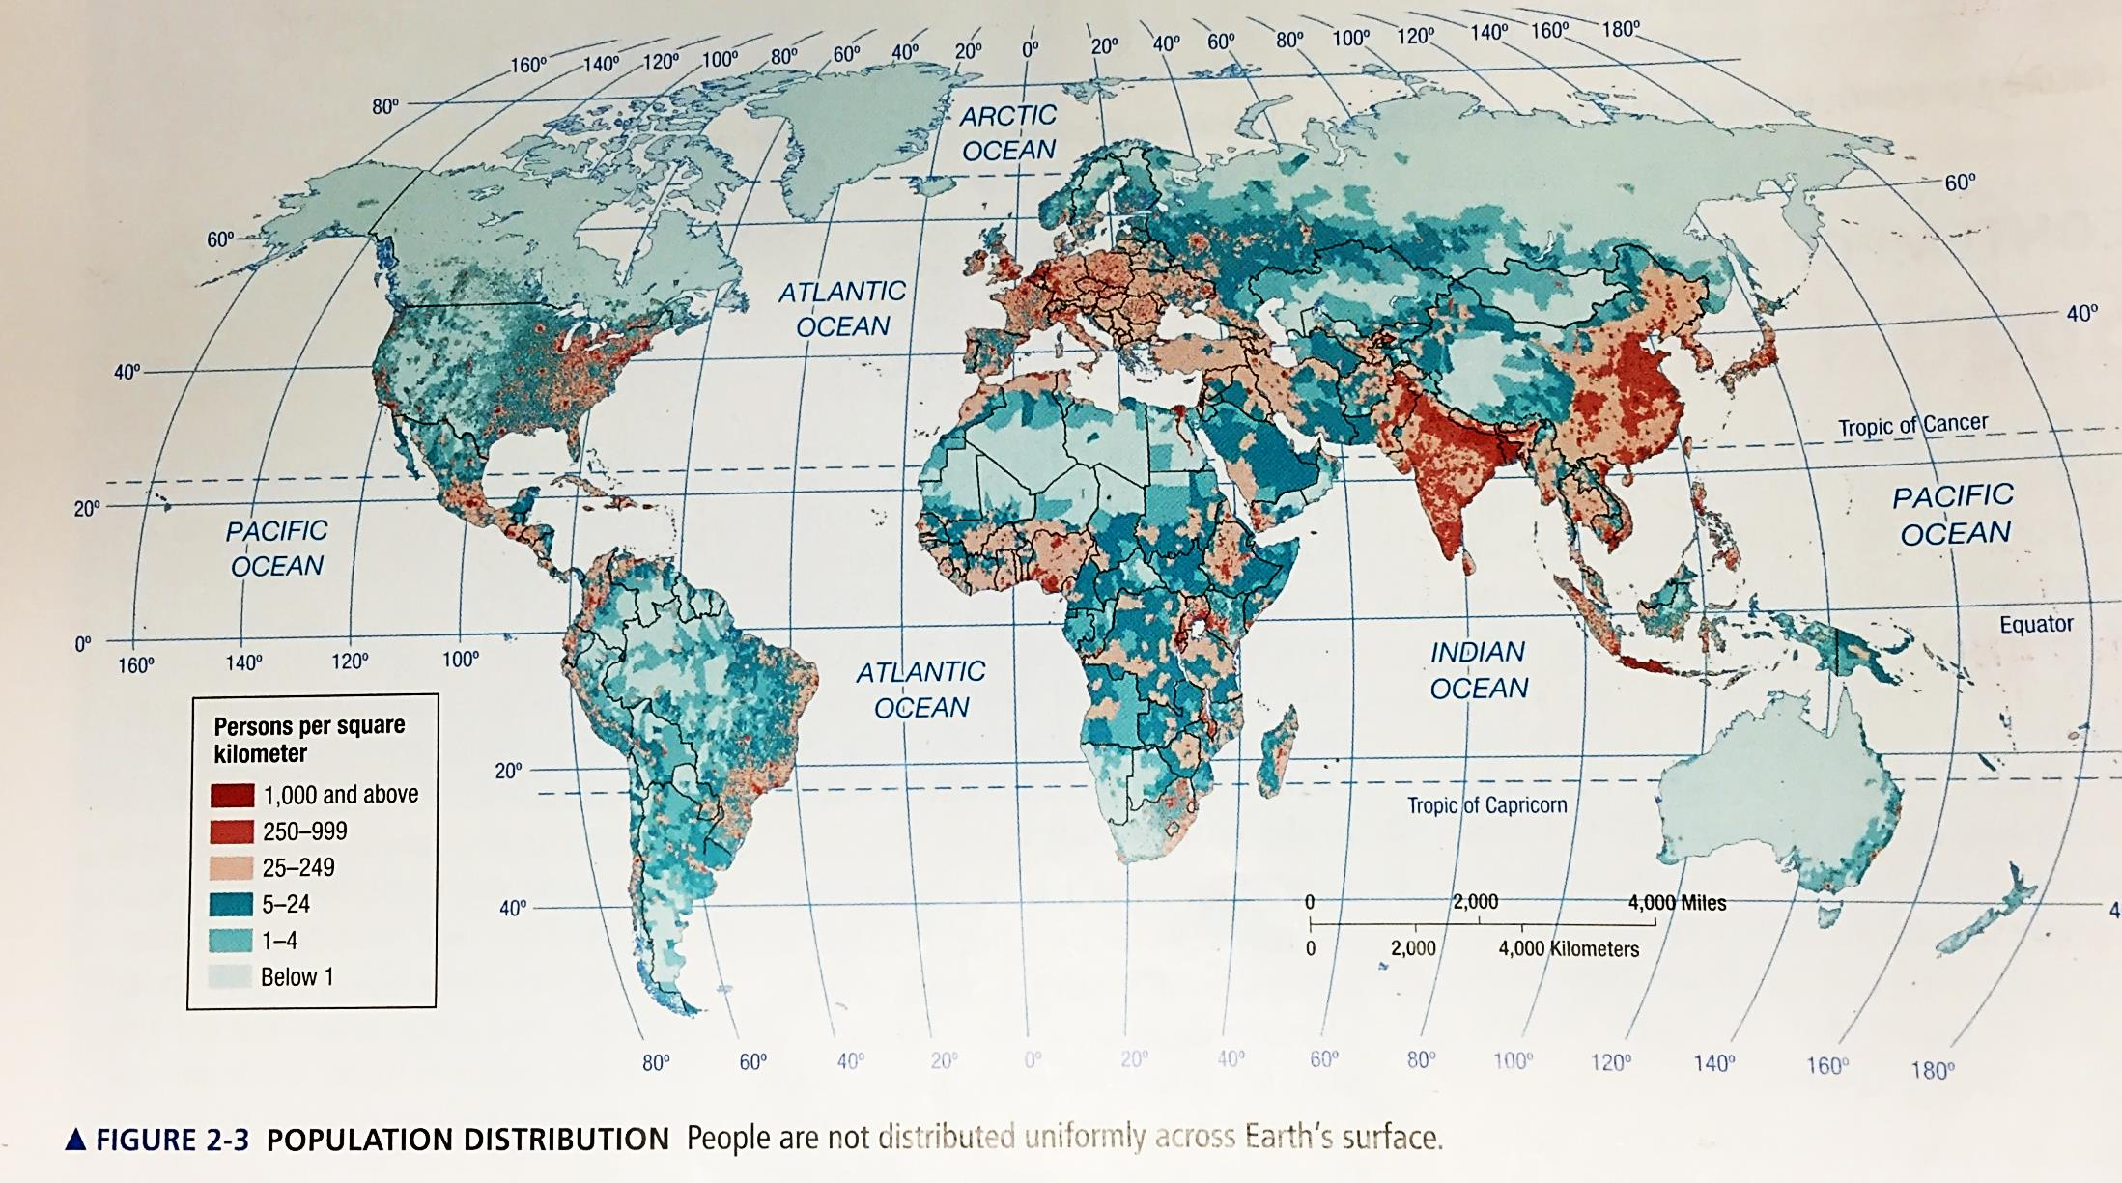

Slide 24
Day 2

Slide 25
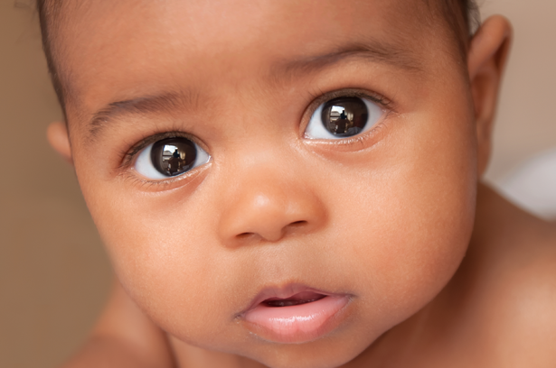
Demographic Vocab Bellwork 8/24
What country do you think has the highest birthrate? Why?
Use complete sentences!

Slide 26
Agenda:
Notes: Population Growth
HW: Reading #6-10, Map (countries + capitals)

Slide 27
Objective:
You will be able to describe how geographers analyze population change in writing.

Slide 28
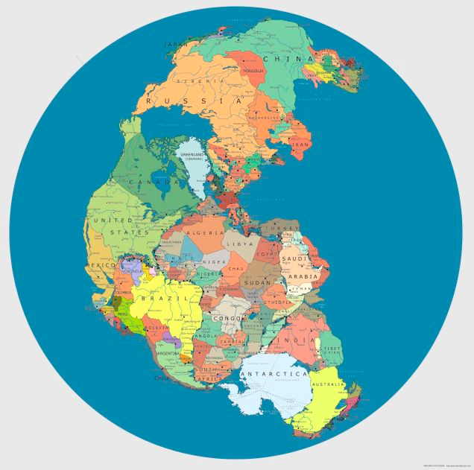
FFotD:
Pangea!

Slide 29
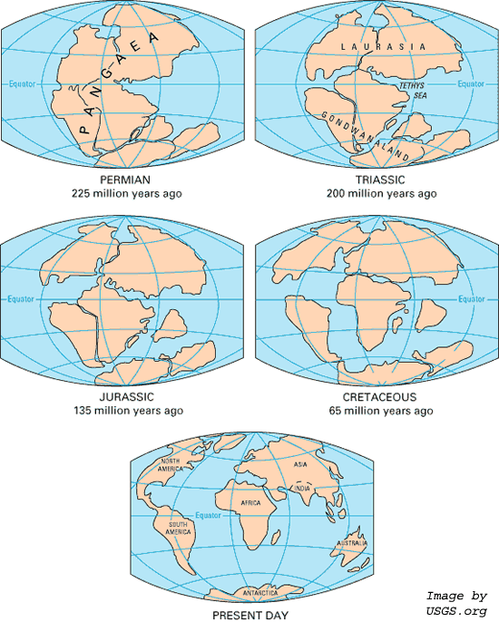

Slide 30
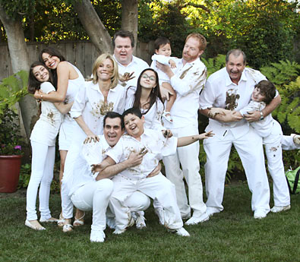
Let’s Predict the Future
NO NAMES!!!!!
Write down:
ON ONE HALF: The age and sex of every person in your immediate fam
ON OTHER HALF: How many kids you plan on having eventually
Notes:
Use this data to calculate the TFR of your classes and to create a population pyramid.

Slide 31
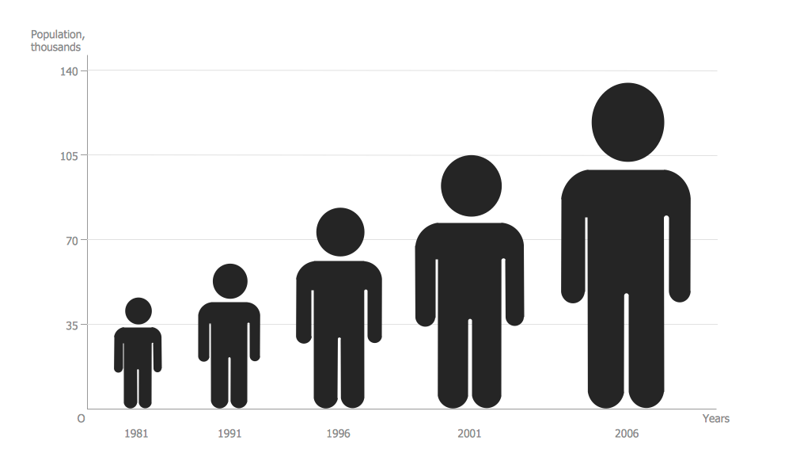
I. Population Growth

Slide 32
NPR: How did we get so big so fast?
Notes:
https://www.youtube.com/watch?v=VcSX4ytEfcE

Slide 33
A. Demographic Vocab
Crude Birth Rate (CBR)
# of births per 1,000 ppl
Influenced by age, development, culture, laws

Slide 34
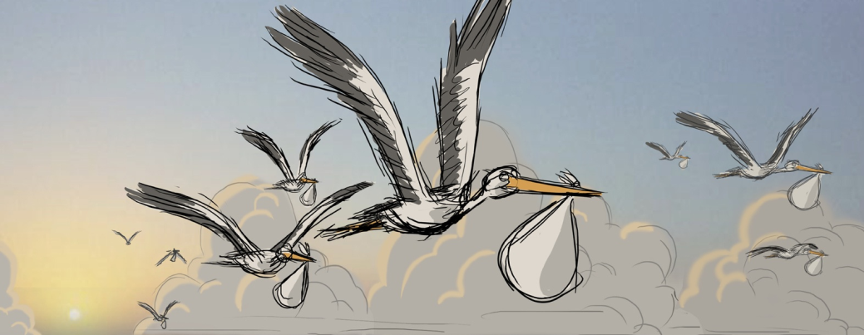
Crude Death Rate (CDR)
How many people die per 1,000 people
Infant mortality rate: infants 1 year and younger die per 1,000 live births

Slide 35
B. Natural Increase Rate
CBR-CDR / 10 =NIR
Current NIR on Earth: 1.14
NATURAL= birth not migration

Slide 36
2. 7.6 Billion people on Earth
3. Doubling time: how long it takes to double the population

Slide 37
C. Fertility
Total Fertility Rate (TFR) = Average # of babies a fertile woman will have
More accurate than CBR
CBR = population right now
TFR = population in future

Slide 40
2. Replacement Level Fertility: # of babies born ensure the same # of women will survive to have babies
So no population increase! Your population stays the same
You are replacing yourself

Slide 41
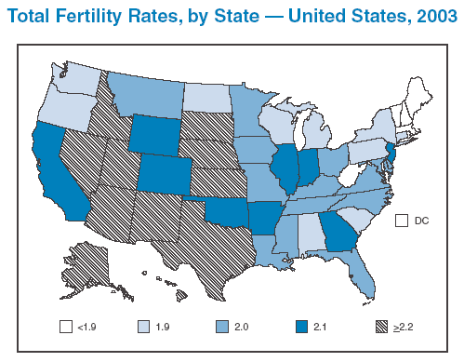
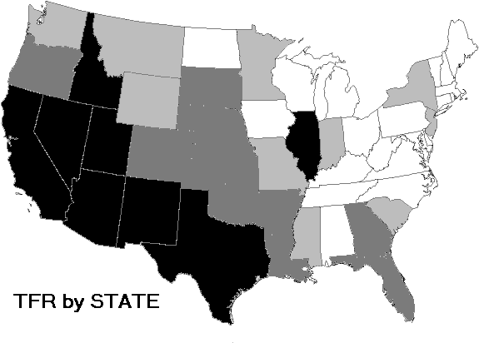

Slide 42
Discuss
How do you think the development of a country affects the CBR & CDR?

Slide 43
D. Population Density
Arithmetic Density: Crude density - population ÷ unit of land area
Physiological Density: # of ppl a unit of arable land can support
Agricultural Density: # of farmers to unit of arable land

Slide 44
DRAW THE FOLLOWING SLIDE

Slide 45
Country of BOX - Population: 6 Area: 6 sq miles
LAVA
1 person
per 1sq Mile
3 people
per 1sq Mile
of ARABLE LAND
1 FARMER
per 1sq Mile
of ARABLE LAND
Arithmetic
Density
Physiological
Density
Agricultural
Density

Slide 46
Summary:
Explain the ways human geographers analyze population change.
Describe the relationship between population growth, population density and development.

Slide 47
Day 3

Slide 48
Population Pyramids Bellwork 8/27+8/28
Why would a family choose to have 1 or 0 kids?
Use complete sentences!

Slide 49
Agenda:
Notes: Population Structure
Population Pyramid Activity
HW: KBAT Map, Finish Population Pyramid Activity

Slide 50
Objective:
You will be able to create a population pyramid.

Slide 51
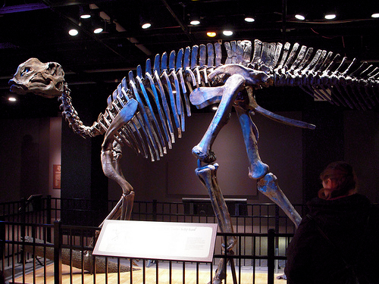
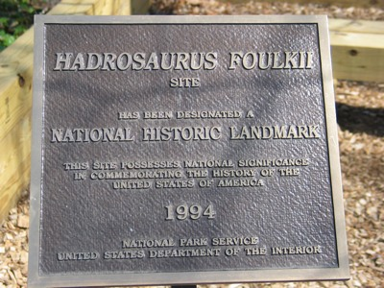
FFotD
Where was the first dinosaur skeleton found?
NEW JERSERY!

Slide 52
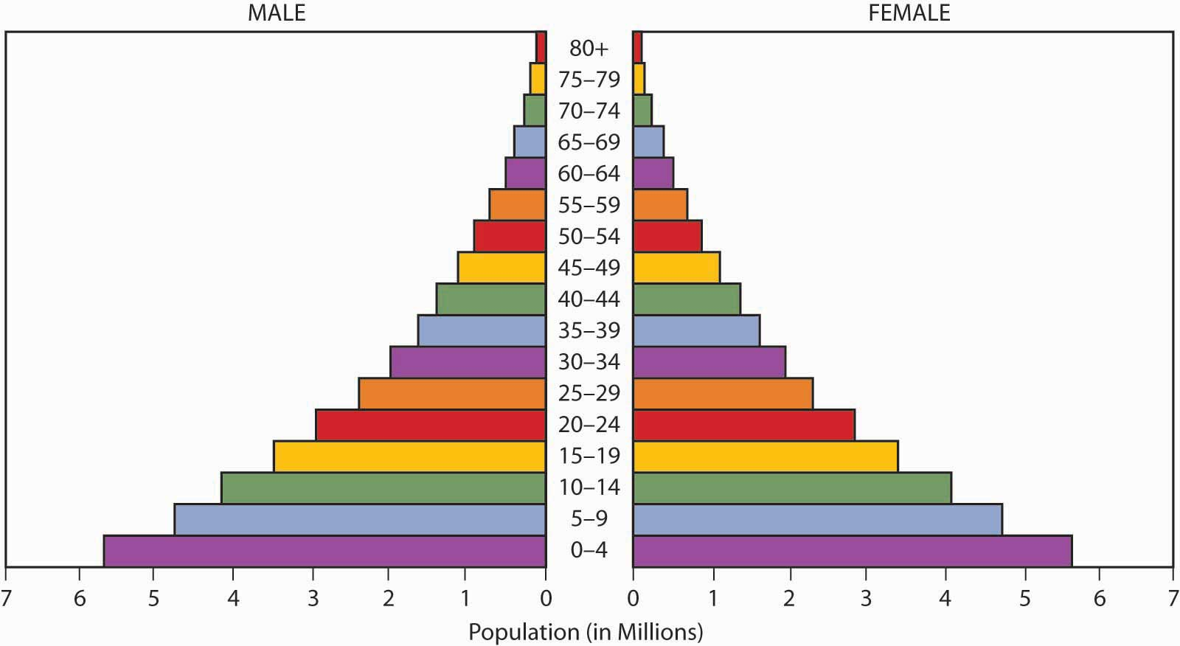
I. Population Structure

Slide 53
A. Vocab
Population Pyramid: A bar graph to show population structure by comparing pop. age & sex
Cohort: population group unified by the same time constraints
CLASS OF 2022

Slide 54
Video: Ted-Ed
Notes:
https://youtu.be/RLmKfXwWQtE?list=PLsi__M0qVoTIFtbxbkVyjA59hSexiOQEq

Slide 55
b. Dependency Ratio: # of people who are too young/old to work compared to people who can work
c. Life Expectancy: the average length of life

Slide 56
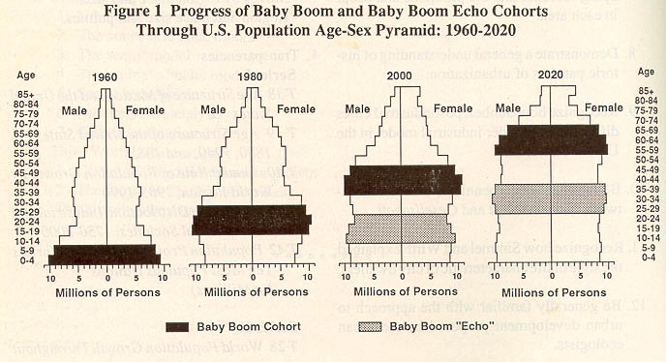

Slide 57
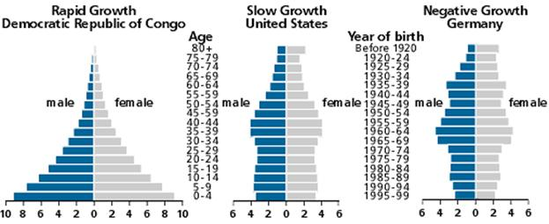
2. 3 Types of Pyramid

Slide 59
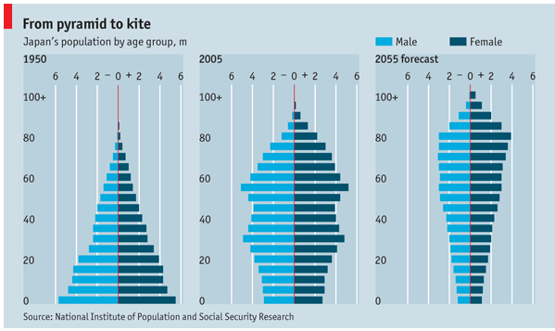

Slide 60
Discuss
Why would a population pyramid be useful for human geographers?

Slide 61
Video: Do it For Denmark
Notes:
https://www.youtube.com/watch?v=vrO3TfJc9Qw

Slide 62
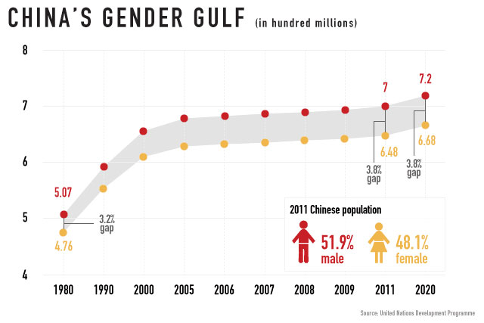
3. Sex ratio: # of males per 100 females in a population

Slide 63
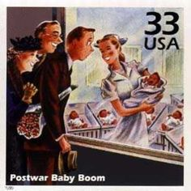
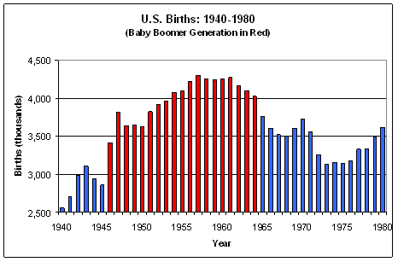
4. Baby Boom: a sudden increase in birth rates for a generation

Slide 64
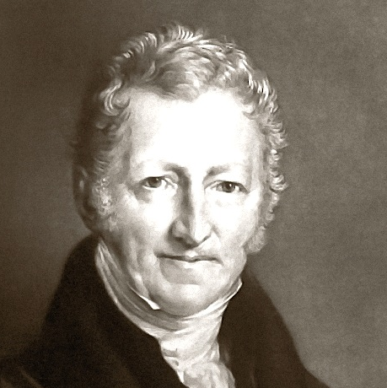
B. Malthus & Overpopulation
Thomas Malthus
British, lived in 19th century
SAID: Earth’s population is growing faster than its food supply
Overpopulation: there are more people than the environment can support

Slide 65
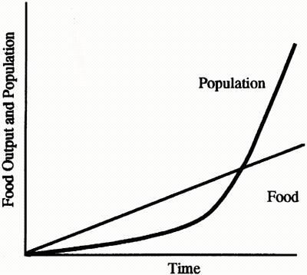
Malthus’s Theory

Slide 66
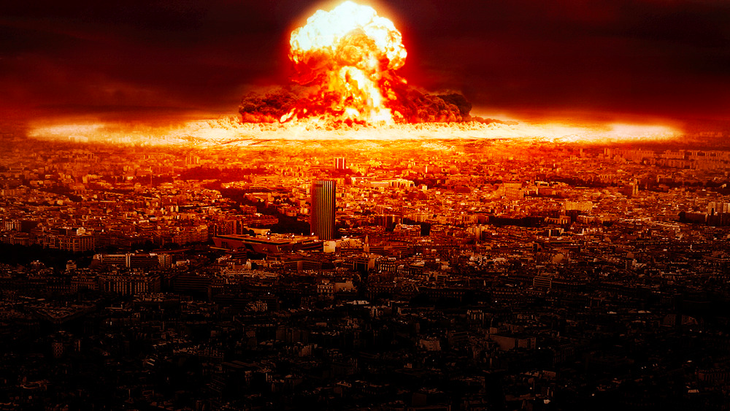

Slide 67
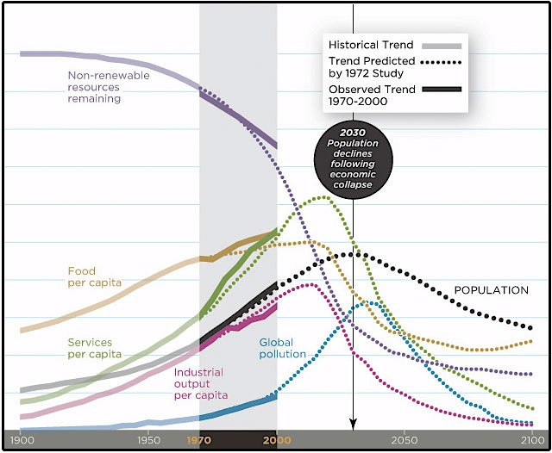
2. Neo Malthusians
Some people still believe this!
1968: Paul Ehrlich

Slide 68
3. Critics
Resource Depletion
Our resources are expanding
Population Growth
More population isn’t necessarily bad
More people = more innovations

Slide 69
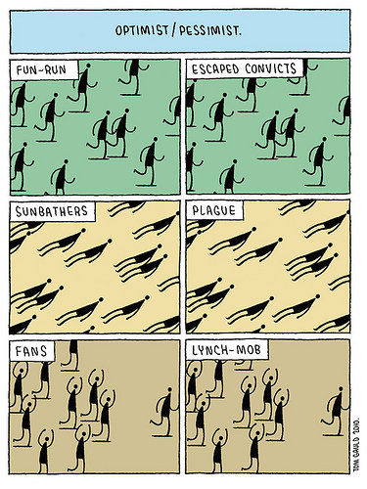
Discuss
What do you think?
Do you agree with Malthus?
Is our growing population ultimately going to doom us or save us?

Slide 70
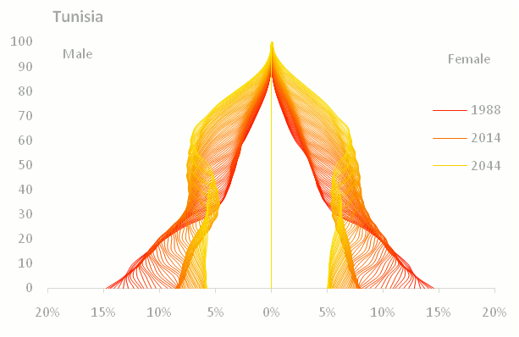
Population Pyramid Activity
Notes:
http://populationpyramid.net/

Slide 71
Summary
Define population pyramid.
Discuss the different challenges a country might face based on the shape of their population pyramid.

Slide 72
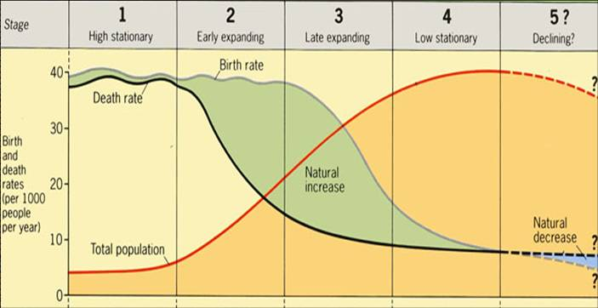
I. Demographic Transition Model

Slide 73
Demographic Transition Model*: the way a country’s demographics change as the country develops in 4 stages
*DTM is slightly different for APES

Slide 74
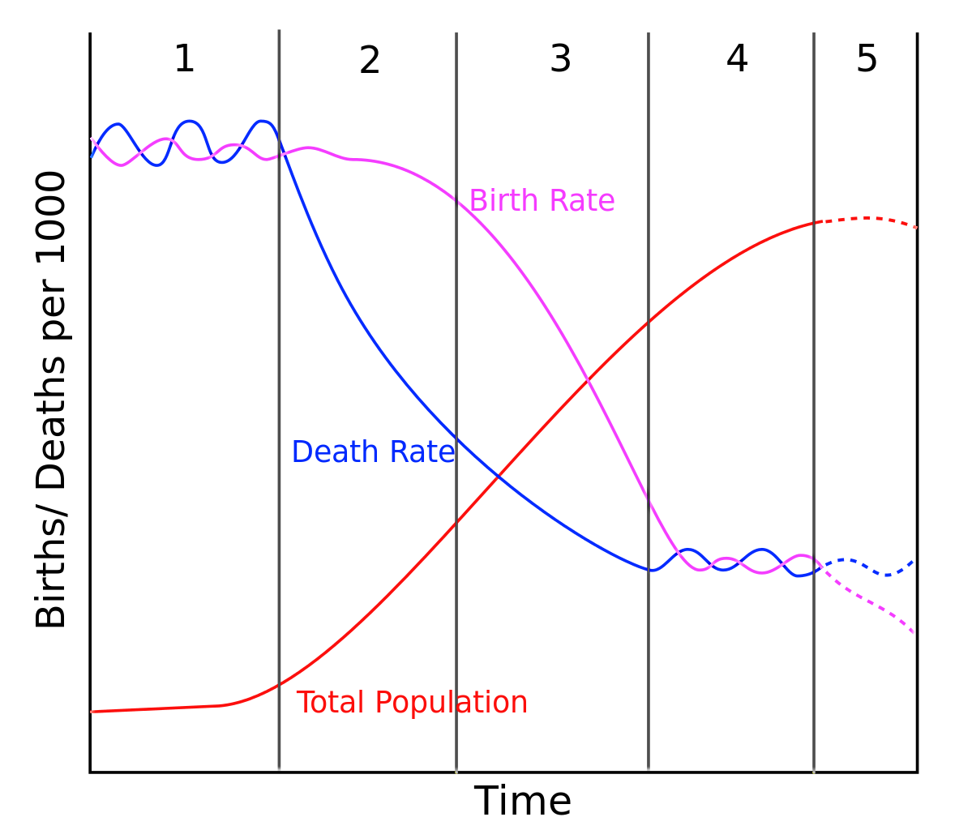
Draw it in notes:

Slide 75
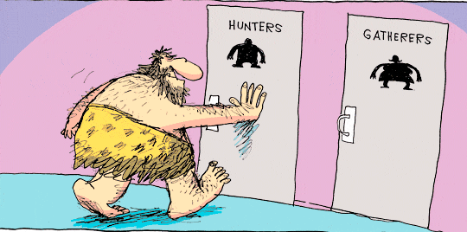
1. Stage 1: Hunter/Gatherer
Early humans, through medieval: hunting/gathering
This doesn’t really exist now
VERY high birth and death rates with almost no long term natural increase

Slide 76
2. Stage 2: Agricultural Revolution
People get more stable food sources, live longer
Having children is still desirable, to work the land for food
Rapid decline in death + high birth rates = high natural increase

Slide 77
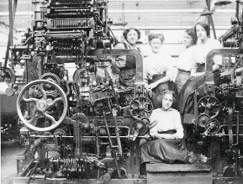
3. Stage 3: Industrial Revolution
People move to cities; having babies becomes less desirable
Birth rates rapidly decline, death rates decline, and natural increase begin to balance

Slide 78
4. Stage 4: Post-Industrial
Very low birth and death rates = no natural increase and maybe even a decrease
Zero Population Growth (ZPG): when CBR = CDR

Slide 79
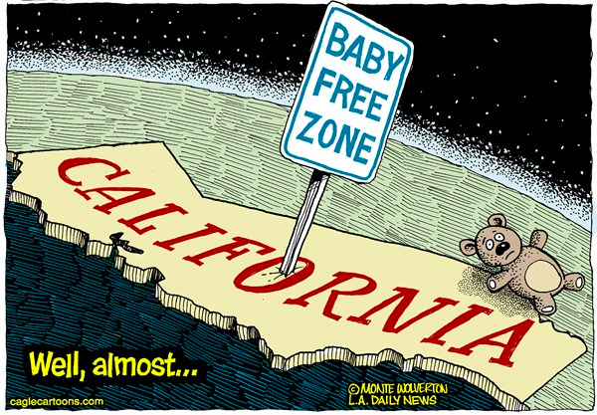
5. HYPOTHETICAL STAGE 5
Population starts to decline, CDR > CBR, Negative NIR
Pro-Natalist Policies: Laws and programs to encourage reproduction (ex. Denmark)
Anti-Natalist Policies: laws to discourage reproduction (China’s One Child Policy)

Slide 80
Discuss:
Come up with an example country for:
Stage 1:
Stage 2:
Stage 3:
Stage 4:
Stage 5:

Slide 81
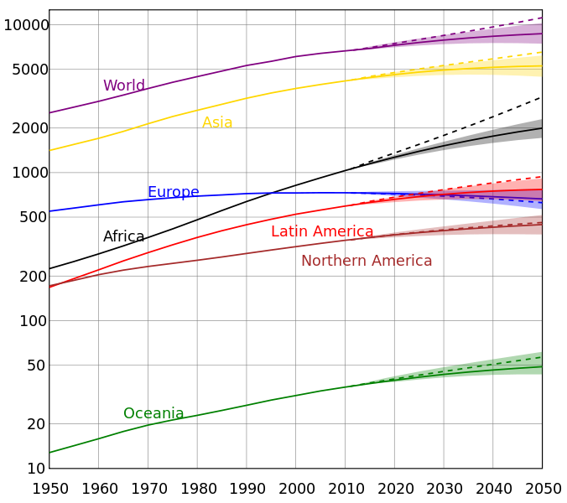

Slide 89
Video: Hans Rosling
Notes:
https://www.youtube.com/watch?v=jbkSRLYSojo

Slide 90
What does this mean for the old people?

Slide 91
Discuss
What is the socio-economic status of the world’s aged population now?
What will it be in the future?

Slide 92
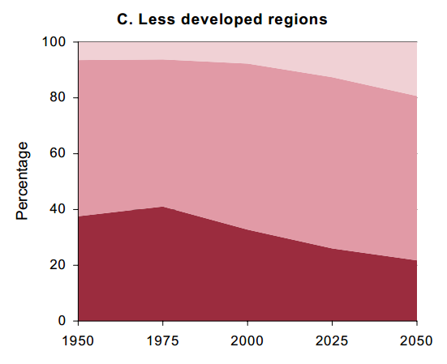
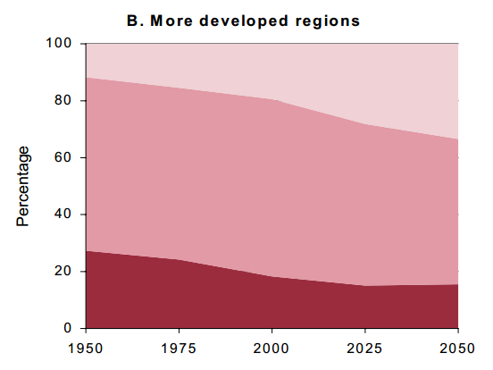

Slide 93
Video: BBC
Notes:
https://www.youtube.com/watch?v=x4r0S5qoIXc

Slide 94
Summary
Discuss the Demographic Transition Model and its significance.
Describe a country in stage 2 verses a country in stage 4. Use real examples.

Slide 95
Demographic Transition Activity
You may work with a partner to complete the demographic transition activity.
#5 – Tell me the years for each stage as well as drawing them on the graph

Slide 96
Health and Human Services Bellwork 8/31:
Turn in Population Pyramid! Get out your map!
How old are your grandparents?
What age do you want to live to? Why?

Slide 97
Day 5

Slide 98
Health and Human Services Bellwork 8/31:
Spot Check RQ # 10!
Draw the simple Demographic Transition Model.
At what point does Stage 3 turn into Stage 4? Describe using CBR, CDR, and NIR

Slide 99
Agenda:
Notes: Health
HW: Extra Credit Opportunity!

Slide 100
Objective:
You will be able to discuss the relationship between demographics, development and health.

Slide 101
TUBI
Octopi move with elegance but no rhythm, unlike other animals.

Slide 102
I. Population and Health

Slide 103
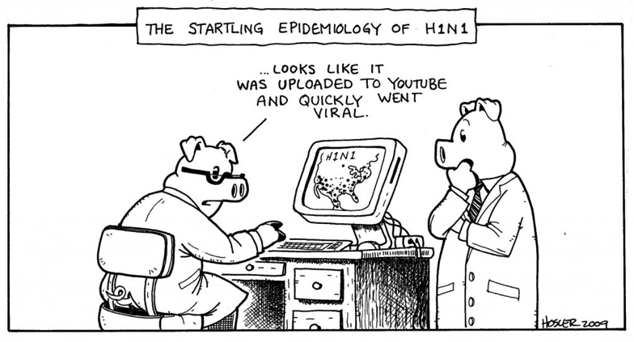
Epidemiologic Transition: The way health evolves as demographics and development change

Slide 104
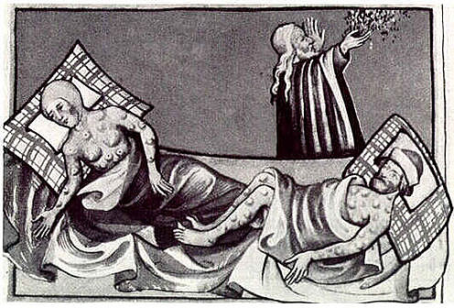
1. Stage 1: PESTILENCE & FAMINE
Infectious and parasitic diseases (+ animal/human attacks and accidents)
HIGH CDR
Example: BUBONIC PLAGUE

Slide 105
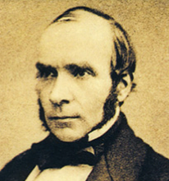
2. Stage 2: RECEDING PANDEMICS
Pandemic: disease that happens all over the world
Rapidly declining CDR
EX: Cholera!
Dr. John Snow figured out the problem and fixed it!

Slide 106
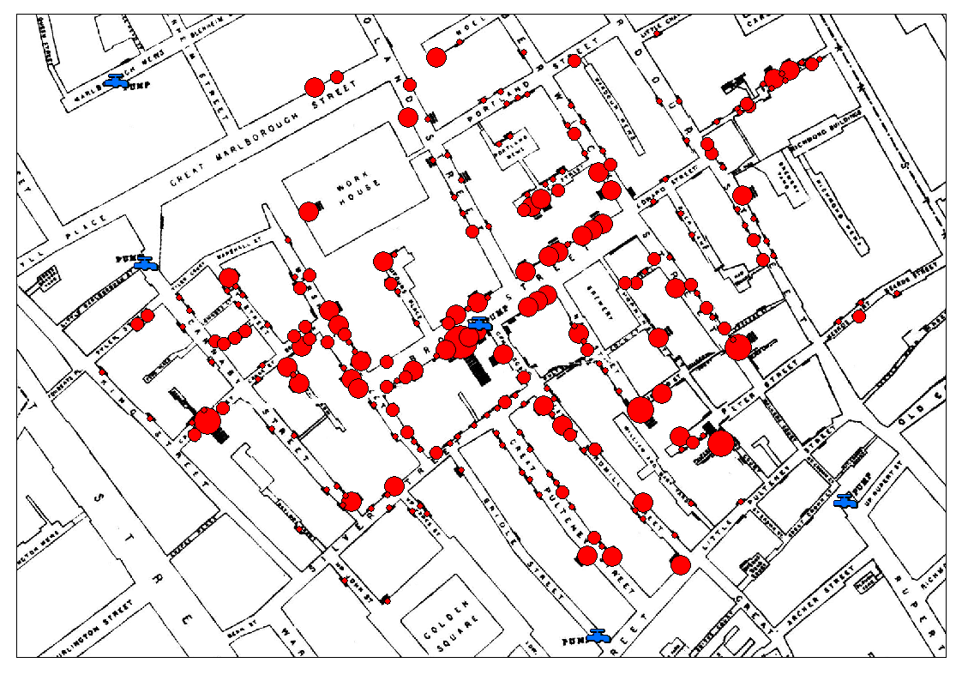

Slide 107
3. Stage 3: DEGENERATIVE DISEASES
More human created diseases and disorders, less infectious ones
Like, chronic problems b/c of aging OR CANCER OR HEART ATTACKS
Moderately declining CDR

Slide 108
4. Stage 4: DELAYED DEGENERATIVE
We are delaying the things that could kill us with medicine
Ex: Heart surgery, chemotherapy

Slide 109
5. Infectious Diseases
Hypothetical Stage 5: Infectious Diseases Return
EX: Ebola, Malaria, Polio, Tuberculosis,
New Infectious Diseases!
HIV/AIDS!!!

Slide 110
Discuss:
What do you know about HIV/AIDS?

Slide 111
Video: HIV/AIDS
Notes:
https://www.youtube.com/watch?v=0TipTogQT3E

Slide 112
B. HIV/AIDS
35 million people live with HIV/AIDS - 3.2 million are children
Spreads through body fluids (blood, breast milk, or sexual contact)
The virus breaks down your immune system

Slide 115
C. Epidemic diseases become endemic
With more food, sanitation and hygiene
Epidemic: Widespread disease
Endemic: disease within a community

Slide 116
Discuss
How can habitat, population and behavior affect human health?

Slide 117
D. Health Care
Habitat, population and behavior affect health
Habitat: Air or water quality, exposure to viruses, quality of home
Population: age, sex, genetics
Behavior: cultural practices, diet, smoking

Slide 118
2. More developed countries have better health care
Leads to lower CDR, IMR
Longer life expectancy
3. Immunizations save lives!!!

Slide 119
Summary
Explain the difference between an endemic, epidemic, and pandemic disease.
Discuss the relationship between demographics, development and health. Use at least 2 vocab words.

Slide 120
Day 6

Slide 121
Bellwork:
SPOT CHECK #19
Consider the KBAT map:
1 country that shares one border
2 countries that share no borders
2 countries that share two borders

Slide 122
Agenda
QUIZ
CASE STUDY
HW: Read #21-26

Slide 123
TUBI:
Who lives in Australia?

Slide 124
QUIZ
Write clearly.
# 6/7 HAVE NOTHING TO DO WITH #8/9/10
THEY ARE 2 DIFFERENT COUNTRIES
Done? NO TECH!!

Slide 125
Day 7

Slide 126
Bellwork
What are challenges of an aging population?

Slide 127
Agenda:
Practice FRQ
HW: #21-25, quiz tomorrow!

Slide 128
Objective:
You will be able to identify and explain the consequences of an aging population.

Slide 129
TUBI
When we shiver, our bodies are doing the opposite of sweating. Sweating cools the body by putting a layer of liquid on the skin. Shivering tightens the skin and shakes the muscles, a process that conserves and generates heat.

Slide 130
FRQ
Get out your FRQ cheat sheet and a piece of paper
Mark up the prompt and write an outline – 10 minutes!
Use your notes and the people around you

Slide 131
WRITE THE FRQ
20 minutes
Write in pen
You can still use your notes!
Staple prompt to back and turn in when done.

Slide 132
SAMPLE FRQ RESPONSES
What did these students do well?
Is this what you expected?

Slide 133
SCORE THE FRQ
USE A DIFFERENT COLORED PEN/PENCIL/HIGHLIGHTER
Mark where they get the point
Put the score at the top of the page
Add a compliment and a constructive criticism.

Slide 134
ESPEN
Economic
Social
Political
Environmental Science

Slide 135
Interactive Reading
Find an article in a National Geographic – must be at least 3 pages long. (Not counting pictures)
Read & analyze using ESPEN - 16 bullet points total
2 Paragraphs
How does this article relate to Human geo?
How does this article relate to Environmental Science

