Slide 1
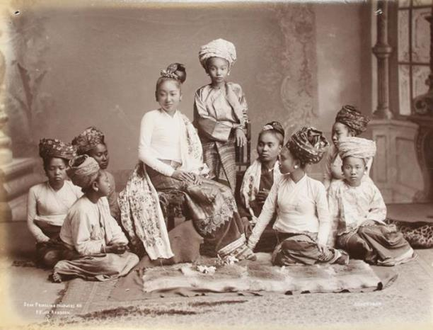
AP Human Geography
Chapter 7: Ethnicity

Slide 2
Day 1

Slide 3
Bellwork (1/7/2019):
How would you define ethnicity?
How have you felt defined (by yourself or others) by your ethnicity?

Slide 4
Agenda:
Ch. 7 KBAT
Notes: Distribution of Ethnicities
Suggested Line of Study: #1-7, KBAT Map

Slide 5
But First: New Semester, New Us
Remember phone policy: Need to be kept away (quick use okay)
Homework will now be called Suggested Line of Study. It will NOT be collected for a grade, but it will help you perform on the test.
KBAT Maps will still be collected for points.

Slide 6
But First: New Semester, New Us
Test Re-Takes: You may re-take a test as much as you want. You will need to schedule the re-take with me outside of class time.
We will start having practice and test FRQs. The purpose behind these is to measure your APHG Essential Skill.

Slide 7
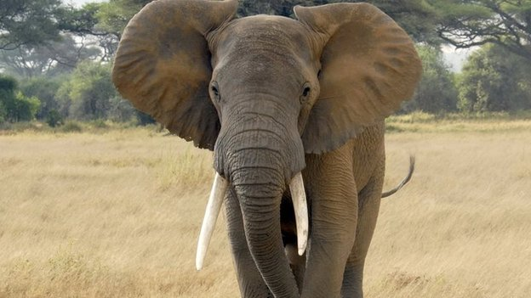
Fun Fact:
Elephants are the only mammals that can't jump

Slide 8
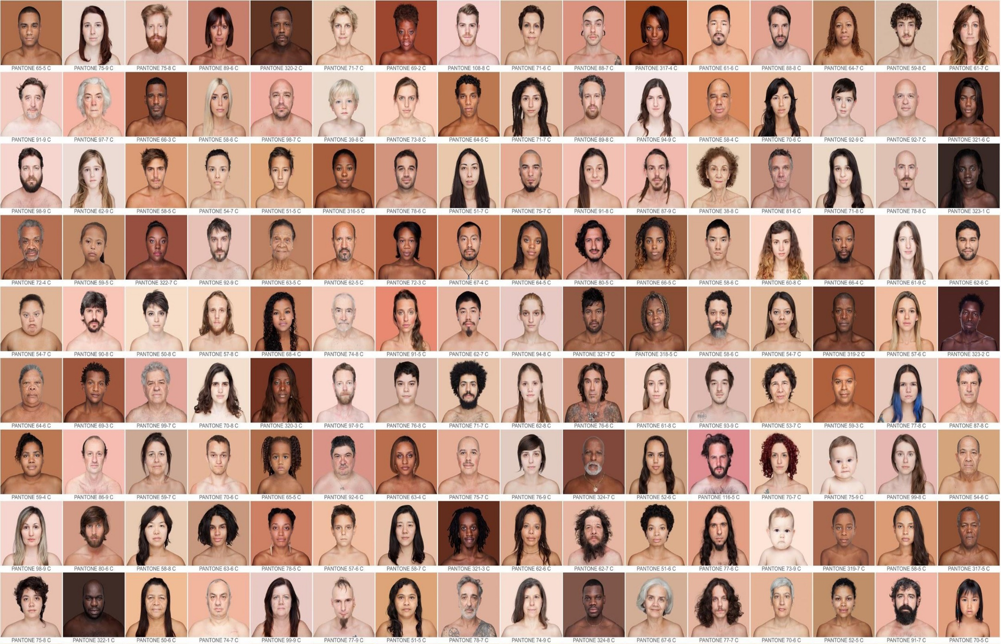
CHAPTER 7 ETHNICITY

Slide 9

I.ETHNIC DISTRIBUTION

Slide 10
A. Ethnicity
Definition: the identity with a group of people who share cultural traditions of a particular hearth

Slide 11
2. Ethnicity is NOT
  Race: social construct of the identity of a group of people who share biological ancestry
    RACISM: one race is inherently better than others

Slide 12

Video: Myth of Race
Notes:
https://www.youtube.com/watch?v=VnfKgffCZ7U

Slide 13
Discuss in your tables:
Racial vs. Ethnic Discrimination in the US
Come up with 2 examples of each

Slide 14
B. Ethnicity in the USA
Official U.S. Bureau of Census
  Asks 2 questions about ethnicity
  Identifies 3 main ethnicities:
    Asian American
    African American
    Hispanic

Slide 15
Official U.S. Bureau of Census
1. Check the box next to one or more of the following fifteen categories (pick yours)
White
Black, African American, or Negro
American Indian or Alaska Native
Asian Indian
Chinese
Filipino
Japanese
Korean
Vietnamese
Other Asian
Native Hawaiian
Guamanian or Chamorro Samoan
Other Pacific Islander
Other race

Slide 16
2. Respond to yes or no to being of Hispanic, Latino, or Spanish origin (pick your answer)
• If yes pick on of these categories
  • Mexican, Mexican American, Chicano
  • Puerto Rican
  • Cuban
  • Another Hispanic, Latino, or Spanish origin

Slide 17
Discuss in your tables…
Do you identify more with your race or your ethnicity?
What would you identify as your main ethnicity?

Slide 18

VIDEO: What it’s like to be Ambiguously Ethnic
Notes:
https://www.youtube.com/watch?v=1JteTVW83lg

Slide 19
Discuss in your tables…
Think back to earlier chapters
In your notes, make a list of vocab words and ideas that might apply to this chapter
Yes, you can look at old KBATS

Slide 20
C. Ethnic Distribution in USA
Hispanics: Arizona, California, New Mexico, and Texas
  Los Angeles, Phoenix
African Americans: Georgia, Alabama, Mississippi; Northern cities
    Detroit, Chicago

Slide 21
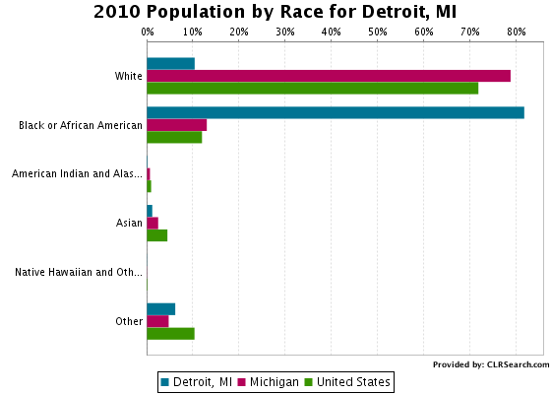

Slide 22
3. Asian Americans: West – Hawaii, California
  Honolulu, San Francisco

Slide 23
4. Urban Distribution:
  African Americans and Hispanics in urban areas
  Ethnic neighborhood: an area in a city containing members of the same ethnic background

Slide 24
LOS ANGELES
￼

Slide 25
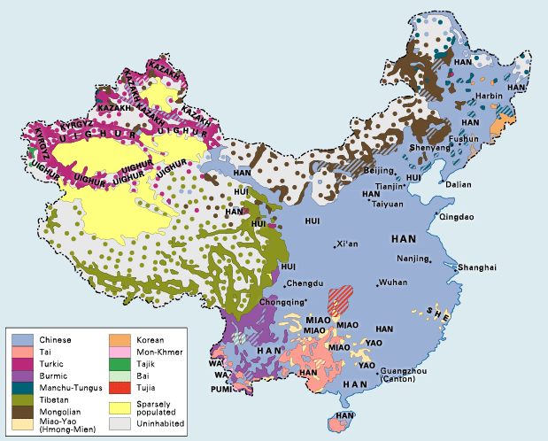
D. Reasons for US Ethnic Distribution

Slide 26
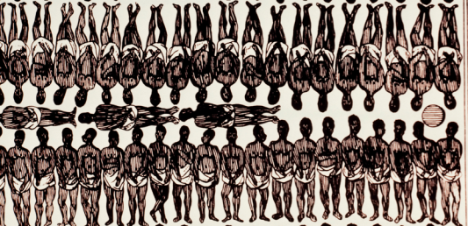
1. International Migration
Forced Migration from Africa
  Africans brought as slaves

Slide 27
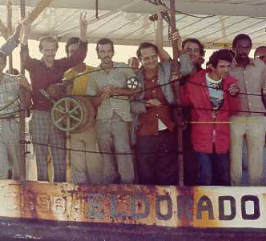
b. Voluntary Migration from Latin America and Asia
  Late 20th/21st century
    1970’s:
      Hispanics: Mexico, Puerto Rico and Cuba
      Asian: China, India, Philippines

Slide 28
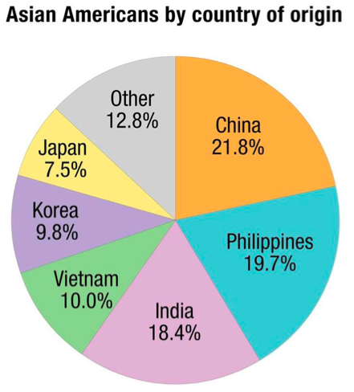
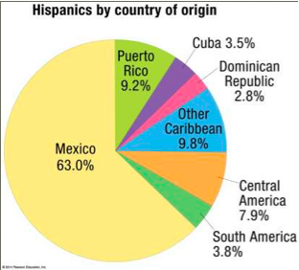

Slide 29
DRAW THE USA
Leave space around it & in it
Use arrows to show where ethnicities came from & where they settled
Label the Who, From Where, To Where and Why

Slide 30
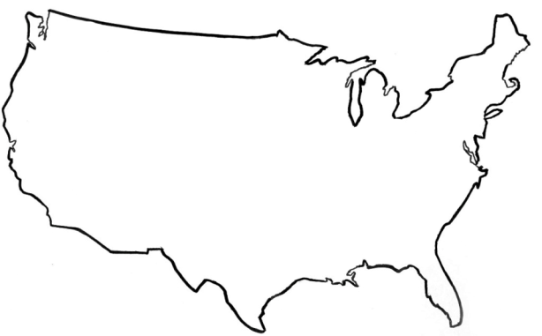
ASIANS
From: China,
Philippines, & India
To: West Coast
Why: Economics
AFRICANS
From: West Africa
To: South East
Why: Slavery
HISPANICS
From: Mexico, Central/
South America
To: South West
Why: Economics

Slide 31
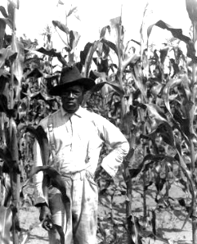
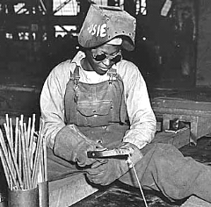
2. Internal Migration
African Americans
  Interregional Migration
    1900’s: Southern Farms -> Northern Cities
      Shrinking agricultural jobs, growing industrial jobs

Slide 32
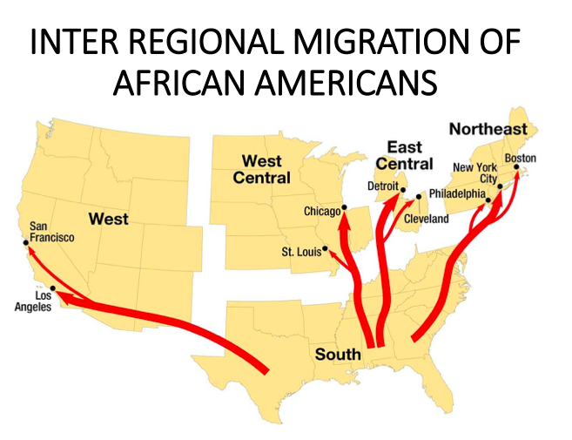

Slide 33
Add to USA Map
Add the internal migration of African Americans
Label the Who, From Where, To Where and Why

Slide 34

AFRICAN AMERICANS
From: Southern Farms
To: North Cities
Why: Jobs

Slide 35
Ticket Out the Door:
Define ethnicity in your own words.
Describe ethnic distribution in the United States. (2-3 sentences using vocabulary)
Describe how international and internal migration lead to modern ethnic distribution in the USA.

Slide 36
Day 2

Slide 37
Bellwork (1/8/2019):
What nationality are you?

Slide 38
Agenda
Notes: Ethnicity Identity
Computer activity
HW:#8-14, map

Slide 39
Objective
You will be able to describe the effect of nationalism and ethnic diversity in the world.

Slide 40
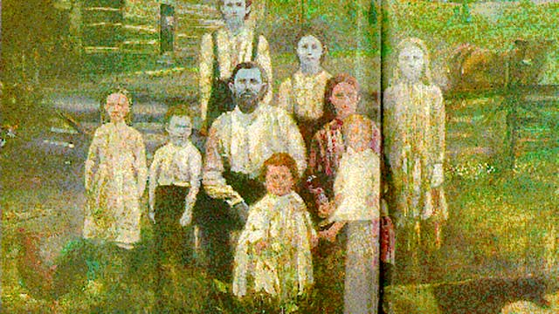
TUBI
Methemoglobinemia is a blood disorder that makes you blue

Slide 41

I. Ethnic Identity

Slide 42
A. Reasons for US Ethnic Distribution

Slide 43
1. International Migration
Forced Migration from Africa
  Africans brought as slaves

Slide 44
b. Voluntary Migration from Latin America and Asia
  Late 20th/21st century
    1970’s:
      Hispanics: Mexico, Puerto Rico and Cuba
      Asian: China, India, Philippines

Slide 46
DRAW THE USA
Leave space around it & in it
Use arrows to show where ethnicities came from & where they settled
Label the Who, From Where, To Where and Why

Slide 47
ASIANS
From: China,
Philippines, & India
To: West Coast
Why: Economics
AFRICANS
From: West Africa
To: South East
Why: Slavery
HISPANICS
From: Mexico, Central/
South America
To: South West
Why: Economics

Slide 48
2. Internal Migration
African Americans
  Interregional Migration
    1900’s: Southern Farms -> Northern Cities
      Shrinking agricultural jobs, growing industrial jobs

Slide 50
Add to USA Map
Add the internal migration of African Americans
Label the Who, From Where, To Where and Why

Slide 51
AFRICAN AMERICANS
From: Southern Farms
To: North Cities (ghettos)
Why: Jobs

Slide 52
B. Nationality
Nationality: is the identity with a group with legal/personal attachment to a country
  Ethnicity vs. Nationality?
CULTURE: language, religion,
food, clothing
LEGAL: voting, passport, civic duties

Slide 53

2. Nationalities in USA vs UK
a. AMERICAN
b. English, Welsh, Scottish, Irish

Slide 54
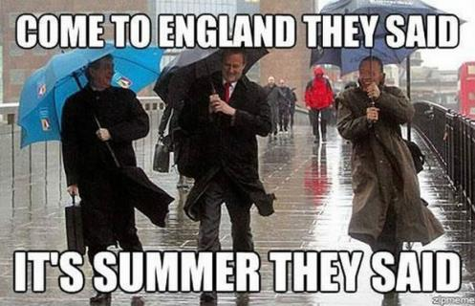
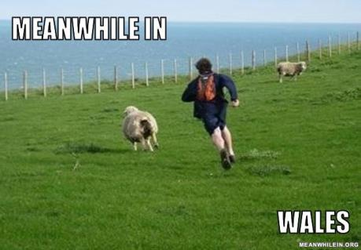
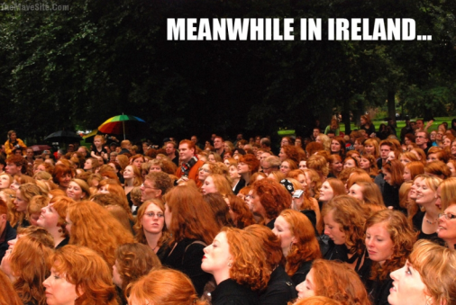
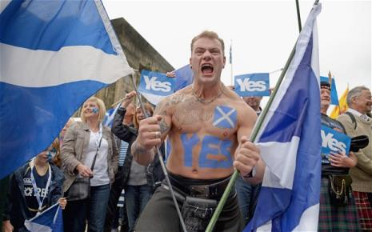

Slide 55
Discuss
How do we show nationalism in America?

Slide 56
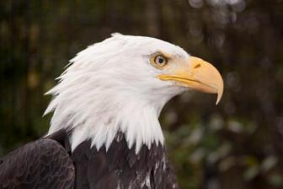

C. Nationalism
Nationalism: pride in one’s country
How do you foster nationalism?
  Symbols: flags/songs
  Images: The Bald Eagle
  Slogans: LAND OF THE FREE

Slide 57

3. Some nationalism is good, sometimes it is really bad
4. Centripetal force: attitudes that tend to unify and increase support
5. Centrifugal force: attitudes that tend to divide and decrease support

Slide 58
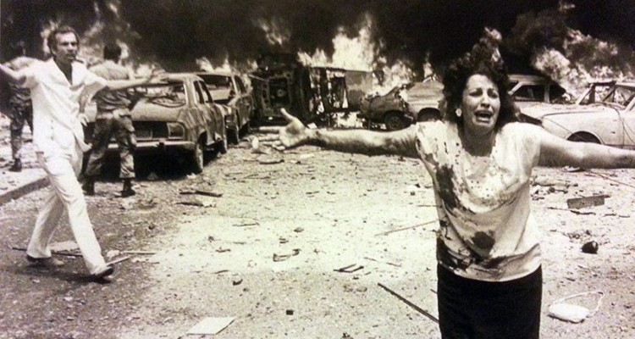
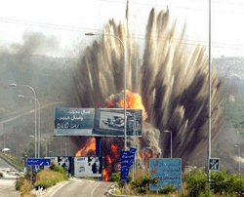
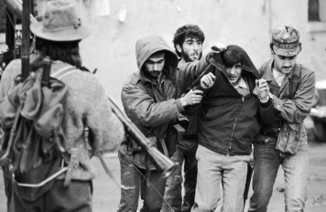
D. Ethnic Competition

Slide 59
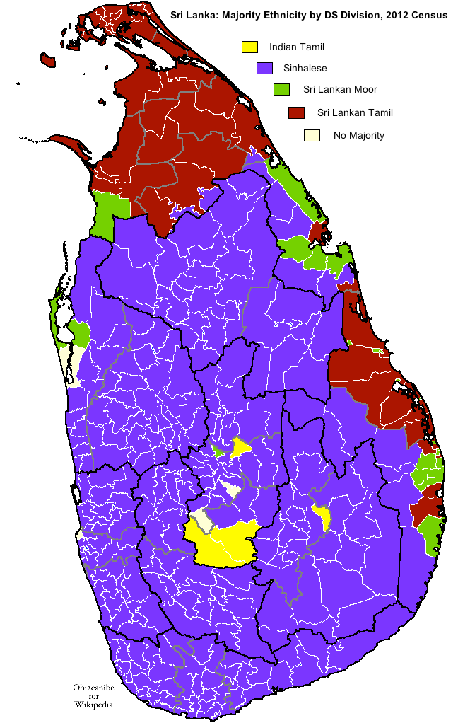
Sri Lanka
  3 major ethnicities:
      Sinhalese: 74%, Buddhist
      Tamils: 16%, Hindu
      Moors: 10%, Muslim

Slide 60
Discuss
What is a good way governments can reassure/honor minority ethnicities?

Slide 61
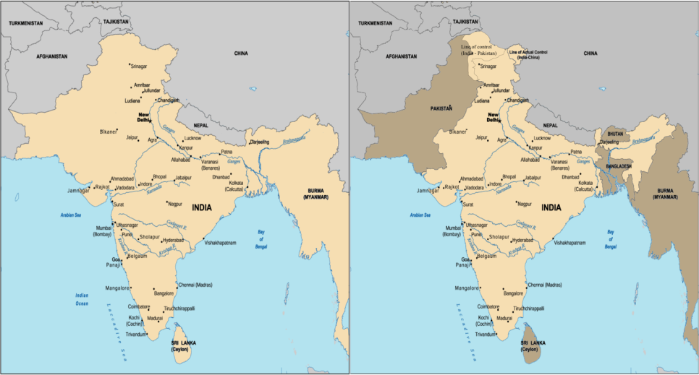

Slide 62
E. Dividing Ethnicities
South Asia
  British rule in India ended in 1947
  2 ethnicities based on religion: Hindus and Muslims
  Division of country into India & West and East Pakistan (now Bangladesh)
    Muslims in Pakistan & Bangladesh
    Hindus in India

Slide 63
d. Migration Problems
In late 1940s mass migration occurred
7 million Muslims from India to Pakistan
9.5 million Hindus moved from Pakistan to India
Consequences: over 500,000 killed in genocide

Slide 64
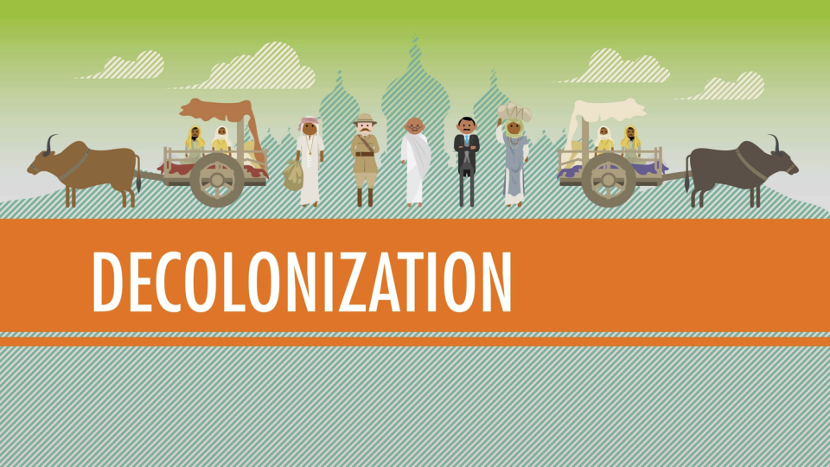
Video: Crash Course
Notes:
https://www.youtube.com/watch?v=T_sGTspaF4Y

Slide 66
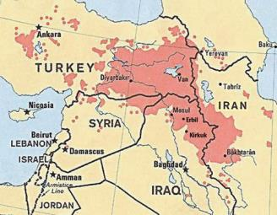
2. Kurds
a. 30 million Kurds split between Turkey, Iraq, Iran and Syria
b. Who are the Kurds?
•Sunni Muslims
•Speak a language in the Iranian group
•Feature distinctive literature, dress, and cultural traditions

Slide 67

Video: Who are the Kurds?
Notes:
https://www.youtube.com/watch?v=Uv5-q_9fpro

Slide 68
Discuss
We see ethnic conflict and extreme nationalism around the world.
Should the US address this? How?

Slide 69
Summary
Explain the difference between ethnicity and nationality.
Using an example, describe one way these two concepts have effected the world.

Slide 70
Day 3

Slide 71
Bellwork
MAP CHECK
Describe the ethnic distribution in the US.

Slide 72
Agenda:
Practice FRQ
HW: Quiz Friday

Slide 73
Objective:
You will be able to describe the difference between centripetal and centrifugal forces.

Slide 74

TUBI
On November 21, 1783 in Paris, France was a hot air balloon made of paper and silk made by the Montgolfier brothers.

Slide 75
Practice FRQ
Plan and Write both FRQ
Use neighbors, notes, FRQ Cheat Sheet
Write in Pen

Slide 76
Day 4

Slide 77
Bellwork
Write down two examples of genocide.

Slide 78
Agenda
Notes: Ethnic Conflict
HW: #21-28, Quiz tomorrow

Slide 79
Objective:
You will be able to summarize the motivation and effects of ethnic conflict.

Slide 80
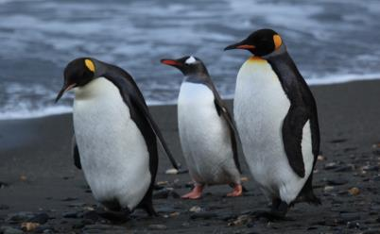
TUBI
Since penguins don't leave the nesting areas to feed, some species go through the entire courtship, nesting, and incubation period without food or water. For male king penguins, this period lasts for 55 days. For the male emperor penguin, the fast can last up to 120 days.

Slide 81
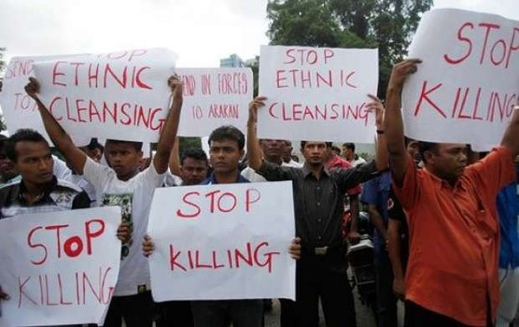
I. Ethnic Conflict

Slide 82
A. Urban Distribution:
  African Americans and Hispanics in urban areas
  Ethnic neighborhood/enclave: an area in a city containing members of the same ethnic background

Slide 83
LOS ANGELES
￼

Slide 84
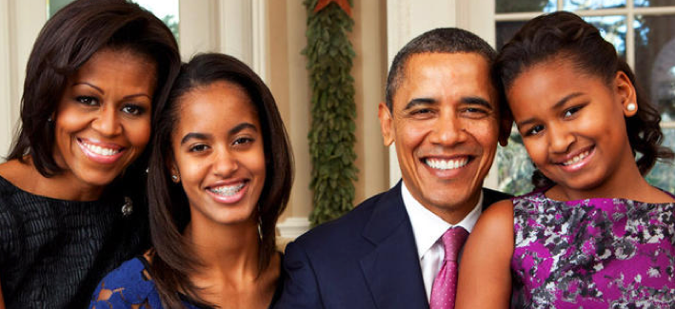
  3. Blockbusting: convincing white families to leave b/c black families were moving in
    Leads to white flight

Slide 85

4. Segregation: Separating people, items or communities in law
  5. Suffrage: The right to vote

Slide 86

B. South Africa
  Apartheid: physical separation of different races in different geographic areas
  Policies of institutionalized racial discrimination beginning in 1948
      Prevented intermarriage
      Created “white-only” jobs
      Took away citizenship from “Africans”
      Assigned to ethnic states called “homelands”
      Violent punishment of protesting

Slide 87
Discuss
What are some ways that the legacy of segregation and apartheid still effect the world today?

Slide 88
C. Definitions:
Ethnic cleansing: more powerful ethnic group removes a weaker one to create a homogenous region
Xenophobia: fear of foreigners

Slide 89
3. Self-determination: the process where people create their own country and constitution
4. Nation-state: A country with a dominant ethnicity that has been turned into a nationality

Slide 90
5. Multi-Ethnic vs. Multinational
  Multi-ethnic: more than one ethnicity in the country
  Multinational: country multiple ethnic groups that agree to coexist but recognize each other as distinct nationalities

Slide 91
Geographic Connections
What are some countries that are multi-ethnic?
What are some countries that are multi-national?

Slide 92
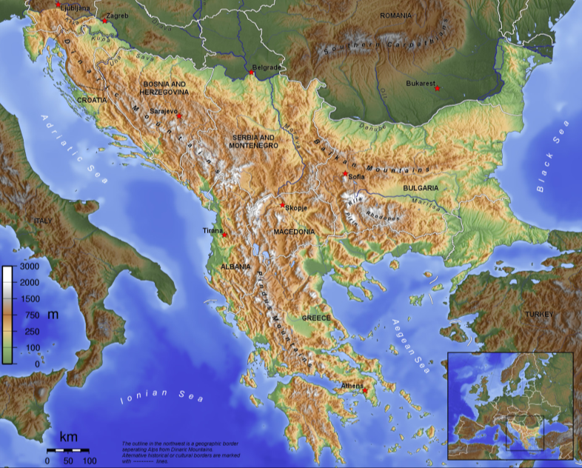
D. BALKANS

Slide 93
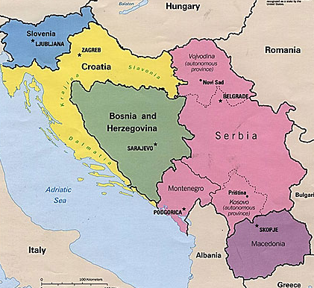
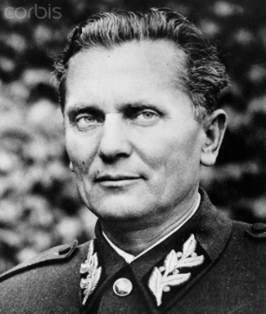
1. Yugoslavia
Post-WWI Western Europe creates Yugoslavia
Josip Broz Tito ruled the communist nation from 1953-1980

Slide 94
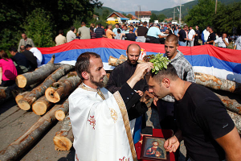
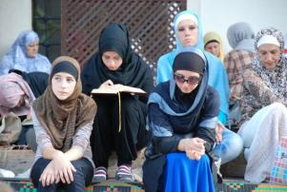
c. Ethnic groups
  Croats, Macedonians, Montenegrins, Serbs, and Slovenes
  Bosnia—Herzegovina: mix of Serbs, Croats, and Bosnian Muslims

Slide 95
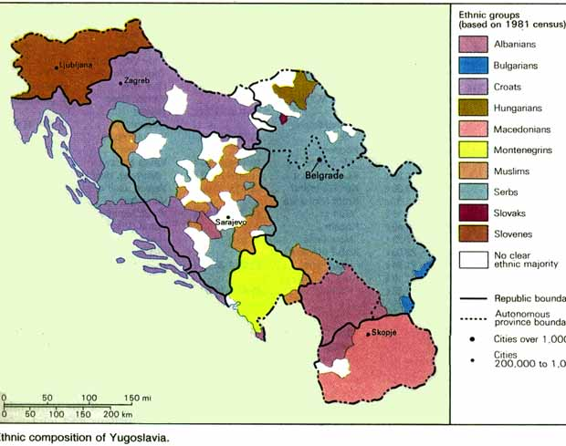

Slide 96
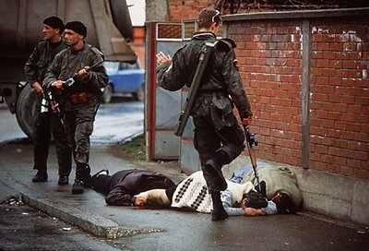
2. Ethnic Cleansing in Yugoslavia
  Post Tito there are ethnic tensions
  Bosnian Genocide (1992)
    8,000 dead, 30,000 forced migration
  International economic pressure ends it

Slide 97

d. Balkanization: a state breaks down b/c of internal ethnic conflict

Slide 98
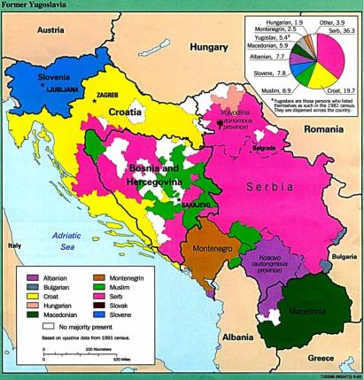
e. Cultural Shatterbelt: A politically unstable region where differing cultural elements come into contact and conflict.

Slide 99
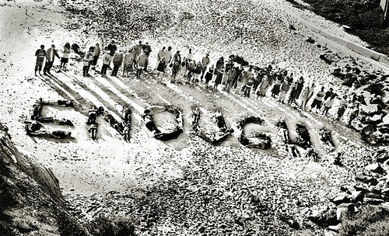
f. Genocide: mass killing of a group of people to eliminate them from existence

Slide 100
Video: CNN- Genocide
WARNING
Notes:
http://www.cnn.com/videos/world/2015/07/08/pkg-amanpour-bosnia-srebrenica.cnn

Slide 101
Discuss
Think about what you saw about Bosnia and Kosovo in the video, how does this reflect ethnic conflict?

Slide 102
C. SUBSAHARAN AFRICA
Colonial legacy
  Europe created nations without thinking about tribes and ethnicities
  Historic enemies are now neighbors

Slide 103
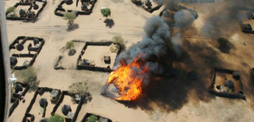
3. Sudan
South Sudan: Christians and animists resisting Muslim government
  1.9 million dead
  2011: independent country, Now: in a civil war

Slide 104
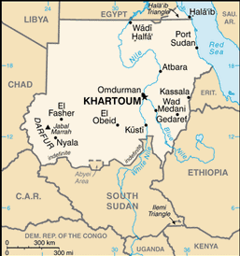
b. Darfur:
2 non-Arab rebel groups based in Darfur region
  b/c gov not providing for minority
Gov. funded/armed militia attacks Darfur civilians
480,000 dead, 2.8 million refugees

Slide 105
4. Rwandan Genocide
Hutus: farmers, Tutsis: herders
1994: Hutu president murdered
  In retaliation: Hutus start murdering Tutsis
  800,000 dead
Spilled into Congo (5.4 million dead)

Slide 106
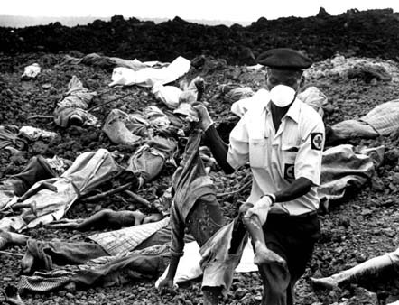
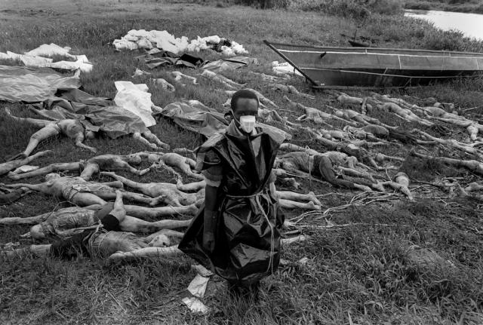

Slide 107
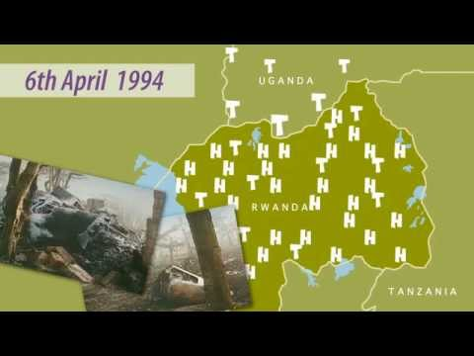
Video: A Very Short History
Notes:
ttps://www.youtube.com/watch?v=vwT9aTrAfQE

Slide 108
Summary:
Explain the difference between ethnic cleansing and genocide.
Describe the causes and effects of ethnic cleansing using an example.

Slide 109

Video: Danger of Silence
Notes:
https://www.ted.com/talks/clint_smith_the_danger_of_silence?language=en

Slide 110
Day 5

Slide 111
Bellwork
Name 4 countries and capitals that border the Mediterranean Sea from the map.
Name 2 countries that are landlocked.
Name 3 countries that border the Atlantic Ocean.

Slide 112
Agenda:
Quiz

Slide 113
Objective:
You will be able to describe the difference between centripetal and centrifugal forces.

Slide 114
QUIZ
Write clearly
Capital, Country on Map
Done? No Tech, No Naps

Slide 115
Day 6

Slide 116
Bellwork:
What’s the main motivation of genocide for its leadership and participants? Are those motivations different?

Slide 117
Agenda:
Test Review
HW: Study

Slide 118


TUBI
Robot comes from the Czech word robota, meaning forced labor or drudgery. In a 1920 play, human-like mechanical creatures produced in a factory are docile slaves.

Slide 119
Practice Multiple Choice
Find a partner
Write 4 MULTIPLE CHOICE QUESTIONS
(needs 5 choices, A B C D E)
  All the following is true about _____________ EXCEPT
  ______________ is an example of
  An example of ___________________ is
  From what we know about _____________ we can assume

