Slide 1
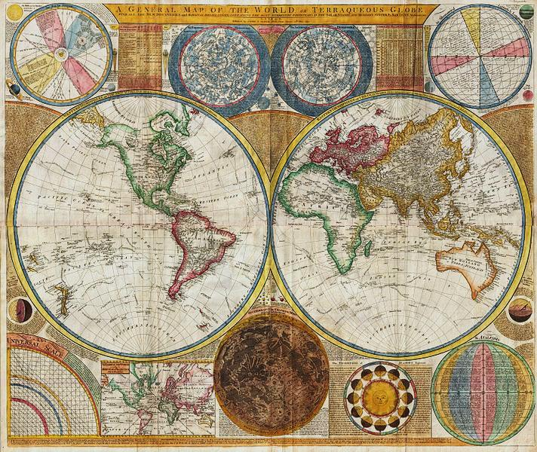
AP Human Geography
Chapter 8: Political Geography
Although this includes a powerpoint for each day of the chapter, it references assignments and activities not included in the bundle. For the most effective instruction, purchase the Comprehensive Guide to Teaching Human Geography too.

Slide 2
DAY 1
This is an edit just to see how this works...

Slide 3
Bellwork
What are the differences in a border between states and a border between countries?

Slide 4
Agenda:
Notes: Introduction to States and Government
HW: Map, #1-7

Slide 5
Objective
You will be able to summarize the development of states.

Slide 6
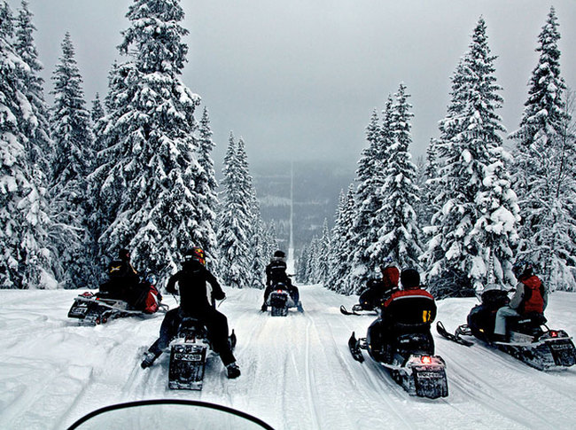
TUBI
Interesting international borders!!
Norway &
Sweden

Slide 7
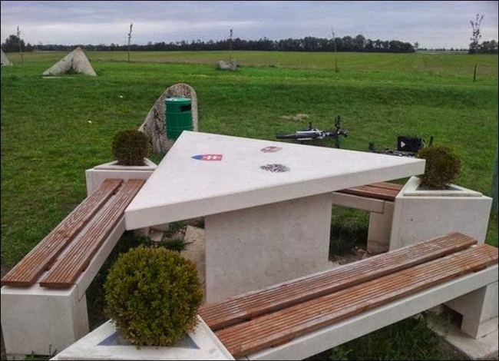
Austria, Hungary, and Slovakia

Slide 8
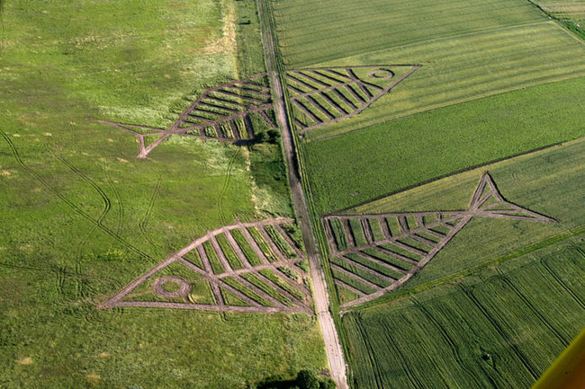
Poland and Ukraine

Slide 9
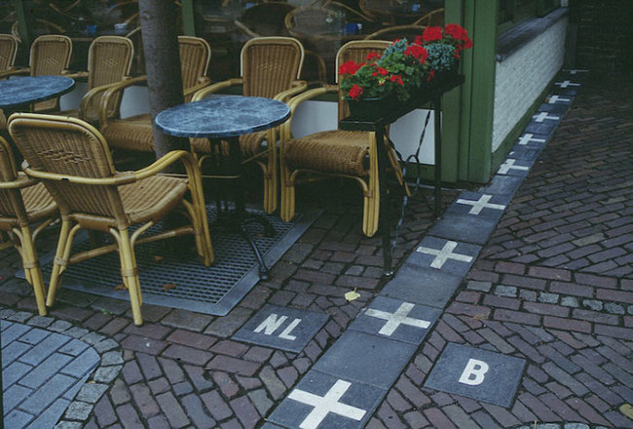
Netherlands and Belgium

Slide 10
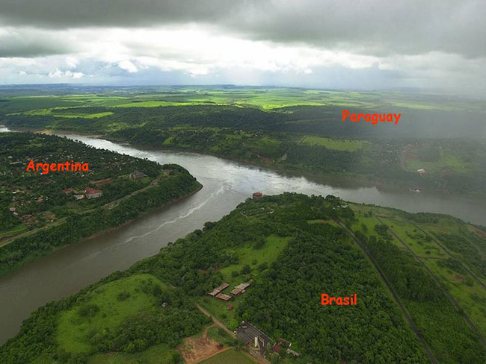
Argentina, Paraguay, and Brazil

Slide 11
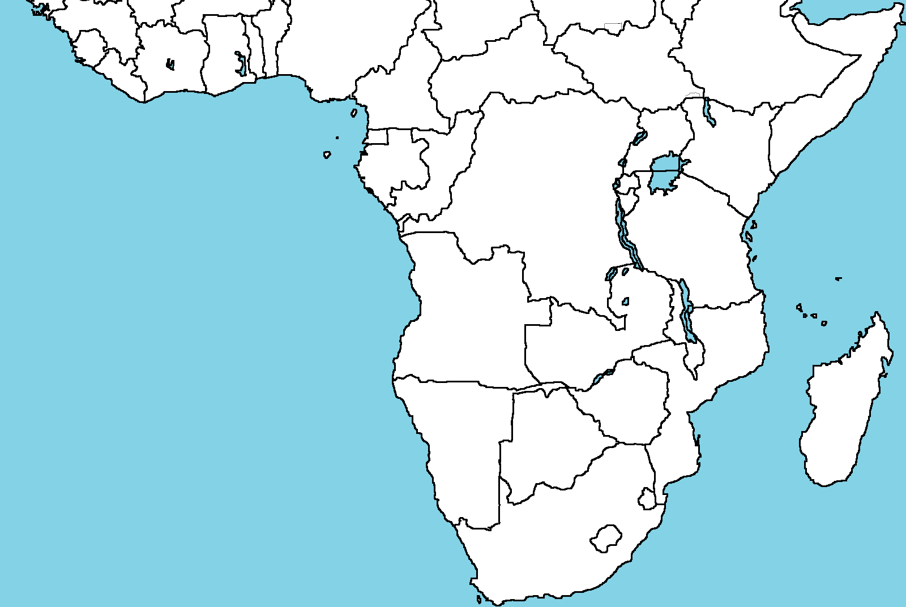
CHAPTER 8 OVERVIEW

Slide 12
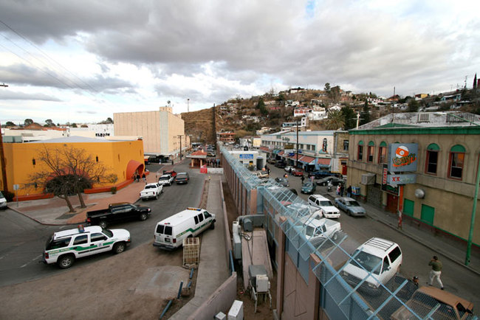
CH. 8: POLITICAL GEOGRAPHY

Slide 13
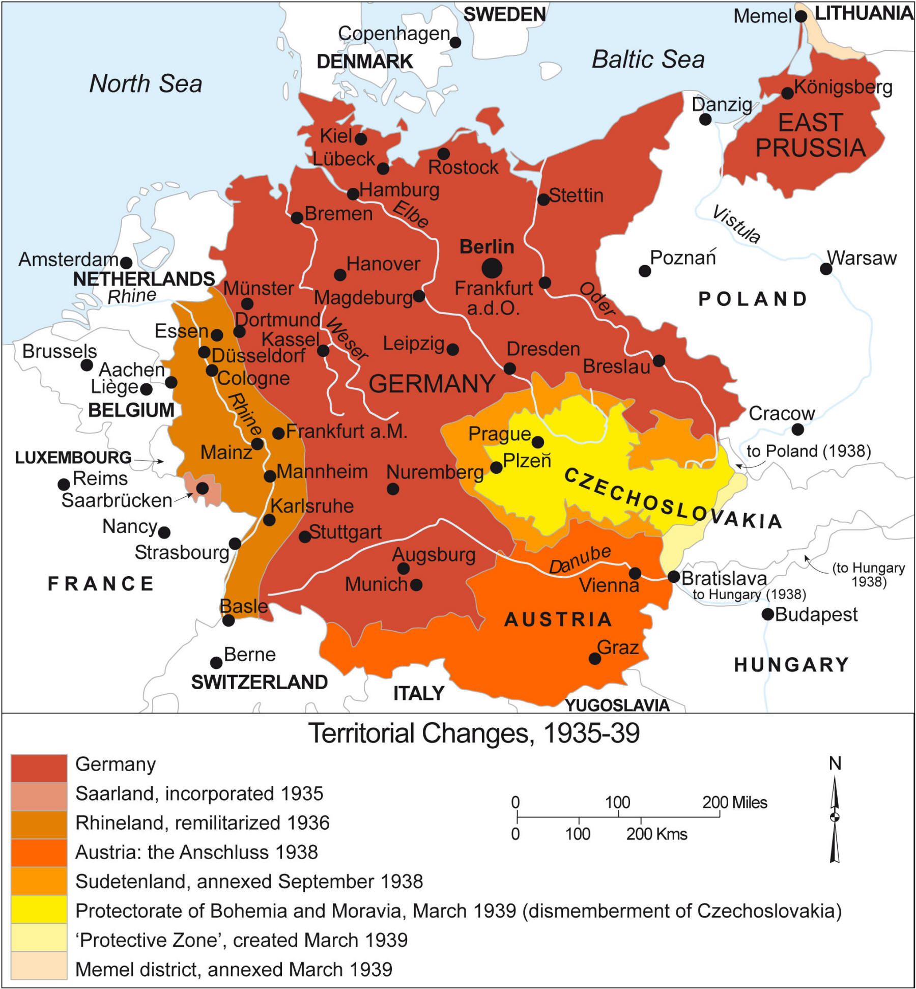
I. Distribution of States

Slide 14
A. The Basics:
State: area organized into a political unit and ruled by gov. (which deals with internal/foreign matters)
Sovereign: independent of control from other countries
Microstate: super small states

Slide 15
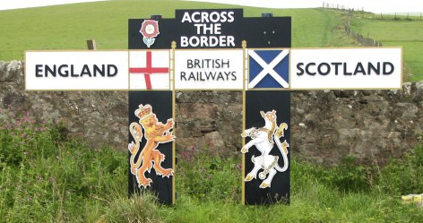
Discuss
Why are the borders where they are? What do you think decides where one country starts and another one ends?

Slide 16
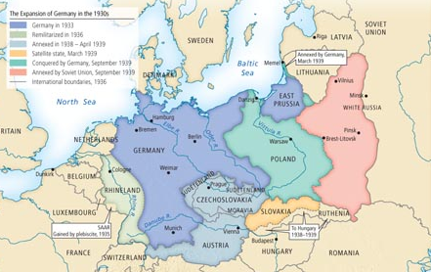
B. Origins of a state
Irredentism: when one state wants to take land that is related but no longer part of the state

Slide 17
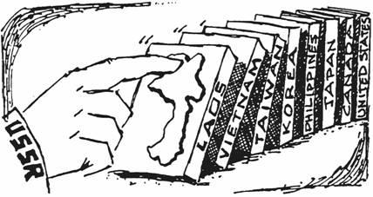
2. Territoriality: efforts to control parts of land for political and social ends
-Domino Theory: during the Cold War, if one country falls to communism so will all of the countries around it

Slide 18
3. United Nations
UN: international organization to solve global problems
Officially recognize new nations and negotiate disputes

Slide 19
Video: How Does the UN Work
Notes:
https://www.youtube.com/watch?v=QoIafzc0k74

Slide 20
C. How to define a state
Land/Territory – borders!
Political System
Economic System
Cultural Landscape

Slide 21
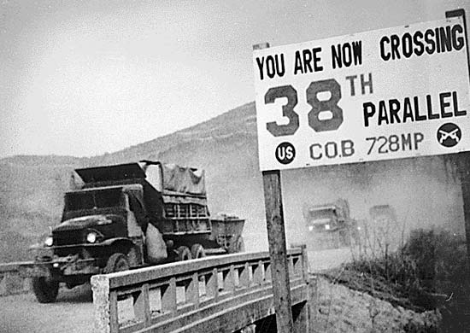
Korea
Still technically at war
Divided along the 38th parallel

Slide 22
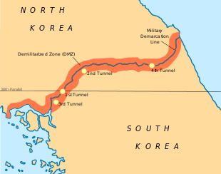
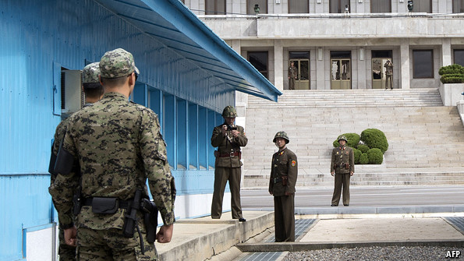
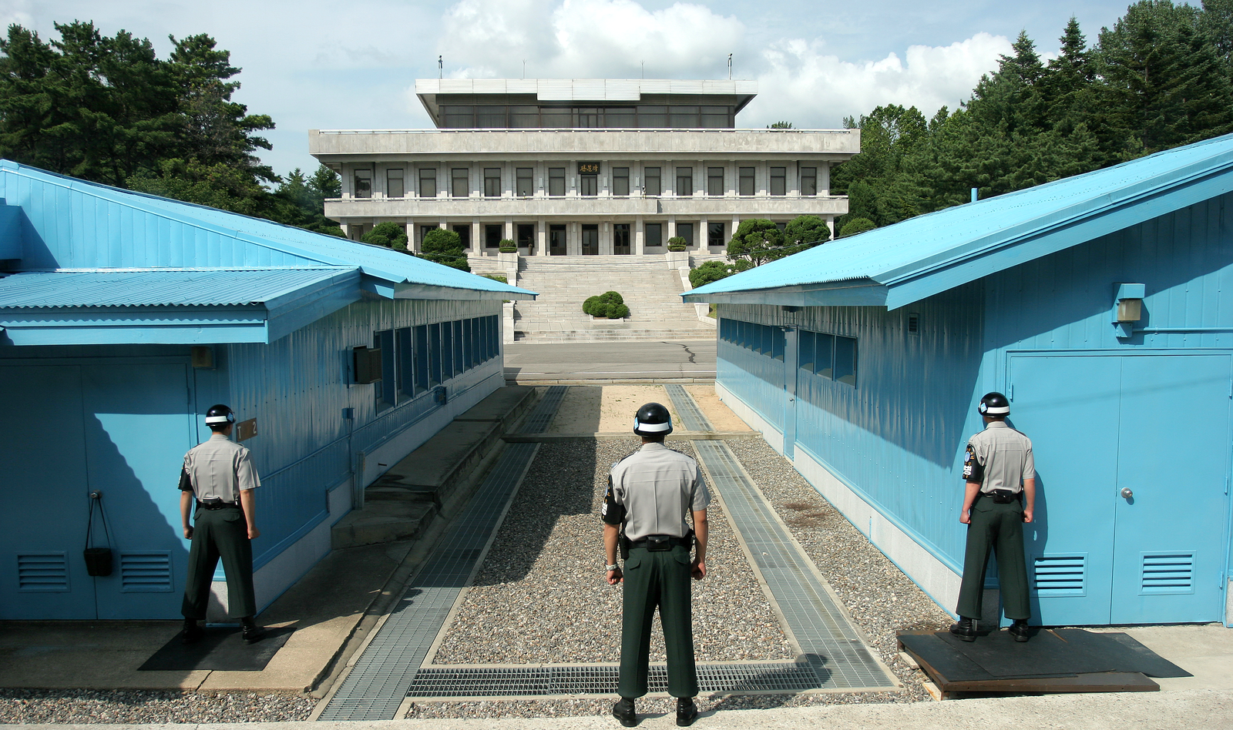

Slide 23
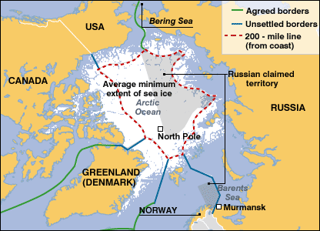
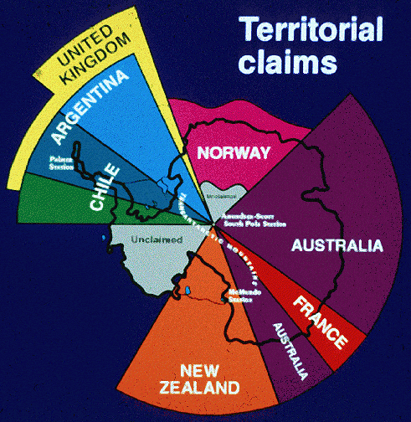
Arctic Circle
Antarctica

Slide 24
Discuss
Define a state in your own words.
Explain how states develop, use a contemporary example.

Slide 25
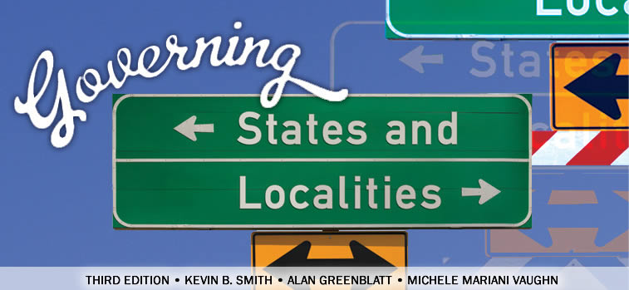
II. Government

Slide 26
A. National Scale
3 types:
Democracy: citizens elect leaders and can run
Autocracy: country according to ruler’s interests
Theocracy: priests rule in the name of God or a god.

Slide 27
 | Democracy | Autocracy
Selection of Leaders | citizens can express multiple opinions and choose leaders | Leaders selected via succession and from political elite
Citizen Participation | Restraints on the power of the executive | Citizen participation restricted and repressed
Checks and Balances | Guaranteed civil liberties for everyone at all times | No checks from legislative, judicial, or civil society institutions

Slide 28
2. Democracy is winning
irrelevant monarchies replaced
gov. regulate, tax and mobilize citizens in exchange for rights and liberties
diffusion from Europe and North America

Slide 29
Geographic Connections
Come up with 3 examples for democratic and autocratic countries each
Discuss!

Slide 30
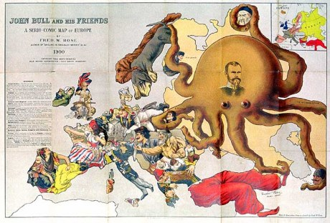
3. Geopolitics: how spatial relations among regions influence their political activities

Slide 31
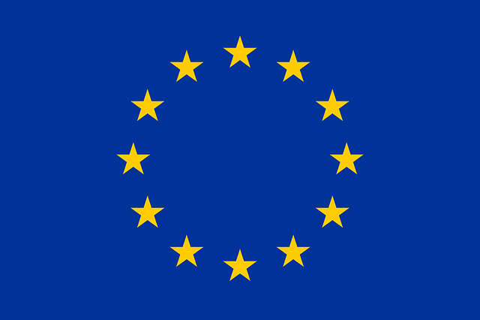
4. Supranational Organization: an organization with 3 or more countries
NATO: North Atlantic Treaty Organization; military partnership
European Union: economic agreement

Slide 32
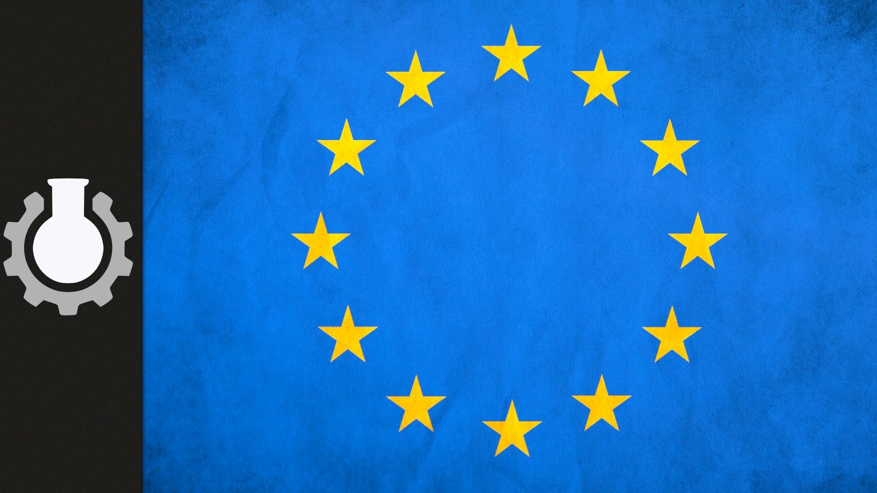
Video: EU
Notes:
https://www.youtube.com/watch?v=O37yJBFRrfg\
This video is a little outdated, but it does a good job explaining the basic principles

Slide 33
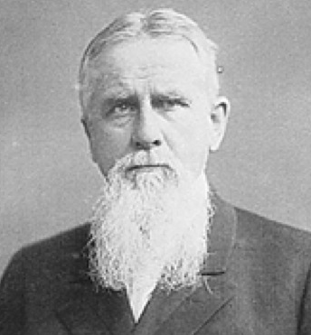
5. Models:
Friedrich Ratzel: a state is like a living thing with a life cycle from birth to death

Slide 34
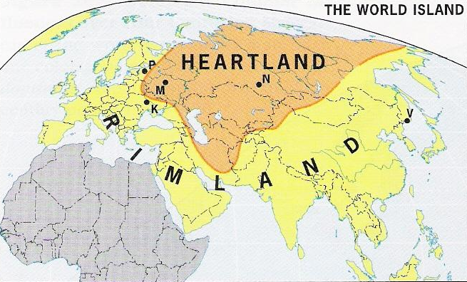
b. Heartland theory: Eurasia holds the resources to dominate the earth (USSR)
c. Rimland Theory: Eurasia’s rim hold the key to global power (China, Japan, India, Saudi Arabia, Europe)

Slide 35
Discuss
Do you agree with any of these theories? Why or why not?

Slide 36
B. Local Scale
Unitary State: power is in the hands of central government officials
Federal State: puts strong power to units of local government

Slide 37
Discuss
Which do you think works better a unitary or federal system?
Why?

Slide 38
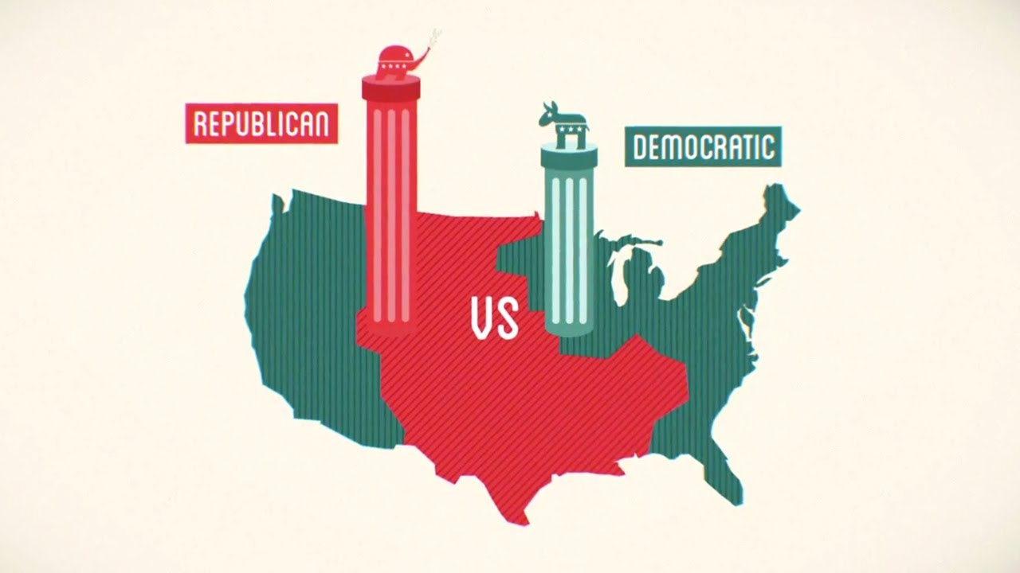
Video: TED-Ed Gerrymandering
Notes:
https://www.youtube.com/watch?v=YcUDBgYodIE

Slide 39
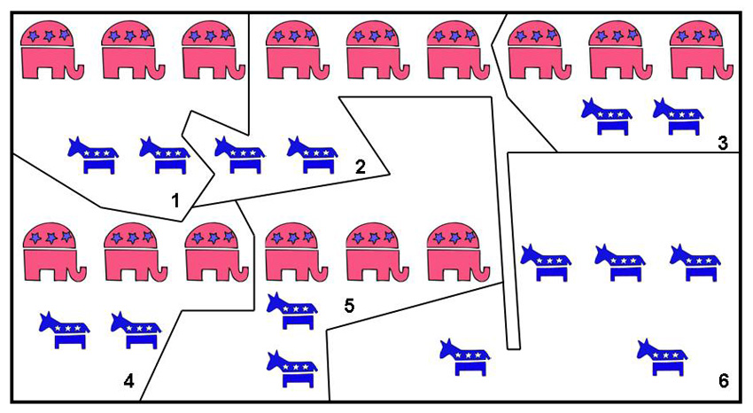
2. Federal State
USA: 435 legislative districts
Gerrymandering: redraw the boundaries to benefit a political party

Slide 40
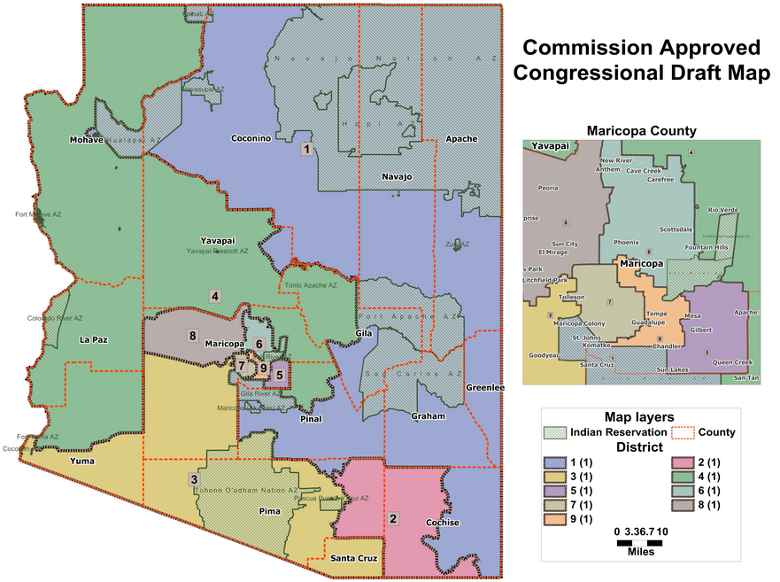

Slide 41
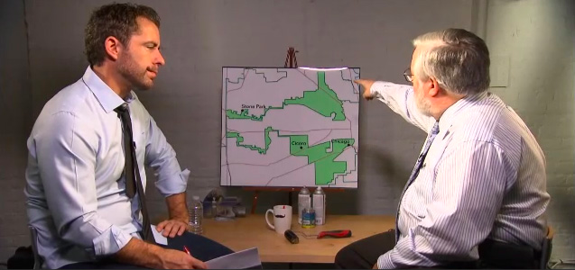
Video: Daily Show – Gerrymandering (2013)
Notes:
http://thedailyshow.cc.com/videos/0adjfq/american-horrible-story---gerrymandering

Slide 42
Summary:
Identify an example of a state and a microstate.
Explain two ways states are governed.
Describe the influence of geopolitics on states, use supranational organizations.

Slide 43
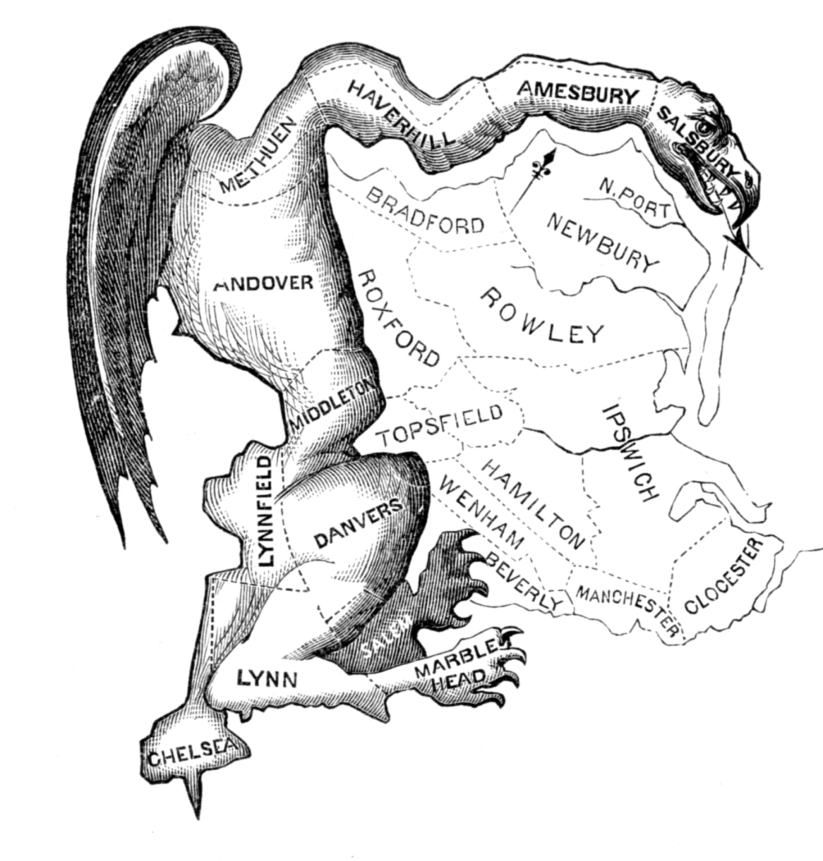
Re-Districting Game
Notes:
redistrictinggame.org

Slide 44
DAY 2

Slide 45
Bellwork
Describe a time when you have created a boundary (real or imaginary) to separate your space from someone else (sibling, cousin, friend)

Slide 46
Agenda:
Notes: Boundaries
HW: Map check Friday, #8-14

Slide 47
Objective
You will be able to summarize the different shapes of states and kinds of boundaries.

Slide 48
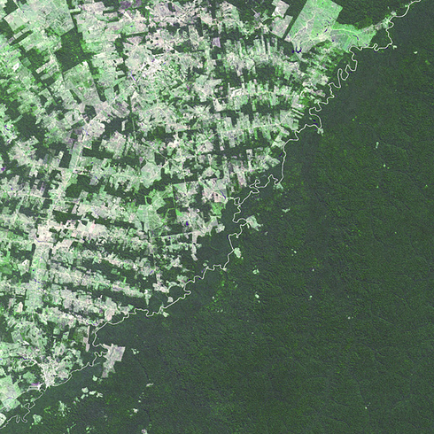
TUBI
Border between Brazil and Bolivia
Bolivia has deforestation laws

Slide 49
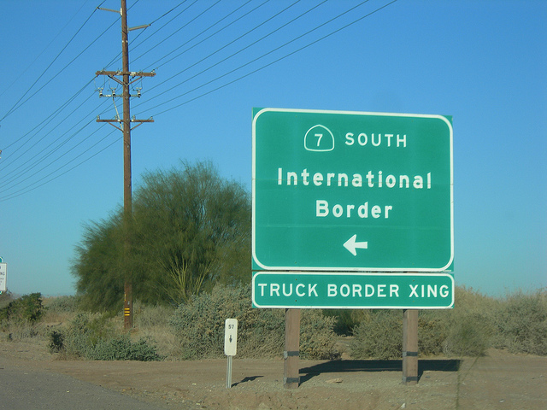
I. BOUNDARIES

Slide 50
A. Types of Boundaries
Physical boundaries: match the physical landscape
Deserts:
b/c they are hard to cross and have few people

Slide 51
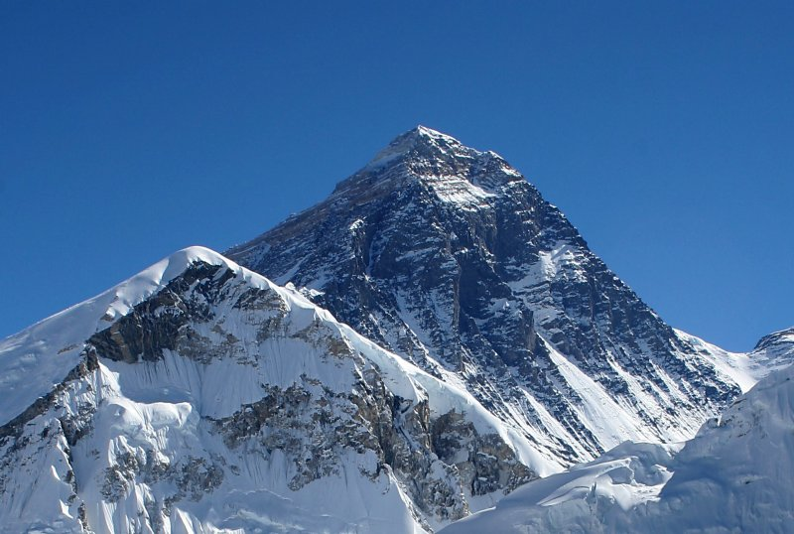
b. Mountains:
difficult to cross (especially during winter)
BUT: where draw the line?

Slide 52
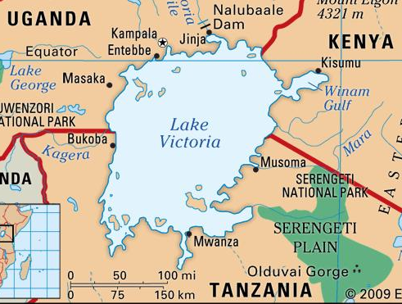
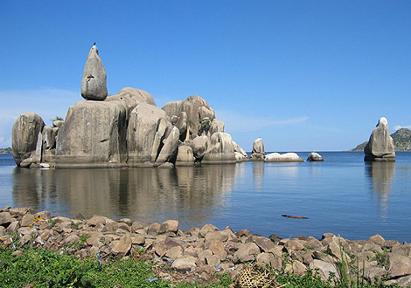
c. Water:
Rivers, lakes, oceans
Good because:
obvious boundaries
transportation for trade/military
protection

Slide 53
Geographic Connections
Come up examples for each type of physical boundary!
Include the name of the physical feature and the states it separates
Put this in your notes!

Slide 54
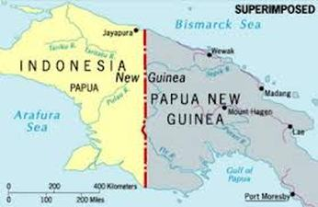
2. Cultural Boundaries
a. Geometric Boundary: boundary drawn without thought to culture, population, or physical features
Artificial boundary

Slide 55
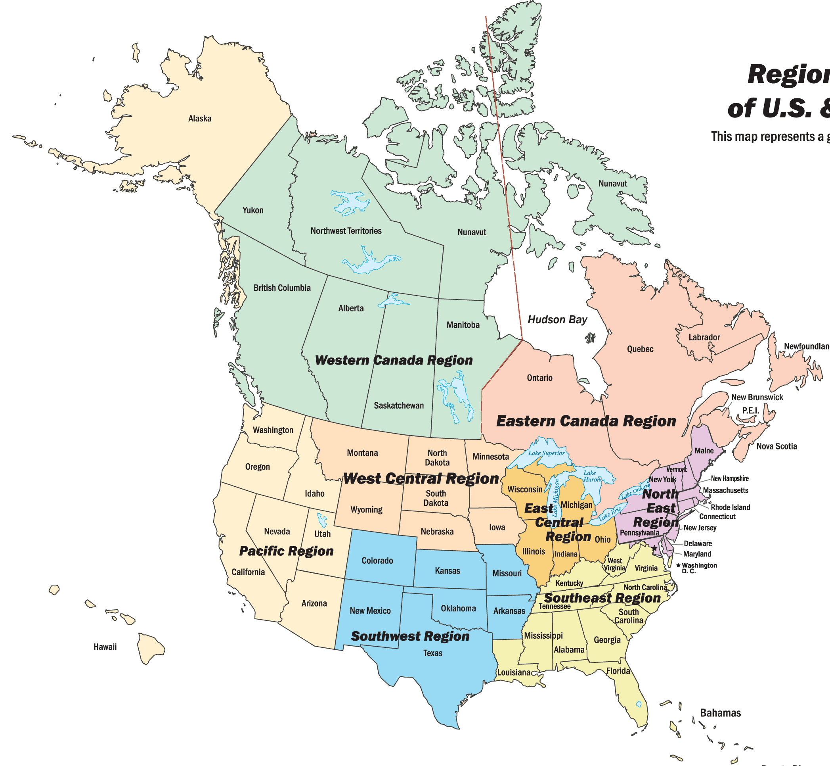
3. Antecedent Boundary: boundary drawn before an area is populated
4. Subsequent Boundary: boundary drawn after the
area is populated
and reflects that

Slide 56
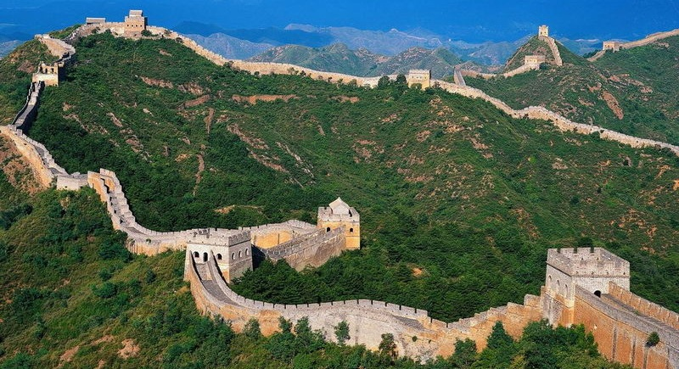
5. Relic Boundary: a former boundary line that is no longer relevant, but is still obvious
Great Wall of China

Slide 57
Geographic Connections
Come up examples for each type of cultural boundary!
Include the names of the states Put this in your notes!

Slide 58
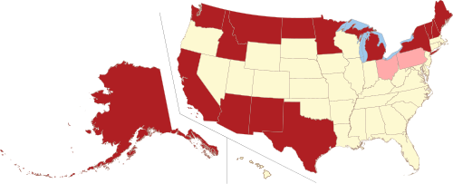
B. Shapes of States
Shape of a state effects the LENGTH of the boundary, thus the relationship with neighbors

Slide 59
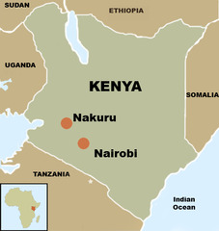
2. COMPACT STATE: distance from center to edges about the same
a. good for small states!
Easy communication and organization

Slide 60
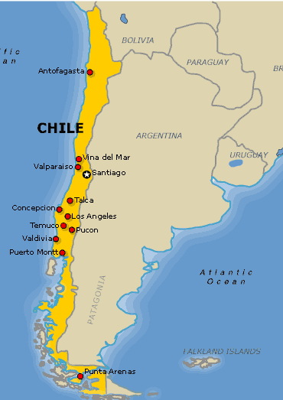
3. ELONGATED STATES:
Why would this be problematic? Discuss!

Slide 61
3. ELONGATED STATES: states with a long and narrow shape
a. bad for internal communication, edges get isolated

Slide 62
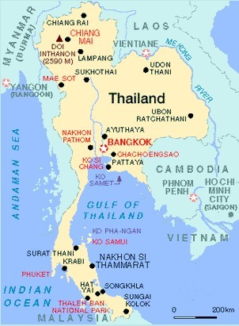
4. PRORUPTED STATES: a compact state with a large projecting extension
Why would a state have this?
Discuss!

Slide 63
4. PRORUPTED STATES: a compact state with a large projecting extension
a. Why have a proruption?
Access to a resource
To separate other states

Slide 64
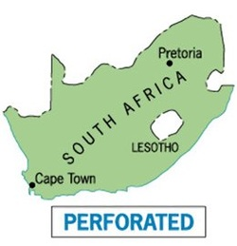
5. PERFORATED STATE:
Why would this be problematic?
Think about it silently.

Slide 65
5. PERFORATED STATE: A state that completely surround another
a. This causes problems:
Access for the surrounded state
Interference by the
surrounding state

Slide 66
DAY 3

Slide 67
Bellwork
Spot check #9
Give a new example of each of the following state shapes:
Compact
Elongated
Prorupted
Fragmented

Slide 68
Agenda
Finish Notes
Boundary Activity
HW: Map check Friday, #15-21

Slide 69
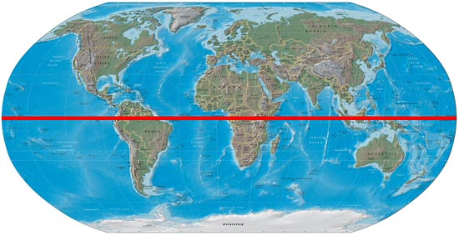
TUBI
The equator passes through 13 countries:
Ecuador, Colombia, Brazil, Sao Tome & Principe, Gabon, Republic of the Congo, Democratic Republic of the Congo, Uganda, Kenya, Somalia, Maldives, Indonesia and Kiribati

Slide 70
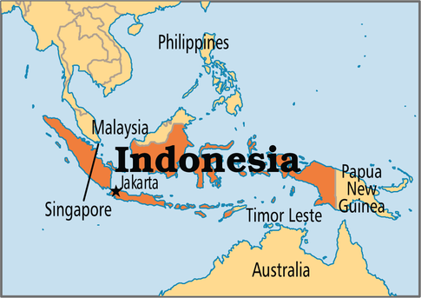
6. FRAGMENTED STATES:
Pros and cons? Discuss

Slide 71
6. FRAGMENTED STATES: states that are lot of disconnected territories
Separated by water or land:
Difficult to travel, maintain nationalism and communicate within a state

Slide 72
b. Separated by another state
difficult to communicate, travel and maintain nationalism

Slide 73
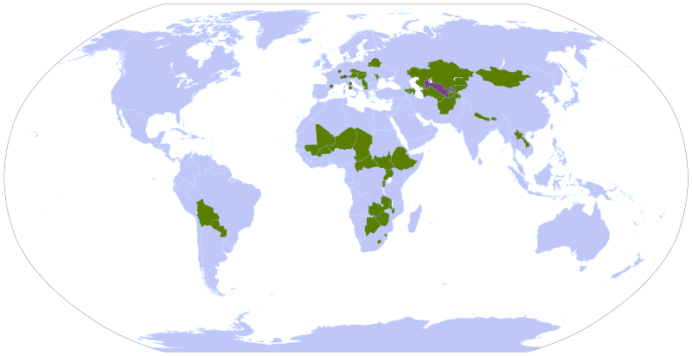
7. LANDLOCKED STATES:
Why would this be problematic? Discuss!

Slide 74
7. LANDLOCKED STATES: state that lacks direct access to an ocean
a. Problems with transportation and access

Slide 75
8. Enclave: a bit of land within a state that doesn’t belong to it
9. Exclave: portion of a state that is separated from the rest and surrounded by another country

Slide 76
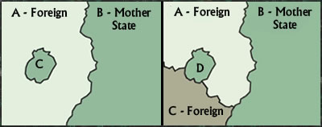
Left side: C is B’s exclave, and A’s enclave. Right side: D is B’s exclave, but is not an enclave.

Slide 77
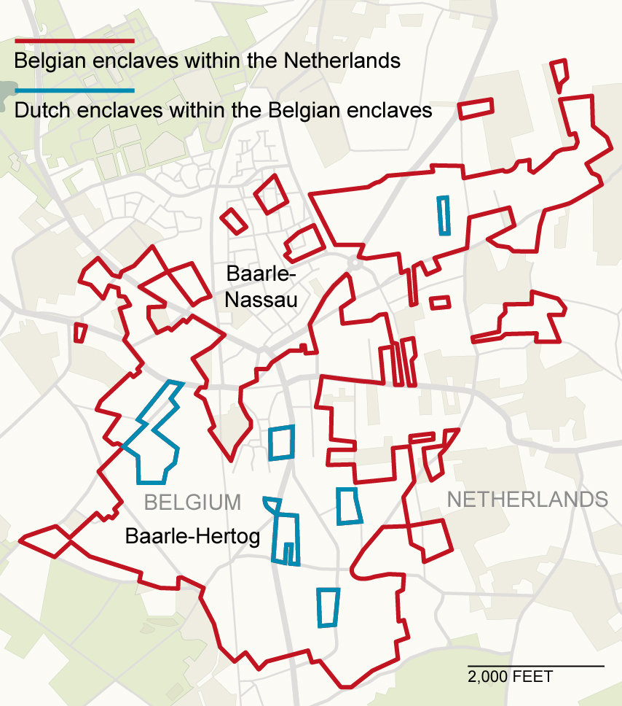

Slide 78
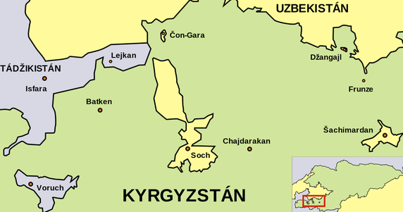

Slide 79
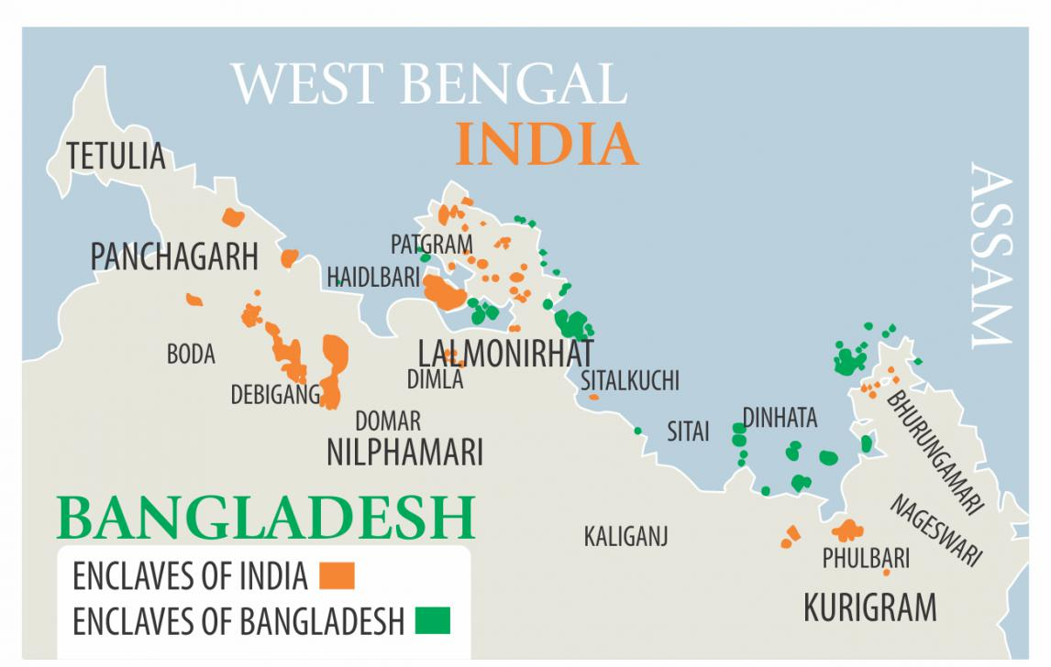

Slide 80
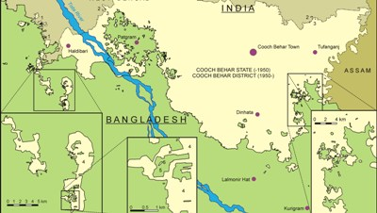

Slide 82
Geographic Connections
Come up with as many examples for each type of state shape as you can!

Slide 83
Summary:
Identify four of the different types of boundaries and state shapes.
Using two specific examples, explain how state shape can affect the country.

Slide 84
DAY 4

Slide 85
Bellwork
Get out map!
Pick two state shapes.
Identify a pro and a con for each shape.

Slide 86
Agenda
Boundary Activity
HW: Boundary Activity

Slide 87
Objective
You will be able to apply what you’ve learned about state shapes by drawing your own countries.

Slide 88
TUBI
Typical lightning bolt moves at 224,000 mph (3,700 miles per second)

Slide 89
Boundary Activity
You get to play god!
Notes:
See Comprehensive Guide to Human Geography for the Boundary Activity

Slide 90
DAY 5

Slide 91
Bellwork
Turn in Boundary Activity, Do not staple!
Describe a time you make an alliance, or teamed up, with others.
Why did you do it?

Slide 92
Agenda:
Notes: Alliances and Colonies
HW: #22-28, Quiz tomorrow

Slide 93
Objective
You will be able to summarize the major alliances in the world and the influence they have on the world.

Slide 94
TUBI
Montengro concentration camp being turned into resort

Slide 95
I. Allies

Slide 96
A. Economic Alliances:
European Union
North America Free Trade Agreement (NAFTA): easy trade between Canada, USA and Mexico
Organization of Petroleum Exporting Countries (OPEC): countries producing oil

Slide 97
OPEC

Slide 98
B. Other Alliances
African Union: set up to end colonialism, now economic integration
Arab League: cooperation between North African and Middle Eastern countries
Commonwealth: Former British Colonies, economic cooperation

Slide 99
Discuss
Why would a country want to be in an alliance? (Economic, military or otherwise)
What would be some negatives?

Slide 100
C. UN and Its Agencies
Other Supranational organizations:
World Health Organization (WHO)
UN Education, Scientific, and Cultural Organization (UNESCO)

Slide 101
2. Who Controls The Oceans?
United Nations Convention of the Law of the Sea (UNCLOS): international laws about the oceans

Slide 102
Territorial Waters: 12 miles off the coast of a state, its laws still apply
Exclusive Economic Zone (EEZ): 200 miles off the coast the state controls the resources
High Seas: Water beyond the EEZ

Slide 103
TERRITORIAL
WATERS
HIGH SEAS
EEZ

Slide 104
Discuss: How might these rules cause conflicts between states?

Slide 105
D. Divisions
North/South Divide: economic division between the wealthy countries in the northern hemisphere verses the southern one
Brandt Line

Slide 107
2. East/West Divide
Economic divide between capitalism and communism
Cultural divide created by Europe as a way to define their own culture

Slide 110
Discuss
Describe the major alliances in the world and the influence they have on the world.
Explain the role of centripetal and centrifugal forces in alliances.

Slide 111
II. Colonies

Slide 112
A. Colonies
Colonialism: a state establishes settlements in a territory and forces its principles on it
Europe colonized the world!

Slide 113
3. WHY?
GOD: Promote Christianity
GOLD: natural resources captive workforce/market
GLORY: more colonies = more power

Slide 114
4. Colonies Back then
a. Spanish: Latin America
b. Portugal: Brazil and Africa
c. UK: EVERYWHERE
d. France: West Africa, South East Asia

Slide 115
5. Most colonies became independent after WWII
End of Imperialism: building of an empire
Superimposed Boundary: boundary line is placed over and ignores cultural patterns

Slide 116
What is the message of this political cartoon from 1884?

Slide 117
1914 Colonial Possessions

Slide 118
C. Colonies Today
68 Colonies left
Mostly islands
KIND of colonies
Greenland
Now Chinese special administrative regions
Hong Kong (UK)
Macao (Portugal)

Slide 119
DISCUSS
Puerto Rico doesn’t want to be a colony any more.
Should they be incorporated as a state, become sovereign, or stay a colony??

Slide 120
Video: Sir Mapsalot
Notes:
http://www.cc.com/video-clips/kovgs5/the-daily-show-with-jon-stewart-sir-archibald-mapsalot-iii

Slide 121
B. Nation-states & Ethnicity
20th century ethnicities become a big deal in Europe again
USSR said: NO ETHNICITIES, YES COMMUNISM
Now: resurgence
of folk culture

Slide 122
USSR

Slide 123
USSR Satellite States

Slide 124
2. Separatism: Nationalities demand independence
Devolution: transfer of power from central to local government
Core area: original economic, cultural and political center
Multicore State: more than one

Slide 125
3. Forward Capital: a capital that has been moved to a country’s interior to undermine regionalism
Regionalism: when a group identifies more with a region than the state
Frontier: area where borders are shifting and weak

Slide 126
Video: Cold War
Notes:
https://www.youtube.com/watch?v=y9HjvHZfCU

Slide 127
Discuss
How do we see the legacy of the colonialization and Soviet Rule in international politics today?

Slide 128
Summary:
Describe the motivations for forming colonies.
Explain how colonialism still affects the world today. Use two examples.

Slide 129
DAY 6

Slide 130
Bellwork
Without looking at your notes, name 4 countries and capitals in Sub-Saharan Africa.

Slide 131
Agenda
Quiz
Finish Notes
Categorilla??
HW: #29-35

Slide 132
Quiz
Write clearly!
Capital, Country
Done? No tech, no naps

Slide 133
DAY 7

Slide 134
Bellwork:
What are some ways the consequences of colonialism affect the world today?

Slide 135
Agenda:
2 Practice FRQ
Bring book tomorrow!
HW: #36-45

Slide 136
Objective:
You will be able to analyze the use of gerrymandering in the USA.

Slide 137
TUBI
The Sahara covers large parts of Algeria, Chad, Egypt, Libya, Mali, Mauritania, Morocco, Niger, Western Sahara, Sudan and Tunisia, extends over 3,475,000 sq mi and it covers about 1/4 of the African continent.

Slide 138
FRQ
Plan and write for 25 minutes
Write responses in PEN
Can use notes and neighbors
Staple prompt to back and turn in when done

Slide 139
Score
Look over the rubric
Score your classmate’s FRQ, underline where they get the point
Add one compliment and one constructive criticism

Slide 140
DAY 8

Slide 141
Bellwork:
How does the geography of the UK affect how it functions?

Slide 142
Agenda:
Turn in bellwork
4 Level Map pg. 274
Test review
HW: STUDY

Slide 143
Objective:
You will be able to analyze a map of the world in 1914.

Slide 144
TUBI
William Henry Harrison holds the record for giving the longest inaugural address.
His 8,500-word address took about an hour and 45 minutes to read.
But it was a super cold and rainy day in 1841, and Harrison refused to wear a hat or coat. He caught a cold that developed into pneumonia and died a month later.

Slide 145
4 Level Map Analysis
Do you understand the map?
Type of map, information depicted, etc
Where do you see things?
Patterns, distribution, unique things
Why there?
Reasons for you Level 2 Observations
So what?
Connect this to at least 3 other chapters. What models apply?
BULLET POINTS
COMPLETE SENTENCES

Slide 146
Practice Multiple Choice
Find a partner
Write 4 MULTIPLE CHOICE QUESTIONS
(needs 5 choices, A B C D E)
All the following is true about _____________ EXCEPT
______________ is an example of
An example of ___________________ is
From what we know about _____________ we can assume

