Slide 1
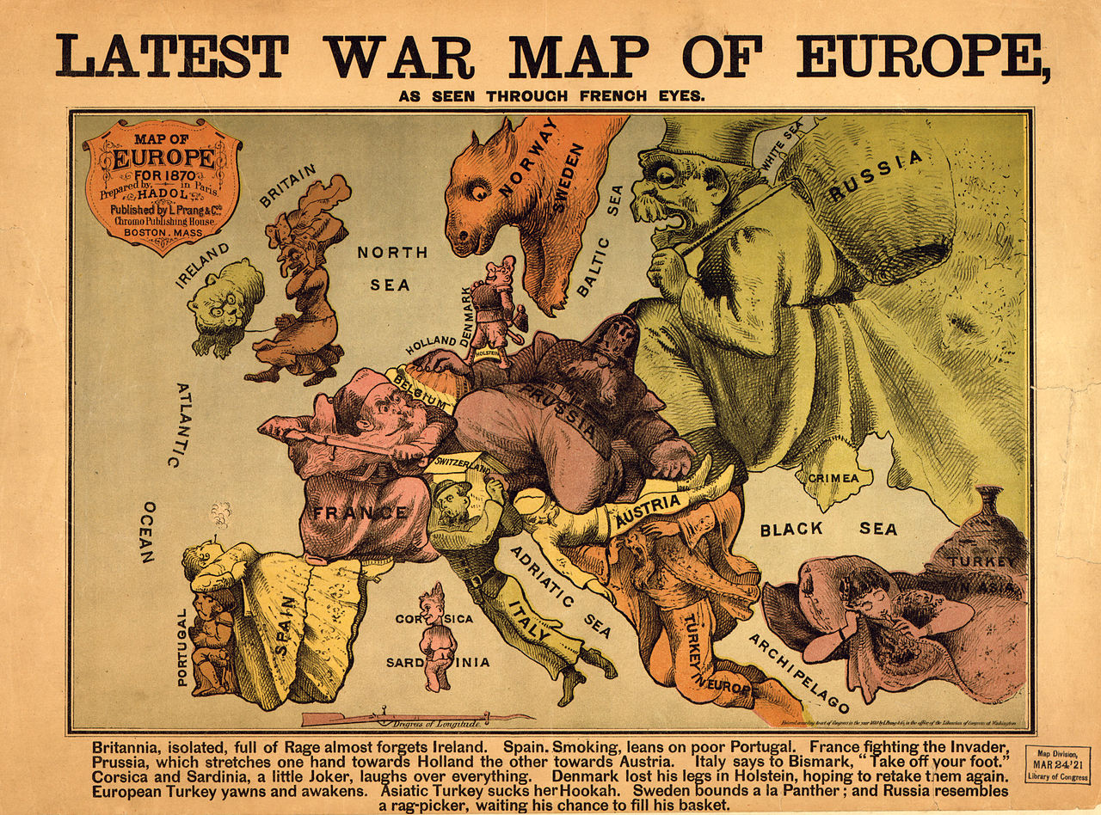
AP Human Geography
Chapter 9: Development
Although this includes a powerpoint for each day of the chapter, it references assignments and activities not included in the bundle. For the most effective instruction, purchase the Comprehensive Guide to Teaching Human Geography too.

Slide 2
DAY 1

Slide 3
Bellwork
Other than age and physical development, what makes an adult different from a teenager?

Slide 4
Agenda:
Notes: Intro to Development
HW: Map, #1-6

Slide 5
Objective:
You will be able to define and describe development of countries in writing.

Slide 6
TUBI
Norway Knighted a Penguin
Sir Nils Olav

Slide 7
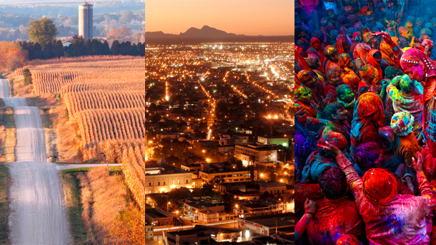
CHAPTER 9: DEVELOPMENT

Slide 8
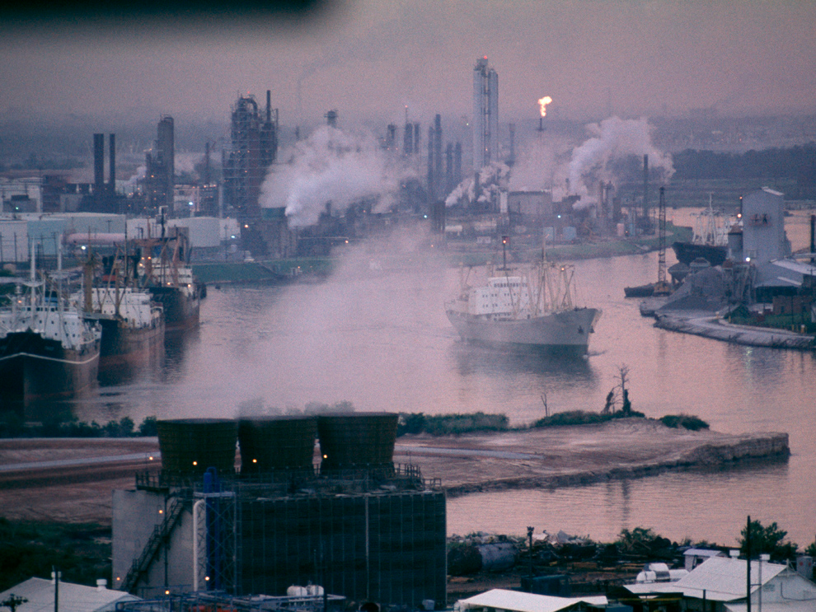
I. Introduction to Development

Slide 9
A. The Basics
Development: process of improving the lives of people with diffusion of knowledge and tech
Developed/More Developed Country (MDC) vs. Developing/Less Developed Country (LDC)

Slide 10
Geographic Connections
Quick! What are some MDC’s and LDC’s?? What decides the difference?

Slide 11
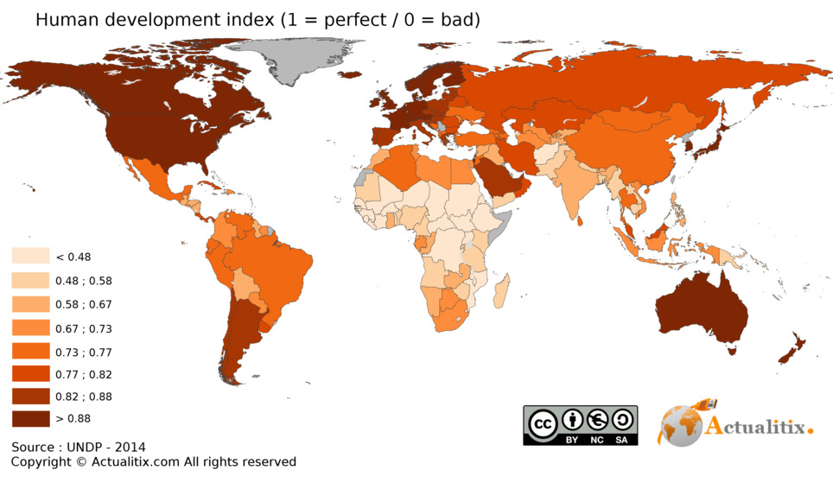

Slide 12
2. Wealth doesn’t depend only one what is produced, but how and where it is produced
3. Development isn’t always 100% positive

Slide 13
Discuss
What are ways development might be negative?

Slide 14
B. Measuring Wealth
Gross National Product: total value of goods and services produced BY a country’s citizens and corporations in a year
Gross Domestic Product: total value of goods and services produced IN a country in a year

Slide 15
3. Gross National Income: Calculates monetary worth of what’s produced inside a country, plus income from investments internationally
Per Capita GNI: GNI per person in a country

Slide 16
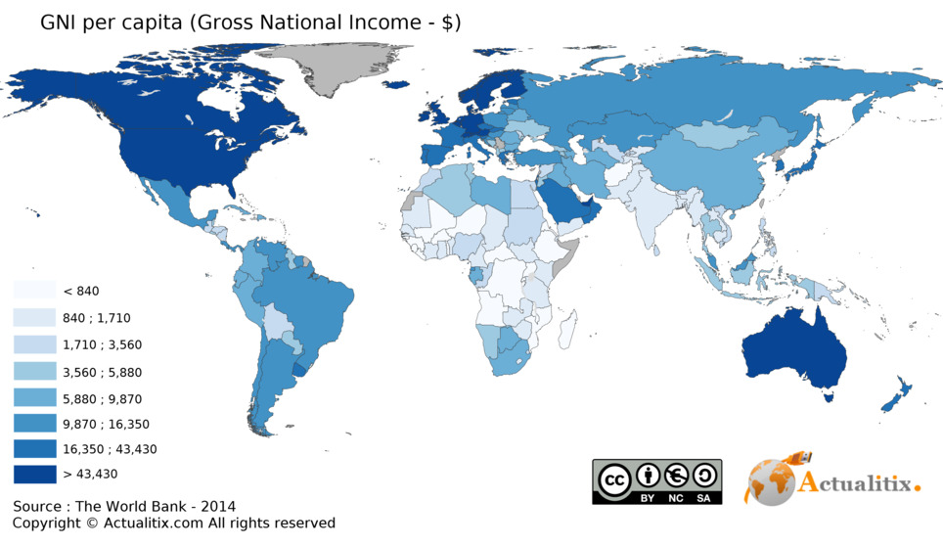

Slide 17
4. Formal vs. Informal economy
Informal is illegal or uncounted (and thus untaxed) economic activity
Common in LDC’s

Slide 18
Geographic Connections
What activities would count as informal?
What countries do you think have informal economies as big part?

Slide 19
C. World Systems Theory
Immanuel Wallerstein
Direct consequence of imperialism
Divides with world into Core, Semi-Periphery, and Periphery by looking at international relations, history and sociology
Core = Developed
Periphery = undeveloped

Slide 20
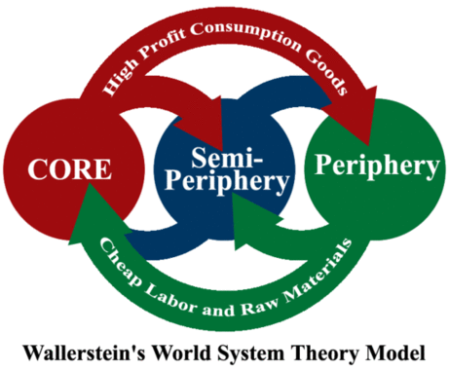
4. So Core ALWAYS exploits the Periphery
DRAW
THIS

Slide 21
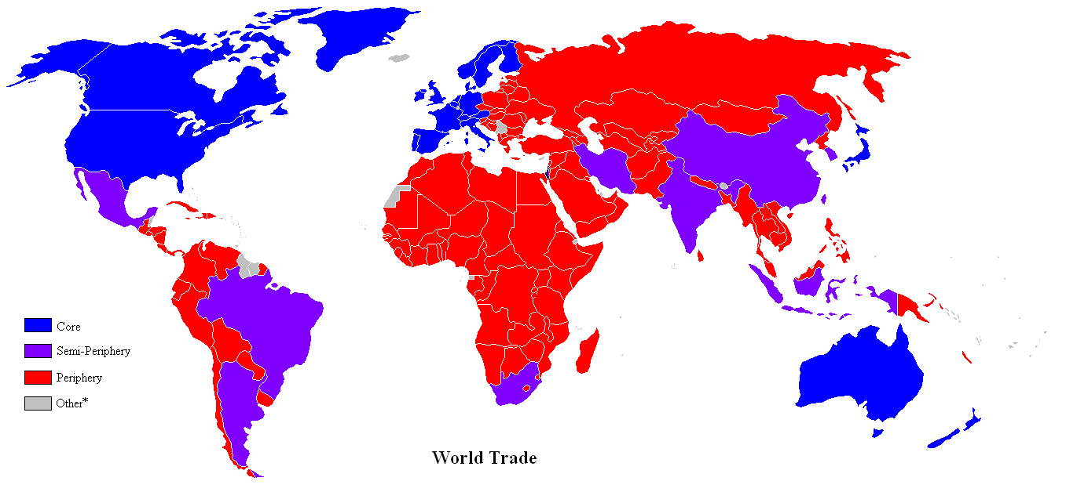

Slide 22
Summary:
Define development.
Describe the differences between a MDC and a LDC using real examples.

Slide 23
DAY 2

Slide 24
Bellwork
Write a goal for yourself in this class, this semester.
What should a class goal be?

Slide 25
Agenda:
Notes: Paths to Development
HW: #7-12, Map, article

Slide 26
Objective:
You will be able to describe the relationship between economics and development using real examples.

Slide 27
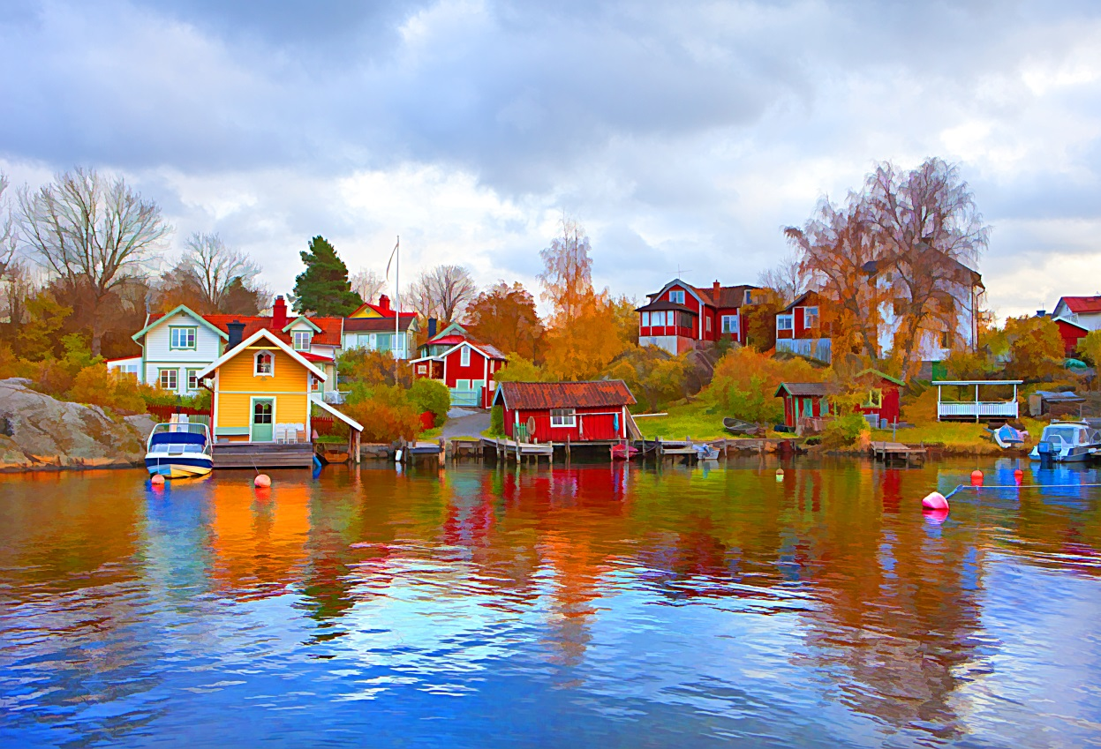
TUBI
Swedish word for Friday cozy time: Fredagsmys

Slide 28
I. Paths to Development

Slide 29
A. Millennium Development Goals
To eradicate extreme poverty and hunger
To achieve universal primary education
To promote gender equality
To reduce child mortality
To improve maternal health
To combat HIV/AIDS, and other diseases
To ensure environmental sustainability

Slide 30
Discuss
16 years later, how has the world done so far?

Slide 31
B. Human Development Index
HDI: created by the UN to measure development of a country
Developed countries have:
Decent standard of living
Long and Healthy life
Access to knowledge

Slide 32
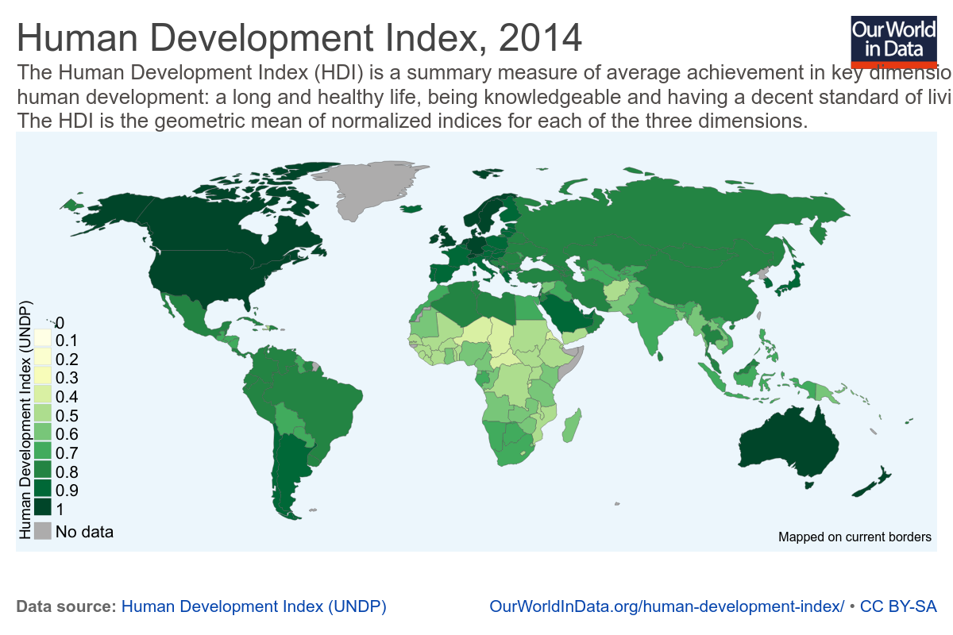
Notes:
https://ourworldindata.org/human-development-index/
http://hdr.undp.org/en/countries

Slide 33
d. Inequality-adjusted HDI
Inequality-adjusted HDI (IHDI): modifies HDI to account for inequality within a country
Ideally, HDI and IHDI should be the same

Slide 34
Exam Focus

Slide 35
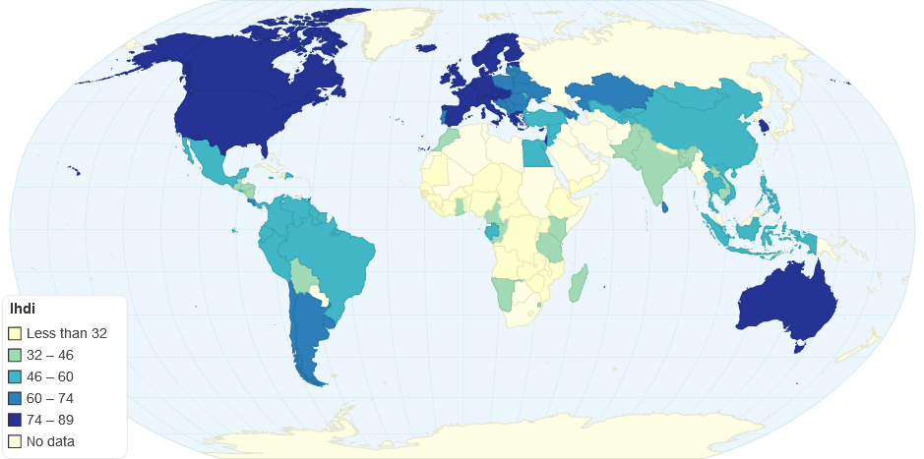
IHDI 2012

Slide 36
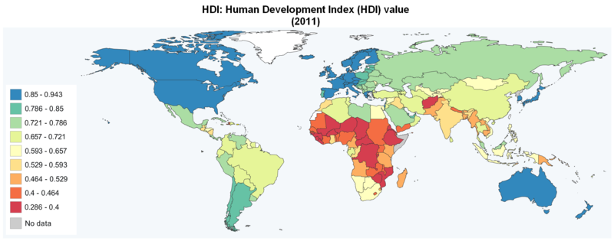
Notes:
https://ourworldindata.org/human-development-index/
http://hdr.undp.org/en/countries

Slide 37
Discuss
What are some of the types of inequality they look at?
Why does it matter?

Slide 38
C. Economic Indicators of Development
Types of jobs
Primary sector: things from Earth (agriculture, fishing, mining)
Secondary sector: manufacturing
Tertiary Sector: goods and service for payment (retail, banking, law, education, gov)

Slide 39
2. Worker productivity
3. Access to raw materials
4. Availability of consumer goods

Slide 40
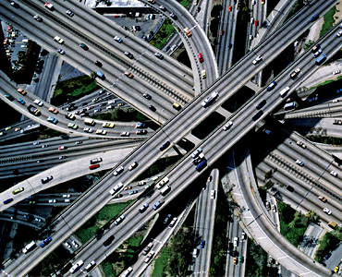
5. Standard of Living
Infrastructure: the basic physical and organizational structures needed for the operation of a society

Slide 41
Discuss
Why does infrastructure and major economic sector matter for a developing country?

Slide 42
D. Paths to Development
Self-sufficiency: encourage domestic production, no international intervention
Limits on imports
Protection from international competition
Investment equal across country

Slide 43
d. Challenges
protection of bad businesses
need for a large bureaucracy

Slide 44
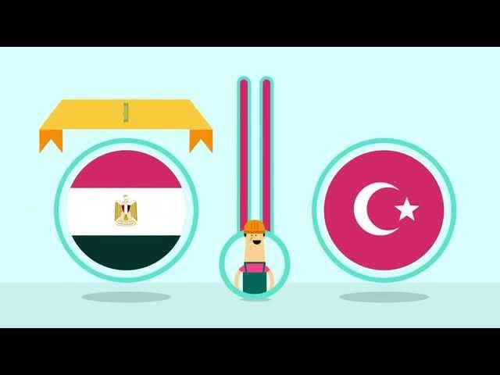
Video: Create Jobs in Arab World (World Bank)
Notes:
https://www.youtube.com/watch?v=61DMHiGOhEQ

Slide 45
2. International trade: open up to international investment
Figure out what resource they have that everyone else wants
Instantly gets you into international markets
Faster

Slide 46
d. Challenges
uneven resource distribution
dependence on developed countries
market decline

Slide 47
3. International Approach Winning
Some countries became developed with this
Developing countries have a lot of raw materials
Makes them competitive

Slide 48
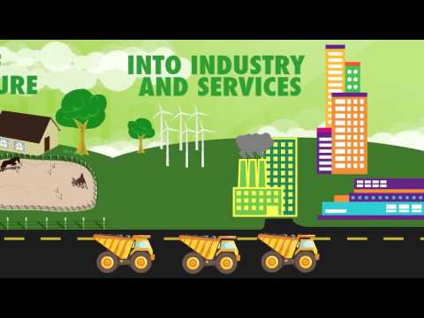
Video: Turkey’s Growth (World Bank)
Notes:
https://www.youtube.com/watch?v=d5BUdgDSi4U

Slide 49
E. Rostow’s Stages of Development
Traditional Society: not started development; high % of agriculture
Preconditions for Takeoff: new businesses, gov. invests in tech and infrastructure = MORE PRODUCTIVITY

Slide 50
3. Takeoff: Rapid growth from limited economic activities
4. Drive to maturity: diffusion of modern tech, more growth, more skilled workers
5. Age of Mass Consumption: shift from heavy industry to consumer goods

Slide 51
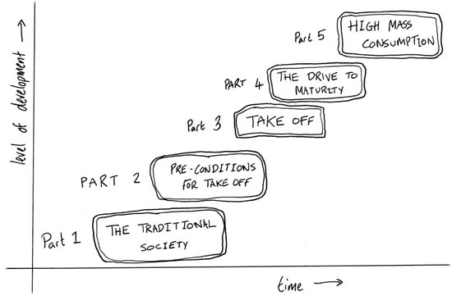
Draw in + Geographic Connections

Slide 52
F. Money for Development
Loans:
World Bank: loans money to developing countries to help with infrastructure
International Monetary Fund: loans money to stabilize the country’s economy

Slide 53
Discuss
What are some challenges organizations like these might face?

Slide 54
c. BUT most of the projects fail
faulty engineering
Countries misuse funds or it is stolen
New infrastructure does NOT attract other investments
d. ALL countries in a lot of debt

Slide 55
G. Dependency Theory
The reason why developing countries are so poor is because developed countries exploit them

Slide 56
2. Fair Trade
Commerce where products are made and traded according to standards that protect workers and small businesses in developing countries

Slide 57
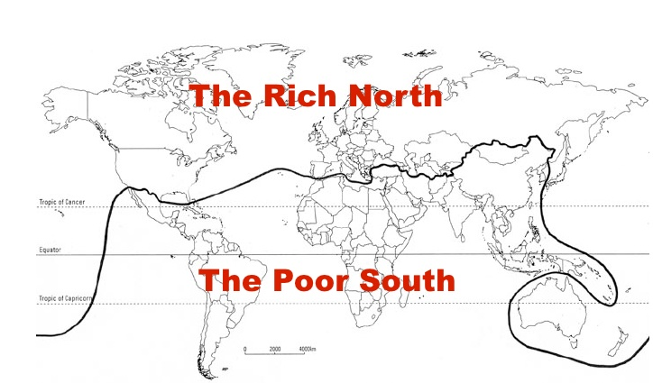
2. Brandt Line = North-South Line
Willy Brandt (1980)
Divide of wealth according to north and south

Slide 58
Summary:
Describe the relationship between economics and development using real examples.

Slide 59
Video: John Oliver, Infrastructure
Notes:
https://www.youtube.com/watch?v=gvZSpET11ZY

Slide 60
DAY 3

Slide 61
Bellwork
What do you do if you want to buy a house but don’t have the cash for it?

Slide 62
Agenda
World Bank/IMF Activity
HW: Article

Slide 63
Objective:
You will be able to articulate the purpose of the IMF and World Bank in writing.

Slide 64
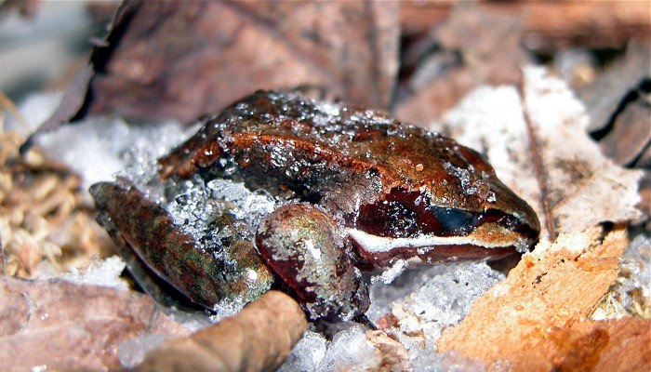
TUBI:
Wood Frogs Can Survive Being Frozen Solid, Over and Over.

Slide 65
Activity
Find a partner
Grab a computer for your pair and log on

Slide 66
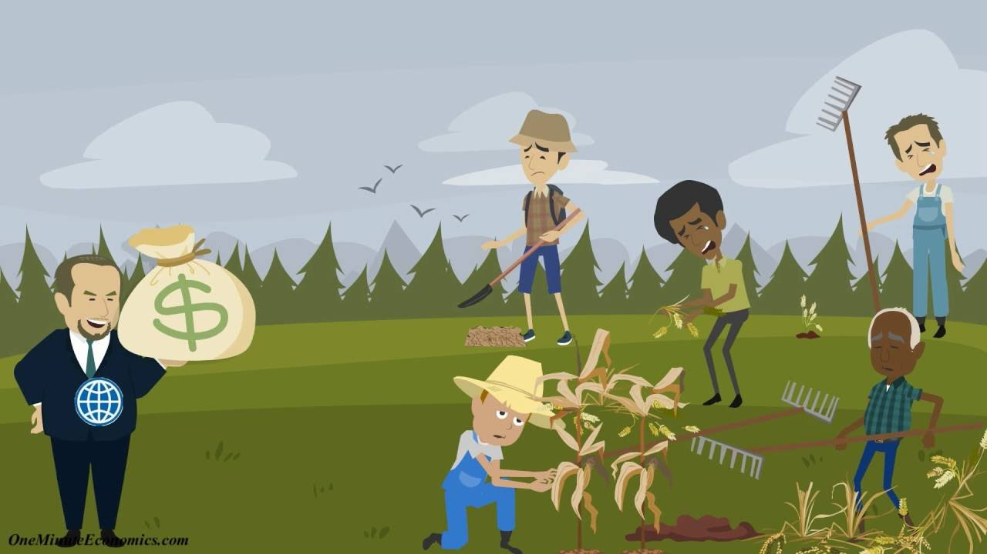
World Bank Video
Notes:
https://www.youtube.com/watch?v=WG72yk60tbA

Slide 67
Notes:
Names:
World Bank and IMF Activity
Read through the hand out.
What is the purpose of the World Bank and the IMF?
Your first task as a member of the team is to individually generate a set of 5 questions that you believe may be important for the World Bank to consider in evaluating the stability of a newly independent country prior to lending money. Using the terms associated with the reading and lecture for this section, list the questions that you believe should be considered, keeping in mind that your questions should reflect issues related to economic development, stability, and long-term improvement of the countries’ sustainable infrastructure. In parenthesis after each question, justify why this question is valid and important in loan consideration.
1.
2.
3.
4.
5.
Next, go to the CIA Fact book online and locate a developing country that you believe would be a good risk for the World Bank based on the questions for part one that you deemed important. A good risk is one that will probably pay off. This part should be a written statement, explanation, and summary of the country you deem the best risk for the World Bank.
Country:
Why choose this country instead of others?
What specific attributes does the country possess that may make it worthy of consideration?
Criticism:
What kind of projects could this loan be used for? What are some potential problem and difficulties with this project or loan?
Should the project funding be denied if people would be displaced? Does it matter how many people?
Is there anything that can be done to mitigate this dislocation problem?
Should the panel members take into account the protesters and lobbyists outside the World Bank office? Should they be invited to speak at the meeting?
The IMF and the World Bank
The International Monetary Fund (IMF) and the World Bank are institutions in the United Nations system. They share the same goal of raising living standards in their member countries. Their approaches to this goal are complementary, with the IMF focusing on macroeconomic issues and the World Bank concentrating on long-term economic development and poverty reduction.
What are the purposes of the Bretton Woods Institutions?
The International Monetary Fund and the World Bank were both created at an international conference convened in Bretton Woods, New Hampshire, United States in July 1944. The goal of the conference was to establish a framework for economic cooperation and development that would lead to a more stable and prosperous global economy. While this goal remains central to both institutions, their work is constantly evolving in response to new economic developments and challenges.
The IMF’s mandate. The IMF promotes international monetary cooperation and provides policy advice and technical assistance to help countries build and maintain strong economies. The IMF also makes loans and helps countries design policy programs to solve balance of payments problems when sufficient financing on affordable terms cannot be obtained to meet net international payments. IMF loans are short and medium term and funded mainly by the pool of quota contributions that its members provide. IMF staff are primarily economists with wide experience in macroeconomic and financial policies.
The World Bank’s mandate. The World Bank promotes long-term economic development and poverty reduction by providing technical and financial support to help countries reform particular sectors or implement specific projects—such as, building schools and health centers, providing water and electricity, fighting disease, and protecting the environment. World Bank assistance is generally long term and is funded both by member country contributions and through bond issuance. World Bank staff are often specialists in particular issues, sectors, or techniques.
Framework for cooperation
The IMF and World Bank collaborate regularly and at many levels to assist member countries and work together on several initiatives. In 1989, the terms for their cooperation were set out in a concordat to ensure effective collaboration in areas of shared responsibility.
High-level coordination. During the Annual Meetings of the Boards of Governors of the IMF and the World Bank, Governors consult and present their countries’ views on current issues in international economics and finance. The Boards of Governors decide how to address international economic and financial issues and set priorities for the organizations.
A group of IMF and World Bank Governors also meet as part of the Development Committee, whose meetings coincide with the Spring and Annual Meetings of the IMF and the World Bank. This committee was established in 1974 to advise the two institutions on critical development issues and on the financial resources required to promote economic development in low-income countries.
Management consultation. The Managing Director of the IMF and the President of the World Bank meet regularly to consult on major issues. They also issue joint statements and occasionally write joint articles, and have visited several regions and countries together.
Staff collaboration. IMF and Bank staffs collaborate closely on country assistance and policy issues that are relevant for both institutions. The two institutions often conduct country missions in parallel and staff participate in each other’s missions. IMF assessments of a country’s general economic situation and policies provide input to the Bank’s assessments of potential development projects or reforms. Similarly, Bank advice on structural and sectoral reforms is taken into account by the IMF in its policy advice. The staffs of the two institutions also cooperate on the conditionality involved in their respective lending programs.
The 2007 external review of Bank-Fund collaboration led to a Joint Management Action Plan on World Bank-IMF Collaboration (JMAP) to further enhance the way the two institutions work together. Under the plan, Fund and Bank country teams discuss their country-level work programs, which identify macro-critical sectoral issues, the division of labor, and the work needed in the coming year. A review of Bank-Fund Collaboration underscored the importance of these joint country team consultations in enhancing collaboration.
Reducing debt burdens. The IMF and World Bank have also worked together to reduce the external debt burdens of the most heavily indebted poor countries under the Heavily Indebted Poor Countries (HIPC) Initiative and the Multilateral Debt Relief Initiative (MDRI). They continue to help low-income countries achieve their development goals without creating future debt problems. IMF and Bank staff jointly prepare country debt sustainability analyses under the Debt Sustainability Framework (DSF) developed by the two institutions.
Reducing poverty. In 1999, the IMF and the World Bank launched the Poverty Reduction Strategy Paper (PRSP) approach as a key component in the process leading to debt relief under the HIPC Initiative and an important anchor inconcessional lending by the Fund and the Bank. While PRSPs continue to underpin the HIPC Initiative, the World Bank and the IMF adopted in July 2014 and July 2015, respectively, new approaches to country engagement that no longer requires PRSPs. The IMF streamlined its requirement for poverty reduction documentation for programs supported under the Extended Credit Facility (ECF) or the Policy Support Instrument (PSI).
Setting the stage for the 2030 development agenda. Between 2004 and 2015 the IMF and the Bank jointly published the annual Global Monitoring Report (GMR), which assessed progress towards meeting the Millennium Development Goals (MDGs). In 2015, with the replacement of the MDGs with the Sustainable Development Goals (SDGs) under the 2030 Global Development Agenda, the IMF and the Bank have actively engaged in the global effort to support the Agenda. Each institution has committed to new initiatives, within their respective remits, to support member countries in reaching their SDGs. They are also working together to better assist the joint membership, including by an enhanced support ofstronger tax systems in developing countries.
Assessing financial stability. The IMF and the World Bank are also working together to make financial sectors in member countries resilient and well regulated. The Financial Sector Assessment Program (FSAP) was introduced in 1999 to identify the strengths and vulnerabilities of a country's financial system and recommend appropriate policy responses.
The IMF at a Glance
The International Monetary Fund (IMF) promotes international financial stability and monetary cooperation. It also seeks to facilitate international trade, promote high employment and sustainable economic growth, and reduce poverty around the world. The IMF is governed by and accountable to its 189 member countries.
The IMF’s responsibilities: The IMF's primary purpose is to ensure the stability of the international monetary system—the system of exchange rates and international payments that enables countries (and their citizens) to transact with each other.
Surveillance: To maintain stability and prevent crises in the international monetary system, the IMF reviews country policies and national, regional, and global economic and financial developments through a formal system known assurveillance. The IMF advises its 189 member countries, encouraging policies that foster economic stability, reduce vulnerability to economic and financial crises, and raise living standards. It provides regular assessment of global prospects in its World Economic Outlook, of financial markets in its Global Financial Stability Report, and of public finance developments in its Fiscal Monitor, and publishes a series of regional economic outlooks.
Financial assistance : IMF financing provides its members breathing room to correct balance of payments problems: national authorities design adjustment programs in close cooperation with the IMF that are supported by IMF financing; continued financial support is conditional on effective implementation of these programs. In response to the global economic crisis, the IMF strengthened its lending capacity and approved a major overhaul of its financial support mechanisms in April 2009, with further reforms adopted in 2010 and 2011. These reforms focused on enhancing crisis prevention, mitigating contagion during systemic crisis, and tailoring instruments based on members’ performances and circumstances. Following the effectiveness of the quota increases under the 14thGeneral Review of Quotas, access limits under the IMF’s non-concessional lending facilities were reviewed and increased in early 2016.To increase financial support to the world’s poorer countries, concessional resources available to low-income countries through the Poverty Reduction and Growth Trust were substantially boosted in 2009, while average access limits under the IMF’s concessional loan facilities were doubled. In addition, access norms and limits were increased by 50 percent in 2015. These loans are interest-free through end-2018, while the interest rate on emergency financing is permanently set at zero. Finally, efforts are currently under way to secure additional loan resources of about $15 billion (SDR 11 billion) to support the IMF’s concessional lending activities.
Capacity Development: The IMF provides capacity development and training to help member countries strengthen their ability to design and implement effective policies including in the areas of tax policy and administration, expenditure management, monetary and exchange rate policies, banking and financial system supervision and regulation, legislative frameworks, and statistics.
Resources: The primary source of the IMF's financial resources is its members’ quotas, which broadly reflect members’ relative position in the world economy. With the recent effectiveness of the 14th General Review of Quotas, total quota resources amount to about SDR 477 billion (about $668 billion). In addition, the IMF can borrow temporarily to supplement its quota resources. The New Arrangements to Borrow (NAB), which can provide supplementary resources of up to SDR 182 billion (about $254 billion), is the main backstop to quotas. In mid-2012, member countries also pledged to increase the IMF’s resources through bilateral borrowing agreements; currently about SDR 280 billion (about $393 billion) are effective.
Fast Facts
Membership: 189 countries
Headquarters: Washington, D.C.
Executive Board: 24 Directors each representing a single country or groups of countries
Staff: Approximately 2,700 from 148 countries
Total quotas: US$668 billion (as of 9/13/16)
Additional pledged or committed resources: US $668 billion
Committed amounts under current lending arrangements (as of 9/8/16): US$159 billion, of which US$144 billion have not been drawn (see table).
Biggest borrowers (amount outstanding as of 8/31/16): Portugal, Greece, Ukraine, Pakistan
Biggest precautionary loans (amount agreed as of 9/8/16): Mexico, Poland, Colombia, Morocco
Surveillance consultations: 130 consultations in 2013, 132 in 2014 and 124 in 2015
Capacity development: 274 person years in FY2013, 285 in FY2014 and 288 in FY2015
Original aims:
promote international monetary cooperation;
facilitate the expansion and balanced growth of international trade;
promote exchange stability;
assist in the establishment of a multilateral system of payments; and
make resources available (with adequate safeguards) to members experiencing balance of payments difficulties.

Slide 68
Day 5

Slide 69
Bellwork:
What is one way we see gender equality in the US?
What is one way we see gender inequality in the US?

Slide 70
Agenda:
Notes: Gender Inequality
HW: #25-30, Quiz tomorrow,
4 Level Map postponed still Monday/Tuesday

Slide 71
Objective:
You will be able to analyze gender inequality in the world.

Slide 72
TUBI:
Groundhog Day: Saw his shadow, 6 more weeks of winter

Slide 73
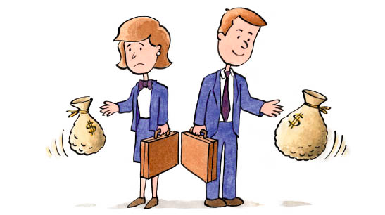
I. Gender Inequality

Slide 74
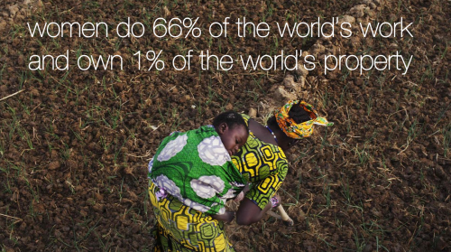

Slide 75
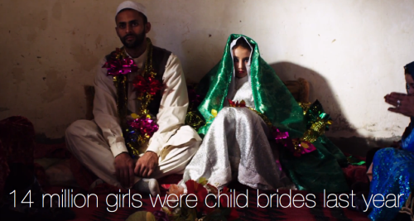

Slide 78
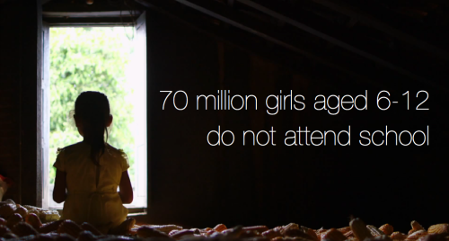

Slide 79
A. Gender Inequality Measures
Just because a country is developed, doesn’t mean everyone experiences that
Gender Equity: the process of allocating resources, programs, and decision making to both males and females …and addressing any imbalances in the benefits

Slide 80
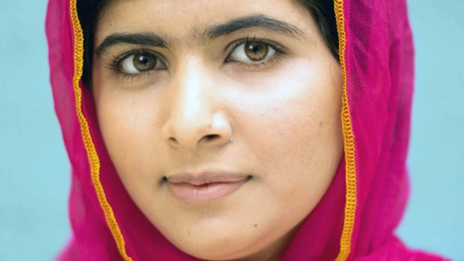
3. Empowerment
Can women achieve economic and political power?
% of women in national legislature
% of women who finished high school
Literacy Rate: percentage of the population that can read and write

Slide 81
Video: Inspire Her Mind (Verizon)
Notes:
https://www.youtube.com/watch?v=DQXZ_g2d5ao

Slide 82
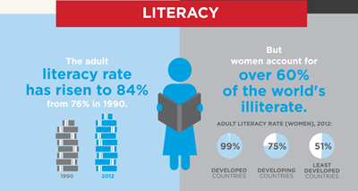
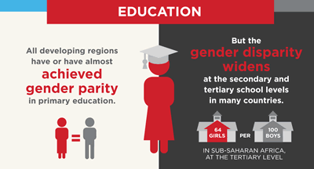

Slide 83
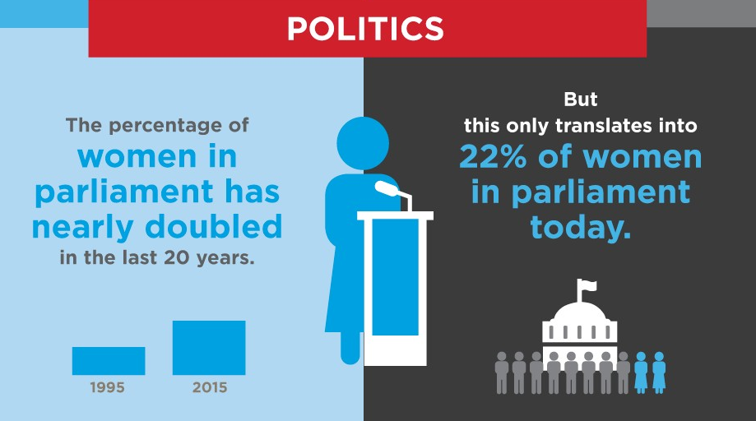

Slide 85
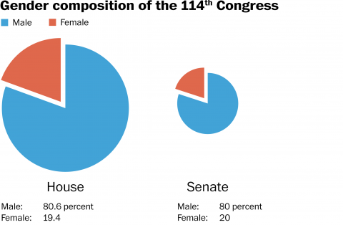

Slide 86
Discuss
50% of Americans are women, but 20% of legislators are.
Why aren’t women able to achieve political equality in the USA??

Slide 87
4. Labor Force:
What percentage of working citizens are women?
Not necessarily accurate, in many parts of the world women’s work is not counted

Slide 88
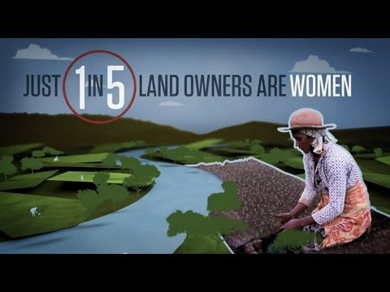
Video: Equality (World Bank)
Notes:
https://www.youtube.com/watch?v=KxECHRlrHu

Slide 89
5. Reproductive Health:
Why do women die so much more than men?
Maternal Mortality Rate: # of women who die per 1,000 births
Adolescent Fertility Rate: # of births per 1,000 women between 15-19

Slide 90
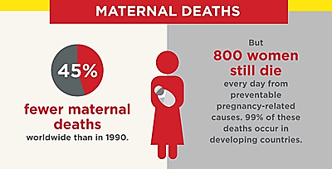
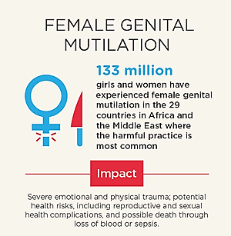

Slide 91
b. UN Women: NGO to work towards gender equality and the empowerment of women internationally
Non-Governmental Organization: any non-profit, voluntary citizens' group which is organized on a local, national or international level

Slide 92
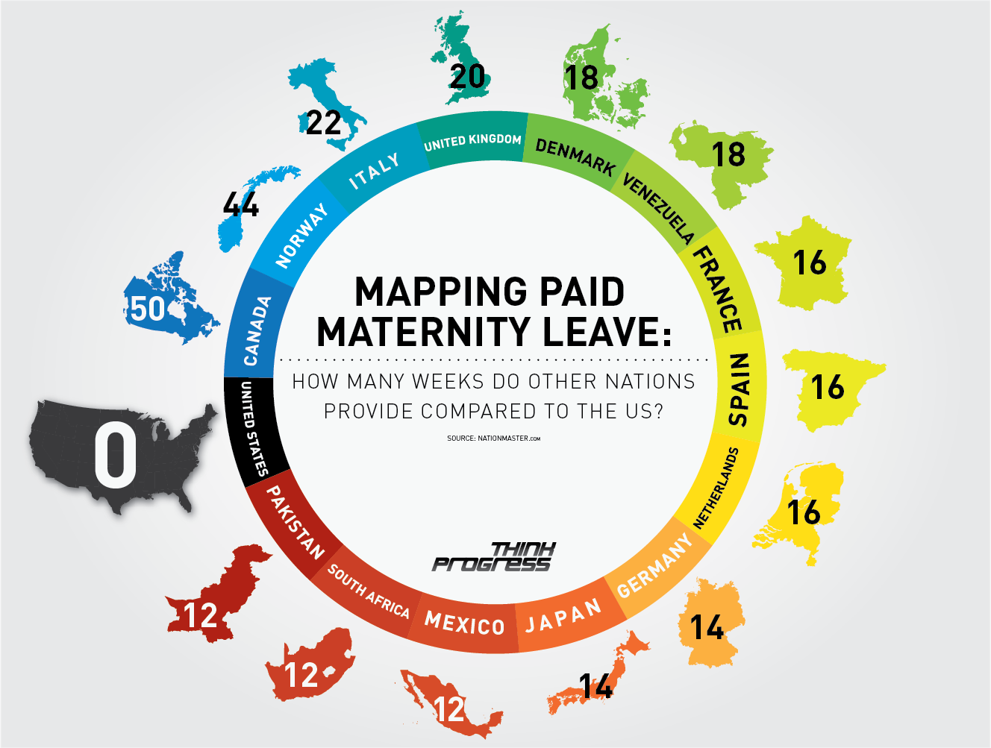

Slide 93
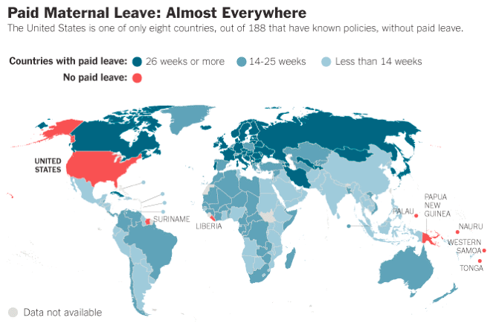

Slide 94
Video: Maternity Leave
Notes:
https://www.youtube.com/watch?v=1ziPPItLiSY

Slide 95
Discuss
Why don’t we have maternity leave in the US? (Patriarchy isn’t an acceptable answer)
Why is it important?

Slide 96
Infographic: Violence Against Women
Notes:
http://beijing20.unwomen.org/en/infographic/evaw

Slide 97
Video: Egypt PSA
Notes:
https://www.youtube.com/watch?v=jePvXFz4XDc

Slide 98
B. Dangers of Language
Language reflects and molds culture
It can be bad for EVERYONE
FEMINIST: Someone who advocates for equal political, economic, cultural, and social rights between men and women.

Slide 99
Video: Like a Girl
Notes:
https://www.youtube.com/watch?v=XjJQBjWYDTs

Slide 100
Split a piece of paper. Name is optional.
Did you consider yourself a feminist before this lesson? Do you consider yourself a feminist now? Explain.
If not, why don’t you want equality between the genders?

Slide 101
Video: Dear Daddy
Notes:
https://www.youtube.com/watch?v=dP7OXDWof30

Slide 102
Video: The Mask You Live In
Notes:
https://www.youtube.com/watch?v=hc45-ptHMxo

Slide 103
Summary:
Describe the impact of gender equity on a developing country.
Use at least three vocab words from this chapter.

Slide 104
Class Discussion

Slide 105
Day 6

Slide 106
Bellwork:
Without looking at your map, name 6 countries and capitals

Slide 107
Agenda:
Turn in bellwork
Quiz!
Videos/Summary
HW: Bring book Monday

Slide 108
Quiz
Do NOT talk about the quiz with other classes
Write clearly
Done? No tech, no naps, do something

Slide 109
DAY 7

Slide 110
Bellwork
Where do you, as an individual, get your energy from?
How do you use up your energy? Be specific.

Slide 111
Agenda:
Notes: Energy
MEGA 4 Level Map pg. 316
HW: #31-35

Slide 112
Objective:
You will be able to summarize the different types of energy.

Slide 113
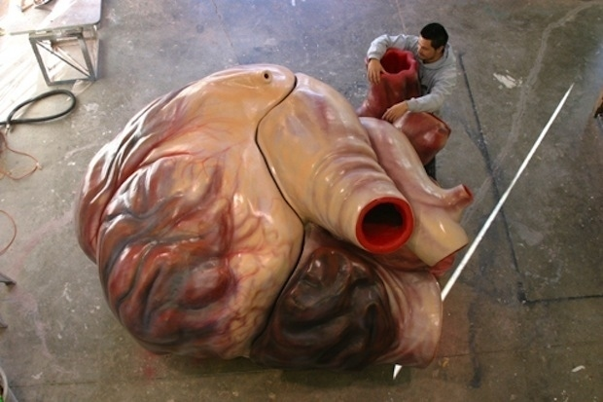
TUBI
You can swim through a blue whale’s heart

Slide 114
I. Energy

Slide 115
APES BRAIN STORM
Discuss with your partner, everything you know about energy from AP Environmental Science

Slide 116
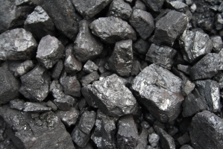
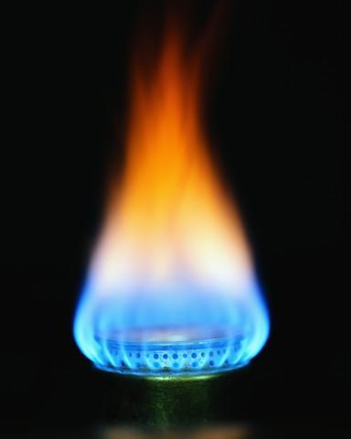
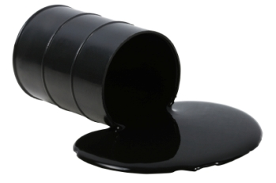
A. Energy Demand
We get energy from raw materials: the basic material from which a product is made
Coal
Petroleum
Natural Gas

Slide 117
2. Demand for Energy
Developed countries consume half of all energy
Why?
Businesses, Homes, Transportation
Inequality:
Most DEMAND is from MDC’s (but LDC’s have the reserves)
Distribution not equal across LDC’s
THIS CAUSES INSTABILITY

Slide 118
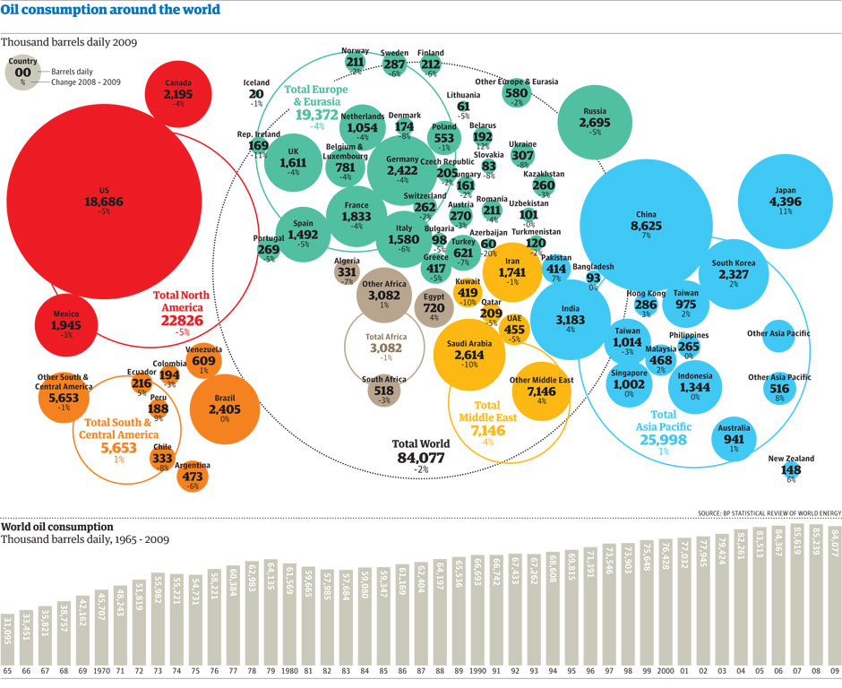

Slide 119
Discuss
What are some ways energy directly effects the global economy?

Slide 120
B. Energy Supply
Coal: Former tropical regions w/ a lot of plants (China, USA)
Petroleum: From ocean residue (Russia, Saudi Arabia)
Natural Gas: From ocean residue (Russia, USA)

Slide 121
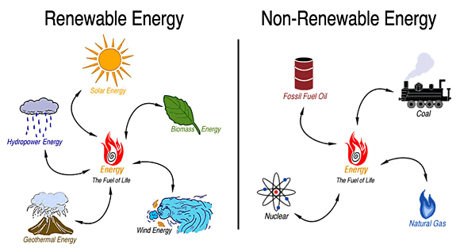
4. Our demand is outpacing our supply of energy (esp. as most countries become developed)
Renewable vs. Nonrenewable energy

Slide 122
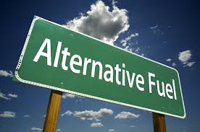
Discuss
Although, fossil fuels are cheaper what are some ways alternative energy could benefit developing countries?

Slide 123
C. MDC’s Control LDC’s
Neo-colonialism: the use of economic, political, or cultural to influence LDC’s
Economic Development: simple, low-income national economies grow into modern industrial economies

Slide 124
3. Fair Trade: Commerce where products are made in a way that protects workers and small businesses in developing countries

Slide 125
4. Money for Development
World Bank: loans money to developing countries to help with infrastructure
International Monetary Fund: loans money to stabilize the country’s economy

Slide 126
c. BUT most of the projects fail
faulty engineering
Countries misuse funds or it is stolen
New infrastructure does NOT attract other investments
d. ALL countries in a lot of debt

Slide 127
5. Dependency Theory: The reason why developing countries are so poor is because developed countries exploit them
6. Brandt Line = North-South Line: Divide of wealth according to north and south

Slide 128
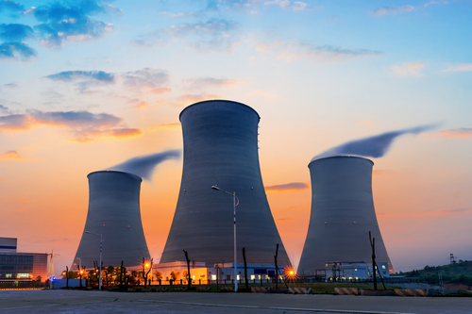
D. Alternative Energy
Nuclear Energy:
A little material = a LOT of energy
Can be SUPER DANGEROUS and expensive

Slide 129
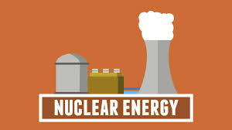
Video: Nuclear Energy Explained
Notes:
https://www.youtube.com/watch?v=d7LO8lL4Ai4

Slide 130
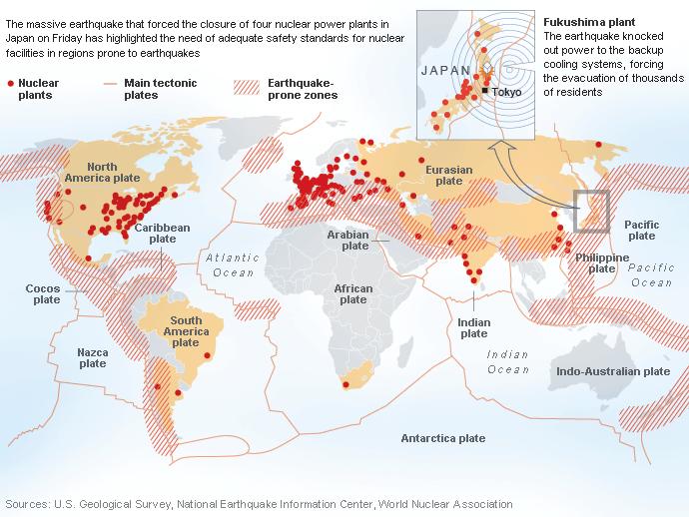

Slide 131
Discuss
What should we do with radioactive waste?
Is the manufacture and stockpiling of nuclear weapons necessary? Why?

Slide 132
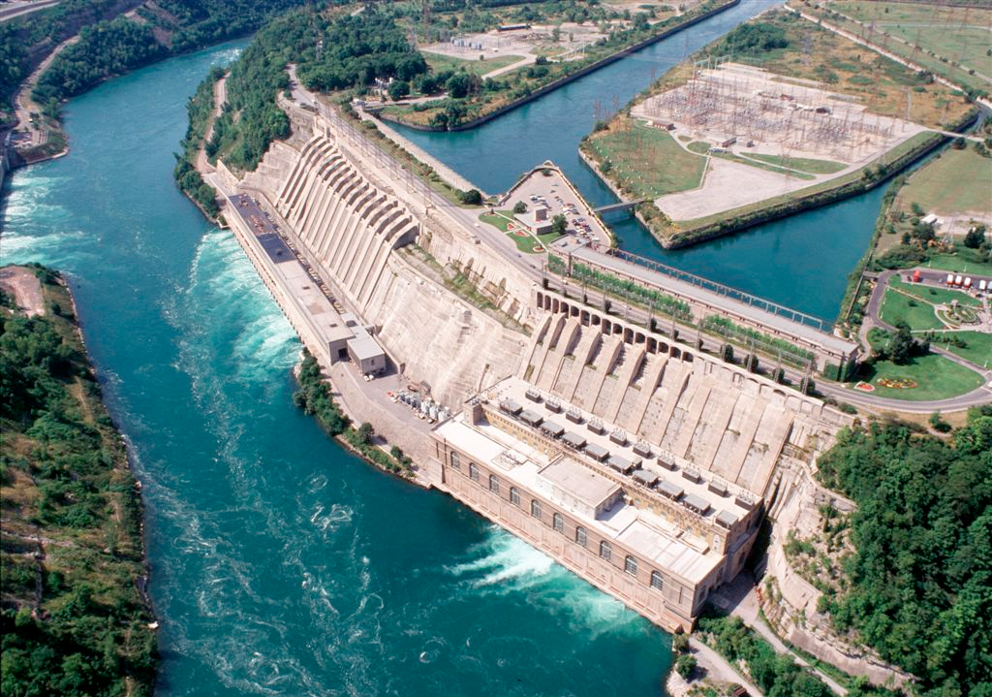
2. Renewable Energy
Hydroelectric Power: power that comes from the movement of water

Slide 133
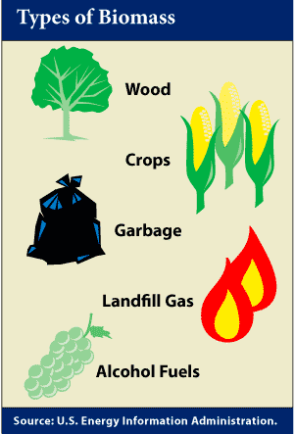
b. Biomass Fuel: fuel from biological stuff (plants, animal waste)

Slide 134
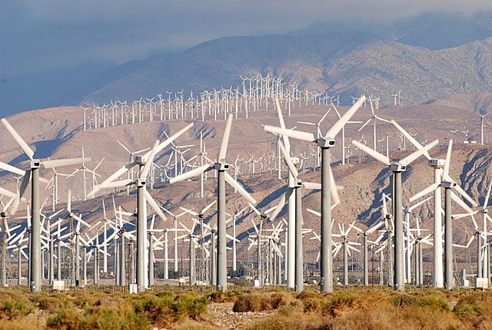
c. Wind Power: energy from movement of air

Slide 135
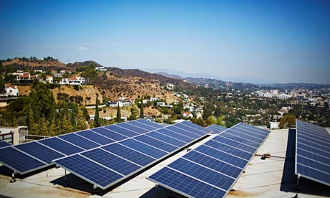
d. Solar Energy: energy that comes from the sun
BUT:
solar cells are expensive
we need better batteries

Slide 136
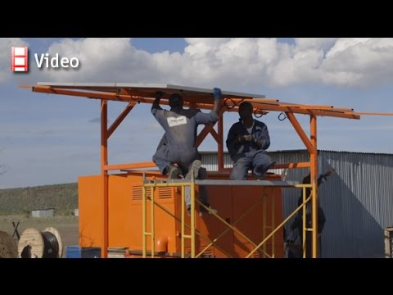
Video: Solar Energy in Africa (Economist)
Notes:
https://www.youtube.com/watch?v=tkvbZ0ADmz0

Slide 137
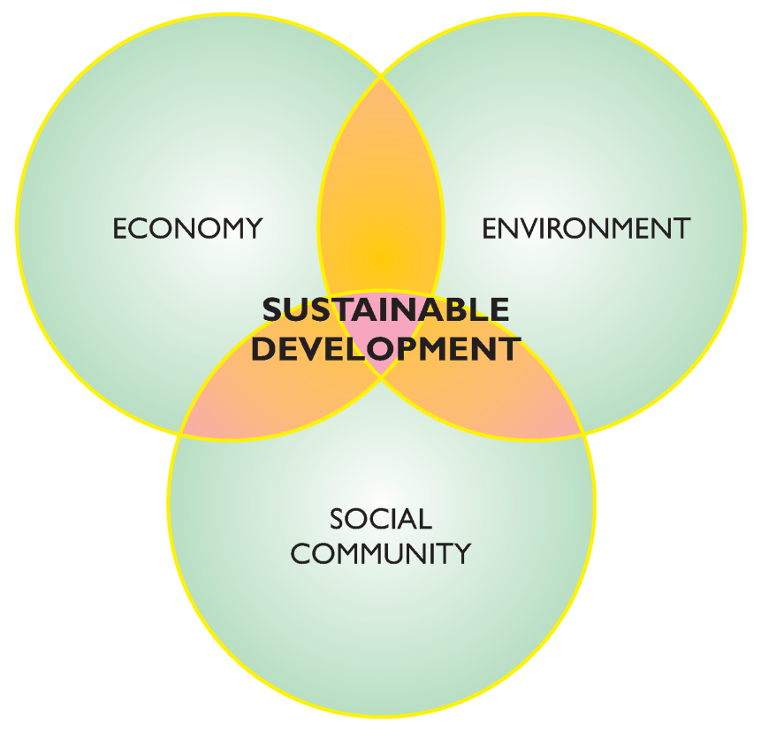
3. Sustainable Development: economic development that is conducted without depletion of natural resources
Must be good for economy, environment and the community

Slide 138
Summary:
Identify the main sources of energy for LDC’s and MDC’s.
Discuss the relationship between energy and development.

Slide 139
MEGA 4 Level Map Analysis – Page 316 (Figures 9-30, 9-31, 9-32)
Level 1: GENERALLY (shared)
Level 2: 4 observations per map – CAN’T BE THE SAME OBSERVATIONS
Level 3: 4 Reasons per map (one for each observation) – Complete and THOUGHTFUL sentences
Level 4: 8-12 sentences comparing the three maps, make connections to other chapters and APES

Slide 140
DAY 8

Slide 141
Bellwork:
Compare and contrast a developed and a developing country. Consider our models.
Use real examples.

Slide 142
Agenda:
2 Practice FRQ
Bring book tomorrow!
HW:

Slide 143
Objective:
You will be able to analyze the use of gerrymandering in the USA.

Slide 144
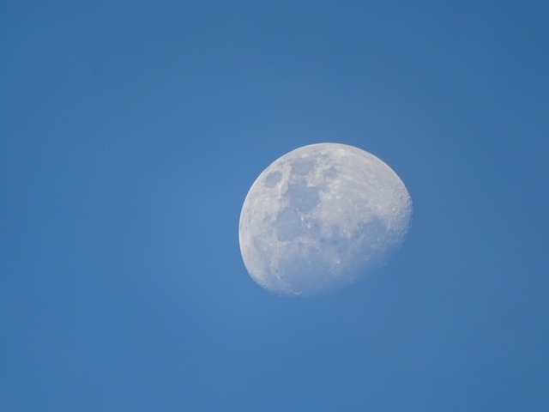
TUBI
As it turns out, whether or not we can see the moon during the day depends on the brightness of its light—which is really just the sun's light reflecting off of the moon's surface—and the earth's rotation. In order for the moon to be visible in the sky, it needs to be above the horizon.

Slide 145
FRQ
Plan and write for 25 minutes
Write responses in PEN
Can use notes and neighbors
Staple prompt to back and turn in when done

Slide 146
Score
Look over the rubric
Score your classmate’s FRQ, underline where they get the point
Add one compliment and one constructive criticism

Slide 147
DAY 9

Slide 148
Bellwork
Consider Switzerland, Bolivia, Malaysia, Singapore, and Uganda.
What stage of Rostow’s Model would each be in?

Slide 149
Agenda:
Write multiple choice questions
HW: reading questions, study

Slide 150
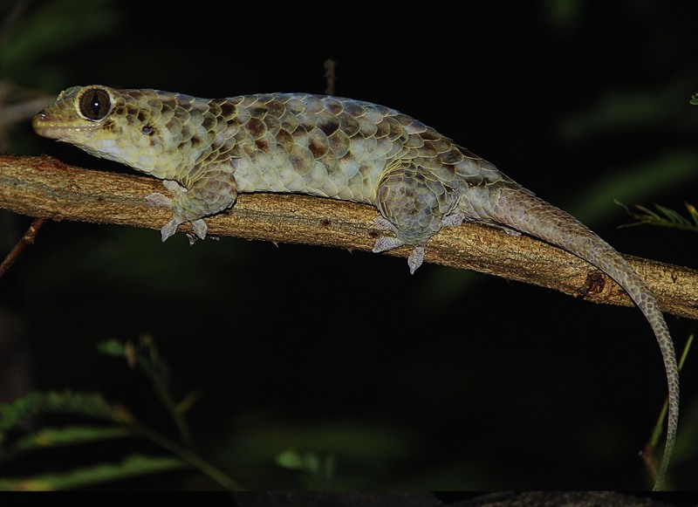
TUBI
New gecko in Madagascar loses scales.

Slide 151
Practice Multiple Choice
Find a partner
Write 4 MULTIPLE CHOICE QUESTIONS
(needs 5 choices, A B C D E)
All the following is true about _____________ EXCEPT
______________ is an example of
An example of ___________________ is
From what we know about _____________ we can assume

